Slide 1
10th Science
CHAPTER 15
PART 1
www.Padasalai.Net

Slide 2
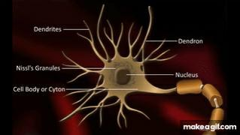
Nervous System The nervous system is made up of nervous tissues.
It is formed of three distinct components namely the neurons, neuroglia and nerve fibres.
i. Neuron or nerve cell:
A neuron or nerve cell is the structural and functional unit of the nervous system.
It is the longest cell of the human body with a length of over 100mm.
These cells are highly specialised to detect, receive and transmit different kinds of stimuli. Information is conducted through neurons in the form of electrical impulses from one part of the body to another.
(ii) Neuroglia:
Neuroglia are also called as glial cells.
They are non-exciting, supporting cell of the nervous system.
They do not initiate or conduct nerve impulses.
(iii) Nerve fibres:
The nerve fibres are the long slender processes of neurons.
A number of nerve fibres are bundled up together to form nerves.

Slide 3
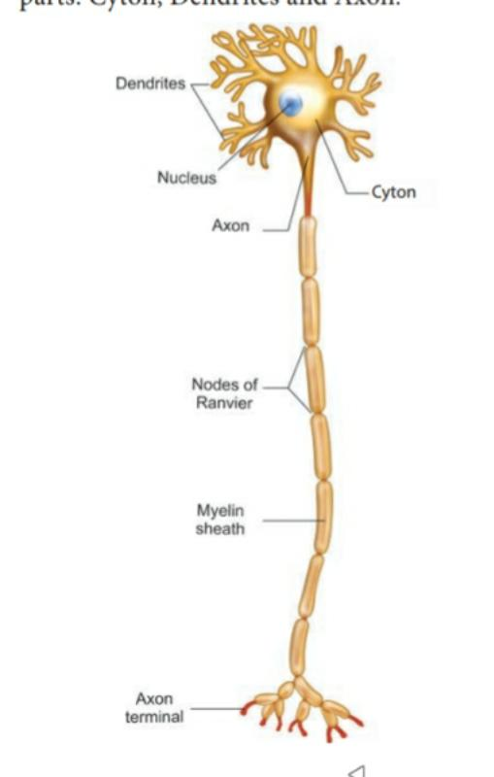
Structure of Neuron
Parts
Cyton
Dentrites
Axon
cyton:
cyton is also called cell body orperikaryon.
has a central nucleus with abundant cytoplasm called neuroplasm.
the cytoplasm has large granular body called nissl’s granules and the other
cell organelles like mitochondria, ribosomes, lysosomes, and endoplasmic recticulum.
neurons do not have the ability to divide.
several neurofibrils are present in the cytoplasm that help in
transmission of nerve impulses to and from the cell body.

Slide 4
Dendrites:
These are the numerous branched cytoplasmic processes that project from the surface of the cell body.
They conduct nerve impulses towards the cyton.
The branched projections increase the surface area for receiving the signals from other nerve cells.

Slide 5
Axon: The axon is a single, elongated, slender projection. The end of axon terminates as fine branches which terminate into knob like swellings called synaptic knob.
The plasma membrane of axon is called axolemma, while the cytoplasm is called axoplasm. It carries impulses away from the cyton.
The axons may be covered by a protective sheath called myelin sheath which is further covered by a layer of Schwann cells called neurilemma. Myelin sheath breaks at intervals by depressions called Nodes of Ranvier. The region between the nodes is called as internode.
Myelin sheath acts as insulator and ensures rapid transmission
of nerve impulses

Slide 6
Synapse:
A junction between synaptic knob of axon of one neuron and dendron
of next neuron is called synaptic junction.
Information from one neuron can pass to another neuron through
these junctions with the release of chemicals known as neurotransmitters
from the synaptic knob.

Slide 7
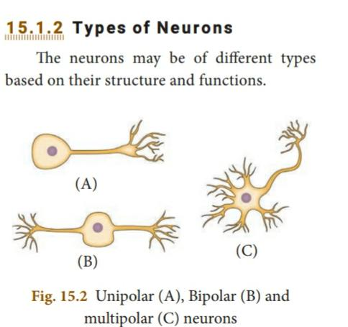
Types of Neurons
The neurons may be of different types based on their structure and functions.
Structurally the neurons may be of the following types:
(i) Unipolar neurons: Only one nerve process arises from the cyton which acts as both axon and dendron.
(ii) Bipolar neurons: The cyton gives rise to two nerve processes of
which one acts as an axon while another as a dendron.
(iii) Multipolar neurons: The cyton gives rise to many dendrons and
an axon

Slide 8
On the basis of functions neurons are categorised as:-
Sensory or afferent neurons which carry impulses from the sense organ to the central nervous system.
(ii) Motor or efferent neurons which carry impulses from the central nervous system to effector organ such as the muscle fibre or the gland.
(iii) Association neurons conduct impulses between sensory and motor neurons.
Types of Nerve Fibres
Nerve fibres are of two types based on the presence or absence of myelin sheath.
Myelinated nerve fibre:
The axon is covered with myelin sheath
ii) Non-myelinated nerve fibre: The axon is not covered by myelin sheath.
Myelinated and non-myelinated nerve fibres form the white matter and grey matter of the brain.

Slide 9
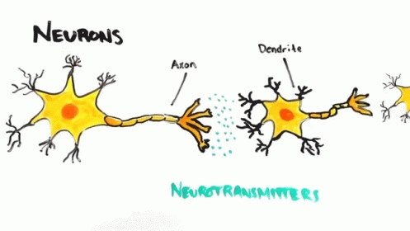
TRANSMISSION OF NERVE IMPULSE
Receptors ( Sense organs)
Electrical impulse
Dentrites
(Received by the dendritic tips of the neuron)
Muscles or glands
Cell body
Terminal end
Release a chemical - neurotransmitter
To brain or spinal cord
(Diffuses across a synopse)

Slide 10
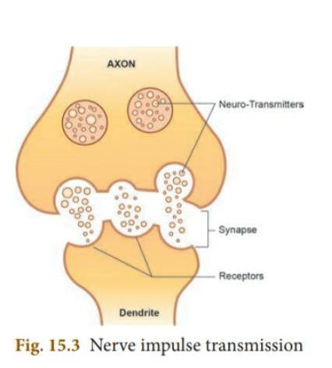
The flow of nerve impulses from axonal
end of one neuron to dendrite of another
neuron through a synapse is called synaptic
transmission
Neurotransmitters
Neurotransmitters are the chemicals
which allow the transmission of nerve impulse
from the axon terminal of one neuron to the
dendron of another neuron or to an effector
organ. The important neurotransmitter
released by neurons is called Acetylcholine

