Slide 1

www.Padasalai.Net

Slide 2
M.KULANDAIVELU
M.Sc.,M.Phil.,B.Ed
Karaikudi Maharishi Vidya Manddir Matric. Hr.Sec.school

Slide 3
UNIT-III
CHAPTER-7
HUMAN HEALTH AND DISEASES
PART- I

Slide 4

INTRODUCTION
WHO(world health organization)
Define WHO:
  “A state of complete physical mental and social wellbeing and not merely absense of disease.
Healthy people:
More efficient at work.
Maintain good health:
Personal hygiene,
regularexercise,
balanced diet.

Slide 5

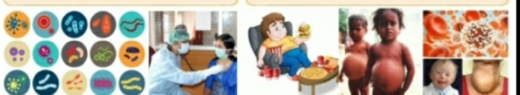
COMMON DISEASES IN HUMAN BEINGS
Disease: Disorder or malfunctional of the mind or body.
Disease involving agent:
Morphological
Physiological
Psycological disturbances
Environmental factors or pathogens or genetic anomalies or life style changes.

Slide 6
DISEASES CAN BE BROADLY TWO GROUPS
I. Infectious diseases
(or)
Communicabel diseases
II.Non-infectious diseases (or)
Non-communicable diseases

Slide 7
I. INFECTIOUS DISEASES (or) COMMUNICABLE DISEASES
Define: Disease are transmitted from one person to other person.
Pathogen: Disease causing organisms.
Transmitted agent disease:
Air,water,Food,Physical contact and Vectors.
Disease causes pathogen:
Virus,Bacteria,Fungi,Protozoan,Helminthic,parasites etc.,
Most common diseases at some time.
Curable disease: most bacteria disease curable but all viral disease are not Ex.AIDS,May be fatal.

Slide 8
II.Non-infectious diseases (or)
Non-communicable diseases
Define:
Not transmitted from an infected person to a healthy person.
Origin:
I.Genetic (cystic fibrosis)
II.Nutritional (vitamin deficiency diseases)
III.Degenetive (Arthritis,heart attack,stroke)
Ex:Cancer(major causes of death)

Slide 9
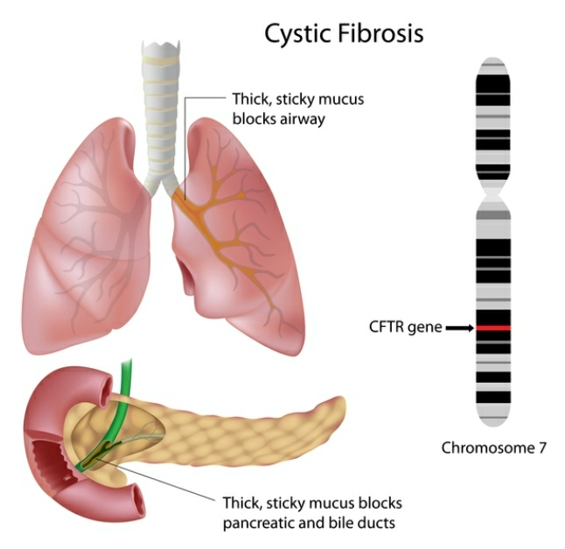
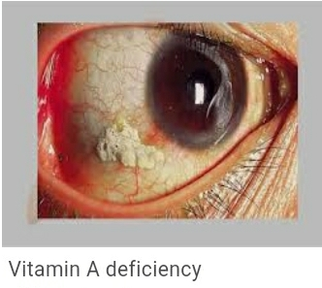
I.Genetic II.Nutritional
(cystic fibrosis) (vitamin deficiency diseases)

Slide 10
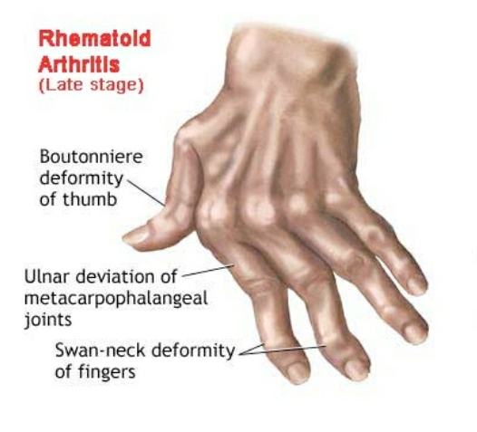
iii.Degenrative (Arthritis,heart attack,stroke)
Ex:Cancer(major causes of death)

Slide 11

BACTERIAL DISEASES
Pathogenic bacteria:
No of bacterial species is very high.
only a few bacteria are associated with human diseases and are called pathogenic bacteria.
Such pathogens may emit toxins and affected the body.
Widal test: Typhoid fever can be confirmed test.
Bacteria spread:
Air, water or by inhaling the droplets/aerosols or even by sharing utensils, dresses with an infected person.

Slide 12

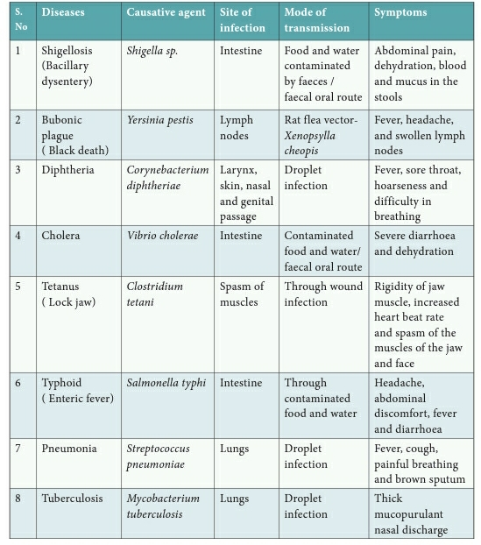
COMMON BACTERIAL DISEASES HUMAN DISEASES

Slide 13
VIRAL DISEASES
Viruses common characters:
Smallest intracellular obligate parasites.
Multiply within living cells.
Outside the living cells they cannot carryout the characterstics of a living organisms.
Viruses invade living cells forces to create new viruses.
The new viruses break out of the cell, killing it and invade other cells in the body, causing diseases in human beings Ex.Rhino viruses (“Common cold”- most infectious human ailment)

Slide 14
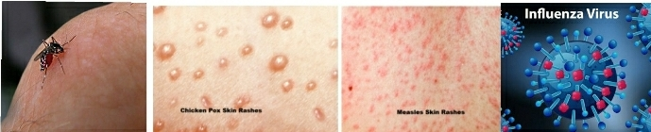
VIRAL DISEASES GENERALLY FOUR GROUPS
(classify based on symptoms produced in the body organs)
I.Pneumotropic diseases: Ex.influenza(Respiratory tract infect)
II.Dermotropic disease: Ex.Chicken pox,Measles.
(Skin and subcutaneous tissues)
III.Viscerotropic diseases: Ex.Yellow fever,Dengue fever (Blood,visceral organ affected)
IV.Neurotropic deseases:Ex.Rabies and polio
(central nervous system affected)

Slide 15
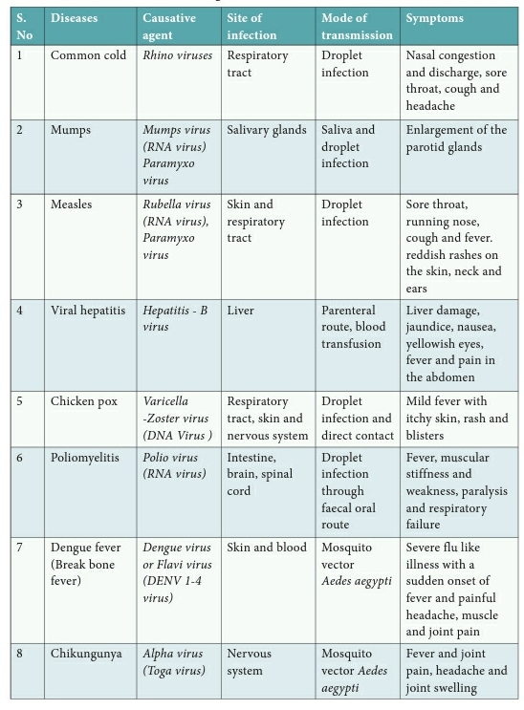
VIRAL - COMMON DISEASES IN HUMAN BEING

Slide 16
PROTOZOAN DISEASES
{About 15 genera protozoans, parasites(with in human body)}
a.Amoebiasis: Amoebic dysebtry (or) Amoebic colitis.
Caused organisms | Entomoeba histolytica
Entomoeba histolytica live | Human large intestine
Feeds | Food particles,bacteria
Infective stages parasite | Trophozoite (Penetrates the walls of the host intestine (colon) large intestine).
Secretes enzymes | Histolytic enzymes
Causes | ulceration, bleeding, abdominal pain and stools with excess mucus.
Symptoms | diarrhoea to dysentery with blood and mucus in the stool.
Transmitted agent vector | House fly(Musca domestica)
Transmitted materials | Contaminated water,faeces

Slide 17
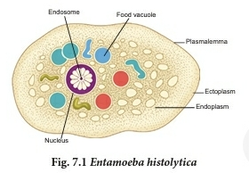
PROTOZOAN DISEASES
{About 15 genera protozoans, parasites(with in human body)}

Slide 18
PROTOZOAN DISEASES
B.AFRICAN SLEEPING SICKNESS
Caused organism | Trypanosoma species.
Trypanosoma meaning | generally transmitted by the blood sucking Tsetse flies.
Three species of Trypanosoma cause sleeping sickness in man.
1.Trypanosoma gambiense
Transmitted | Glossina palpalis (Tsetse fly)
Causes | Gambian or Central African sleeping sickness
2. Trypanosoma rhodesiense
Transmitted | Glossina morsitans
Causes | Rhodesian or East African sleeping sickness.
3. Trypanosoma cruzi
Transmitted | Bug(Triatoma megista)
Causes | Chagas disease or American trypanosomiasis.

Slide 19
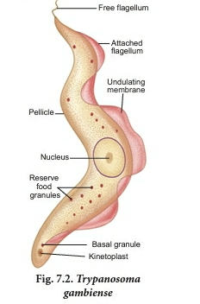
PROTOZOAN DISEASES
B.AFRICAN SLEEPING SICKNESS

Slide 20
KALA-AZAR (OR) VISCERAL LEISHMANIASIS
Caused | Leishmania donovani
Transmitted | vector Phlebotomus (sand fly).
Infection occur | endothelial cells, bone marrow, liver, lymph glands and blood vessels of the spleen.
Symptoms | weight loss, anaemia, fever, enlargement of spleen and liver.

Slide 21



FUNGAL DISEASES
Casuative agent | Human disease
Dermatomycosis | Cutaneous infection
Fungi belong three genera | i.Trichophyton ii.Microsporum iii.Epidermophyton
Ring worm Human most common fungal disease
Symptoms | Appearance of Dry ,scaly lesions on the skin,nails and scalp
Fungi growth | Heat and moisture Thrive in skin groin or between toes.
Ringworm feet (Athlete’s foot)
Athlete’s foot caused | Tinea pedis
Ringworm transmitted | Acquired from soil or by using clothes, towels and comb used by infected persons.

Slide 22
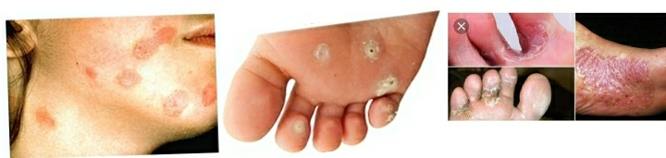
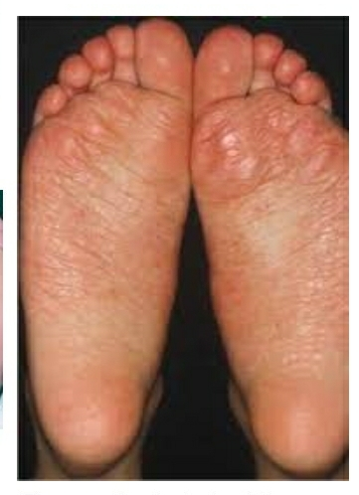
Ring worm Athletes foot Tinea pedis

Slide 23
Helminthic disease
Helminthiasis | Mostly endoparasitic in the gut and blood of human beings and cause diseases called helminthiasis.
Helminthic diseases two | i.Ascariasis ii.Filariasis
i.Ascariasis
Characters | Monogenic parasite Exhibits sexual dimorphism.
Caused | Intestinal endoparasite Ascaris lumbricoides commonly called the round worms
Transmitted | Through ingestion of embryonated eggs through contaminated food and water. contaminated soils(Children playing areas)
Symptoms | abdominal pain, vomiting, headache,anaemia, irritability and diarrhoea
Heavy infection Symptoms | Nutritional deficiency,severe abdominal pains,Stunted growth in children,enteritis, hepatitis and bronchitis.

Slide 24

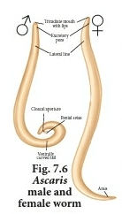
Helminthic disease- i. Ascariasis

Slide 25
Helminthic disease- ii. Filariasis
Caused | Wuchereria bancrofti
Commonly | Filarial worm
Found | Lymph vessels and lymph nodes of man
Characters | Sexually dimorphic, viviparous and digenic.
Life cycle two host | i.Man ii.Female Culex mosquito.
Microfilariae larvae | Female filarial worm gives rise to juveniles
Lymph glands | Juveniles develop into adults. Worms block the lymphatic system resulting in inflammation of the lymph nodes.
Lymph vessels causes | Elephantiasis or filariasis (limbs, scrotum and mammary glands)

Slide 26
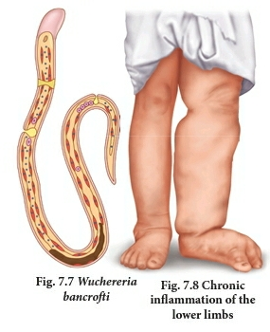
Helminthic disease- ii. Filariasis

Slide 27
THANK YOU

