Slide 1
www.Padasalai.Net
UNIT : 01
NATURE OF PHYSICAL WORLD AND MEASUREMENT
Higher Secondary – First Year
By
RAJENDRAN M, M.Sc., B.Ed., C.C.A.,
PGT IN PHYSICS, SRMHSS, KAVERIYAMPOONDI
TIRUVANNAMALAI – 606603.
(c) Shanthimalai Trust 2023
1

Slide 2
Learning Objectives:
In this unit, the student is exposed to
Excitement generated by the discoveries in Physics.
An understanding of physical quantities of importance.
Different system of units.
An understanding of errors and corrections in physics measurements.
The importance of significant figures.
Usage of dimensions to check the homogeneity of physical quantities.
(c) Shanthimalai Trust 2023
2

Slide 3
The word ‘science’ was coined only in the 19th century
Introduction:
Science – Latin - Scientia – “to know” “Knowing the truth”
Natural philosophy – when ancient civilization knew and practiced astronomy, chemistry, human physiology& agriculture.
Science - the systematic organization of knowledge gained through observation, experimentation and logical reasoning.
The knowledge of science dealing with non-living things is physical science and that dealing with living things is biological science etc.).
Scientific and mathematical excellence in India dates back to prehistoric human activity in the Indus Valley Civilization
(3300 – 1300 BC(BCE).
(c) Shanthimalai Trust 2023
3

Slide 4
1.1.1
THE SCIENTIFIC METHOD
Example
Consider a metalic rod being heated. When one end of the rod is heated, heat is felt at the other end. The following questions can be asked on this observation.
1. What happens within the rod when it is
heated?
2. How does the heat reach the other end?
3. Is this effect true for all materials?
4. If heat flows through the material, is it
possible to visualize heat?
A step-by-step approach in studying natural phenomena and establishing laws which govern.
Any scientific method : General features.
(i) Systematic observation
(ii) Controlled experimentation
(iii) Qualitative and quantitative reasoning
(iv) Mathematical modelling
(v) Prediction and verification or
falsification of theories
(c) Shanthimalai Trust 2023
4

Slide 5
1.2
PHYSICS - INTRODUCTION
Reductionism :
An attempt to explain a macroscopic system in terms of its microscopic constituents is reductionism. For example, thermodynamics was developed to explain macroscopic properties like temperature, entropy, etc., of bulk systems. The above properties have been interpreted in terms of the molecular constituents (microscopic) of the bulk system by kinetic theory (unit 9) and statistical mechanics.
PHYSICS - The Greek - “Fusis”, - Nature.
The study of nature and natural phenomena. The most basic of all sciences.
Unification : Attempting to explain diverse physical phenomena with a few concepts and laws is unification.
For example, Newton’s universal law of gravitation , explains the motion of freely falling bodies towards the Earth, motion of planets around the Sun, motion of the Moon around the Earth.
(c) Shanthimalai Trust 2023
5

Slide 6
1.2.1
BRANCHES OF PHYSICS
Unit 5 : Deals with the mechanics of rigid bodies.
Unit 6 : The basics of gravitation and its consequences .
Unit 7 : Older branches of physics such as different properties of matter are discussed.
Unit 8 & 9 : The impact of heat and investigations of its consequences are covered.
Unit 10 & 11 : Important features of oscillations and wave motion are covered.
Physics as a fundamental science helps to uncover the laws of nature. The language of its expression is mathematics.
Unit 1: The development of physics along with discussion on basic elements such as measurement, units etc.
Unit 2: The basic mathematics needed to express the impact of physical principles and their governing laws.
Unit 3: The impact of forces acting on objects in terms of the fundamental laws of motion of Newton.
Unit 4 : Work and energy : The basic parameters of investigation of the mechanical world.
(c) Shanthimalai Trust 2023
6

Slide 7
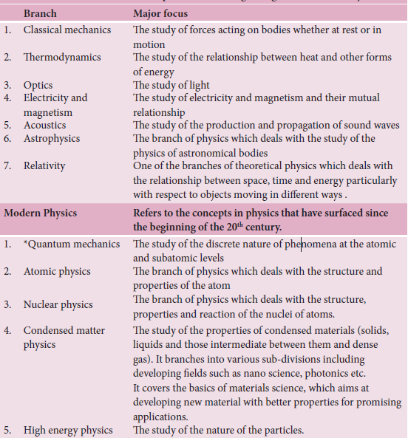
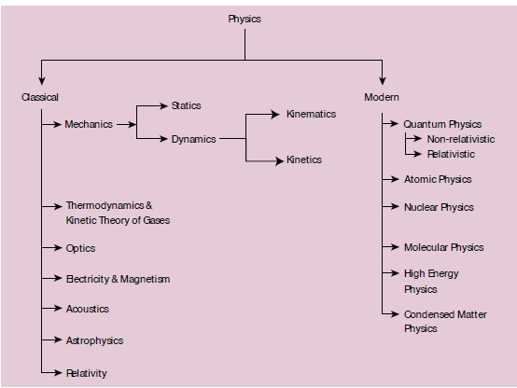
(c) Shanthimalai Trust 2023
7

Slide 8
1.
SCOPE & EXCITEMENT OF PHYSICS
Physics has a huge scope as it covers a tremendous range of magnitude of various physical quantities (length, mass, time, energy etc). It deals with systems of very large magnitude as in astronomical phenomena as well as those with very small magnitude involving electrons and protons.
Discoveries in physics are of two types; accidental discoveries and well-analyzed research outcome in the laboratory based on intuitive thinking and prediction.
For example, magnetism was accidentally observed but the reason for this strange behavior of magnets was later analyzed theoretically.
Range of time scales: astronomical scales to microscopic scales, 10¹⁸s to 10⁻²²s.
Theoretical predictions are the most important contribution of physics to the developments in technology and medicine. For example, the famous equation of Albert Einstein, E=mc² was a theoretical prediction in 1905 and experimentally proved in 1932 by Cockcroft and Walton. Theoretical predictions aided with recent simulation and computation procedures are widely used to identify the most suited materials for robust applications.
Range of masses: from heavenly bodies to electron, 10⁵⁵ kg (mass of known observable universe) to 10⁻³¹ kg (mass of an electron) [the actual mass of an electron is 9.11×10^{–31} kg].
(c) Shanthimalai Trust 2023
8

Slide 9
The study of physics is not only educative but also exciting in many ways.
A small number of basic concepts and laws can explain diverse physical phenomena.
The most interesting part is the designing of useful devices based on the physical laws.
For example i) use of robotics ii) journey to Moon and to nearby planets with controls from the ground iii) technological advances in health sciences etc.
In today’s world of technological advancement, the building block of all engineering and technical education is physics which is explained with the help of mathematical tools.
Probing and understanding the science behind natural phenomena like the eclipse, and why one feels the heat when there is a fire? (or) What causes the wind, etc.
(c) Shanthimalai Trust 2023
9

Slide 10
1.3
PHYSICS IN RELATION TO TECHNOLOGY AND SOCIETY
I.Basic laws of electricity and magnetism led to the discovery of wireless communication technology which has shrunk the world with effective communication over large distances.
ii. The launching of satellite into space has revolutionized the concept of communication.
iii. Microelectronics, lasers, computers, superconductivity and nuclear energy have comprehensively changed the thinking and living style of human beings.
Technology is the application of the principles of physics for practical purposes. The application of knowledge for practical purposes in various fields to invent and produce useful products or to solve problems is known as technology
(c) Shanthimalai Trust 2023
10

Slide 11
PHYSICS IN RELATION TO CHEMISTRY
PHYSICS IN RELATION TO BIOLOGY
Study the structure of atom, radioactivity, X-ray diffraction etc.
To arrange elements in the periodic table on the basis of their atomic numbers.
Biological studies are impossible without a microscope designed using physics principles. The invention of the electron microscope has made it possible to see even the structure of a cell. X
To know the nature of valency, chemical bonding and to understand the complex chemical structures.
X-rays are used for diagnostic purposes. Radio-isotopes are used in radiotherapy for the cure of cancer and other diseases. In recent years, biological processes are being studied from the physics point of view.
PHYSICS IN RELATION TO MATHEMATICS
Physics is a quantitative science. It is most closely related to mathematics as a tool for its development
(c) Shanthimalai Trust 2023
11

Slide 12
PHYSICS IN RELATION TO ASTROMOMY
PHYSICS IN RELATION TO GEOLOGY
Astronomical telescopes are used to study the motion of planets and other heavenly bodies in the sky.
Radio telescopes have enabled the astronomers to observe distant points of the universe. Studies of the universe are done using physical principles.
Diffraction techniques help to study the crystal structure of various rocks. Radioactivity is used to estimate the age of rocks, fossils and the age of the Earth.
PHYSICS IN RELATION TO OCEANOGRAPHY
Oceanographers seek to understand the physical and chemical processes of the oceans. They measure parameters such as temperature, salinity, current speed, gas fluxes, chemical components.
PHYSICS IN RELATION TO PSYCHOLOGY
The movements of neurotransmitters are governed by the physical properties of diffusion and molecular motion.
(c) Shanthimalai Trust 2023
12

Slide 13
Thank you !
(c) Shanthimalai Trust 2023
13

