Slide 1
www.Padasalai.Net
UNIT : 01
NATURE OF PHYSICAL WORLD AND MEASUREMENT
Higher Secondary – First Year
By
RAJENDRAN M, M.Sc., B.Ed., C.C.A.,
PGT IN PHYSICS, SRMHSS, KAVERIYAMPOONDI
TIRUVANNAMALAI – 606603.
(c) Shanthimalai Trust 2023
1

Slide 2
Learning Objectives:
In this unit, the student is exposed to
Excitement generated by the discoveries in Physics.
An understanding of physical quantities of importance.
Different system of units.
An understanding of errors and corrections in physics measurements.
The importance of significant figures.
Usage of dimensions to check the homogeneity of physical quantities.
(c) Shanthimalai Trust 2023
2

Slide 3
1.4
MEASUREMENT
1.4.1
PHYSICAL QUANTITY
The comparison of any physical quantity with its standard unit is known as measurement.
Quantities that can be measured, and in terms of which, laws of physics are described are called physical quantities. Examples are length, mass, time, force, energy, etc.
Measurement is the basis of all scientific studies and experimentation. It plays an important role in our daily life. Physics is a quantitative science and physicists always deal with numbers which are the measurement of physical quantities.
(c) Shanthimalai Trust 2023
3

Slide 4
1.4.2
TYPES OF PHYSICAL QUANTITIES
1.4.3
UNIT & TYPES
Fundamental or base quantities are quantities which cannot be expressed in terms of any other physical quantities. These are length, mass, time, electric current, temperature, luminous intensity and amount of substance.
To measure a quantity, we always compare it with some reference standard. For example, when we state that a rope is 10 meter long, it is to say that it is 10 times as long as an object whose length is defined as 1 metre. Such a standard is known as the unit of the quantity.
Quantities that can be expressed in terms of fundamental quantities are called derived quantities. For example, area, volume, velocity, acceleration, force, etc.
An arbitrarily chosen standard of measurement of a quantity, which is accepted internationally is called unit of the quantity
(c) Shanthimalai Trust 2023
4

Slide 5
1.4.4
DIFFERENT TYPES OF MEASUREMENT SYSTEMS
The units in which the fundamental quantities are measured are called fundamental or base units and the units of measurement of all other physical quantities, which can be obtained by a suitable multiplication or division of powers of fundamental units, are called derived units.
A complete set of units which is used to measure all kinds of fundamental and derived quantities is called a system of units.
(a) the f.p.s. system is the British Engineering system of units, which uses foot, pound and second as the three basic units for measuring length, mass and time respectively.
(c) Shanthimalai Trust 2023
5

Slide 6
1.4.5
SI UNIT SYSTEMS
(b) The c.g.s system is the Gaussian system, which uses centimeter, gram
and second as the three basic units for measuring length, mass and time respectively.
The system of units used by scientists and engineers around the world is commonly called the metric system but, since 1960,
(c) The m.k.s system is based on metre, kilogram and second as the three basic units for measuring length, mass and time respectively.
The SI with a standard scheme of symbols, units and abbreviations, were developed and recommended by the General Conference on Weights and Measures in 1971 for international usage in scientific, technical, industrial and commercial work.
(c) Shanthimalai Trust 2023
6

Slide 7
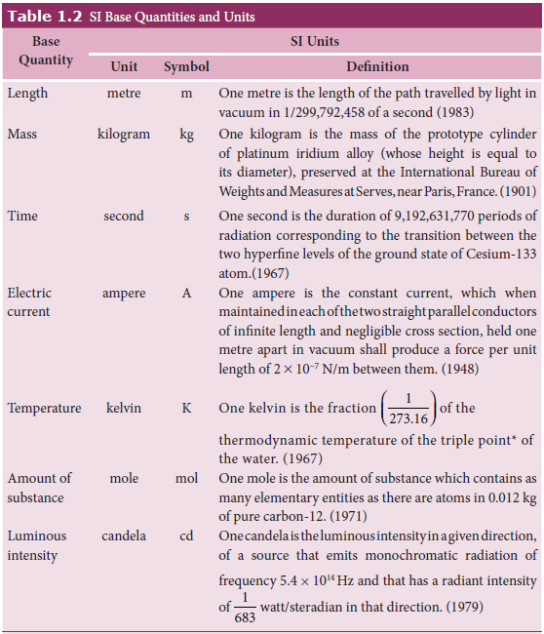
THE ADVANTAGES OF THE SI SYSTEM
i) This system makes use of only one unit for one physical quantity, which means a rational system of units.
ii) In this system, all the derived units can be easily obtained from basic and supplementary units, which means it is a coherent system of units.
iii) It is a metric system which means that multiples and submultiples can be expressed as powers of 10.
(c) Shanthimalai Trust 2023
7

Slide 8
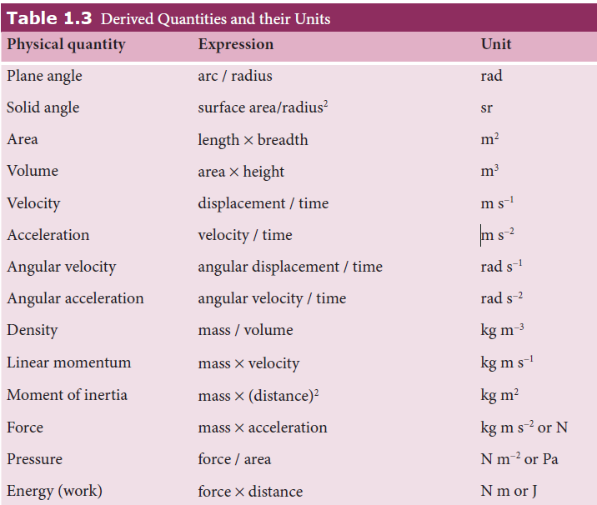
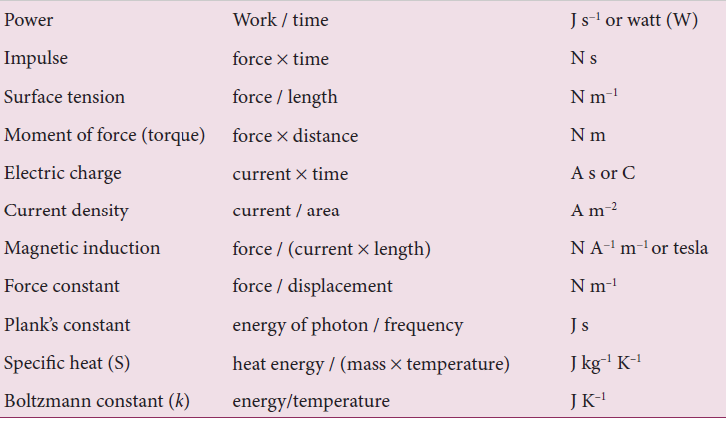
(c) Shanthimalai Trust 2023
8

Slide 9
1.5.1
MEASUREMENT OF LENGTH
Distances ranging from 10⁻⁵ m to 10² m can be measured by direct methods. For example, a metre scale can be used to measure the distance from 10⁻³ m to 1 m, vernier calipers up to 10⁻⁴ m, a screw gauge up to 10⁻⁵ m and so on. The atomic and astronomical distances cannot be measured by any of the above mentioned direct methods. Hence, to measure the very small and the very large distances, indirect methods have to be devised and used.
Length is defined as the distance between any two points in space. The SI unit of length is metre.
For example, large objects like the galaxy, stars, Sun, Earth, Moon etc., and their distances constitute a macrocosm in which both objects and distances are large.
On the contrary, objects like molecules, atoms, proton, neutron, electron, bacteria etc., and their distances constitute microcosm, Small world in which both objects and distances are small-sized.
(c) Shanthimalai Trust 2023
9

Slide 10
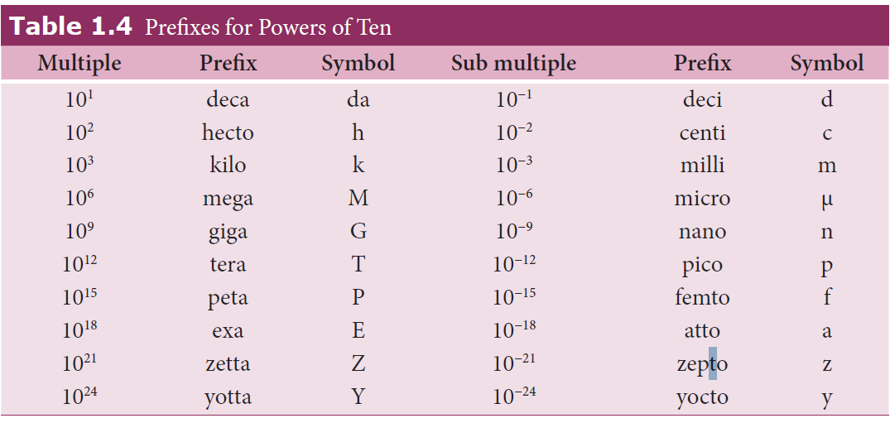
(c) Shanthimalai Trust 2023
10

Slide 11
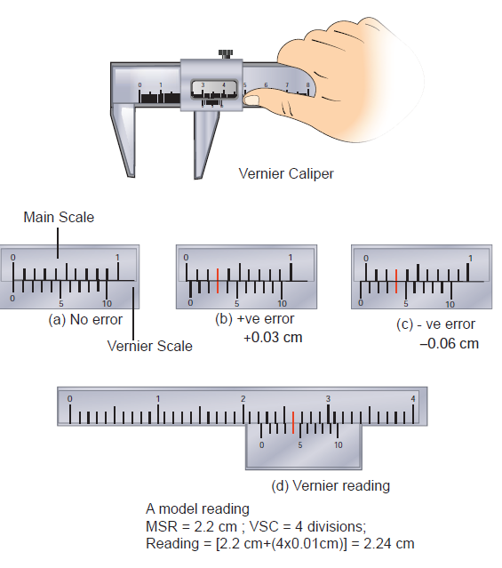
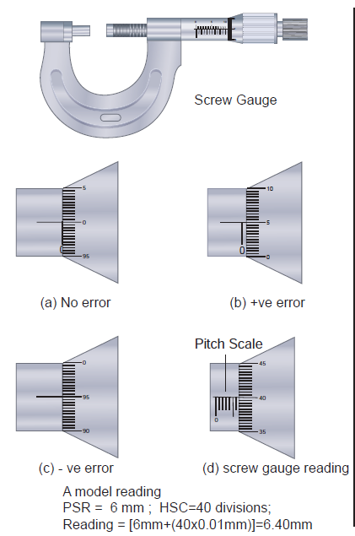
1. Measurement of small distances:
Vernier caliper: A vernier caliper is a versatile instrument for measuring the dimensions of an object namely diameter of a hole, or a depth of a hole. The least count of the vernier caliper is 0.01 cm
Screw gauge: The screw gauge is an instrument used for measuring accurately the dimensions of objects up to a maximum of about 50 mm. The principle of the instrument is the magnification of linear motion using the circular motion of a screw. The least count of the screw gauge is 0.01 mm
(c) Shanthimalai Trust 2023
11

Slide 12
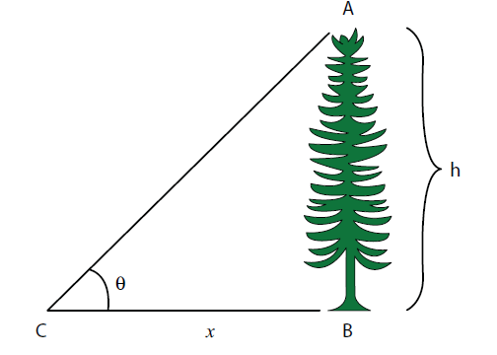
2. Measurement of large distances:
Triangulation method for the height of an accessible object:
For measuring larger distances such as the height of a tree, distance of the Moon or a planet from the Earth, some special methods are adopted. Triangulation method, parallax method and radar method are used to determine very large distances.
Let AB = h be the height of the tree or tower
to be measured.
Let C be the point of observation at distance x from B. Place a range finder at C and measure the angle of elevation, ∠ACB = θ. From right angled triangle ABC,
tanθ = AB/BC = h/x (or) height h = x tan θ
Knowing the distance x, the height h can be determined
(c) Shanthimalai Trust 2023
12

Slide 13
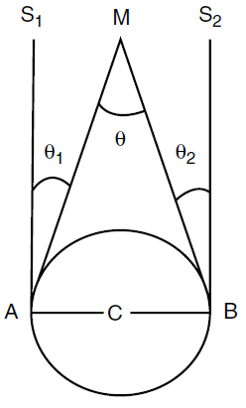
Parallax method:
Very large distances, such as the distance of a planet or a star from the Earth can be measured by the parallax method.
Determination of distance of Moon from Earth
1. C is the centre of the Earth. A and B are two diametrically opposite places on the surface of the Earth. From A and B, the parallaxes θ₁ and θ₂ respectively of Moon M with respect to some distant star are determined with the help of an astronomical telescope. Thus, the total parallax of the Moon subtended on Earth $∠AMB$ = θ₁ + θ₂ = θ.
2. If θ is measured in radians, then θ = $\frac{AB}{AM}$ ; AM≈MC θ = $\frac{AB}{MC}$ $⟹$ MC = $\frac{AB}{θ}$ .Knowing the values of AB and θ, we can calculate the distance MC of Moon from the Earth.
Parallax is the name given to the apparent change in the position of an object with respect to the background, when the object is seen from two different positions.
(c) Shanthimalai Trust 2023
13

Slide 14
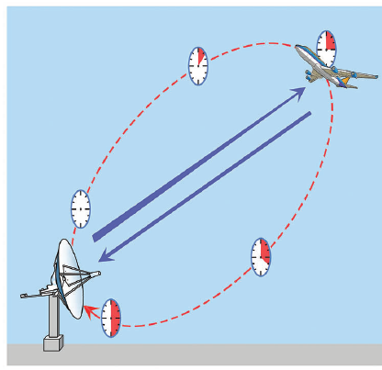
RADAR method:
1. The word RADAR stands for Radio Detection and Ranging. Radar can be used to measure accurately the distance of a nearby planet such as Mars. In this method, radio waves are sent from transmitters which, after reflection from the planet, are detected by the receiver.
2. By measuring, the time interval (t) between
the instants the radio waves are sent and
received, the distance of the planet can be
determined as d= (v x t) / 2 .
where v is the speed of the radio wave.
As the time taken (t) is for the distance covered during the forward and backward path of the radio waves, it is divided by 2 to get the actual distance of the object. This method can also be used to determine the height, at which an aero-plane flies from the ground
(c) Shanthimalai Trust 2023
14

Slide 15
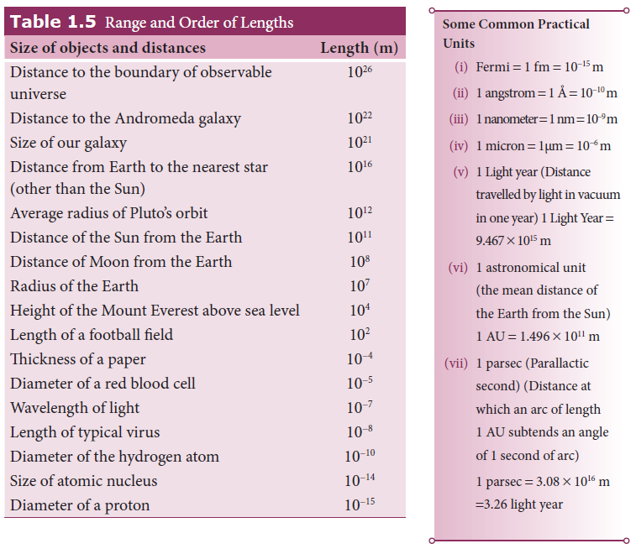
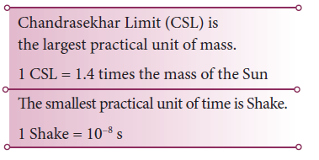
(c) Shanthimalai Trust 2023
15

Slide 16
1.5.2
MEASUREMENT OF MASS
Ordinarily, the mass of an object is determined in kilograms using a common balance like the one used in a grocery shop. For measuring larger masses like that of planets, stars etc., we make use of gravitational methods. For measurement of small masses of atomic/subatomic particles etc., we make use of a mass spectrograph.
Mass is a property of matter. It does not depend on temperature, pressure and location of the body in space. Mass of a body is defined as the quantity of matter contained in a body. The SI unit of mass is kilogram (kg). The masses of objects which we shall study in this course vary over a wide range. These may vary from a tiny mass of electron (9.11×10⁻³¹kg) to the huge mass of the known universe (=10⁵⁵ kg).
Some of the weighing balances commonly used are common balance, spring balance, electronic balance, etc.
(c) Shanthimalai Trust 2023
16

Slide 17
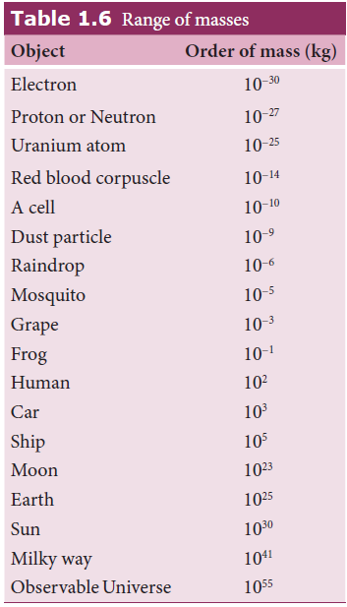
1.5.3
MEASUREMENT OF TIME INTERVALS
A clock is used to measure the time interval. An atomic standard of time, is based on the periodic vibration produced in a Cesium atom. Some of the clocks developed later are electric oscillators, electronic oscillators, solar clock, quartz crystal clock, atomic clock, decay of elementary particles, radioactive dating etc.
(c) Shanthimalai Trust 2023
17

Slide 18
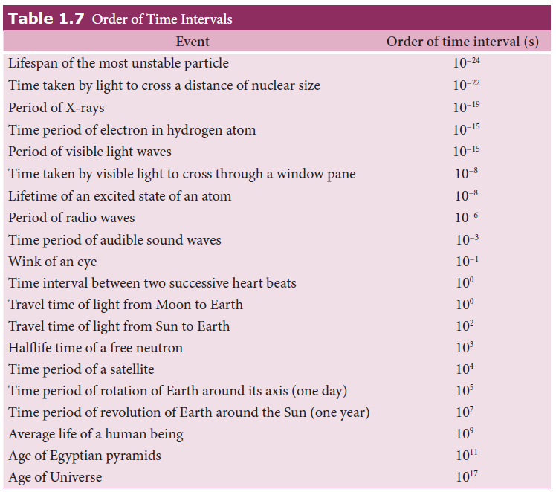
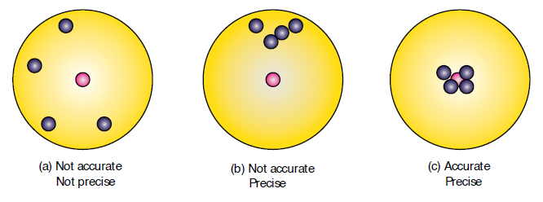
1.6.1
ACCURACY AND PRECISION
The shots are focused so as to reach the bull’s eye (midpoint), but the arrows have reached only around this point. Hence the shots are not accurate and also not precise.
All the shots are close to each other but not at the central point. Hence the shots are said to be precise but not accurate.
(c) Shanthimalai Trust 2023
18

Slide 19
A numerical example
The true value of a certain length is nearly 5.678 cm. In one experiment, using a measuring instrument of resolution 0.1 cm, the measured value is found to be 5.5 cm. In another experiment using a measuring instrument of greater resolution, say 0.01 cm, the length is found to be 5.38 cm. We find that the first measurement is more accurate as it is closer to the true value, but it has lesser precision. On the contrary, the second measurement is less accurate, but it is more precise.
The shots are closer and also at the central point. Hence the shots are both precise and accurate.
Let the temperature of a refrigerator repeatedly measured by a thermometer be given as 10.4ºC, 10.2ºC, 10.3ºC, 10.1ºC, 10.2ºC, 10.1ºC, 10.1ºC, 10.1ºC. However, if the real temperature inside the refrigerator is 9ºC, we say that the thermometer is not accurate (it is almost one degree off the true value), but since all the measured values are close to 10ºC, hence it is precise.
(c) Shanthimalai Trust 2023
19

Slide 20
Thank you !
(c) Shanthimalai Trust 2023
20

