Slide 1
www.Padasalai.Net
UNIT : 01
NATURE OF PHYSICAL WORLD AND MEASUREMENT
Higher Secondary – First Year
By
RAJENDRAN M, M.Sc., B.Ed., C.C.A.,
PGT IN PHYSICS, SRMHSS, KAVERIYAMPOONDI
TIRUVANNAMALAI – 606603.
(c) Shanthimalai Trust 2023
1

Slide 2
Learning Objectives:
In this unit, the student is exposed to
Excitement generated by the discoveries in Physics.
An understanding of physical quantities of importance.
Different system of units.
An understanding of errors and corrections in physics measurements.
The importance of significant figures.
Usage of dimensions to check the homogeneity of physical quantities.
(c) Shanthimalai Trust 2023
2

Slide 3
1.6.2
ERRORS IN MEASUREMENT
INSTRUMENTAL ERRORS
The uncertainty in a measurement is called an error. Random error, systematic error and gross error are the three possible errors.
When an instrument is not calibrated properly at the time of manufacture, instrumental errors may arise. If a measurement is made with a meter scale whose end is worn out, the result obtained will have errors. These errors can be corrected by choosing the instrument carefully.
SYSTEMATIC ERRORS
Reproducible inaccuracies that are consistently in the same direction. These occur often due to a problem that persists throughout the experiment.
(c) Shanthimalai Trust 2023
3

Slide 4
IMPERFECTIONS IN EXPERIMENTAL TECHNIQUE OR PROCEDURE
PERSONAL ERRORS
These errors arise due to the limitations in the experimental arrangement. As an example, while
performing experiments with a calorimeter, if there is no proper insulation, there will be radiation losses. This results in errors and to overcome these, necessary correction has to be applied.
These errors are due to individuals performing the experiment, may be due to incorrect initial setting up of the experiment or carelessness of the individual making the observation due to improper precautions.
(c) Shanthimalai Trust 2023
4

Slide 5
ERRORS DUE TO EXTERNAL CAUSES
LEAST COUNT ERROR
The change in the external conditions during an experiment can cause error in measurement. For example, changes in temperature, humidity, or pressure during measurements may affect the result of the measurement
Least count is the smallest value that can be measured by the measuring instrument, and the error due to this measurement is least count error. The instrument’s resolution hence is the cause of this error. Least count error can be reduced by using a high precision instrument for the measurement.
(c) Shanthimalai Trust 2023
5

Slide 6
Random errors:
1. Random errors may arise due to random and unpredictable variations in experimental conditions like pressure, temperature, voltage supply etc.
2. Errors may also be due to personal errors by the observer who performs the experiment. Random errors are sometimes called “chance error”
3. It can be minimized by repeating the observations a large number of measurements are made and then the arithmetic mean is taken.
Gross Error
The error caused due to the shear carelessness of an observer is called gross error.
For example
(i) Reading an instrument without setting it properly.
(ii) Taking observations in a wrong manner without bothering about the sources of errors and the precautions.
(iii) Recording wrong observations.
(iv) Using wrong values of the observations in calculations.
These errors can be minimized only when an observer is careful and mentally alert.
(c) Shanthimalai Trust 2023
6

Slide 7
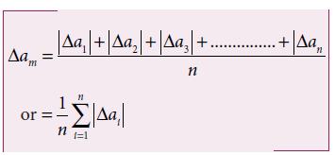
1.6.3
ERROR ANALYSIS
Mean Absolute error
The arithmetic mean of absolute errors in all the measurements is called the mean absolute error.
Absolute Error
The magnitude of difference between the true value and the measured value of a quantity is called absolute error.
(c) Shanthimalai Trust 2023
7

Slide 8
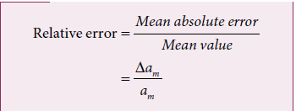
Relative error
The ratio of the mean absolute error to the mean value is called relative error. This is also called as fractional error.
Percentage error
The relative error expressed as a percentage is called percentage error.
For example, a driver’s speedometer shows that his car is travelling at 60 km h⁻¹ when it is actually moving at 62 km h⁻¹. Then absolute error of speedometer is 62-60 km h⁻¹ = 2 km h⁻¹ Relative error of the measurement is 2 km h⁻¹ / 62 km h⁻¹ = 0.032.
(c) Shanthimalai Trust 2023
8

Slide 9
1.6.4
PROPAGATION OF ERRORS
(i) Error in the sum of two quantities:
Let ΔA and ΔB be the absolute errors in the two quantities A and B respectively.
Then, Measured value of A = A ± ΔA ; Measured value of B = B ± ΔB
Consider the sum, Z = A + B
The error ΔZ in Z is then given by
Z ± ΔZ = (A ± ΔA) + (B ± ΔB) ;
= (A + B) ± (ΔA + ΔB)
= Z ± (ΔA + ΔB) (or) ΔZ = ΔA + ΔB
The maximum possible error in the sum of two quantities is equal to the sum of the absolute errors in the individual quantities.
A number of measured quantities may be involved in the final calculation of an experiment
The error in the final result depends on
(i) The errors in the individual measurements
(ii) On the nature of mathematical operations performed to get the final result. So we should know the rules to combine the errors.
(c) Shanthimalai Trust 2023
9

Slide 10
(ii) Error in the difference of two quantities:
Let ΔA and ΔB be the absolute errors in the two quantities, A and B, respectively. Then,
Measured value of A = A ± ΔA ;
Measured value of B = B ± ΔB
Consider the difference, Z = A – B
The error ΔZ in Z is then given by
Z ± ΔZ = (A ± ΔA) – (B ± ΔB) ;
= (A − B) ± ΔA ± ΔB
= Z ± ΔA ± ΔB (or) ΔZ = ΔA + ΔB
The maximum error in difference of two quantities is equal to the sum of the absolute errors in the individual quantities.
(iii) Error in the product of two quantities:
Let ΔA and ΔB be the absolute errors in the two quantities A, and B, respectively. Consider the product Z = AB
The error ΔZ in Z is given by Z ± ΔZ
= (A ± ΔA) (B ± ΔB)
= (AB) ± (A ΔB) ± (B ΔA) ± (ΔA . ΔB)
Dividing L.H.S by Z and R.H.S by AB, we get, 1±$\frac{∆Z}{Z}$ = 1±$\frac{∆B}{B}$ ±$\frac{∆A}{A}$ ±$\frac{∆A}{A}$ . $\frac{∆B}{B}$
As ΔA /A, ΔB / B are both small quantities,
their product term$\frac{∆A}{A}$ . $\frac{∆B}{B}$ can be neglected
The maximum fractional error in Z is $\frac{∆Z}{Z}$ = ± $\left(\frac{∆A}{A}+ \frac{∆B}{B}\right)$
(c) Shanthimalai Trust 2023
10

Slide 11
1.7.1
RULES OF SIGNIFICANT FIGURES
The number of meaningful digits which contain numbers that are known reliably and first uncertain number.
Examples: The significant figure for the digit 121.23 is 5, significant figure for the digit 1.2 is 2, significant figure for the digit 0.123 is 3, significant digit for 0.1230 is 4, significant digit for 0.0123 is 3, significant digit for 1230 is 3, significant digit for 1230 (with decimal) is 4 and significant digit for 20000000 is 1 (because 20000000=2×10⁷ has only one significant digit, that is, 2). In physical measurement, if the length of an object is l = 1230 m, then significant digit for l is 4.
Suppose we ask three students to measure the length of a stick using metre scale (the least count for metre scale is 1 mm or 0.1 cm). So, the result of the measurement (length of stick) can be any of the following, 7.20 cm or 7.22 cm or 7.23 cm. Note that all the three students measured first two digits correctly (with confidence) but last digit varies from person to person. So, the number of meaningful digits is 3
(c) Shanthimalai Trust 2023
11

Slide 12
1.7.1
ROUNDING OFF
EXAMPLE 1.10
State the number of significant figures in the following
i) 600800 iv) 5213.0
ii) 400 v) 2.65 × 10²⁴m
iii) 0.007 vi) 0.0006032
Solution:
i) four ii) one iii) one
iv) five v) three vi) four
Calculators are widely used now-a-days to do calculations. The result given by a calculator has too many figures. In no case should the result have more significant figures than the figures involved in the data used for calculation. The result of calculation with numbers containing more than one uncertain digit should be rounded off.
(c) Shanthimalai Trust 2023
12

Slide 13
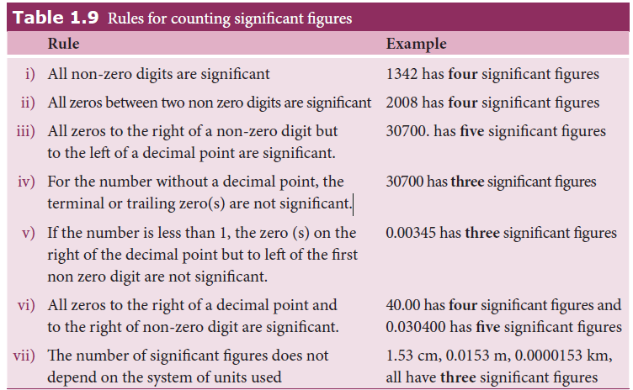
(c) Shanthimalai Trust 2023
13

Slide 14
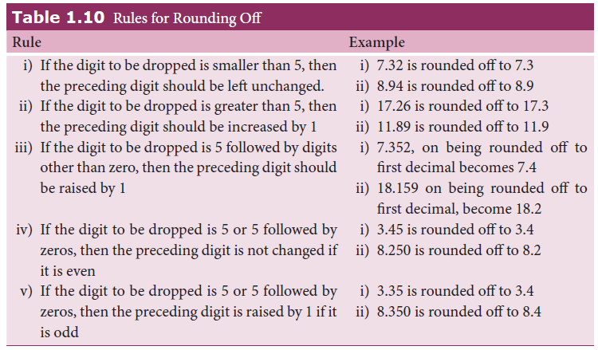
(c) Shanthimalai Trust 2023
14

Slide 15
1.7.3
ARITHMETICAL OPERATIONS WITH SIGNIFICANT FIGURES
Multiplication and Division
In multiplication or division, the final result should retain as many significant figures as there are in the original number with smallest number of significant figures.
Example:
1.21 × 36.72 = 44.4312 = 44.4
Here the least number of significant digits in the measured values is three. Hence the result when rounded off to three significant digits is 44.4
36.72 ÷ 1.2 = 30.6 = 31
Here the least number of significant digits in the measured values is two. Hence the result when rounded off to significant digit becomes 31.
Addition and subtraction
In addition and subtraction, the final result should retain as many decimal places as there are in the number with the smallest number of decimal places.
Example:
3.1 + 1.780 + 2.046 = 6.926
Here the least number of significant digits after the decimal is one. Hence the result will be 6.9.
12.637 – 2.42 = 10.217
Here the least number of significant digits after the decimal is two. Hence the result will be 10.22
(c) Shanthimalai Trust 2023
15

Slide 16
Thank you !
(c) Shanthimalai Trust 2023
16

