Slide 1
www.Padasalai.Net
UNIT : 01
NATURE OF PHYSICAL WORLD AND MEASUREMENT
Higher Secondary – First Year
By
RAJENDRAN M, M.Sc., B.Ed., C.C.A.,
PGT IN PHYSICS, SRMHSS, KAVERIYAMPOONDI
TIRUVANNAMALAI – 606603.
(c) Shanthimalai Trust 2023
1

Slide 2
Learning Objectives:
In this unit, the student is exposed to
Excitement generated by the discoveries in Physics.
An understanding of physical quantities of importance.
Different system of units.
An understanding of errors and corrections in physics measurements.
The importance of significant figures.
Usage of dimensions to check the homogeneity of physical quantities.
(c) Shanthimalai Trust 2023
2

Slide 3
1.8.1
DIMENSION OF PHYSICAL QUANTITIES
The dimension of length can be expressed in terms of base quantities as
[length] = M⁰ LT⁰ = L
Similarly, [area] = M⁰ L² T⁰ = L²
Similarly, [volume] = M⁰ L³ T⁰ = L³
Note that in all the cases, the base quantity L is same but exponent (power) are different, which means dimensions are different. For a pure number, exponent of base quantity is zero. For example, consider the number 2, which has no dimension and can be expressed as
⇒[2]=M⁰ L⁰ T⁰ (Dimensionless)
In mechanics, we deal with the physical quantities like mass, time, length, velocity, acceleration, etc. which can be expressed in terms of three independent base quantities such as M, L and T.
For an example, [length] means dimension of length, [area] means dimension of area, etc.
(c) Shanthimalai Trust 2023
3

Slide 4
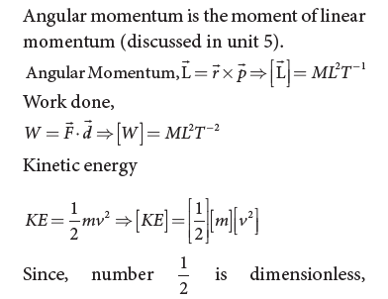
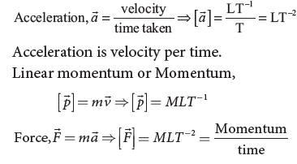
(c) Shanthimalai Trust 2023
4

Slide 5
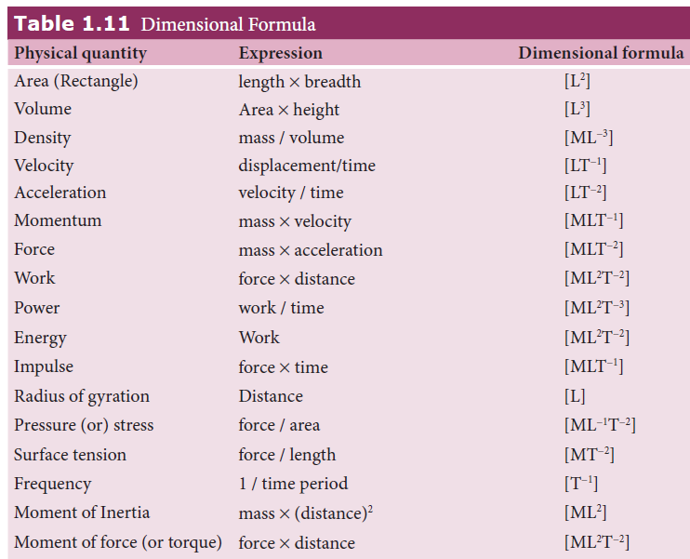
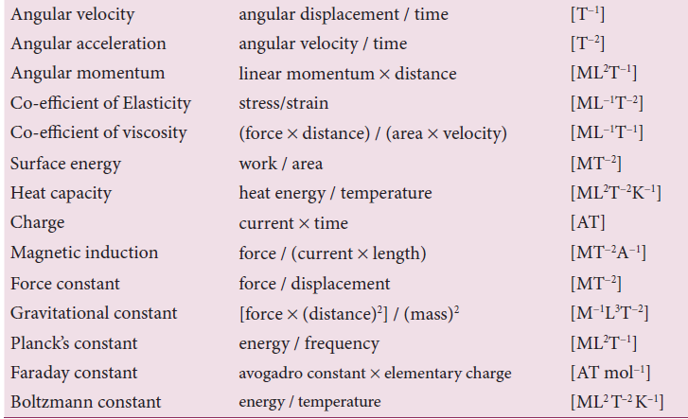
(c) Shanthimalai Trust 2023
5

Slide 6
Dimensionless variables
Physical quantities which have no dimensions, but have variable values are called dimensionless variables. Examples are specific gravity, strain, refractive index etc.
1.8.2
DIMENSIONAL QUANTITIES
Dimensional variables
Physical quantities, which possess dimensions and have variable values are called dimensional variables. Examples are length, velocity, and acceleration etc.
Dimensionless Constant
Quantities which have constant values and also have no dimensions are called dimensionless constants. Examples are π, e (Euler’s number), numbers etc
Dimensional Constant
Physical quantities which possess dimensions and have constant values are called dimensional constants. Examples are Gravitational constant, Planck’s constant etc.
(c) Shanthimalai Trust 2023
6

Slide 7
Principle of homogeneity of dimensions
The principle of homogeneity of dimensions states that the dimensions of all the terms in a physical expression should be the same. For example, in the physical expression v² = u² + 2as, the dimensions of v², u² and 2 as are the same and equal to [L²T⁻²].
1.8.3
APPLICATION AND LIMITATIONS OF THE METHOD OF DIMENSIONAL ANALYSIS
This method is used to
Convert a physical quantity from one
system of units to another.
(ii) Check the dimensional correctness of a given physical equation.
(iii) Establish relations among various
physical quantities.
(c) Shanthimalai Trust 2023
7

Slide 8
To convert a physical quantity from one system of units to another
This is based on the fact that the product of the numerical values (n) and its corresponding unit (u) is a constant. i.e, n [u] = constant (or) n₁[u₁] = n₂[u₂].
Consider a physical quantity which has dimension ‘a’ in mass, ‘b’ in length and ‘c’ in time. If the fundamental units in one system are M₁, L₁ and T₁ and the other system are M₂, L₂ and T₂ respectively, then we can write, n₁ [M₁ª L₁^{b} T₁^{c}] = n₂ [M₂ª L₂^{b} T₂^{c}]
We have thus converted the numerical value of physical quantity from one system of units into the other system.
To check the dimensional correctness of a given physical equation
Let us take the equation of motion v = u + at
Apply dimensional formula on both sides [LT⁻¹] = [LT⁻¹] + [LT⁻²] [T]
[LT⁻¹] = [LT⁻¹] + [LT⁻¹]
(Quantities of same dimension only can be added)
We see that the dimensions of both sides are same. Hence the equation is dimensionally correct.
(c) Shanthimalai Trust 2023
8

Slide 9
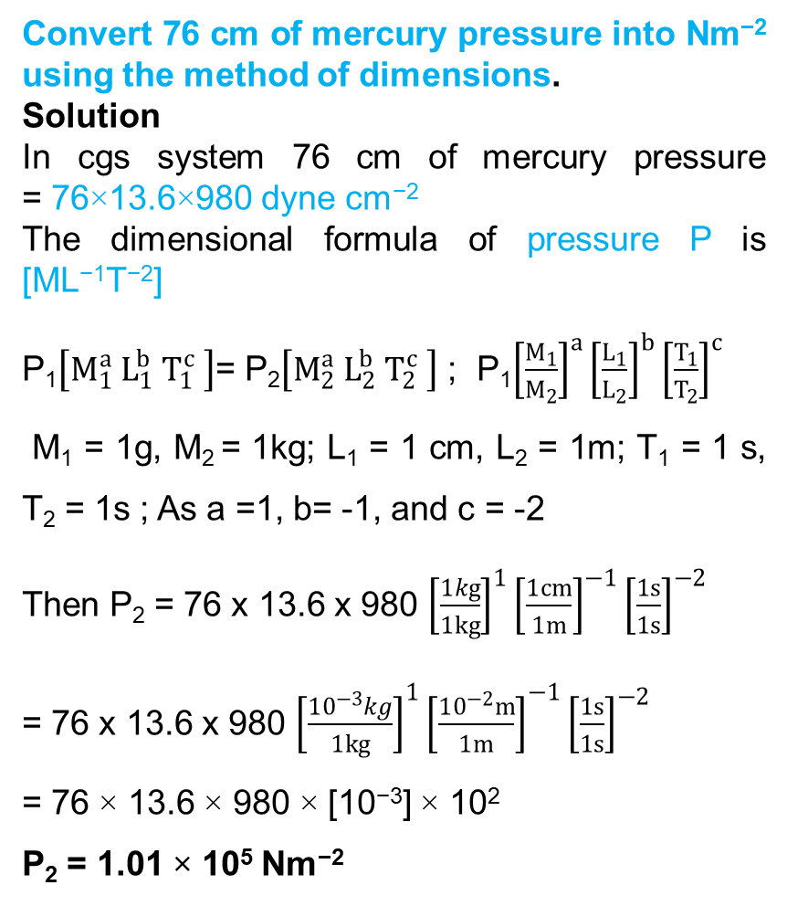
To establish the relation among various physical quantities:
If the physical quantity Q depends upon the quantities Q₁, Q₂ and Q₃ ie. Q is proportional to Q₁, Q₂ and Q₃.
Then, Q ∝ Q₁ª Q₂^{b} Q₃^{c} ; Q = k Q₁ª Q₂^{b} Q₃^{c}
where k is a dimensionless constant. When the dimensional formula of Q, Q₁, Q₂ and Q₃ are substituted, then according to the principle of homogeneity, the powers of M, L, T are made equal on both sides of the equation. From this, we get the values of a, b, c
Convert 76 cm of mercury pressure into Nm⁻² using the method of dimensions.
Solution
In cgs system 76 cm of mercury pressure = 76×13.6×980 dyne cm⁻²
The dimensional formula of pressure P is [ML⁻¹T⁻²]
P₁$\left[M_{1}^{a} L_{1}^{b} T_{1}^{c} \right]$= P₂$\left[M_{2}^{a} L_{2}^{b} T_{2}^{c} \right]$ ; P₁${\left[\frac{M_{1}}{M_{2}}\right]}^{a}{\left[\frac{L_{1}}{L_{2}}\right]}^{b}{\left[\frac{T_{1}}{T_{2}}\right]}^{c}$
M₁ = 1g, M₂ = 1kg; L₁ = 1 cm, L₂ = 1m; T₁ = 1 s, T₂ = 1s ; As a =1, b= -1, and c = -2
Then P₂ = 76 x 13.6 x 980 ${\left[\frac{1kg}{1kg}\right]}^{1}{\left[\frac{1cm}{1m}\right]}^{−1}{\left[\frac{1s}{1s}\right]}^{−2}$
= 76 x 13.6 x 980 ${\left[\frac{{10}^{−3}kg}{1kg}\right]}^{1}{\left[\frac{{10}^{−2}m}{1m}\right]}^{−1}{\left[\frac{1s}{1s}\right]}^{−2}$
= 76 × 13.6 × 980 × [10⁻³] × 10²
P₂ = 1.01 × 10⁵ Nm⁻²
(c) Shanthimalai Trust 2023
9

Slide 10
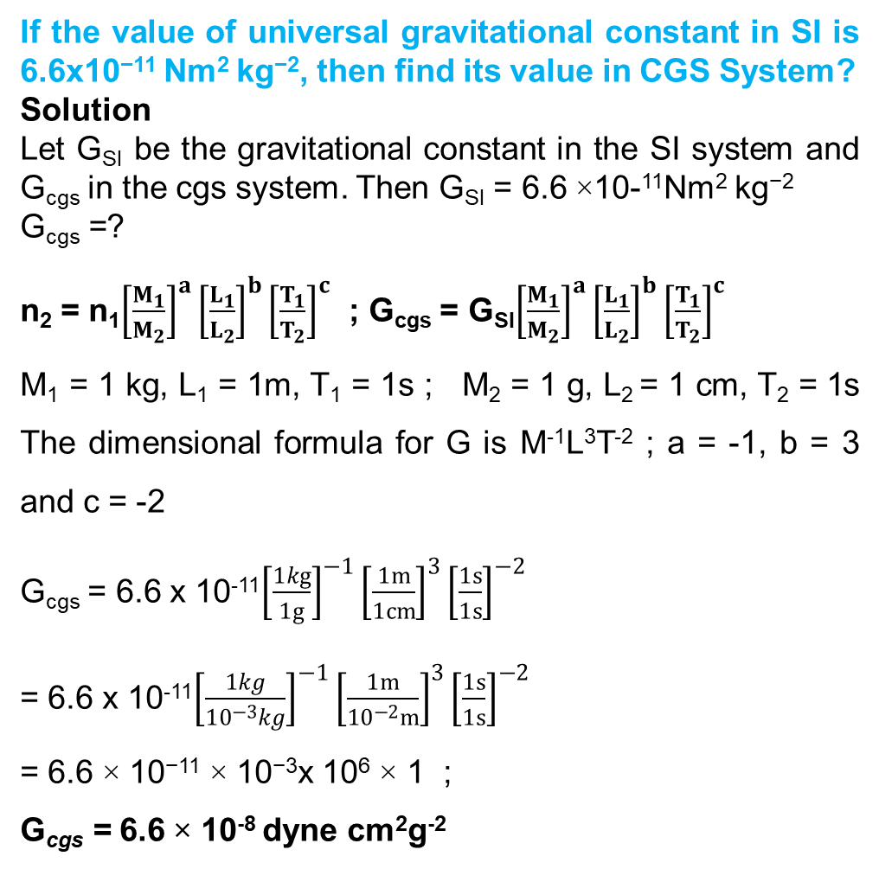
If the value of universal gravitational constant in SI is 6.6x10⁻¹¹ Nm² kg⁻², then find its value in CGS System?
Solution
Let G_{SI} be the gravitational constant in the SI system and G_{cgs} in the cgs system. Then G_{SI} = 6.6 ×10-¹¹Nm² kg⁻²
G_{cgs} =?
n₂ = n₁${\left[\frac{M_{1}}{M_{2}}\right]}^{a}{\left[\frac{L_{1}}{L_{2}}\right]}^{b}{\left[\frac{T_{1}}{T_{2}}\right]}^{c}$ ; G_{cgs} = G_{SI}${\left[\frac{M_{1}}{M_{2}}\right]}^{a}{\left[\frac{L_{1}}{L_{2}}\right]}^{b}{\left[\frac{T_{1}}{T_{2}}\right]}^{c}$
M₁ = 1 kg, L₁ = 1m, T₁ = 1s ; M₂ = 1 g, L₂ = 1 cm, T₂ = 1s The dimensional formula for G is M⁻¹L³T⁻² ; a = -1, b = 3 and c = -2
G_{cgs} = 6.6 x 10⁻¹¹${\left[\frac{1kg}{1g}\right]}^{−1}{\left[\frac{1m}{1cm}\right]}^{3}{\left[\frac{1s}{1s}\right]}^{−2}$
= 6.6 x 10⁻¹¹${\left[\frac{1kg}{{10}^{−3}kg}\right]}^{−1}{\left[\frac{1m}{{10}^{−2}m}\right]}^{3}{\left[\frac{1s}{1s}\right]}^{−2}$
= 6.6 × 10⁻¹¹ × 10⁻³x 10⁶ × 1 ;
G_{cgs} = 6.6 × 10⁻⁸ dyne cm²g⁻²
Check the correctness of the equation
½ mv² = mgh using dimensional analysis method.
Solution
Dimensional formula for
½ mv² = [M][LT⁻¹]² = [ML²T⁻²]
Dimensional formula for
mgh = [M][LT-²][L]=[ML²T⁻²]
[ML²T⁻²] = [ML²T⁻²]
Both sides are dimensionally the same, hence the equations ½ mv² = mgh is dimensionally correct.
(c) Shanthimalai Trust 2023
10

Slide 11
Obtain an expression for the time period T of a simple pendulum. The time period T depends on (i) mass ‘m’ of the bob (ii) length ‘$l$’ of the pendulum and (iii) acceleration due to gravity g at the place where the pendulum is suspended. (Constant k = 2π)
Solution
T$∝m^{a}l^{b}g^{c}$ ; T = k $m^{a}l^{b}g^{c}$
Here k is the dimensionless constant. Rewriting the above equation with dimensions
[T¹] = [Mª] [L^{b}] [LT⁻²]^{c} [M⁰L⁰T¹] = [Mª L^{b+c} T^{−2c}]
Comparing the powers of M, L and T on both sides, a=0, b+c=0, -2c=1
Solving for a,b and c a = 0, b = 1/2, and c = −1/2
From the above equation T = k. m⁰ $l^{1/2}$ $g^{1/2}$
T = k ${\left(\frac{l}{g}\right)}^{1/2}$ ; k $\sqrt{l/g}$ ; Experimentally k = 2π, hence T = 2π $\sqrt{l/g}$
(c) Shanthimalai Trust 2023
11

Slide 12
Limitations of Dimensional analysis:
This method gives no information about the dimensionless constants in the formula like
1, 2, ……..π,e, etc.
2. This method cannot decide whether the given quantity is a vector or a scalar.
This method is not suitable to derive relations involving trigonometric, exponential and
logarithmic functions.
4. It cannot be applied to an equation involving more than three physical quantities.
It can only check on whether a physical relation is dimensionally correct but not the
correctness of the relation. For example, using dimensional analysis,
s = ut + $\frac{1}{3}$ at² is dimensionally correct whereas the correct relation is s = ut + $\frac{1}{2}$ at²
(c) Shanthimalai Trust 2023
12

Slide 13
DIMENSIONAL ANALYSIS
PROPAGATION OF ERRORS
ICT CORNER
(c) Shanthimalai Trust 2023
13

Slide 14
Thank you !
(c) Shanthimalai Trust 2023
14

