Slide 1
Student’s are advice to tab
F5
Button first;
Then tab only
Space bar
www.Padasalai.Net

Slide 2
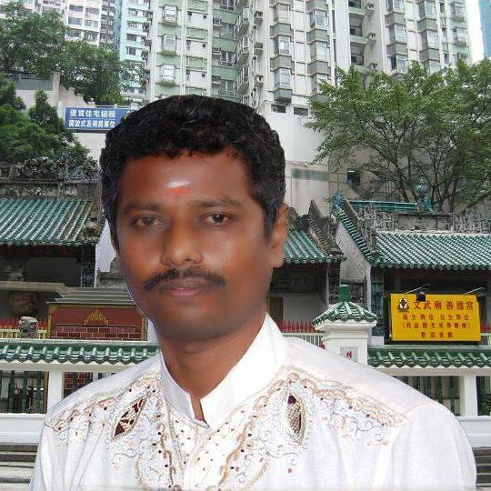
WISH YOU ALL
SUCCESS
FROM
MANAGEMENT&TEACHERS
V.V.D.MEM.HR.SEC.SCHOOL
TUTICORIN
  THIS POWER POINT PRESENTATION CREATED
  BY
  C.RAMASUBRAMANIAN

Slide 3
tuyhW (ghlk;-1)
www.Padasalai.Net
Kjy; cyfg;Nghupd; ntbg;Gk;
mjd; gpd;tpisTfSk;;
Nfhbl;l ,lj;ij epug;Gf

Slide 4
Nfhbl;l ,lj;ij epug;Gf
------------------------- Mz;by; [g;ghd; rPdhTld; tYf;fl;lhakhfg; Nghupl;lJ.
1894

Slide 5
Nfhbl;l ,lj;ij epug;Gf
1913 Mk; Mz;L Nk khj ifnaOj;jplg;gl;l -------------------------- cld;gbf;ifapd;gb my;Ngdpah vDk; Gjpa ehL cUthf;fg;gl;lJ..
yz;ld;

Slide 6
Nfhbl;l ,lj;ij epug;Gf
------------------------- Mz;by; [g;ghd; ,q;fpyhe;Jld; el;gpid xg;ge;jk; nra;J nfz;lJ..
1902

Slide 7
Nfhbl;l ,lj;ij epug;Gf
ghy;fdpy; -------------------- ehL gy;tif ,dkf;fisf; nfhz;bUe;jJ..
khrpNlhdpah

Slide 8
Nfhbl;l ,lj;ij epug;Gf
lhndd;gu;f; Nghupy; ------------------------- Ngupog;GfSf;F cs;shdJ.
u\;ah

Slide 9
Nfhbl;l ,lj;ij epug;Gf
ghhp]; mikjp khehl;by; gpujpepjpahfg; gq;Nfw;w gpuhd;]pd; gpujkh; ------------- Mthh;.
fpsnkd;Nrh

Slide 10
Nfhbl;l ,lj;ij epug;Gf
---------- Mz;by; nyhf;fhu;Ndh cld;gbf;if ifnaOj;jplg;gl;lJ.
1925

Slide 11
tuyhW (ghlk;-2)
,U cyfg;Nghu;fSf;F ,ilapy; cyfk;;;
Nfhbl;l ,lj;ij epug;Gf

Slide 12
tuyhW (ghlk;-3)
,uz;lhk; cyfg;Nghu;;
Nfhbl;l ,lj;ij epug;Gf

Slide 13
Nfhbl;l ,lj;ij epug;Gf
,uhZtf; ePf;fk; nra;ag;gl;l gFjpahd --------------------- I `pl;yu; jhf;fpdhu;.
iud;yhe;J

Slide 14
Nfhbl;l ,lj;ij epug;Gf
,j;jhyp, n[u;kdp, [g;ghd; Mfpatw;wpf;fpilNahd xg;ge;jk; ------------- vd miof;fg;gl;lJ.
Nuhk; ngh;ypd; Nlhf;fpNah xg;ge;jk;

Slide 15
Nfhbl;l ,lj;ij epug;Gf
------------- fld; Fj;jifj; jpl;lj;ijj; njhlf;fp itj;jhu.;
&];nty;l;

Slide 16
Nfhbl;l ,lj;ij epug;Gf
1940 ,y; uh[pdhkh nra;j ,q;fpyhe;J gpujku; --------------- Mthu;.
Nrk;gh;ypd;

Slide 17
Nfhbl;l ,lj;ij epug;Gf
------------- vd;gJ njhiytpypUe;Nj vjpupfspd; Nghu; tpkhdq;fisf; fz;Lgpbg;gjw;fhd xU fUtp.
Nulhh;

Slide 18
tuyhW (ghlk;-4)
,uz;lhk; cyfg;NghUf;F gpe;ija cyfk;;
Nfhbl;l ,lj;ij epug;Gf

Slide 19
Nfhbl;l ,lj;ij epug;Gf
etPd rPdhtpd; je;ij vd;W miof;fg;gLgtu; ----------------- Mthu;.
lhf;lh; rhd;ahl; nrd;

Slide 20
Nfhbl;l ,lj;ij epug;Gf
1918 Mk; Mz;L -------------------- gy;fiyfofj;jpy; khu;f;]paf; Nfhl;ghl;il mwpAk; mikT epWtg;gl;lJ.
gPfpq;

Slide 21
Nfhbl;l ,lj;ij epug;Gf
lhf;lu; rd;ahl;nrd;dpd; kiwTf;Fg; gpd;du; Nfhkpq;lhq; fl;rpapd; jiytuhf ,Ue;jtu; -------------------- Mthu;.
\pahq; - if - N\f;

Slide 22
Nfhbl;l ,lj;ij epug;Gf
mikjpiaAk; ghJfhg;igAk; tpUk;gpa muGNjrq;fSf;F jpwe;Nj ,Ue;j xg;ge;jk; ---------------------- MFk;.
nrd;Nlh / ghf;jhj; xg;ge;jk;

Slide 23
Nfhbl;l ,lj;ij epug;Gf
JUf;fp muGg;Nguuir Vw;gLj;Jk; Nehf;iff; nfhz;bUe;j xg;ge;jk; -------------- MFk;.
nth;nrapy;];

Slide 24
Nfhbl;l ,lj;ij epug;Gf
n[u;kdp Nel;Nlhtpy; --------------------- Mz;L ,ize;jJ.
1955

Slide 25
Nfhbl;l ,lj;ij epug;Gf
INuhg;gpaf; FOtpd; jiyikafk; -------- efupy; mike;Js;sJ.
];l;uh]; gh;f;

Slide 26
Nfhbl;l ,lj;ij epug;Gf
INuhg;gpa ,izg;ig cWjp nra;a gpg;utup 1992 ,y; ifnaOj;jlg;gl;l xg;ge;jk; ----------------- MFk;.
kh];bhpf;l; - nejh;yhe;J

Slide 27
tuyhW (ghlk;-5)
19Mk; E}w;whz;by; r%f rka rPu;jpUj;j ,af;fq;fs;;;;
Nfhbl;l ,lj;ij epug;Gf

Slide 28
Nfhbl;l ,lj;ij epug;Gf
----------- rkur Ntjrd;khu;f;f rq;fj;ij epWtpdhu;.
,uhkypq;f mbfs;

Slide 29
Nfhbl;l ,lj;ij epug;Gf
GNd ru;t[dpf; rghit epWtpatu; ---------------------
uhdNl

Slide 30
Nfhbl;l ,lj;ij epug;Gf
Fyhk; fpup Ehiy vOjpatu; ---------------
N[hjpgh g+Ny

Slide 31
Nfhbl;l ,lj;ij epug;Gf
uhkfpU\;zhkp\d; --------------------- My; epWtg;gl;lJ.
tpNtfhde;juhy;

Slide 32
Nfhbl;l ,lj;ij epug;Gf
----------------- mfhyp ,af;fj;jpd; Kd;NdhbahFk;.
rpq;rgh

Slide 33
Nfhbl;l ,lj;ij epug;Gf
‘xU igrh jkpod’ gj;jpupf;ifiaj; Jtf;fpatu; -------- Mthu;.
mNahj;jp jhrh;

Slide 34
tuyhW (ghlk;-6)
Mq;fpNya Ml;rpf;F vjpuhf jkpofj;jpy; epfo;e;j njhlf;ffhy fpsu;r;rpfs;;;;;;
Nfhbl;l ,lj;ij epug;Gf

Slide 35
Nfhbl;l ,lj;ij epug;Gf
ghisaf;fhuh; Kiw jkpofj;jpy; ----------------- vd;gtuhy; mwpKfg;gLj;jg;gl;lJ.
tp];tehj; ehaf;fh;

Slide 36
Nfhbl;l ,lj;ij epug;Gf
NtYehr;rpahUk; mtuJ kfSk; vl;lhz;Lfshf -------------------ghJfhg;gpy; ,Ue;jdh;.
Nfhghy ehaf;fh;

Slide 37
Nfhbl;l ,lj;ij epug;Gf
fl;lnghk;kid ruzilaf; NfhUk; jftiyj; njhptpf;f ghndh;nkd; ------------------ vd;gtiu mDg;gp itj;jhh;.
,uhkypq;fh;

Slide 38
Nfhbl;l ,lj;ij epug;Gf
fl;lnghk;kd; ------------------- vd;w ,lj;jpy; J}f;fpyplg;gl;lhh;.
faj;jhW

Slide 39
Nfhbl;l ,lj;ij epug;Gf
kUJ rNfhjuh;fspd; Gul;rp gphpl;b\; Fwpg;Gfspy; -------------- vd;W
tifg;gLj;jg;gl;Ls;sJ.
,uz;lhtJ ghisaf;fhuh; Nghh;

Slide 40
Nfhbl;l ,lj;ij epug;Gf
-------------- vd;gth; Gul;rpf;fhuh;fshy; NtY}h; Nfhl;ilapd; Gjpa Ry;jhdhf mwptpf;fg;gl;lhh;.
gNjf; i`jh;

Slide 41
tuyhW (ghlk;-7)
fhydpaj;jpw;F vjpuhd ,af;fq;fSk; Njrpaj;jpd; Njhw;wKk;;;;
Nfhbl;l ,lj;ij epug;Gf

Slide 42
Nfhbl;l ,lj;ij epug;Gf
kd;duhl;rpf;Fk; epyRthd;jhuh;fSf;Fk; vjpuhd ----------- ,af;fk; 1827Mk; Mz;L thf;fpy; njhlq;fg;gl;lJ.
t`hgp

Slide 43
Nfhbl;l ,lj;ij epug;Gf
Nrhl;lh ehf;g+h; gFjpapy; ele;j kpfg;nghpa goq;Foapdh; fpsh;r;rp -----------
Nfhy; fpsu;r;rp

Slide 44
Nfhbl;l ,lj;ij epug;Gf
----------- rl;lk; goq;Foapduy;yhj kf;fis goq;Fb epyj;jpy; Eioa jil tpjpj;jJ.
Nrhl;lh, ehf;g+u; Fj;jifr;

Slide 45
Nfhbl;l ,lj;ij epug;Gf
Nrhl;lh ehf;g+h; rl;lk; epiwNtw;wg;gl;l Mz;L -----------
1908

Slide 46
Nfhbl;l ,lj;ij epug;Gf
W.C. ghdh;[p ,e;jpa Njrpa fhq;fpu]pd; jiytuhfj; Njh;e;njLf;fg;gl;l Mz;L -----------
1885

Slide 47
tuyhW (ghlk;-8)
Njrpak;
fhe;jpa fhyfl;lk;
Nfhbl;l ,lj;ij epug;Gf

Slide 48
Nfhbl;l ,lj;ij epug;Gf
fhe;jpabfspd; murpay; FU ----------- Mthh;.
NfhghyfpU\;z NfhFNy

Slide 49
Nfhbl;l ,lj;ij epug;Gf
fpyhgj; ,af;fj;Jf;F ----------- jiyik Vw;whh;.
myp rNfhjuu;fs;

Slide 50
Nfhbl;l ,lj;ij epug;Gf
1919 Mk; Mz;bd; ,e;jpa muRr; rl;lk; khfhzq;fspy; ----------- mwpKfk; nra;jJ.
,ul;il Ml;rpKiwia

Slide 51
Nfhbl;l ,lj;ij epug;Gf
tlNkw;F vy;iy khfhzj;jpy; rl;lkWg;G ,af;fj;ij jiyikNaw;W elj;jpath; -----------
fhd; mg;Jy; f/ghu;fhd;

Slide 52
Nfhbl;l ,lj;ij epug;Gf
rpWghd;ikapdh; kw;Wk; xLf;fg;gl;l tFg;gpdUf;F jdpj; njhFjpfis toq;Fk; ----------- I uhk;Nr nkf;nlhdhy;L mwptpj;jhh;.
tFg;Gthup xJf;fPl;il

Slide 53
Nfhbl;l ,lj;ij epug;Gf
----------- vd;gth; nts;isaNd ntspNaW ,af;fj;jpd; NghJ fhq;fpu]; thndhypia jpiukiwthf nray;gLj;jpdhh;.
c\h Nkj;jh

Slide 54
tuyhW (ghlk;-9)
jkpo;ehl;by; tpLjiyg; Nghuhl;lk;;
Nfhbl;l ,lj;ij epug;Gf

Slide 55
Nfhbl;l ,lj;ij epug;Gf
nrd;id cah; ePjpkd;wj;jpy; gzpakh;j;jg;gl;l Kjy; ,e;jpa ePjpgjp ----------- Mthh;.
T. Kj;Jrhkp

Slide 56
Nfhbl;l ,lj;ij epug;Gf
----------- vDk; ufrpa mikg;ig ePyfz;l gpuk;kr;rhhp njhlq;fpdhh;.
ghujkhjh rq;fk;

Slide 57
Nfhbl;l ,lj;ij epug;Gf
nrd;idapy; njhopw;rq;fq;fisj; njhlq;Ftjpy; Kd;Ndhbahfj; jpfo;e;jth; ----------- Mthh;.
B.P. thbah

Slide 58
Nfhbl;l ,lj;ij epug;Gf
nrd;idapy; KjyhtJ fhq;fpu]; mikr;ruitia mikj;jth; -----------
uh[h[p

Slide 59
Nfhbl;l ,lj;ij epug;Gf
----------- K];yPk; yPf;fpd; nrd;idf; fpisia cUthf;fpatuhthh;.
ah$g; `rd;

Slide 60
Nfhbl;l ,lj;ij epug;Gf
1932 [dthp 26 ,y; ------------ Gdpj [hh[; Nfhl;ilapd; cr;rpapy; Njrpaf; nfhbia Vw;wpdhh;.
gh\;ak; (Mupah)

Slide 61
tuyhW (ghlk;-10)
jkpo;ehl;by;
r%f khw;wq;fs;;;;;;;;
Nfhbl;l ,lj;ij epug;Gf

Slide 62
Nfhbl;l ,lj;ij epug;Gf
Kjd;Kjyhf mr;Nrwpa INuhg;gpa nkhop my;yhj nkhop ---------- MFk;.
jkpo;

Slide 63
Nfhbl;l ,lj;ij epug;Gf
Gdpj [hh;[; Nfhl;ilf; fy;Y}hpia cUthf;fpath; ---------- Mthh;.
F.W. vy;yP];

Slide 64
Nfhbl;l ,lj;ij epug;Gf
---------- jkpo;nkhopapay; J}a;ik thjj;jpd; je;ijnadf; fUjg;gLfpwhh;.
kiwkiy mbfs;

Slide 65
Nfhbl;l ,lj;ij epug;Gf
Njh;jy; murpaypy; ngz;fs; gq;Nfw;gij Kjypy; mq;fPfhpj;jJ ---------- MFk;.
ePjpf;fl;rp muR

Slide 66
Nfhbl;l ,lj;ij epug;Gf
#hpaehuhaz rh];jphp vDk; ngah; ---------- vd khw;wk; ngw;wJ.
gupjpkhw;fiyQu;

Slide 67
Nfhbl;l ,lj;ij epug;Gf
---------- jkpo; ,irf;F Kf;fpaj;Jtk; nfhLj;jhh;.
Mgpufhk; gz;bju;

Slide 68
Nfhbl;l ,lj;ij epug;Gf
,e;jpahtpd; Kjy; ngz; rl;lkd;w cWg;gpdh; ---------- Mthh;.
Kj;Jyl;Rkp mk;ikahu;

Slide 69
Gtpapay; (ghlk;-6)
jkpo;ehL
,aw;if gpupTfs;
Nfhbl;l ,lj;ij epug;Gf

Slide 70
Nfhbl;l ,lj;ij epug;Gf
ePyfphp kw;Wk; ju;kGhp khtl;lq;fSf;fpilNa fhzg;gLk; gPlg+kp ------------ MFk;.
Nfhak;Gj;J}u; gPlg+kp

Slide 71
Nfhbl;l ,lj;ij epug;Gf
fpof;Fj; njhlh;r;rp kiyapd; njd; gFjpapy; cs;s caukhd rpfuk; ----------- MFk;.
Nrhiyf;fhL

Slide 72
Nfhbl;l ,lj;ij epug;Gf
Mw;Wj; jPthd =uq;fk; ------------ kw;Wk; ------------ MWfSf;F
,ilNa mike;Js;sJ.
fhtpup, nfhs;splk;

Slide 73
Nfhbl;l ,lj;ij epug;Gf
------------ jkpo;ehl;bd; khepy tpyq;F.
tiuahL

Slide 74
Gtpapay; (ghlk;-7)
jkpo;ehL
khDl Gtpapay;;;;
Nfhbl;l ,lj;ij epug;Gf

Slide 75
Nfhbl;l ,lj;ij epug;Gf
jkpo;ehl;bd; nghUshjhuj;jpy; Ntshz;ik Jiwapd; gq;F ---------
rjtpfpjj;ij tfpf;fpwJ.
21

Slide 76
Nfhbl;l ,lj;ij epug;Gf
rhj;jD}h; miz --------- Mw;wpd; FWf;Nf fl;lg;gl;Ls;sJ.
njd;ngz;iz

Slide 77
Fbikapay; (ghlk;-1)
,e;jpa
murpayikg;G
Nfhbl;l ,lj;ij epug;Gf

Slide 78
Nfhbl;l ,lj;ij epug;Gf
Kjd; Kjypy; murpayikg;G vDk; nfhs;if --------------------- y;
Njhd;wpaJ.
mnkhpf;f If;fpa ehLfspy;

Slide 79
Nfhbl;l ,lj;ij epug;Gf
murpay; epu;za rigapd; jw;fhypf jiytuhf -------------------------- Nju;e;njLf;fg;gl;lhu;.
lhf;lh; rr;rpjhde;jh rpd;fh

Slide 80
Nfhbl;l ,lj;ij epug;Gf
,e;jpa murpayikg;G Vw;Wf;nfhs;sg;gl;l ehs; kw;Wk; Mz;L ------
1949, etk;gh; 26

Slide 81
Nfhbl;l ,lj;ij epug;Gf
-------------- Nguhizfs; gpupT 32 – y; Fwpg;gplg;gLfpd;wd.
ePjpg;

Slide 82
Nfhbl;l ,lj;ij epug;Gf
,e;jpa Fbkf;fSf;F mbg;gil flikfs; ---------------- gpuptpd; fPo;
toq;fg;gl;Ls;sd.
51A

Slide 83
Fbikapay; (ghlk;-2)
kj;jpa muR
Nfhbl;l ,lj;ij epug;Gf

Slide 84
Nfhbl;l ,lj;ij epug;Gf
------------------ kNrhjhit FbauRj; jiytupd; xg;Gjy; ,d;wp ghuhSkd;wj;jpy; mwpKfg;gLj;j KbahJ.
epjp

Slide 85
Nfhbl;l ,lj;ij epug;Gf
-------------------- ehl;bd; jiytuhfTk; ehl;bd; Kf;fpar;nra;jp
njhlu;ghsuhfTk; nray;gLfpwhu;.
gpujk mikr;rh;

Slide 86
Nfhbl;l ,lj;ij epug;Gf
-------------- mYty; topapy; ,uh[;a rghtpd; jiytu; Mthu;.
Jizf; FbauRj; jiyth;

Slide 87
Nfhbl;l ,lj;ij epug;Gf
ghuhSkd;w ,U mitfspYk; ciuahw;wTk;, nray;Kiwfspy; gq;;F nfhs;sTk; cupik ngw;wtu; --------------
,e;jpa ml;lh;dp n[duy;

Slide 88
Nfhbl;l ,lj;ij epug;Gf
cr;rePPjpkd;w jiyik ePjpgjp kw;Wk; kw;w ePjpgjpfspd; Xa;T ngWk; taJ ----------------------
65

Slide 89
Nfhbl;l ,lj;ij epug;Gf
---------------- ,e;jpa murpayikg;Gr; rl;lj;jpd; ghJfhtyd; MFk;.
cr;rePjpkd;wk;

Slide 90
Nfhbl;l ,lj;ij epug;Gf
jw;rkak; cr;rePjpkd;wj;jpy; jiyik ePjpgjp cl;gl ePjpgjpfspd; vz;zpf;if ---------------------
28

Slide 91
Fbikapay; (ghlk;-3)
khepy muR
Nfhbl;l ,lj;ij epug;Gf

Slide 92
Nfhbl;l ,lj;ij epug;Gf
MSeu; jdJ ,uh[pehkh fbjj;ij ,tuplk; nfhLf;fpwhu; --------
FbauRj; jiyth;

Slide 93
Nfhbl;l ,lj;ij epug;Gf
rl;lkd;w cWg;gpdu;fs; (MLAs) ,tu;fshy; Nju;e;njLf;fg;gLfpd;wdu; ----------------
kf;fs;

Slide 94
Nfhbl;l ,lj;ij epug;Gf
---------- gy;fiyf; fofq;fspd; Nte;juhf nray;gLfpwhu;.
MSeh;

Slide 95
Nfhbl;l ,lj;ij epug;Gf
muRg; gzpahsu; Nju;thizaf; FOj; jiytu; kw;Wk; cWg;gpdu;fs; ,jdhy; kl;Lk; gzpePf;fk; nra;a KbAk; ----------------
FbauRj; jiyth;

Slide 96
Fbikapay; (ghlk;-4)
,e;jpahtpd;
ntspAwTf; nfhs;if
Nfhbl;l ,lj;ij epug;Gf

Slide 97
Nfhbl;l ,lj;ij epug;Gf
,e;jpah jdJ Kjy; mZ Nrhjidia elj;jpa ,lk; -----------
Nghf;uhd;;

Slide 98
Nfhbl;l ,lj;ij epug;Gf
jw;NghJ ekJ ntspAwTf; nfhs;ifahdJ cs;ehl;L tsh;r;rp kw;Wk; Nkk;ghl;bw;fhd -------------- cUthf;Ftjw;fhd topKiwahfr; nray;gLfpwJ.
cs; KjyPl;il mjpfhpj;jy;, tzpfk;, njhopy;El;gk;

Slide 99
Nfhbl;l ,lj;ij epug;Gf
----------- vd;gJ Xh; murpd; ntspAwTf; nfhs;ifia nray;gLj;Jtjw;fhd fUtp MFk;.
,uh[je;jpuk;

Slide 100
Nfhbl;l ,lj;ij epug;Gf
,U ty;yuRfspd; gdpg;Nghhpid vjph;nfhs;s ,e;jpah gpd;gw;wpa nfhs;if --------------.
mzpNruhf;nfhs;if

Slide 101
Nfhbl;l ,lj;ij epug;Gf
ekJ kuG kw;Wk; Njrpa newpKiwfs; -------------------- eilKiwg;gLj;JtjhFk;.
gil typik Fiwg;G

Slide 102
Fbikapay; (ghlk;-5)
,e;jpahtpd;
ru;tNjr cwTfs;
Nfhbl;l ,lj;ij epug;Gf

Slide 103
Nfhbl;l ,lj;ij epug;Gf
,kakiyapy; cs;s xU rpwpa Kbahl;rp ehL ----------- MFk;.
g+lhd;

Slide 104
Nfhbl;l ,lj;ij epug;Gf
,e;jpah, njd;fpof;fhrpahtpw;Fs; nry;tjw;fhd xU EioT thapyhf --------------- ,Uf;fpwJ.
kpahd;kh;

Slide 105
Nfhbl;l ,lj;ij epug;Gf
,e;jpahtpw;Fk; rPdhtpw;Fk; ,ilapyhd ,ilg;gL ehL ----------- MFk;.
Neghsk;

Slide 106
Nfhbl;l ,lj;ij epug;Gf
,e;jpahtpw;Fr; nrhe;jkhd ------------ vd;w gFjp Nkw;F tq;fhsk; - tq;fhsNjr vy;iyapy; mike;Js;sJ.
Bd;gpfh

Slide 107
Nfhbl;l ,lj;ij epug;Gf
,b kpd;dy; epyk; vd;W mwpag;gLk; ehL ----------------- MFk;.
g+lhd;

Slide 108
Nfhbl;l ,lj;ij epug;Gf
,e;jpahTk; ,yq;ifAk; ------------------- My; gphpf;fg;gLfpd;wd.
ghf;ePh;r;re;jp

Slide 109
nghUspay; (ghlk;-1)
nkhj;j cs;ehl;L cw;gj;jp kw;Wk; mjd; tsh;r;rp
Xh; mwpKfk;
Nfhbl;l ,lj;ij epug;Gf

Slide 110
Nfhbl;l ,lj;ij epug;Gf
,e;jpahtpy; -------------------- Jiw Kjd;ik JiwahFk;.
Ntshz;

Slide 111
Nfhbl;l ,lj;ij epug;Gf
--------- kf;fspd; thH;f;ifj; juj;ij czh;j;Jk; xU fUtpahFk;.
jyh tUkhdk;

Slide 112
Nfhbl;l ,lj;ij epug;Gf
,uz;lhk; Jiwia NtWtpjkhd ------------------------------ Jiw vd miof;fyhk.;.
njhopy;

Slide 113
nghUspay; (ghlk;-2)
cyfkakhjy;
kw;Wk;
tu;j;jfk;
Nfhbl;l ,lj;ij epug;Gf

Slide 114
Nfhbl;l ,lj;ij epug;Gf
xU ey;y nghUshjhuk; ------------d; tpiuthd tsu;r;rpf;fhf mwpKfg;gLj;jg;gLfpwJ.
%yjd re;ijapd;

Slide 115
Nfhbl;l ,lj;ij epug;Gf
cyf tu;j;jf mikg;G xg;ge;jk; ----------------- ,Ue;J mKYf;F te;jJ.
[dthp 1, 1995

Slide 116
Nfhbl;l ,lj;ij epug;Gf
-------------- My; cyfkakhf;fy; vd;w gjk; fz;Lgpbf;fg;ggl;lJ.
jpNahNlhh; nytpl;

Slide 117
nghUspay; (ghlk;-3)
czT ghJfhg;G
kw;Wk;
Cl;lr;rj;J
Nfhbl;l ,lj;ij epug;Gf

Slide 118
Nfhbl;l ,lj;ij epug;Gf
----------------- Cl;lr;rj;J Fiwghl;bd; Kf;fpakhd FwpaPlhFk;.
vil FiwT

Slide 119
Nfhbl;l ,lj;ij epug;Gf
----------- Mk; Mz;by; Njrpa czT ghJfhg;Grl;lk; ,e;jpa ehlhSkd;wj;jhy; epiwNtw;wg;gl;lJ.
2013

Slide 120
Nfhbl;l ,lj;ij epug;Gf
nghJthd kf;fSf;F nghWg;ghd tpiyapy; jukhd nghUl;fis thq;Ftjpy; ---------------- Kf;fpag; gq;F tfpf;fpwJ.
Efh;Nthh; $l;LwT rq;fq;fs;

Slide 121
nghUspay; (ghlk;-4)
murhq;fKk;
tupfSk;;
Nfhbl;l ,lj;ij epug;Gf

Slide 122
Nfhbl;l ,lj;ij epug;Gf
--------------- khepyq;fspd; nghUshjhu tsh;r;rpf;fhf murhq;fj;jhy; tpjpf;fg;gLfpwJ.
thp

Slide 123
Nfhbl;l ,lj;ij epug;Gf
‘thp’ vd;w thh;j;ij ------------- nrhy;ypypUe;J ngwg;gl;lJ.
thptpjpg;G

Slide 124
Nfhbl;l ,lj;ij epug;Gf
------------- thpapy; thpapd; Rikia kw;wth;fSf;F khw;w KoahJ.
Neh;Kf

Slide 125
Nfhbl;l ,lj;ij epug;Gf
gz;lq;fs; kw;Wk; gzpfs; thp ------------- Mz;L Kjy; eilKiwf;F te;jJ.
1 [{iy 2017

Slide 126
Nfhbl;l ,lj;ij epug;Gf
thp eph;thfpaplkpUe;J kiwf;fg;gl;l, fzf;fplg;glhj gzk; -------- vd;W miHf;fg;gLfpwJ.
fUg;G gzk;

Slide 127
nghUspay; (ghlk;-5)
jkpo;ehl;by;
njhopy;Jiw njhFg;Gfs;;
Nfhbl;l ,lj;ij epug;Gf

Slide 128
Nfhbl;l ,lj;ij epug;Gf
E}w;Wf;fzf;fhd Njhy; kw;Wk; Njhy; gjdpLk; trjpfs; jkpo;ehl;by; ---------- khtl;lj;ijr; Rw;wp mike;Js;sd.
NtY}h;

Slide 129
Nfhbl;l ,lj;ij epug;Gf
rpwg;Gg; nghUshjhu kz;lyf; nfhs;iffs; ----------- Mk; Mz;L mwpKfg;gLj;jg;gl;lJ
Vg;uy; 2000

Slide 130
Nfhbl;l ,lj;ij epug;Gf
---------------- vd;gth; Gj;jhf;f rpe;jidfs; kw;Wk; tzpf nray;Kiwfspd; Gj;;jhf;fk; Gidgth; Mthh;.
njhopy; KidNthh;

Slide 131
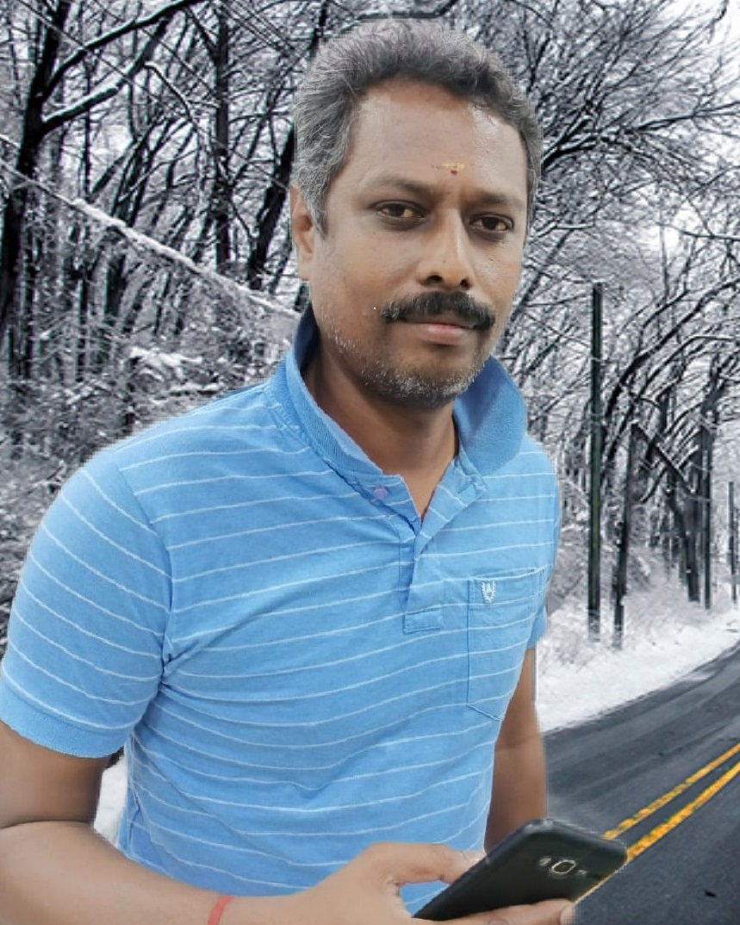
rp.uhkRg;gpukzpad; M.A,B.Ed
gl;ljhup Mrphpah;
tp.tp.b.epidT Nky;epiyg;gs;sp
J}j;Jf;Fb
Cell Number: 9965255226
Email: senrammani@gmail.com

