Slide 1
Student’s are advice to tab
F5
Button first;
Then tab only
Space bar
(Before installed Bamini font)
www.Padasalai.Net

Slide 3
khzth;fs; ntw;wp ngw tho;j;JfpNwhk;
eph;thfk; kw;Wk; Mrphpah;fs;
tp.tp.b. epidT Nky;epiyg;gs;sp
J}j;Jf;Fb

Slide 4

WISH YOU ALL
SUCCESS
FROM
MANAGEMENT&TEACHERS
V.V.D.MEM.HR.SEC.SCHOOL
TUTICORIN
  THIS POWER POINT PRESENTATION CREATED
  BY
  C.RAMASUBRAMANIAN

Slide 5
tuyhW (tiuglk;)
cyfk;

Slide 6
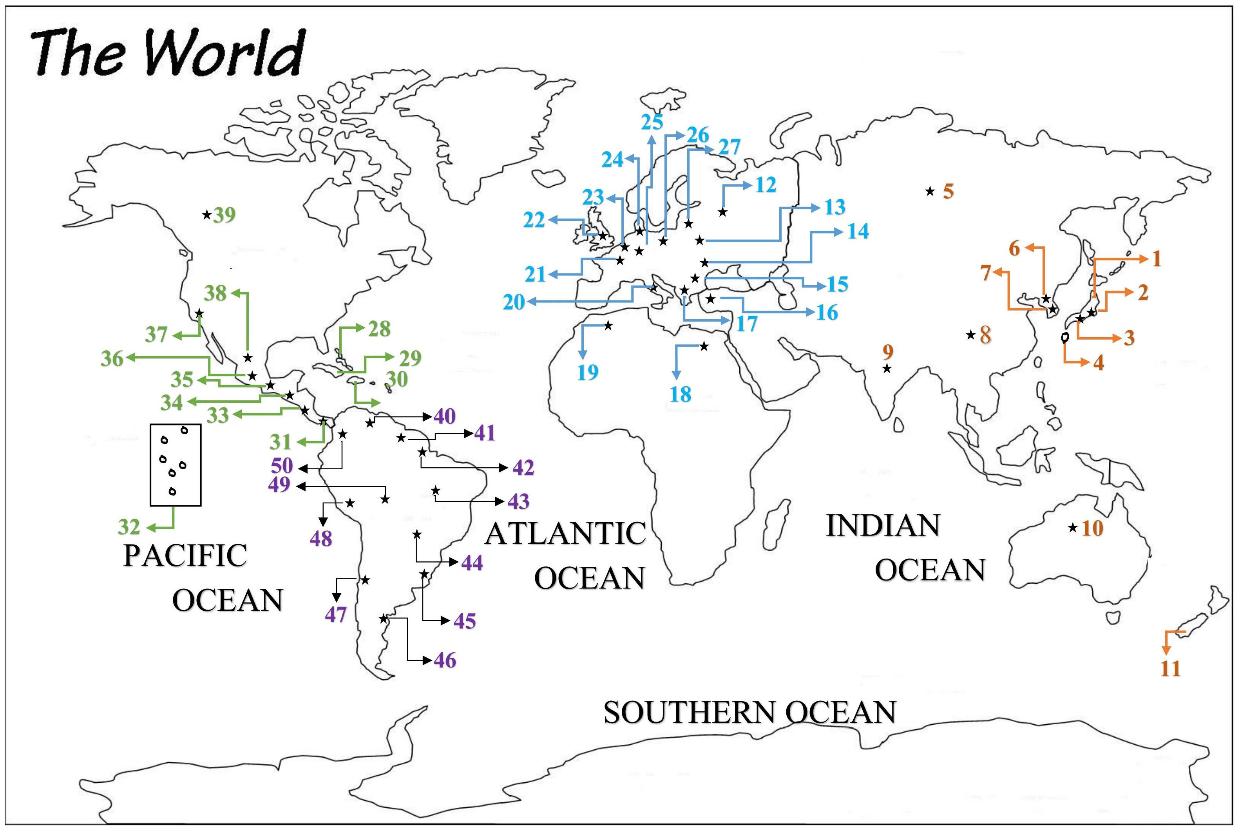
,lk;
1
[g;ghd;

Slide 7
,lk;
2
Nlhf;fpNah

Slide 8
,lk;
3
`pNuh\pkh

Slide 9
,lk;
4
ehfrhfp

Slide 10
5
u\;ah
PLACE

Slide 11
6
tl nfhupah
PLACE

Slide 12
7
njd; nfhupah
PLACE

Slide 13
8
rPdh
PLACE

Slide 14
9
,e;jpah
PLACE

Slide 15
10
M];jpNuypah
PLACE

Slide 16
11
epa+rpyhe;J
PLACE

Slide 17
12
kh];Nfh
PLACE

Slide 18
13
`q;Nfup
PLACE

Slide 19
14
UNkdpah
PLACE

Slide 20
15
gy;Nfupah
PLACE

Slide 21
16
JUf;fp
PLACE

Slide 22
17
fpuP];
PLACE

Slide 23
18
vfpg;J
PLACE

Slide 24
19
nkhuhf;Nfh
PLACE

Slide 25
20
,j;jhyp
PLACE

Slide 26
21
gpuhd;];;
PLACE

Slide 27
22
gpupl;ld;
PLACE

Slide 28
23
neju;yhe;J
PLACE

Slide 29
24
nld;khu;f;;
PLACE

Slide 30
25
ngy;[pak;;
PLACE

Slide 31
26
n[u;kdp
PLACE

Slide 32
27
Nghye;J
PLACE

Slide 33
28
g`hkh];;
PLACE

Slide 34
29
fpa+gh
PLACE

Slide 35
30
[ikf;fh
PLACE

Slide 36
31
gzhkh
PLACE

Slide 37
32
`tha; jPTfs;;
PLACE

Slide 38
33
Nfh];lhupf;fh
PLACE

Slide 39
34
epfuhFth
PLACE

Slide 40
35
vy;rhy;tlhu;
PLACE

Slide 41
36
nfsjkhyh
PLACE

Slide 42
37
rhd; gpuhd;]p];Nfh
PLACE

Slide 43
38
nkf;]pNfh
PLACE

Slide 44
39
fdlh
PLACE

Slide 45
40
GUYANA
PLACE

Slide 46
41
SURINAME
PLACE

Slide 47
42
FRENCH GUYANA
PLACE

Slide 48
43
BRAZIL
PLACE

Slide 49
44
PARAGUAY
PLACE

Slide 50
45
URUGUAY
PLACE

Slide 51
46
ARGENTINA
PLACE

Slide 52
47
CHILE
PLACE

Slide 53
48
PERU
PLACE

Slide 54
49
BOLIVIA
PLACE

Slide 55
50
COLOMBIA
PLACE

Slide 56

rp.uhkRg;gpukzpad; M.A, B.Ed
gl;ljhup Mrpupau;
tp.tp.b. epidT Nky;epiyg;gs;sp
J}j;Jf;Fb
Cell Number: 9965255226
Email: senrammani@gmail.com

