Slide 1
Student’s are advice to tab
F5
Button first;
Then tab only
Space bar
(Before installed Bamini font)

Slide 2
khzth;fs; ntw;wp ngw tho;j;JfpNwhk;
eph;thfk; kw;Wk; Mrphpah;fs;
tp.tp.b. epidT Nky;epiyg;gs;sp
J}j;Jf;Fb

Slide 3
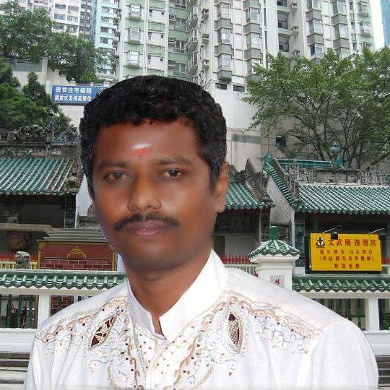
WISH YOU ALL
SUCCESS
FROM
MANAGEMENT&TEACHERS
V.V.D.MEM.HR.SEC.SCHOOL
TUTICORIN
  THIS POWER POINT PRESENTATION CREATED
  BY
  C.RAMASUBRAMANIAN

Slide 4
tuyhW
www.Padasalai.Net
ghlk; - 1
nghUj;Jf

Slide 5
nghUj;Jf (Nfs;tp)
gpnu];l;-ypNlht];f; cld;gbf;if –
[pq;Nfhaprk; –
fkhy; ghl;rh –
vk;ld; –
fz;zhb khspif –
ntu;nrapy;];
JUf;fp
u\;ahTk; n[u;kdpAk;
,q;fpyhe;J
nrd;id

Slide 6
nghUj;Jf (tpil)
gpnu];l;-ypNlht];f; cld;gbf;if –
[pq;Nfhaprk; –
fkhy; ghl;rh –
vk;ld; –
fz;zhb khspif –
u\;ahTk; n[u;kdpAk;
,q;fpyhe;J
JUf;fp
nrd;id
ntu;nrapy;];

Slide 7
tuyhW
ghlk; - 2
nghUj;Jf

Slide 8
,e;j ghlj;jpy;
tpdhf;fs;
fpilahJ

Slide 9
tuyhW
ghlk; - 3
nghUj;Jf

Slide 10
nghUj;Jf (Nfs;tp)
gpspl;];fpupf; –
uhay; fg;gw;gil –
fld; Fj;jif –
Nthy;fh –
f;thly;nfdhy; –
&];nty;l;
];lhypd; fpNuL
rhyNkhd; jPT
gpupl;ld;
kpd;dy;Ntfjhf;Fjy;

Slide 11
nghUj;Jf (tpil)
gpspl;];fpupf; –
uhay; fg;gw;gil –
fld; Fj;jif –
Nthy;fh –
f;thly;nfdhy; –
kpd;dy;Ntfjhf;Fjy;
gpupl;ld;
&];nty;l;
];lhypd; fpNuL
rhyNkhd; jPT

Slide 12
tuyhW
ghlk; - 4
nghUj;Jf

Slide 13
,e;j ghlj;jpy;
tpdhf;fs;
fpilahJ

Slide 14
tuyhW
ghlk; - 5
nghUj;Jf

Slide 15
nghUj;Jf (Nfs;tp)
xUigrh jkpod; –
jpUtUl;gh –
ghgh jahs;jh]; –
<];tu; re;jpu tpj;ahrhfu; –
NjNte;jpuehj; –
tpjit kWkz rPu;jpUj;j rl;lk;
epuq;fhp ,af;fk;
Mjp gpuk;krkh[k;
gj;jpupf;if
[PtfhUz;ag; ghly;fs;

Slide 16
nghUj;Jf (tpil)
xU igrh jkpod; –
jpUtUl;gh –
ghgh jahs;jh]; –
<];tu; re;jpu tpj;ahrhfu; –
NjNte;jpuehj; –
gj;jpupf;if
[PtfhUz;ag; ghly;fs;
epuq;fhp ,af;fk;
tpjit kWkz rPu;jpUj;j rl;lk;
Mjp gpuk;krkh[k;

Slide 17
tuyhW
ghlk; - 6
nghUj;Jf

Slide 18
nghUj;Jf (Nfs;tp)
jPu;j;jfpup; –
Nfhghy ehaf;fu; –
ghdu;nkd;; –
RNgjhu; N\f; Mjk;; –
fu;dy; Ngd;Nfhu;l; –
NtY}u; Gul;rp
,uhkypq;fdhu;
jpz;Lf;fy;;
NtY}u; Nfhl;il
Xlhepiy

Slide 19
nghUj;Jf (tpil)
jPu;j;jfpup; –
Nfhghy ehaf;fu; –
ghdu;nkd;; –
RNgjhu; N\f; Mjk;; –
fu;dy; Ngd;Nfhu;l; –
Xlhepiy
jpz;Lf;fy;;
,uhkypq;fdhu;
NtY}u; Gul;rp
NtY}u; Nfhl;il

Slide 20
tuyhW
ghlk; - 7
nghUj;Jf

Slide 21
nghUj;Jf (Nfs;tp)
t`hgp fpsh;r;rp –
Kz;lh fpsh;r;rp –
Ngfk; `];uj; kfhy;;; –
fd;th; rpq; –
ehdhrhfpg; –
yf;Ndh
Ng\;th ,uz;lhk; gh[p uht;
bL kPh;;;
uhQ;rp
gPfhh;

Slide 22
nghUj;Jf (tpil)
t`hgp fpsh;r;rp –
Kz;lh fpsh;r;rp –
Ngfk; `];uj; kfhy;;; –
fd;th; rpq; –
ehdhrhfpg; –
bL kPh;;;
uhQ;rp
yf;Ndh
gPfhh;
Ng\;th ,uz;lhk; gh[p uht;

Slide 23
tuyhW
ghlk; - 8
nghUj;Jf

Slide 24
nghUj;Jf (Nfs;tp)
nusyl; rl;lk; –
xj;Jioahik ,af;fk; –
1919 Mk; Mz;bd; ,e;jpa muR rl;lk;;; –
,e;jpa nghJTilik fl;rp –
16 Mf];l; 1946 –
gl;lq;fisj; jpUk;g xg;gilj;jy;
,ul;il Ml;rp
M.N.uha;;;
Neub eltbf;if ehs;
fUg;Gr; rl;lk;

Slide 25
nghUj;Jf (tpil)
nusyl; rl;lk; –
xj;Jioahik ,af;fk; –
1919 Mk; Mz;bd; ,e;jpa muR rl;lk;;; –
,e;jpa nghJTilik fl;rp –
16 Mf];l; 1946 –
fUg;Gr; rl;lk;
gl;lq;fisj; jpUk;g xg;gilj;jy;
,ul;il Ml;rp
M.N.uha;;;
Neub eltbf;if ehs;

Slide 26
tuyhW
ghlk; - 9
nghUj;Jf

Slide 27
nghUj;Jf (Nfs;tp)
nrd;idthrpfs; rq;fk; –
<.Nt.uh –
S.N. Nrhikah[{Y –
Ntjhuz;ak;
jhsKj;J –
,e;jp vjph;g;Gg; Nghuhl;lk;
ePy; rpiyia mfw;Wjy;
cg;Gr; rj;jpahfpufk;
rpj;jutij Mizak;
itf;fk; tPuh;

Slide 28
nghUj;Jf (tpil)
nrd;idthrpfs; rq;fk; –
<.Nt.uh –
S.N. Nrhikah[{Y –
Ntjhuz;ak;
jhsKj;J –
,e;jp vjph;g;Gg; Nghuhl;lk;
ePy; rpiyia mfw;Wjy;
cg;Gr; rj;jpahfpufk;
rpj;jutij Mizak;
itf;fk; tPuh;

Slide 29
tuyhW
ghlk; - 10
nghUj;Jf

Slide 30
nghUj;Jf (Nfs;tp)
kiwkiyabfs;
,ul;ilkiy rPdpthrd;
rpq;fhuNtyh;
eNlrdhh;
jpuhtplh; ,y;yk; –
njhopyhsd; –
jdpj; jkpo; ,af;fk; –
[{tpa rhpj RUf;fk; –

Slide 31
nghUj;Jf (tpil)
eNlrdhh;
rpq;fhuNtyh;
kiwkiyabfs;
,ul;ilkiy rPdpthrd;
jpuhtplh; ,y;yk; –
njhopyhsd; –
jdpj; jkpo; ,af;fk; –
[{tpa rhpj RUf;fk; –

Slide 32
Gtpapay;
ghlk; - 1
nghUj;Jf

Slide 33
nghUj;Jf (Nfs;tp)
aKid –
Gjpa tz;ly; gbTfs; –
fhl;tpd;-M];bd; (K2) –
Nrho kz;lyf;flw;fiu –
fq;if Mw;wpd; Jiz MW
,e;jpahtpd; cau;e;j rpfuk;
njd;fpof;F flw;fiu rkntsp
fhju;

Slide 34
nghUj;Jf (tpil)
aKid –
Gjpa tz;ly; gbTfs; –
fhl;tpd;-M];bd; (K2) –
Nrho kz;lyf;flw;fiu –
fq;if Mw;wpd; Jiz MW
fhju;
,e;jpahtpd; cau;e;j rpfuk;
njd;fpof;F flw;fiu rkntsp

Slide 35
Gtpapay;
ghlk; - 2
nghUj;Jf

Slide 36
nghUj;Jf (Nfs;tp)
capu; gd;ikr; rpwg;G gFjpfs; –
tlfpof;Fg; gUtf; fhw;W –
Re;jutdk; –
mf;Nlhgu; -- brk;gu;
Nkw;F tq;fhsk;
,kakiyfs;

Slide 37
nghUj;Jf (tpil)
capu; gd;ikr; rpwg;G gFjpfs; –
tlfpof;Fg; gUtf; fhw;W –
Re;jutdk; –
,kakiyfs;
mf;Nlhgu; -- brk;gu;
Nkw;F tq;fhsk;

Slide 38
Gtpapay;
ghlk; - 3
nghUj;Jf

Slide 39
nghUj;Jf (Nfs;tp)
,e;jpahtpd; ru;;;;;;;;;;;;;;;;;;;;;;;;;;;;;;f;fiu fpz;zk;;; –
fhgp –
nlfpup miz –
`puhFl; –
Njhl;lfiy –
kfhejp
jq;f Gul;rp
fu;ehlfh
cj;jpugpuNjrk;, gPfhu;
,e;jpahtpd; ePskhd miz

Slide 40
nghUj;Jf (tpil)
,e;jpahtpd; ru;;;;;;;;;;;;;;;;;;;;;;;;;;;;;;f;fiu fpz;zk;;; –
fhgp –
nlfpup miz –
`puhFl; –
Njhl;lfiy –
cj;jpugpuNjrk;,gPfhu;
fu;ehlfh
kfhejp
,e;jpahtpd; ePskhd miz
jq;f Gul;rp

Slide 41
Gtpapay;
ghlk; - 4
nghUj;Jf

Slide 42
nghUj;Jf (Nfs;tp)
ghf;irl;
[pg;rk; –
fUg;G jq;fk; –
,Uk;G jhJ –
ikf;fh –
rpnkz;l;
thZ}u;jp
kpd;rhjd nghUl;fs;
epyf;fup
Nkf;dill;

Slide 43
nghUj;Jf (tpil)
ghf;irl;-
[pg;rk; –
fUg;G jq;fk; –
,Uk;G jhJ –
ikf;fh –
thZ}u;jp
rpnkz;l;
epyf;fup
Nkf;dill;
kpd;rhjd nghUl;fs;

Slide 44
Gtpapay;
ghlk; - 5
nghUj;Jf

Slide 45
nghUj;Jf (Nfs;tp)
Gwefug; guty; –
Kk;ig
efukakhf;fspd; jhf;fk;

Slide 46
nghUj;Jf (tpil)
Gwefug; guty; –
efukakhf;fspd; jhf;fk;

Slide 47
Gtpapay;
ghlk; - 6
nghUj;Jf

Slide 48
,e;j ghlj;jpy;
tpdhf;fs;
fpilahJ

Slide 49
Gtpapay;
ghlk; - 7
nghUj;Jf

Slide 50
nghUj;Jf (Nfs;tp)
ghf;irl; –
[pg;rk; –
,Uk;G –
Rz;zhk;Gf;fy; –
Nryk;
Nrh;tuhad; kiy
Nfhak;Gj;J}h;
jpUr;rpuhg;gs;sp

Slide 51
nghUj;Jf (tpil)
ghf;irl; –
[pg;rk; –
,Uk;G –
Rz;zhk;Gf;fy; –
Nrh;tuhad; kiy
jpUr;rpuhg;gs;sp
Nryk;
Nfhak;Gj;J}h;

Slide 52
Fbikapay;
ghlk; - 1
nghUj;Jf

Slide 53
nghUj;Jf (Nfs;tp)
FbAupik rl;lk;
KfTiu
FW murpayikg;G
nrk;nkhop
Njrpa mtruepiy
[t`u;yhy; NeU
42-tJ murpayikg;G rl;lj;jpUj;jk;
1955
1962
jkpo;;

Slide 54
nghUj;Jf (tpil)
FbAupik rl;lk;
KfTiu
FW murpayikg;G
nrk;nkhop
Njrpa mtruepiy
1955
[t`u;yhy; NeU
42-tJ murpayikg;G rl;lj;jpUj;jk;
jkpo;
1962

Slide 55
Fbikapay;
ghlk; - 2
nghUj;Jf

Slide 56
nghUj;Jf (Nfs;tp)
khepy neUf;fb epiy
cs;ehl;L neUf;fb epiy
FbauRj; jiytupd; epu;thf mjpfhuq;fs;
JizFbauRj; jiytupd; mYtyfk;
,e;jpa murpd; jiyik tof;Fiuq;fu; mYtyfk;
rl;lg;gpupT 53
rl;lg;gpupT 63
rl;lg;gpupT 356
rl;lg;gpupT 76
rl;lg;gpupT 352

Slide 57
nghUj;Jf (tpil)
rl;lg;gpupT 53
rl;lg;gpupT 63
rl;lg;gpupT 356
rl;lg;gpupT 76
rl;lg;gpupT 352
FbauRj; jiytupd; epu;thf mjpfhuq;fs;
JizFbauRj; jiytupd; mYtyfk;
khepy neUf;fb epiy
,e;jpa murpd; jiyik tof;FiuQ;fu; mYtyfk;
cs;ehl;L neUf;fb epiy

Slide 58
Fbikapay;
ghlk; - 3
nghUj;Jf

Slide 59
nghUj;Jf (Nfs;tp)
MSeu;
Kjyikr;ru;
mikr;ruit
Nkyit cWg;gpdu;
Majg; gilapdu;
murhq;fj;jpd; jiytu;
khepy murpd; jiytu;
jPu;g;ghaq;fs;
rl;lkd;wj;jpw;F nghWg;ghdth;fs;
khdpaq;fSf;F thf;fspf;f KbahJ

Slide 60
nghUj;Jf (tpil)
MSeu;
Kjyikr;ru;
mikr;ruit
Nkyit cWg;gpdu;
Majg; gilapdu;
khepy murpd; jiytu;
murhq;fj;jpd; jiytu;
rl;lkd;wj;jpw;F nghWg;ghdth;fs;
khdpaq;fSf;F thf;fspf;f KbahJ
jPu;g;ghaq;fs;

Slide 61
Fbikapay;
ghlk; - 4
nghUj;Jf

Slide 62
nghUj;Jf (Nfs;tp)
,e;jpa ngUq;flypy; mike;Js;sJ
njd;fpof;fhrpa ehLfspd; $l;likg;gpd; ghyk;
gQ;rrPyk;
Mg;gpupf;f -- Mrpa khehL
cyf mikjp
1955
1954
khyj;jPT
ntspAwTf;nfhs;if
kpahd;kh;

Slide 63
nghUj;Jf (tpil)
,e;jpa ngUq;flypy; mike;Js;sJ
njd;fpof;fhrpa ehLfspd; $l;likg;gpd; ghyk;
gQ;rrPyk;
Mg;gpupf;f -- Mrpa khehL
cyf mikjp
khyj;jPT
kpahd;kh;
1954
1955
ntspAwTf; nfhs;if

Slide 64
Fbikapay;
ghlk; - 5
nghUj;Jf

Slide 65
nghUj;Jf (Nfs;tp)
tpad;dh
tprhfg;gl;bdj;jpd; Mil efuk;
gpuhz;bf;]; (Brandix) --

Slide 66
nghUj;Jf (tpil)
tprhfg;gl;bdj;jpd; Mil efuk;
gpuhz;bf;]; (Brandix) --

Slide 67
nghUspay;
ghlk; - 1
nghUj;Jf

Slide 68
nghUj;Jf (Nfs;tp)
kpd;rhuk;/vhpthA kw;Wk; ePu;
tpiyf;nfhs;if
GST –
jdpegu; tUkhdk; –
C + I + G +(X-M) –
ehl;L tUkhdk;/kf;fs; njhif
nkhj;j ehl;L cw;gj;jp
njhopy; Jiw
Ntshz;ik
gz;lq;fs; kw;Wk; gzpfs; kPjhd tup

Slide 69
nghUj;Jf (tpil)
kpd;rhuk;/vhpthA kw;Wk; ePu;
tpiyf;nfhs;if
GST –
jdpegu; tUkhdk; –
C + I + G +(X-M) –
njhopy; Jiw
Ntshz;ik
gz;lq;fs; kw;Wk; gzpfs; kPjhd tup
tUkhdk;/kf;fs; njhif
nkhj;j ehl;L cw;gj;jp

Slide 70
nghUspay;
ghlk; - 2
nghUj;Jf

Slide 71
,e;j ghlj;jpy;
tpdhf;fs;
fpilahJ

Slide 72
nghUspay;
ghlk; - 3
nghUj;Jf

Slide 73
nghUj;Jf (Nfs;tp)
Efh;Nthh; $l;LwT –
nghJ tpepNahf Kiw –
UNDP –
Njrpa czTg; ghJfhg;Gr;
rl;lk; –
Nfush –
khdpa tpfpjq;fs;
2013
Fiwe;j Vo;ik cs;s gFjp
jukhd nghUl;fis toq;Fjy;
If;fpa ehLfs; rig tsh;r;rpj; jpl;lk;

Slide 74
nghUj;Jf (tpil)
Efh;Nthh; $l;LwT –
nghJ tpepNahf Kiw –
UNDP –
Njrpa czTg; ghJfhg;Gr; rl;lk; –
Nfush –
jukhd nghUl;fis toq;Fjy;
khdpa tpfpjq;fs;
If;fpa ehLfs; rig tsh;r;rpj; jpl;lk;
2013;
Fiwe;j Vo;ik cs;s gFjp;

Slide 75
nghUspay;
ghlk; - 4
nghUj;Jf

Slide 76
nghUj;Jf (Nfs;tp)
tUkhd tup –
Maj;jPu;it –
VAT –
GST –
fWg;G gzk; –
kjpg;Gf; $l;L tup
[Piy 1, 2017;
flj;Jjy;
Neu;Kf tup
kiwKf tup

Slide 77
nghUj;Jf (tpil)
tUkhd tup –
Maj;jPu;it –
VAT –
GST –
fWg;G gzk; –
Neu;Kf tup
kiwKf tup
kjpg;Gf; $l;L tup
[Piy 1, 2017;
flj;Jjy;

Slide 78
nghUspay;
ghlk; - 5
nghUj;Jf

Slide 79
nghUj;Jf (Nfs;tp)
MEPZ –
,e;jpa xOq;FKiw njhopw;rhiy –
TNPL –
njd;dpe;jpahtpd; khd;nr];lh;; –
Vw;Wkjp nrayhf;f kz;lyk;
Nfhak;Gj;J}h;
mutq;fhL
f&u;

Slide 80
nghUj;Jf (tpil)
MEPZ –
,e;jpa xOq;FKiw njhopw;rhiy –
TNPL –
njd;dpe;jpahtpd; khd;nr];lh;; –
Vw;Wkjp nrayhf;f kz;lyk;
mutq;fhL;
f&u;
Nfhak;Gj;J}h;

Slide 81
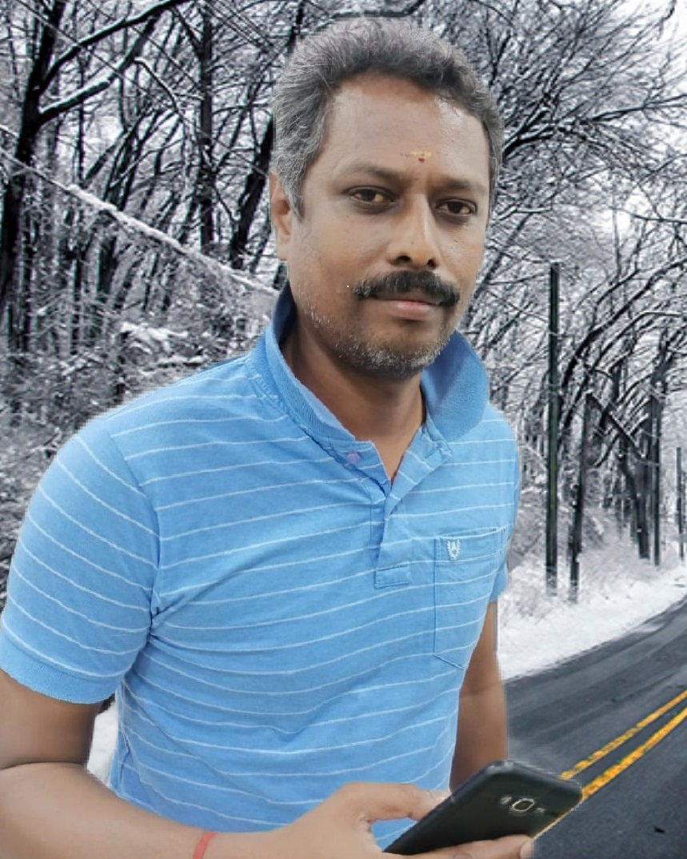
rp.uhkRg;gpukzpad; M.A,B.Ed
gl;ljhup Mrphpah;
tp.tp.b.epidT Nky;epiyg;gs;sp
J}j;Jf;Fb
Cell Number: 9965255226
Email: senrammani@gmail.com

