Slide 1
DATA VISUALIZATION USING PYPLOT: LINE CHART, PIE CHART AND BAR CHART
www.Padasalai.Net

Slide 2
DATA VISUALIZATION DEFINITION

Slide 3
Data Visualization is the graphical representation of information and data.

Slide 4
The objective of Data Visualization is to communicate information visually to users.

Slide 5
General types of Data Visualization
• Charts
• Tables
• Graphs
• Maps
• Infographics
• Dashboards

Slide 6
Data visualization - Uses
Data Visualization help users to analyze and interpret the data easily.
It makes complex data understandable and usable.
Various Charts in Data Visualization helps to show relationship in the data for one or more variables.

Slide 7
Infographics → An infographic (information graphic) is the representation of information in a graphic format.
Dashboard → A dashboard is a collection of resources assembled to create a single unified visual display.
Data visualizations and dashboards translate complex ideas and concepts into a simple visual format. Patterns and relationships that are undetectable in text are detectable at a glance using dashboard.

Slide 8
Introduction to Matplotlib — Data Visualization in Python

Slide 9
Matplotlib is the most popular data visualization library in Python.
It allows you to create charts in few lines of code.

Slide 10
Types of Visualizations in Matplotlib
There are many types of Visualizations under Matplotlib. Some of them are:
Line plot
Scatter plot
Histogram
Box plot
Bar chart and
Pie chart

Slide 11
Scatter plot:
A scatter plot is a type of plot that shows the data as a collection of points.
The position of a point depends on its two-dimensional value, where each value is a position on either the horizontal or vertical dimension.

Slide 12
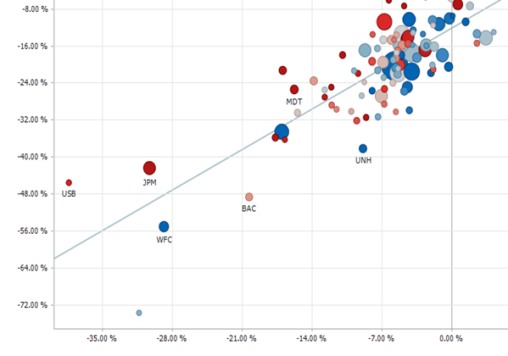
Scatter plot

Slide 13
Box plot:
The box plot is a standardized way of displaying the distribution of data based on the five number summary: minimum, first quartile, median, third quartile, and maximum.

Slide 14
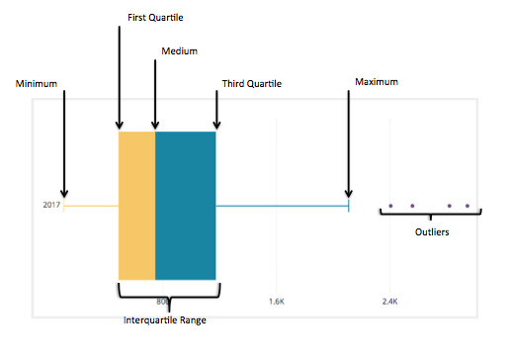

Slide 15
Installing Matplotlib

Slide 16
Getting Started
After installing Matplotlib, we will begin coding by importing Matplotlib using the command:
import matplotlib.pyplot as plt
Now you have imported Matplotlib in your workspace.
You need to display the plots.
Using Matplotlib from within a Python script
Add plt.show() method inside the file to display your plot.

Slide 17
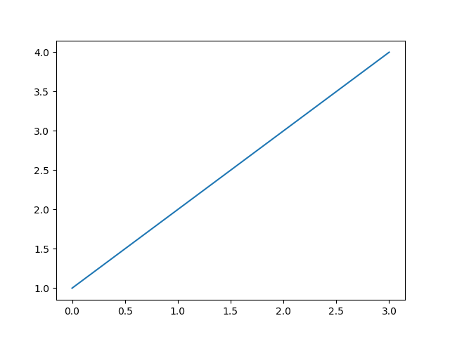
import matplotlib.pyplot as plt
plt.plot([1,2,3,4])
plt.show()

Slide 18
plot() is a versatile command, and will take an arbitrary number of arguments.

Slide 19
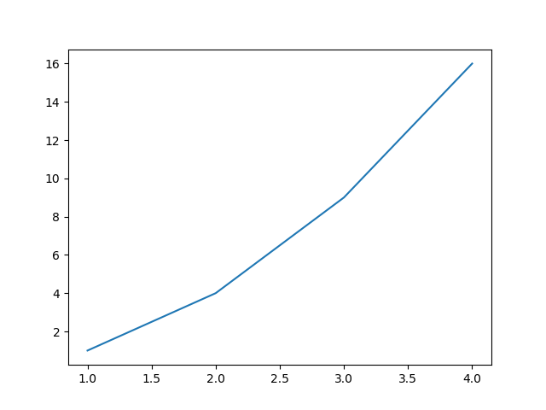
import matplotlib.pyplot as plt
plt.plot([1,2,3,4], [1,4,9,16])
plt.show()
This .plot takes many parameters, but the first two here are 'x' and 'y' coordinates.
This means, you have
4 co-ordinates according to these lists:
(1,1), (2,4), (3,9) and (4,16).

Slide 20
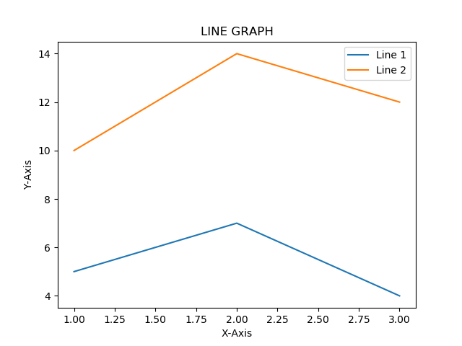
import matplotlib.pyplot as plt
x = [1,2,3]
y = [5,7,4]
x2 = [1,2,3]
y2 = [10,14,12]
plt.plot(x, y, label='Line 1')
plt.plot(x2, y2, label='Line 2')
plt.xlabel('X-Axis')
plt.ylabel('Y-Axis')
plt.title('LINE GRAPH')
plt.legend()
plt.show()

Slide 22
Special Plot Types

Slide 23
Line Chart
A Line Chart or Line Graph is a type of chart which displays information as a series of data points called ‘markers’ connected by straight line segments.
A Line Chart is often used to visualize a trend in data over intervals of time – a time series – thus the line is often drawn chronologically. fhyfzpg;GKiw

Slide 24
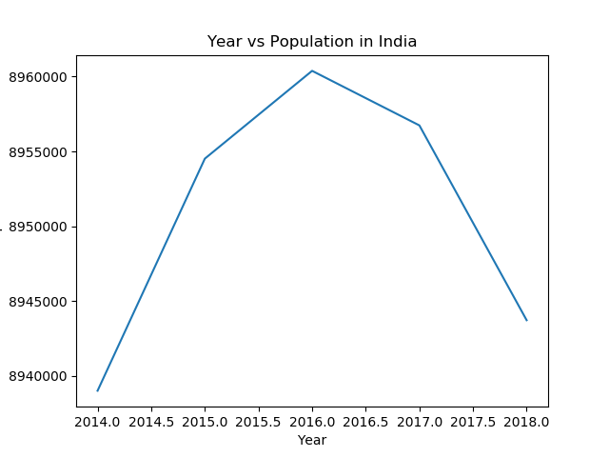
import matplotlib.pyplot as plt
years = [2014, 2015, 2016, 2017, 2018]
total_populations = [8939007, 8954518, 8960387, 8956741, 8943721]
plt.plot (years, total_populations)
plt.title ("Year vs Population in India")
plt.xlabel ("Year")
plt.ylabel ("Total Population")
plt.show()
Plt.title() →
specifies title to the graph
Plt.xlabel() →
specifies label for X-axis
Plt.ylabel() →
specifies label for Y-axis

Slide 25
Bar Chart
A BarPlot (or BarChart) is one of the most common type of plot.
It shows the relationship between a numerical variable and a categorical variable.
Bar chart represents categorical data with rectangular bars.
Each bar has a height corresponds to the value it represents.
The bars can be plotted vertically or horizontally.
It’s useful when we want to compare a given numeric value on different categories. To make a bar chart with Matplotlib, we can use the plt.bar() function.

Slide 26
import matplotlib.pyplot as plt
labels = ["TAMIL", "ENGLISH", "MATHS", "PHYSICS", "CHEMISTRY", "CS"]
usage = [79.8, 67.3, 77.8, 68.4, 70.2, 88.5]
y_positions = range (len(labels))
plt.bar (y_positions, usage)
plt.xticks (y_positions, labels)
plt.ylabel ("RANGE")
plt.title ("MARKS")
plt.show()

Slide 27
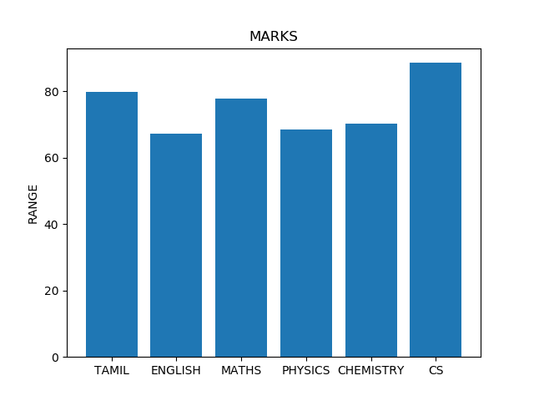
With xticks
Without xticks

Slide 28
Labels → Specifies labels for the bars.
Usgae → Assign values to the labels specified.
Xticks → Display the tick marks along the x-axis at the values represented. Then specify the label for each tick mark.
Range → Create sequence of numbers.

Slide 29
HISTOGRAM | BAR
Refers to a graphical representation; that displays data by way of bars to show the frequency of numerical data | Is a pictorial representation of data that uses bars to compare different categories of data.
Represents the frequency distribution of continuous variables | Is a diagrammatic comparison of discrete variables
Presents numerical data | Shows categorical data
Drawn in such a way that there is no gap between the bars | There is proper spacing between bars in a bar graph that indicates discontinuity
Items of the histogram are numbers, which are categorized together, to represent ranges of data. | Items are considered as individual entities.
This Cannot Be Done, As They Are Shown In The Sequence Of Classes. | It is quite common to rearrange the blocks, from highest to lowest.
The width of rectangular blocks may or may not be same | Width of the bars is always same.

Slide 30
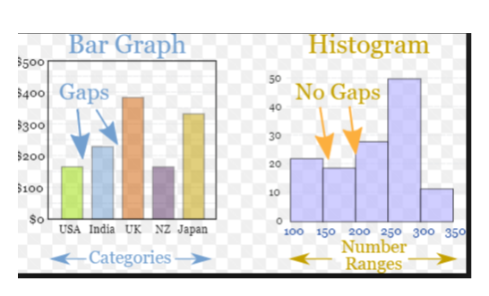

Slide 31
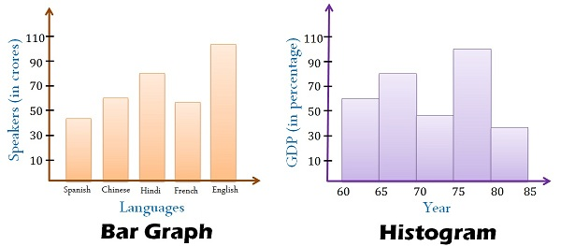

Slide 34
Pie Chart
Pie Chart is probably one of the most common type of chart.
It is a circular graphic which is divided into slices to illustrate numerical proportion.
The point of a pie chart is to show the relationship of parts out of a whole.
To make a Pie Chart with Matplotlib, we can use the plt.pie() function.
The autopct parameter allows us to display the percentage value using the Python string formatting.

Slide 35
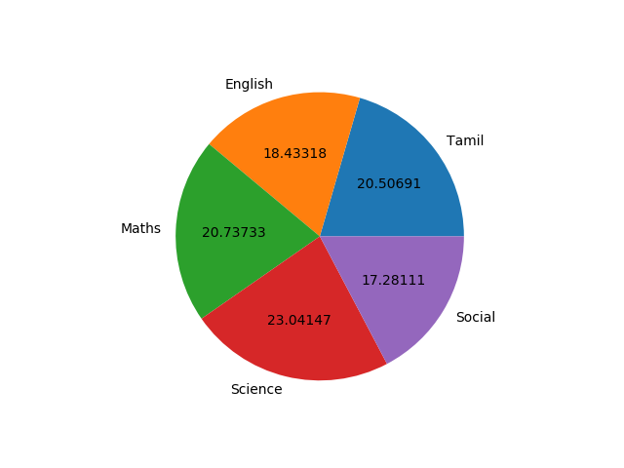
import matplotlib.pyplot as plt
sizes = [89, 80, 90, 100, 75]
labels = ["Tamil", "English", "Maths", "Science", "Social"]
plt.pie (sizes, labels = labels, autopct = "%.5f")
plt.axes().set_aspect ("equal")
plt.show()
set_aspect method of Axes class to set aspect ratio of an Axes object.
Auto or equal

Slide 36
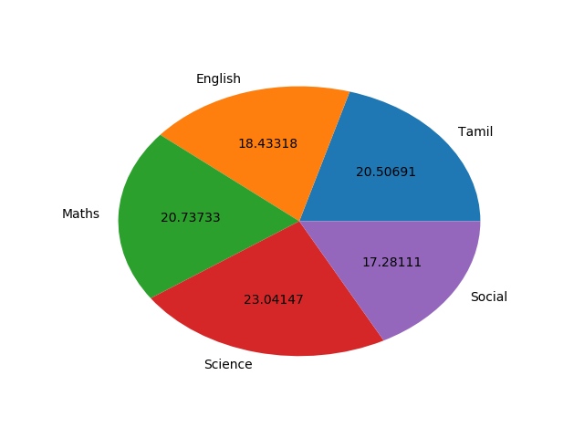
auto
equal

Slide 37
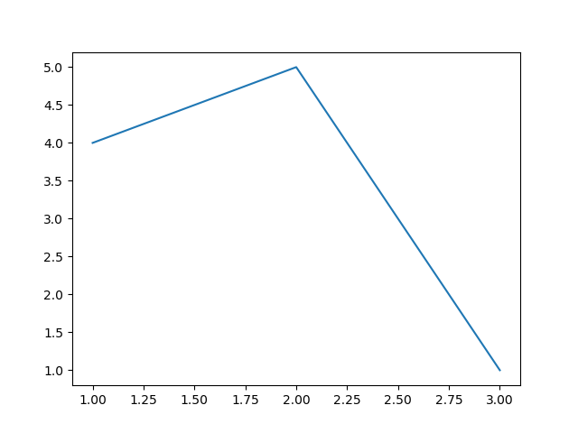
import matplotlib.pyplot as plt
plt.plot([1,2,3],[4,5,1])
plt.show()

Slide 38
import matplotlib.pyplot as plt
plt.plot([1,2],[4,5])
plt.show()

Slide 39
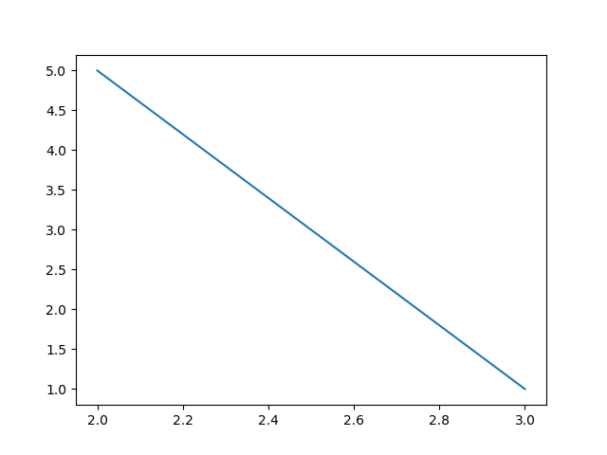
import matplotlib.pyplot as plt
plt.plot([2,3],[5,1])
plt.show()

Slide 40
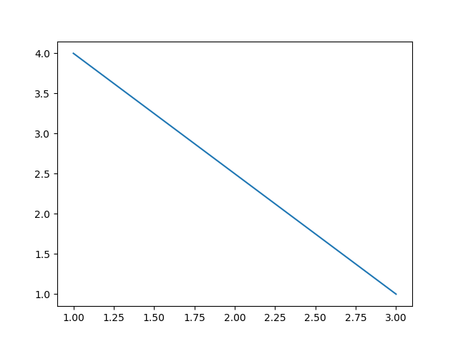
import matplotlib.pyplot as plt
plt.plot([1,3],[4,1])
plt.show()

Slide 41
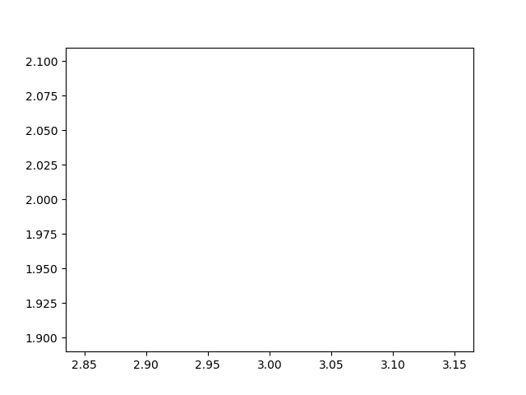
import matplotlib.pyplot as plt
plt.plot(3,2)
plt.show()

Slide 42
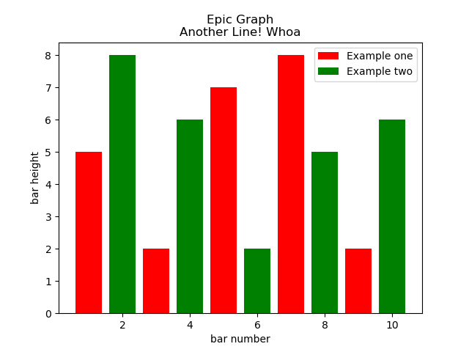
import matplotlib.pyplot as plt
plt.bar([1,3,5,7,9],[5,2,7,8,2],label="Example one" ,color='r')
plt.bar([2,4,6,8,10],[8,6,2,5,6],label="Example two", color='g')
plt.legend()
plt.xlabel('bar number')
plt.ylabel('bar height')
plt.title('Epic Graph\nAnother Line! Whoa')
plt.show()

Slide 43
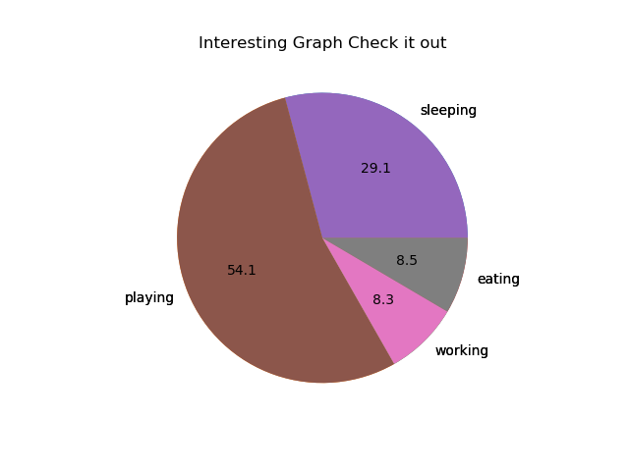
import matplotlib.pyplot as plt
val = [29.2, 54.2, 8.3, 8.5]
labels = ["sleeping", "playing", "working", "eating"]
plt.pie (val, labels = labels)
plt.pie (val, labels = labels, autopct = "%.1f")
plt.axes (). set_aspect ("equal")
plt.title("Interesting Graph Check it out")
plt.show()

Slide 44
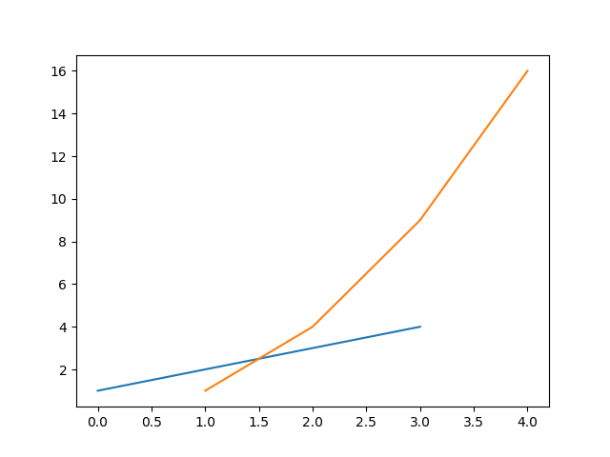
Write the difference between the following functions: plt.plot([1,2,3,4]), plt.plot([1,2,3,4], [1,4,9,16]).

