Slide 1
XII ECONOMICS
LESSON 12
INTRODUCTION TO STATISTICAL METHODS AND ECONOMETRICS

Slide 4
ETYMOLOGY OF statitics
The term statistics originated in the West and was known by various names, such as ‘status’ in Latin, ‘statistik’ in German, ‘statisque’ in French
The first book to have statistics as its title was ‘Contributions to vital Statistics’ by Francis GP Neison in 1845. It was to prepare a systematic study of birth and death related data.

Slide 5
FATHER OF STATISTICS -RONALD FISHER
The fundamental principles of statistics were developed by the biologist, Ronald fisher who lived in England during the last century.
His studies in statistics led to the synthesis of evolution and modern genetics.

Slide 6
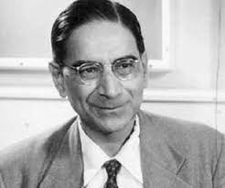
EVOLUTION OF STATISTICS IN INDIA
P.C.Mahalanobis is known as the founder of modern statistics and also as father of Statistics in India. Since 2007 29th of June every year is celebrated as Statistics Day to commemorate his birth anniversary.

Slide 7
DEFINITIONS OF STATISTICS
Statistics as a science of estimates and probabilities - Boddington
Statistics may be defined as the collection, organisation, presentation, analysis and interpretation of numerical data - Croxton & Cowden

Slide 8
CHARACTERISTIC OF STATISTICS
Statistics are an aggregate of facts
Statistics are numerically enumerated, estimated and expressed
Statistical collection should be systematic with a predetermined purpose-
Should be capable of being used as a technique for drawing comparison -

Slide 9
Functions Of Statistics
Statistics presents facts in a definite form.
It simplifies mass of figures.
It facilitates comparison.
It helps in formulating and testing.
It helps in prediction.
It helps in the formulation of suitable policies.

Slide 10
Nature of Statistics
TIPETT “Statistics both as a science as well as an art”.

Slide 11
Scope of statistics
Statistics and Economic
Statistics and Firms
Statistics and Commerce
Statistics and Education
Statistics and Planning
Statistics and Medicine
Statistics and Modern applications

Slide 12
Statistics and Economics
Statistical data and techniques are immensely useful in solving manyeconomic problems such as fluctuation in wages,prices, production, distribution of income and wealth and so on.
Statistics and Firms
Statistics is widely used in many firms to find whether the product is conforming to specifications or not.
Statistics and Commerce
Statistics are life blood of successful commerce. Market survey plays an important role to exhibit the present conditions and to forecast the likely changes in future.

Slide 13
Statistics and Education
Statistics is necessary for the formulation of policies to start new course, according to the changing environment.
Statistics and Planning:
Statistics is indispensable in planning. In the modern world, which can be termed as the “world of planning”, almost all
the organisations in the government are seeking the help of planning for efficient working, for the formulation of policy
decisions and execution of the same.
Statistics and Medicine
In Medical sciences, statistical tools are
widely used. In order to test the efficiency of a new drug or to compare the efficiency of two drugs or two medicines, t - test for the two samples is used.
Statistics and Modern applications
Recent developments in the fields of computer and information technology

Slide 14
Limitations of statistics
Statistics is not suitable to the study of qualitative phenomenon
Statistical laws are not exact
Statistics table may be misused
Statistics is only one of the methods of studying a problem

Slide 16
TYPES OF STATISTICS

Slide 18
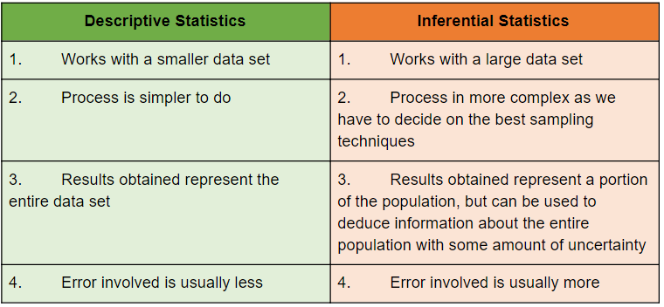
DIFFERENCES BETWEEN DESCRIPTIVE STATISTICS AND INFERENTIAL STATISTICS

Slide 19
DATA

Slide 21
QUALITATIVE DATA
NOMINAL DATA
It can be both qualitative and quantitative. However, the quantitative labels lack a numerical value or relationship (e.g., identification number). ... Also, names of people, gender, and nationality are just a few of the most common examples of nominal data
RANK DATA
In statistics, ranking is the data transformation in which numerical or ordinal values are replaced by their rank when the data are sorted. For example, the numerical data 3.4, 5.1, 2.6, 7.3 are observed, the ranks of these data items would be 2, 3, 1 and 4 respectively.

Slide 22
Sources of Collection of data

Slide 23
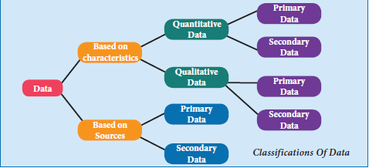

Slide 24
ARITHMETIC MEAN OR MEAN
The average of a set of numerical values, as calculated by adding them together and dividing by the number of terms in the set.
A measure of central tendency is a typical value around which other figures congregate.”
An average stands for the whole group of which it forms a part yet represents the whole.”
One of the most widely used set of summary figures is known as measures of location.”

Slide 25
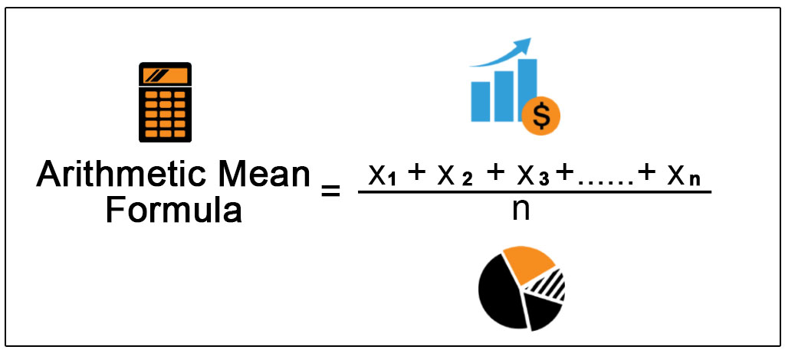
FORMULA
The mean of a variable is defined as the sum of the observations divided by the number of observations. If the variable x assumes n values x1, x2 … xn then the mean, , is given by summing of all x values divided by the number of x values.
This formula is for ungrouped or raw data

Slide 26
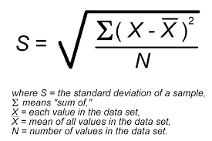
STANDARD DEVIATION (σ)
The Standard Deviation is a measure of how spread out numbers are.
Its symbol is σ (the greek letter sigma)
The formula is easy: it is the square root of the Variance.

Slide 27
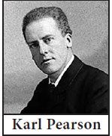
CORRELATION (Υ)
1.Correlation is a statistical device
that helps to analyse the covariation of
two or more variables.
TYPES:

Slide 28
TYPE I
BASED ON THE DIRECTION OF CHANGE OF VARIABLE:
CORRELATION IS
CLASSIFIED INTO 2 TYPES
POSITIVE CORRELATION
NEGATIVE CORRELATION
POSITIVE CORRELATION:
The correlation is said to be positive if the values of two variables move in the same direction.
Ex. Y= a + bx
NEGATIVE CORRELATION:
The Correlation is said to be negative when the values of variables move in the opposite directions.
Ex. Y= a – bx

Slide 29
TYPE II
Simple Correlation
b) Multiple Correlation
c) Partial Correlation
BASED UPON THE NUMBER OF VARIABLE STUDIED.
SIMPLE CORRELATION:
if only two variables are taken for study then it is said to be simple correlation.
Ex. Y= a + bx
B.MULTIPLE CORRELATION:
If three or more than three variables are studied simultaneously, then it is termed as multiple correlation.
Ex: Determinants of Quantity demanded
Qd = f (P, Pc, Ps, t, y).

Slide 30
PARTIAL CORRELATION:
If there are more than two variables but only two variables are considered keeping the other variables constant, then the correlation is said to be Partial Correlation

Slide 31
Linear correlation:
Correlation is said to be linear when the amount of change in one variable tends to bear a constant ratio to the amount of change in the other.
Ex. Y= a + bx
Non linear correlation:
The correlation would be non-linear if the amount of change in one variable does not bear a constant ratio to the amount of change in the other variables.
Ex. Y= a + bx2

Slide 32
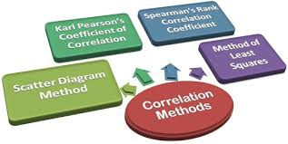
METHODS OF STUDYING CORRELATION:

Slide 33
SCATTER DIAGRAM METHOD:
scatter diagram is a graph of observed plotted points where each point represents the values of x and y as a coordinate. it portrays the relationship between these two variables graphically.
ADVANTAGES
DISADVANTAGES
It is very simple and non- mathematical method .
(2) it is not influenced by the size of extreme item.
(3) It is the first step in resting the relationship between two variables.
(1) It cannot establish the exact degree of correlation between the variables, but provides direction of correlation and depicts it is high or low.

Slide 34
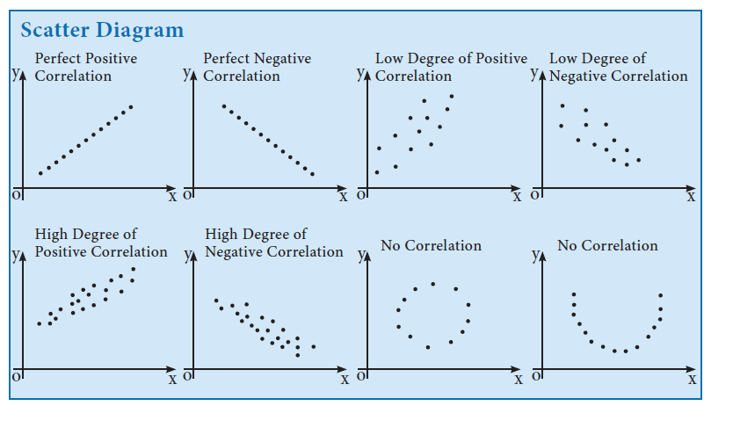
REPRESENTATION:

Slide 35
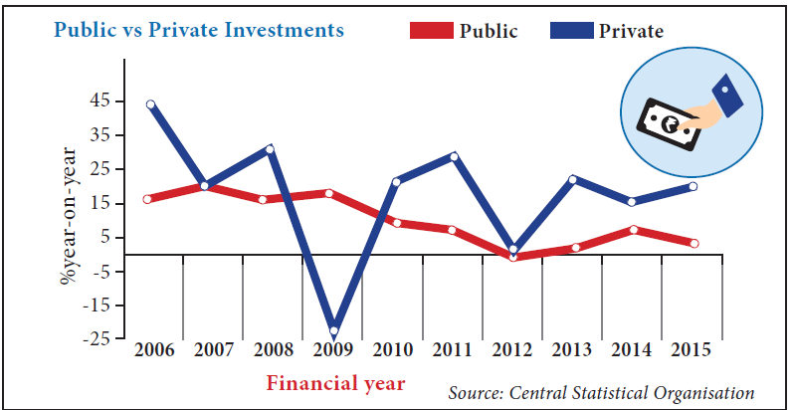
2. GRAPHIC METHOD:
In this method,
the individual values of two variables are plotted on the graph sheet and draw the curves of both the variables say x and y.
If both X and Y are moving in the same direction either upward or downward, then the correlation is said to be positive.
If the curves of X and Y move in the opposite direction;
then the correlation is said to be negative.

Slide 36
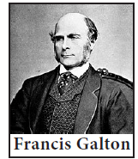
REGRESSION
ITS EVOLUTION:
The term ‘Regression’ was first coined and used in 1877 by Francis Galton.
Galton’s law of universal regression was confirmed by his friend Karl Pearson, who
collected more than a thousand records of heights of members of family groups.
Regression is the study of the relationship between the variables.
The line describing this tendency to regress or going back was called by Galton a “Regression Line”.
The literal meaning of the word “regression” is “Stepping back towards the average”.

Slide 37
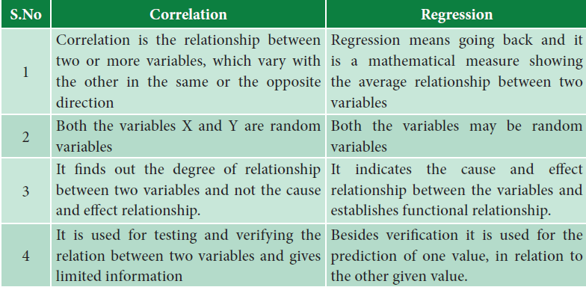
Difference between Correlation and Regression
DIFFERENCE BETWEEN CORRELATION AND REGRESSION

Slide 38
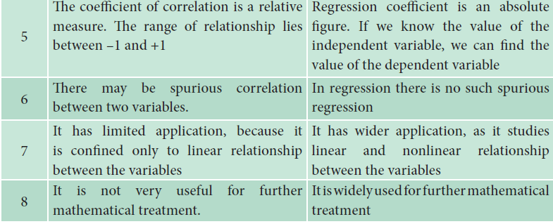
DIFFERENCE BETWEEN CORRELATION AND REGRESSION

Slide 39
RAGNAR ANTON KITTIL FRISCH (3 March 1895 – 31 January 1973) was a Norwegian economist and the co-recipient of the first Nobel Memorial Prize in Economic Sciences

Slide 40
MEANING:
The term econometrics is formed from two words of Greek origin, ‘oukovouia’ meaning economy and ‘uetpov’ meaning measure. Econometrics emerged as an independent discipline studying economic phenomena.

Slide 41
Econometrics may be considered as the integration of
economics, Statistics and Mathematics

Slide 42
DEFINITIONS
H Theil
“Econometrics is concerned with the empirical determination of economic laws”
Ragnar Frisch
“The mutual penetration of quantitative econometric theory and statistical observation is the essence of econometrics .

Slide 43
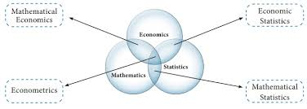
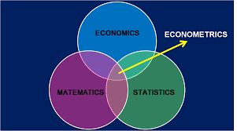

Slide 44
OBJECTIVES OF ECONOMETRICS
It helps to explain the behaviour of a forthcoming period that is forecasting economic phenomena.
It helps to prove the old and established relationships among the variables or between the variables
It helps to establish new theories and new relationships.
It helps to test the hypotheses and estimation of the parameter

Slide 45
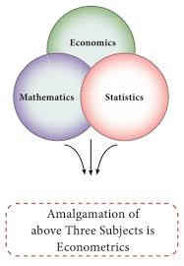
ECONOMETRICS

Slide 46
METHODOLOGY OF ECONOMETRICS
Statement of the theory or hypothesis
Specification of the mathematical model of the theory
Specification of the econometric model of the theory
Obtaining the data
Estimation of the parameters of the econometric model
Hypothesis testing
Forecasting or prediction
Using the model for control or policy purposes

Slide 48
ASSUMPTIONS OF THE LINEAR REGRESSION MODEL
Some of them refer to the distribution of the random variable .
2. Some of them refer to the relationship between ui and the explanatory variables (x1, x2, x3 given in the above example).
3. Some of them refer to the relationship between ui the explanatory variables themselves.

Slide 49
ASSUMPTIONS
1. "U" is a random real variable. That is "U" may assume positive, negative or zero values. Hence the mean of the "U" will be zero.
2. The variance of "U" is constant for all values of "U" .
3. The "U" has a normal distribution.
4. The covariances of any ui with any other are equal to zero .
5. "U" is independent of explanatory variable (s) .
6. Explanatory variables are measured without error.
7. The explanatory variables are not perfectly linearly correlated.
8. The variables are correctly aggregated.
9. The relationship is correctly identified and specified.
10. Parameters are linear.

Slide 50
OFFICIAL STATISTICS
Official statistics make information on economic and social development accessible to the public, allowing the impact of government policies to be assessed, thus improving accountability.

Slide 51
THE MINISTRY OF STATISTICS AND PROGRAMME IMPLEMENTATION (MOSPI)
1.The ministry has two wings, statistics and programme implementation.
2.The statistics wing called the national statistical office (NSO) consists of the central statistical office (CSO), the computer centre and the national sample survey office (NSSO).

Slide 52
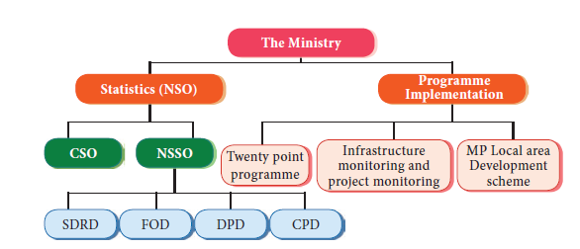

Slide 53
CENTRAL STATISTICAL OFFICE (CSO)
The central statistical office is one of the two wings of the national statistical organisation (NSO).
It is responsible for co-ordination of statistical activities in the country and for evolving and maintaining statistical standards.
Its activities include compilation of national accounts;
conduct of annual survey of industries and economic censuses, compilation of index of industrial production as well as consumer price indices.

Slide 54
NATIONAL SAMPLE SURVEY ORGANISATION (NSSO)
The National Sample Survey Organisation, now known as National Sample Survey Office, is an organization under the Ministry of Statistic of the Government of India.
It is the largest organisation in India, conducting regular socio-economic surveys.
It was established in 1950. NSSO has four divisions:
Survey Design and Research Division (SDRD)
Field Operations Division (FOD)
Data Processing Division (DPD)
Co-ordination and Publication Division (CPD)
The Programme Implementation Wing has three Divisions, namely,
(i) Twenty Point Programme
(ii) Infrastructure Monitoring and Project Monitoring
(iii) Member of Parliament Local Area Development Scheme.

Slide 55
PREPARED BY :
R.Sheela mary m.a, m.phil, pgdst,..
p.g .asst economics
CARMEL garden matriculation higher sec school coimbatore-45

Slide 56
THANK YOU

