Slide 1
Distribution Analysis
www.Padasalai.Net
ECONOMICS

Slide 2
Introduction
The factors of production viz., Land, Labour, Capital and Entrepreneur or Organization are involved in production. The theory of functional distribution deals with how the relative prices of these factors of production are determined. The theory of factor prices is popularly known as the theory of distribution. Interesting aspect here is in the fact that large number of ideas has emerged and various factors have been identified the economists, contributing to the development of Economics Science.

Slide 3
Meaning of Distribution
Distribution means division of income among the four factors of production in terms of rent to landlords, wage to labourer, interest to capital and profit to entrepreneurs.

Slide 4
Kinds of Distribution of
Income
Personal Distribution
Personal Distribution is the distribution
of national income among the individuals.
Functional Distribution
Functional Distribution means the distribution of income among the four factors of production namely land, labour, capital and organisation for their services in production process.

Slide 5
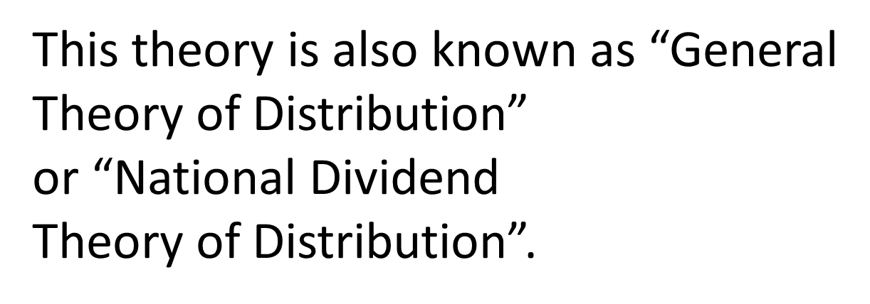
Marginal Productivity Theory of Distribution
Introduction
Marginal Productivity Theory of
distribution was developed by Clark,
Wickseed and Walras. This theory
explains how the prices of various factors
of production are determined. This
theory explains how rent, wages, interest
and profit are determined.

Slide 6
Assumptions
This theory is based on the following
assumptions:
1. All the factors of production are
homogenous.
2. Factors of production can be
substituted for each other.
3. There is perfect competition both in
the factor market and product market.
4. There is perfect mobility of factors
of production.

Slide 7
5. There is full employment of factors.
6. This theory is applicable only in the
long-run.
7. The entrepreneurs aim at profit
maximization.
8. There is no government intervention
in fixing the price of a factor.
9. There is no technological change.

Slide 8
Explanation of the Theory
According to the Marginal Productivity Theory of Distribution, the price or the reward for any factor of production is equal to the marginal productivity of that factor. In short, each factor is rewarded according to its marginal productivity.

Slide 9
Marginal Product
The Marginal product of a factor of production means the addition made to the total product by employment of an additional unit of that factor. The Marginal Product may be expressed as MPP, VMP and MRP.

Slide 10
1. Marginal Physical Product (MPP)
The Marginal Physical Product of a
factor is the increment in the total
product obtained by the employment
of an additional unit of that factor.

Slide 11
2. Value of Marginal Product (VMP)
The Value of Marginal Product is
obtained by multiplying the Marginal
Physical Product of the factor by the
price of product.
Symbolically
VMP = MPP x Price

Slide 12
3. Marginal Revenue Product (MRP)
The Marginal Revenue Product of a
factor is the increment in the total
revenue which is obtained by the
employment of an additional unit of
that factor.
MRP = MPP x MR

Slide 13
Statement of the Theory
An employer employs a factor of
production because it is productive. So,
the price he wants to pay for the factor
depends upon its productivity. The greater
the productivity of a factor, the higher
will be its reward. If the price of a factor
of production is less than its marginal
revenue product, the employer will use
more of this factor, because his profit will
be increased.

Slide 14
When more of a factor is employed, its marginal revenue product diminishes. But the employer will gain by using additional units of the factor until the marginal revenue product of the factor is equal to its price. The employer’s profit will be maximum at this point. Beyond the point, the marginal revenue product is less than the price of the factor. Hence, employer will suffer loss when he uses more of the factor. Therefore, the conclusion is that the employer will so adjust the price of the factor of production so as to equalize the marginal revenue product of that factor.

Slide 15
In short, the Marginal Productivity
Theory of Distribution states that
a) The price of a factor of production
depends upon its productivity.
b) The price of a factor is determined by
and will be equal to marginal revenue
product of that factor.
c) Under certain conditions, the price of a
factor will be equal to both the average
and marginal products of that factor.

Slide 16
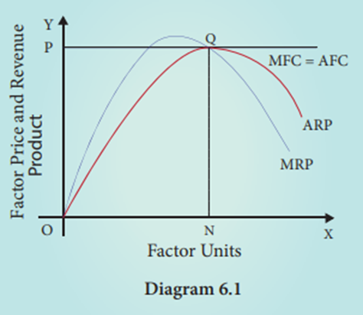
Marginal Productivity under Perfect Competition

Slide 17
The diagram 6.1 refers to the factor pricing
under perfect competition in the factor
market. X axis represents factor units and Y axis represents the factor price and revenue product. MRP is the Marginal Revenue Product Curve and ARP is the Average Revenue Product curve. AFC is the Average Factor Cost curve and MFC
is the Marginal Factor Cost curve. AFC is
horizontal under perfect competition and MFC coincides with it.

Slide 18
When there is perfect competition in the factor market, the firm is in equilibrium (i.e., earning maximum profits) only when MFC = MRP. Hence, in the diagram, the firm reaches equilibrium at point Q by employing ON units of factors and paying OP price (NQ) where MFC = MRP. At the point Q, MRP = ARP. The price paid to the factor (NQ) is also equal to marginal revenue product (NQ) and average revenue product (NQ). This means that there is no exploitation of factors under perfect competition. Beyond the point Q, no employer will employ factors, because after that point, the price paid to the factor is more than marginal revenue product and average revenue product.

Slide 19
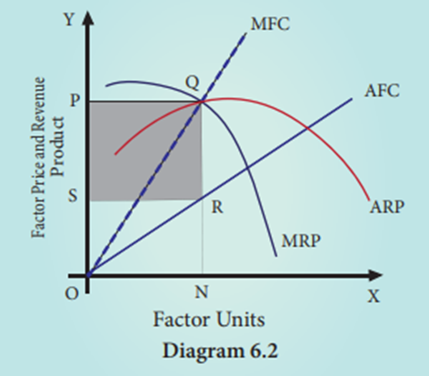
Marginal Productivity Theory under Imperfect Competition

Slide 20
In diagram 6.2 the factor pricing under imperfect competition is represented. AFC is Average Factor Cost curve. It represents the price paid to the factors. It increases as the number of factors demanded by the employer increases. As AFC rises, MFC lies above AFC. It represents the marginal cost paid to the factors. At the point Q, MFC = MRP, where the employer attains his maximum profit and so he stops employment of the factors at the point. But the average cost paid is NRSO and the average revenue obtained is NQ or OP. Total revenue obtained is NQPO. Therefore, exploitation per unit of factor is RQ. But the total number of factors is ON. Thus, the total exploitation of factor by the employer is RQ X SR = “PQRS” (shaded area). Thus, under imperfect competition, factor is exploited at the equilibrium position.

Slide 21
Criticisms
This theory is subject to a few criticisms
1. In reality, the factors of production
are not homogenous.
2. In practice, factors cannot be
substituted for each other.
3. This theory is applicable only in the
long–run. It cannot be applied in the
short-run.

Slide 22
Rent
6.5.1 Meaning
Rent is the price or reward given for the
use of land or house or a machine to
the owner. But, in Economics, “Rent” or
“Economic Rent” refers to that part of payment made by a tenant to his landlords for the use of land only

Slide 23
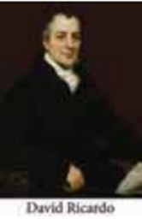
Ricardian Theory of Rent The Classical Theory of Rent is called “Ricardian Theory of Rent”. David Ricardo explained the theory of rent thus:
Assumptions
Ricardian theory of rent assumes the
following:
“Rent is that portion of the produce of the earth which is paid to the landlord for the use of the original and indestructible powers of the soil”.
--David Ricardo

Slide 24
1. Land differs in fertility.
2. The law of diminishing returns operates in agriculture.
3. Rent depends upon fertility and location of land.
4. Theory assumes perfect competition.
5. It is based on the assumption of long period.
6. There is existence of marginal land or no-rent land.
7. Land has certain “original and indestructible powers”.
8. Land is used for cultivation only.
9. Most fertile lands are cultivated first.

Slide 25
Statement of the Theory with Illustration
Assume that some people go to a newly discovered island and settle down there. There are three grades of land, namely A, B and C in that island. ‘A’ being most fertile, ‘B’ less fertile and ‘C’ the least fertile. They will first cultivate all the most fertile land (A grade) available. Since the land is abundant and idle, there is no need to pay rent as long as such best lands are freely available. Given a certain amount of labour and capital, the yield per acre on ‘A’ grade land is 40 bags of paddy.

Slide 26
Suppose another group of people goes and settles down in the same island after some time. Hence the demand for agricultural produce will increase. The most fertile lands [A grade] alone cannot produce all the food grains that are needed on account of the operation of the law of diminishing returns. So the less fertile lands [B grade] will have to be brought under cultivation in order to meet the growing population. For the same amount labour and capital employed in ‘A’ grade land, the yield per acre on ‘B’ grade land is 30 bags of paddy. The surplus of 10 bags [40-30] per acre appears on ‘A’ grade land. This is “Economic Rent” of ‘A’ grade land.

Slide 27
Suppose yet another group of
people goes and settles down in the same
island. So the least fertile land (C grade)
will have to be brought under cultivation.
For the same amount of labour and capital,
the yield per acre on ‘C’ grade land is 20
bags of paddy. This surplus of ‘A’ grade
land is now raised to 20 bags [40-20], and
it is the “Economic Rent” of ‘A’ grade land.
The surplus of ‘B’ grade land is 10 bags
[30-20]. This is the economic rent of ‘B’
grade land.

Slide 28
In the above illustration in ‘C’ grade land, cost of production is just equal to the price of its produce and therefore does not yield any rent (20 - 20). Hence, ‘C’ grade land is called “no-rent land or marginal land”. Therefore, No-Rent Land or Marginal Land is the land in which cost of production is just equal to the price of its produce. The land which yields rent is called “intra –marginal land”. Therefore, rent indicates the differential advantage of the superior land over the marginal land.

Slide 29
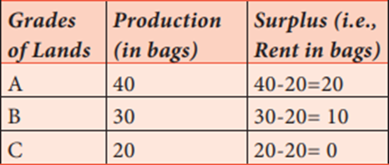
Table 6.1 Ricardian Theory of Rent

Slide 30
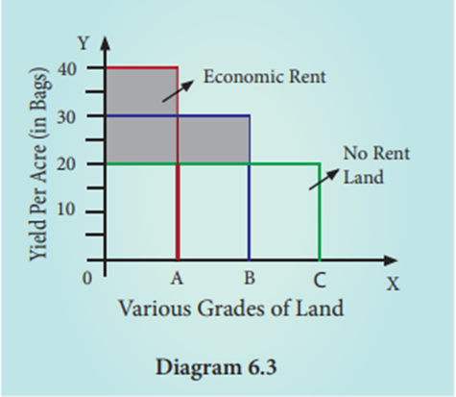
Diagram 6.3

Slide 31
Diagrammatic Explanation
In Diagram 6.3, X axis represents various grades of land and Y axis represents yield per acre (in bags). OA, AB and BC are the ‘A’ grade, ‘B’ grade and ‘C’ grade lands respectively. The application of equal amount of labour and capital on each of them gives a yield represented by the rectangles standing just above the respective bases. The ‘C’ grade land is the “no–rent land” ‘A’ and ‘B’ grade lands are “intra –marginal lands”. The economic rent yielded by ‘A’ and ‘B’ grade lands is equal to the shaded area of their respective rectangles.

Slide 32
Criticisms
Following are the limitations of Ricardian
theory of rent.
1. The order of cultivation from
most fertile to least fertile lands is
historically wrong.
2. This theory assumes that, rent does
not enter into price. But in reality,
rent enters into price.

Slide 33
Quasi-Rent
Marshall introduced the concept of Quasi rent. Factors other than land say plant and machinery are fixed in supply during short period. They earn surplus income when demand rises. It is purely temporary as it disappears in long run due to increase in supply. The quasi-rent is a surplus that a producer receives in the short period over variable costs from the sale of output.

Slide 34
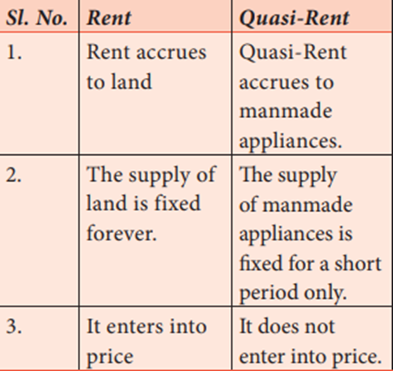
Distinction between “Rent” and “Quasi-Rent”

Slide 35
“Quasi-Rent is the income derived
from machines and other appliances
made by man”. -Alfred Marshall

Slide 36
The Modern Theory of Rent / Demand & Supply Theory of Rent
The classical economists’ thought that land as a factor of production was different from other factors of production. But modern economists thought that all the factors of production are alike and there is no basic difference between them. Hence, a special theory was rent, developed by Ricardo is not necessary. Therefore, economists like Joan Robinson and Boulding have contributed their ideas for the determination of rent, which is known as the “Modern Theory of Rent”.

Slide 37
“The essence of the conception of
rent is the conception of surplus
earned by a particular part of a factor
of production over and above the
minimum earnings that is necessary
to induce it to do work”
- Joan Robinson

Slide 38
The minimum payment that has to be made to a particular factor of production to retain it in its present use is known as transfer earnings.

Slide 39
Wages are a payment for the services of labour, whether intellectual or physical. Wage may be paid daily, weekly, fortnightly, monthly or yearly and partly at the end of the year in the form of bonus.

Slide 40
Meaning
Wage is the price paid to the labourer for
the services rendered.
“A sum of money paid under contract
by an employer to a worker for the
services rendered”.
- Benham

Slide 41
Kinds of Wages
Wages are divided into four types:
1. Nominal Wages or Money Wages.
Nominal wages are referred to the
wages paid in terms of money.
2. Real Wages
Real wages are the wages paid in
terms of goods and services. Hence,
real wages are the purchasing power
of money wages.

Slide 42
3. Piece Wages
Wages that are paid on the basis of
quantum of work done.
4. Time Wages
Wages that are paid on the basis of
the amount of time that the worker
works.

Slide 43
Subsistence Theory of Wages
Subsistence theory is one of the oldest theories of wages. It was first explained by Physiocrats, a group of French economists and restated by Ricardo.
According to this theory, wage must be equal to the subsistence level of the labourer and his family. Subsistence means the minimum amount of food, clothing and shelter which workers and their family require for existence.

Slide 44
If workers are paid higher wages than the subsistence level, the workers would be better off and they will have large families. Hence, the population would increase. When the population increases, the supply of labourer would increase and therefore, wages will come down.
On the other hand, if wages are lower than the subsistence level, there would be a reduction in population and thereby the supply of labour falls and wages increase to the subsistence level. So this theory is closely associated with Malthusian Theory of Population. This theory holds that the wages of workers would not be above or below the subsistence level of the labourer and his family

Slide 45
Criticisms
1. Role of trade unions in collective bargainings was not found.
2. It does not explain the differences in wages in different occupations.
3. The assumption that population would increase with a rise in wage rate is not correct. Poor families (and countries) have more Children than rich families
(countries). Wage rate alone does not-determine birth-rate Actually,as increases, people can afford to downsize their family size for adopting costly family planning procedures; while poor people cannot do so.

Slide 46
Standard of Living
Theory of Wages
The Standard of Living Theory of Wages
developed by Torrance is an improved
and refined version of the Subsistence
Theory of Wage. According to this theory,
wage is equal to the standard of living of
the workers. If standard of living is high,
wages will be high and vice versa.

Slide 47
Standard of living wage means the
amount necessary to maintain the labourer in
the standard of life to which he is accustomed.
Criticism
1. According to this theory, the standard
of living determines wages. But in actual
practice, wages determine the standard
of living.

Slide 48
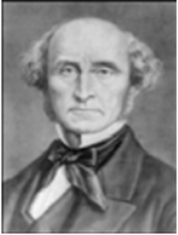
Wage Fund Theory of
Wages
This theory was firstmpropounded by Adam Smith. But the credit goes to J.S.Mill who perfected this theory According to Mill “every employer will keep a given amount of capital for payment to the workers”. It is a known as Wage Fund”. It is fixed and constant. Wages depend directly upon the fund and inversely with number of labourers employed. The average wage of a worker can be calculated by using the formula.

Slide 49
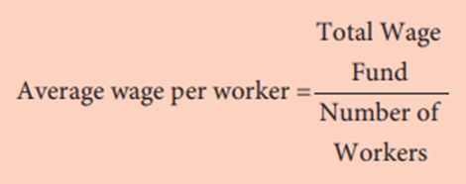
If the number of workers increases, the wage per worker would fall and vice versa.

Slide 50
Criticisms
1. It does not explain the difference in
wages in different occupations.
2. It ignores the role of trade unions.
3. Actually the capitalists will take away
a large sum before making payment of
wages.

Slide 51
Residual Claimant Theory of Wage
This theory was propounded by the American economist F.A.Walkar in 1875, in his book Political Economy. According to this theory, wage is the residual portion after paying the remuneration of all the other three factors, namely, land, capital and organization.

Slide 52
Criticisms
1. This theory does not explain the role
of trade unions can secure higher
wage for workers.
2. Demand side of labour in the
determination of wages needs to be
considered.

Slide 53
Marginal Productivity Theory of Wage
The application of general theory of distribution to wage fixation is the marginal productivity theory of wages.
According to the theory wages are determined by the marginal productivity of labour and equal to it at the point of equilibrium.
Under perfect competition wage is paid equal to marginal product of labour (wage = MPL ) But in real world where there is imperfect competition, there is exploitation of labour and wage is less than MPL .

Slide 54
Interest
Generally speaking, interest is a payment
made by a borrower to the lender for the
money borrowed.

Slide 55
Meaning
Interest is the reward paid by the borrower
to the lender for the use of capital.
“Interest is the price paid for the use
of capital in any market” ALFRED MARSHALL

Slide 56
Kinds of Interest
Gross Interest
Gross interest is the total interest amount received by creditors from debtors. Gross Interest = (Net Interest) + (reward for inconvenience) + (insurance against risk of non-repayment) + (payment for service of debt management)
Net Interest
Net Interest is only a part of the gross
interest. It is the payment for use of capital
only. A good example for net interest
is the interest payable for Government
Securities.

Slide 57
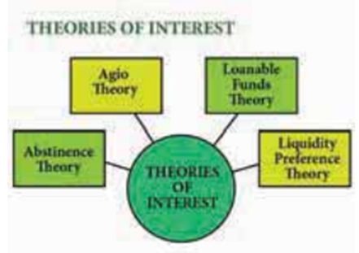
Theories of Interest

Slide 58
Abstinence Theory or Waiting Theory
This theory was propounded by N.W.Senior. To him, interest is the reward for abstaining from the immediate consumption of wealth. According to Senior, capital is the result of saving. But saving involves “abstinence” or “sacrifice”. It is possible to save only if one abstains from present consumption. Such abstinence from present consumption involves some suffering. Hence, it is necessary to reward the saver (capitalist) to compensate for the sacrifice he has to undergo by abstaining from present consumption. Therefore, interest is the reward or compensation paid to the saver (capitalist) for his “abstinence” or “sacrifice”.

Slide 59
Marshall accepted the Abstinence Theory of interest. But he used the word ‘waiting’ instead of “abstinence”. Saving implies waiting. According to him, interest is the reward for waiting. Saving involves waiting. But people do not like to wait. So, in order to make them wait and in turn to save, we have to pay them some reward. Therefore, interest is the reward paid to the saver (capitalist) for his “waiting”

Slide 60
Criticism
1. According to this theory, saving involves
suffering. But savings may not always
involve suffering to some rich people.
Rich people have money for which they
do not get interest. Hoarding of money
is to quench the thirst for liquidity.

Slide 61
Agio Theory of Interest/ The Psychological Theory of Interest/Time Preference Theory
This theory was propounded by John Rae in 1834. But credit goes to Bohm Bawerk an Austrian School economist who has given final shape to the theory. The American economist Irving Fisher modified and gave a new theory viz Time Preference theory.

Slide 62
According to this theory, people prefer present goods rather than future goods. Because the present goods are more certain than future goods, just “as a bird in the hand is worth two in the bush”. There are many countries where no one knows what will happen next day. ASEAN crisis of 1996 and American crisis of 2007-08 were not predicted even for economists, including Nobel Laureats. So, when people save they have to postpone their present enjoyment or satisfaction. If one postpones one’s present satisfaction, one has to be paid an “Agio” or “Premium”. This premium is “interest”. People prefer present consumption than future consumption due to the risk increasing and uncertainties of the present world.

Slide 63
Loanable Funds Theory/ The Neo Classical Theory
The Loanable Funds Theory, also known
as the “Neo–Classical Theory”, was developed by Swedish economists like Wicksell, Bertil Ohlin, Viner, Gunnar Myrdal and others. According to this theory, interest is the price paid for the use of loanable funds. The rate of interest is determined by the equilibrium between demand for and supply of loanable funds in the credit market.

Slide 64
Demand for Loanable Funds
The demand for loanable funds depends
upon the following:
1. Demand for Investment (I)
The most important factor responsible
for the loanable funds is the demand
for investment. Bulk of the demand
for loanable funds comes from
business firms which borrow money
for purchasing capital goods.

Slide 65
2. Demand for Consumption (C)
The demand for loanable funds comes
from individuals who borrow money
for consumption purposes also.
3. Demand for Hoarding (H)
The next demand for loanable funds
comes from hoarders. Demand for
hoarding money arises because of
people’s preference for liquidity, idle
cash balances and so on. The demand
for C, I and H varies inversely with
interest rate.

Slide 66
Supply of Loanable Funds
The supply of loanable funds depends
upon the following four sources:
1. Savings (S)
Loanable funds come from savings.
According to this theory, savings
may be of two types, namely
1. Savings planned by individuals
are called “ex-ante savings”. E.g.
LIC premium, EMI payment etc.
2. The unplanned savings are called,
“ex-post savings”. Savings is left
out after spending are ex post saving.

Slide 67
2. Bank Credit (BC)
The bank credit is another source of loanable funds. Commercial banks create credit and supply loanable funds to the investors.
3. Dishoarding (DH)
Dishoarding means bringing out the hoarded money into use and thus it constitutes a source of supply of loanable funds. In India, after 1991,Public sector undertakings are being sold to private people to mobilize more funds. This is also called disinvestment.

Slide 68
4. Disinvestment(DI)
Disinvestment is the opposite of investment. In other words disinvestment means not providing sufficient funds for depreciation of equipment. It gives rise to the supply of loanable funds. All the four sources of supply of loanable funds vary directly with the interest rate.
Classical theory of Interest
The equilibrium interest rate,
according to classical theory, is
determined by the intersection of
demand and supply curves, Demand
for money refers to investment. Supply
of money refers to savings S=I.

Slide 69
Equilibrium
The rate of interest is determined by the equilibrium between the total demand for and the total supply of loanable funds.
Supply of and Demand for Loanable Funds
Supply of loanable funds = Savings +
Bank Credit + Dishoarding + Disinvestment = S + BC + DH + DI
Demand for loanable funds = Investment + Consumption +Hoarding = I + C + H

Slide 70
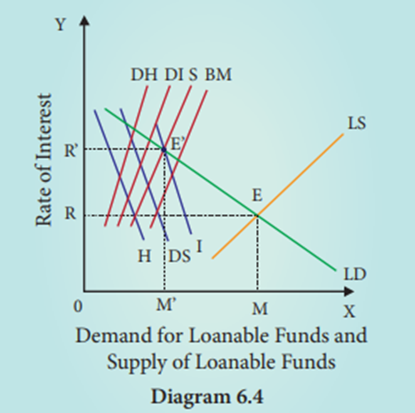
Diagram 6.4

Slide 71
In Diagram 6.4, X axis represents the demand for and supply of loanable funds and Y axis represents the rate of interest. The LS curve represents the total supply curve of loanable funds. This is obtained by the summation of the Saving Curve (S), Bank credit curve (BC), Dishoarding curve (DH) and Disinvestment curve (DI). The LD curve represents the total demand for loanable funds; this is obtained by the summation of the demand for investment curve I, demand curve for consumption demand or dissaving curve and curve for demand for hoarding curve H. The LD and LS curves, intersect each other at the point “E” the equilibrium point. At this point, OR rate of interest and OM is the amount of loanable funds.

Slide 72
Criticisms
1. Many factors have been included in this theory. Still there are many more factors. Two such factors are
1) Asymmetric Information and
2) Moral Hazard. In practice larger firms, due to their political powers, are able to get huge bank credit at lower interest rates. But due to NPAs (Non-Performing Assets)small firms and depositors lose their interest income. The loanable funds theory is “indeterminate”’ unless the income level is already known. (This can be studied in 12th standard Economics)
2. It is very difficult to combine real factors like savings and investment with monetary factors like bank credit and liquidity preference.

Slide 73
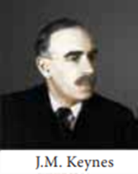
Keynes’ Liquidity Preference Theory of Interest or The Monetary Theory of Interest
Keynes propounded the Liquidity Preference Theory of Interest in his famous book, “The General Theory of Employment, Interest and Money” in 1936. According to Keynes, interest is purely a monetary phenomenon because the rate of interest is calculated in terms of money. To him, “interest is the reward for parting with liquidity for a specifi ed period of time”.

Slide 74
Meaning of Liquidity Preference
Liquidity preference means the preference
of the people to hold wealth in the form
of liquid cash rather than in other nonliquid assets like bonds, securities, bills of exchange, land, building, gold etc.
“Liquidity Preference is the preference to have an amount of cash rather than of claims against others”.
-Meyer

Slide 75
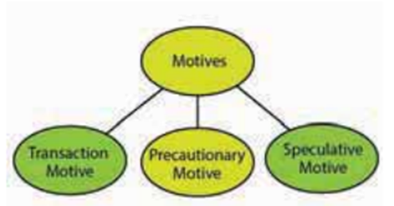
According to Keynes, there are three motives for liquidity preference. They are:

Slide 76
The Transaction Motive
The transaction motive relates to the desire of the people to hold cash for the current transactions (or day–today expenses). The amount saved under this motive depends on the level of income. Mt and Y are positively associated. (Say Mt = 0.125Y; that means if income is ₹ 1000, demand for transaction motive is ₹ 125)

Slide 77
2. The Precautionary Motive
The precautionary motive relates to the desire of the people to hold cash to meet unexpected or unforeseen expenditures such as sickness, accidents, fire and theft. The amount saved for this motive also depends on the level of income. (Say Mp = 0.125Y; it means if income is ₹ 1000, demand for M p is ₹ 125)

Slide 78
3. The Speculative Motive
The speculative motive relates to the desire of the people to hold cash in order to take advantage of market movements regarding the future changes in the price of bonds and securities in the capital market. The amount saved for this motive depends on the rate of interest. Ms = f (i). There is inverse relation between liquidity preference and rate of interest (Say Ms = 450-100i).

Slide 79
Determination of Rate of Interest
According to Keynes, the rate of interest
is determined by the demand for money
and the supply of money. The demand
for money is liquidity preference. In fact, liquidity preference for speculative motive determines rate of interest. The supply of money is determined by the policies of the Government and the Central Bank of a country. The total supply of money consists of coins, currency notes and bank deposits (Say M = 200).

Slide 80
Equilibrium between Demand and Supply of Money
The equilibrium between liquidity preference and demand for money determine the rate of interest. In short-run, the supply of money is assumed to be constant (₹ 200). LP is the liquidity preference Curve (demand curve). M2 M2 shows the supply curve of money to satisfy speculative motive. Both curves intersect at the point E, which is the equilibrium point. Hence, the rate of interest is 2.5. If liquidity preference increases from LP to L1 P1 the supply of money remains constant, the rate of interest would increase from OI to OI1. Numerical examples given above can also be used for better understanding. Total demand for money=Mt +Mp +Ms

Slide 81
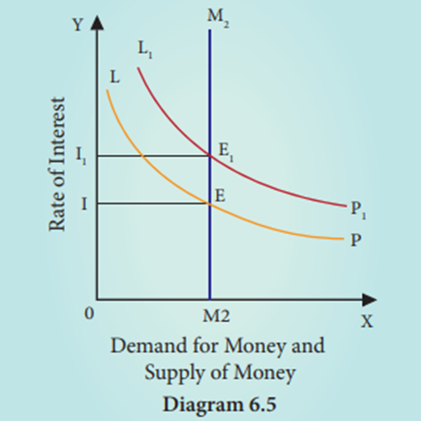
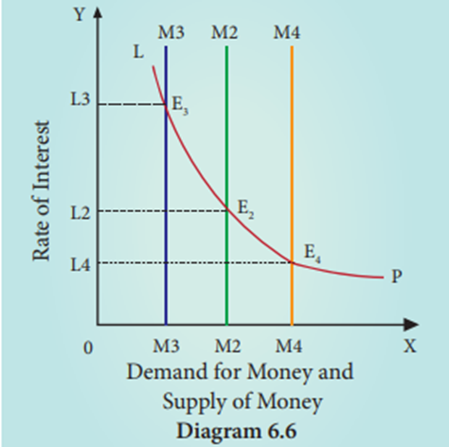

Slide 82
=0.125Y+0.125Y+(450-100i). Total supply of money = ₹ 200. Mt and M p are influenced by Y. Hence for the sake of easy understanding, Ms alone can be considered Demand for money=supply of money at equilibrium point:450- 1 0 0 i = 2 0 0 ; 4 5 0 - 2 0 0 = 1 0 0 i ; 2 5 0 = 1 0 0 i ; i=250/100=2.5.This is equilibrium interest In reality, interest rate is also influenced by national income and commodity sector equilibrium. However, they are not included here for making the understanding easier.

Slide 83
Suppose LP remains constant. If the supply of money is OM2, the interest is OI2 and if the supply of money is reduced from OM2 to OM3, the interest would increase from OI2 to OI3 . If the supply of money is increased from OM2 to OM4 , the interest would decrease from OI2 to OI4 .

Slide 84
Criticisms
1. This theory does not explain the
existence of different interest rates
prevailing in the market at the same
time.
2. It explains interest rate only in the
short-run.

Slide 85
Profit
The entrepreneur coordinates all the other
three factors (land, labour and capital) of
production. Entrepreneur is rewarded for
his services in the form of profit.

Slide 86
Meaning of profit
Profit is a return to the entrepreneur for the
use of his entrepreneurial ability. It is the
net income of the organizer. In other words,
profit is the amount left with the entrepreneur
after he has payments made for all the other
factors (land, labour and capital) used by
him in the production process. However,
there are other versions also.

Slide 87
Kinds of Profit
I. Monopoly Profit: Profit earned by
the firm because of its monopoly
control.
II. Windfall Profit: Some times, profit
arises due to changes in price level.
Profit is due to unforeseen factors.
III. Profit as functional reward: Just
like rent, wage and interest, profit is
earned by the entrepreneur for his
entrepreneurial function.

Slide 88
Concepts of Profit
a. Gross Profit
Gross Profit is the surplus which accrues
to a firm when it subtracts its Total
Expenditure from its Total Revenue.
Gross Profit = Total Revenue Total cost
Here cost implies explicit costs only (Normally economic cost, social cost and environmental cost are not considered by the Accountants in India).

Slide 89
b. Net Profit or Pure Profit or Economic profit or True profit
Net or pure or economic or true profit
is the residual left with entrepreneur
after deducting from Gross profit the
remuneration for the self-owned factors of
production, which are called implicit cost.
Net Profit = Gross Profit Implicit costs

Slide 90
c. Normal Profit
It refers to the minimum expected
return to stay in business.
d. Super Normal Profit
Super normal profits are over and
above the normal profit.
Super Normal Profit = Actual profit – Normal profit

Slide 91
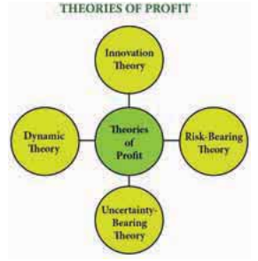
Theories of Profit

Slide 92
Dynamic Theory of Profit
This theory was propounded by the American economist J.B.Clark in 1900. To him, profit is the difference between price and cost of production of the commodity. Hence, profit is the reward for dynamic changes in society. Further he points out that, profit cannot arise in a static society. Static society is one where everything is stationary or stagnant and there is no change at all. Therefore, there is no role for an entrepreneur in a static society. The price of the commodities in a static society would be equal to their cost of production. So, there would be no profit for the entrepreneur. The entrepreneur only gets wages for management and interest on his capital.

Slide 93
At present several changes are taking place in a dynamic society. Changes are permanent. According to Clark, the following five main changes are taking place in a dynamic society.
1. Population is increasing
2. Volume of Capital is increasing.
3. Methods of production are improving.
4. Forms of industrial organization are
changing.
5. The wants of consumer are multiplying.

Slide 94
Innovation Theory of profit
Innovation theory of profit was
propounded by Joesph.A.Schumpeter. To Schumpeter, an entrepreneur is not only an undertaker of a business, but also an innovator in the process of production. To him, profit is the reward for “innovation”. Innovation means invention put into commercial practice.

Slide 95
According to Schumpeter, an innovation may consist of the following:
1. Introduction of a new product.
2. Introduction of a new method of
production.
3. Opening up of a new market.
4. Discovery of new raw materials
5. Reorganization of an industry / firm.

Slide 96
When any one of these innovations is
introduced by an entrepreneur, it leads to
reduction in the cost of production and thereby
brings profit to an entrepreneur. To obtain
profit continuously, the innovator needs to
innovate continuously. The real innovators do
so. Imitative entrepreneurs cannot innovate.

Slide 97
Risk Bearing Theory of Profit
Risk bearing theory of profit was
propounded by the American economist
F.B.Hawley in 1907. According to him,
profit is the reward for “risk taking”
in business. Risk taking is an essential
function of the entrepreneur and is the
basis of profit. It is a well known fact that
every business involves some risks.

Slide 98
Since the entrepreneur undertakes the risks, he receives profits. If the entrepreneur does not receive the reward, he will not be prepared to undertake the risks. Thus, higher the risks, the greater are the profit.
Every entrepreneur produces goods in anticipation of demand. If his anticipation of demand is correct, then there will be profit and if it is incorrect, there will be loss. It is the profit that induces the entrepreneurs to undertake such risks.

Slide 99
Uncertainty Bearing Theory of Profit
Uncertainty theory was propounded
by the American economist Frank H.Knight. To him, profit is the reward for
“uncertainty bearing”. He distinguishes
between “insurable” and “non-insurable”
risks.

Slide 100
Insurable Risks
Certain risks are measurable or calculable.
Some of the examples of these risks
are the risk of fire, theft and natural
disasters. Hence, they are insurable. Such
risks are compensated by the Insurance
Companies.

Slide 101
Non-Insurable Risks
There are some risks which are immeasurable or incalculable. The probability of their occurrence cannot be anticipated because of the presence of uncertainty in them. Some of the examples of these risks are competition, market condition, technology change and public policy. No Insurance Company can undertake these risks. Hence, they are non insurable. The term “risks” covers the first type of events (measurable - insurable) and the term “uncertainty” covers the second type of events (unforeseeable or incalculable or not measurable or non insurable).

Slide 102
According to Knight, profit does
not arise on account of risk taking,
because the entrepreneur can guard
himself against a risk by taking a suitable
insurance policy. But uncertain events
cannot be guarded against in that way.
When an entrepreneur takes himself the
burden of facing an uncertain event, he
secures remuneration. That remuneration
is “profit”.

