Slide 1
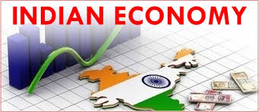
www.Padasalai.Net

Slide 2
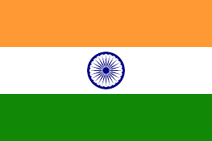
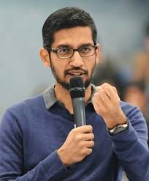
“India will be a global player in the digital economy”
–Sunder Pichai, CEO Google

Slide 3
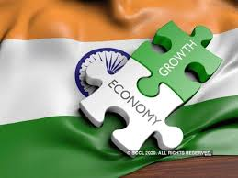
LEARNING OBJECTIVES
To understand the current status of the Indian Economy in terms of features, Natural resources, infrastructure facilities and so on.
To understand the contributions of major Indian Economic Thinkers.

Slide 4
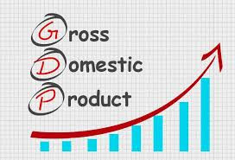
Meaning of Growth and Development
A country’s economic growth is usually measured by National Income, indicated by Gross Domestic Product (GDP).
The GDP is the total monetary value of the goods and services produced by that country over a specific period of time, usually one year.
The level economic development is indicated not just by GDP, but by an increase in citizens’ quality of life or well-being.
The quality of life is being assessed by several indices such as Human Development Index (HDI), Physical Quality of Life Index (PQLI) and Gross National Happiness Index (GNHI).

Slide 5
Gross National Happiness Index (GNHI)
The term “Gross National Happiness” was coined by the fourth king of Bhutan, Jigme Singye Wangchuck, in 1972. It is an indicator of progress, which measures sustainable development, environmental conservation, promotion of culture and good governance.

Slide 6
Sl.No | Developed Economies | Under developed Economies
1. | Countries are industrialised. | Countries are not industrialised.
2. | Efficient utilisation of resources like land, mines, wokers etc. | Not fully utilized their resources like land, mines, workers etc.
3. | High per capita income. | Low per capita income.
4. | Examples are U.S.A , Canada, UK, France and Japan. | Examples are Africa, Bangladesh, Myanmar, Pakistan, Indonesia etc.
5. | Also termed as advanced countries. | Also termed as underdeveloped countries or Backward nations or Third world nations.

Slide 7
Features of a Developed Economy
High National Income
High Per Capita Income
High Standard of Living
Full Employment of Resources
Dominance of Industrial Sector
High Level of Technology
High Industrialisation
High Consumption Level
High Level of Urbanisation
Smooth Economic Growth
Social Equity, Gender Equality and Low Levels of Poverty
Political Stability and Good Governance

Slide 8
Indian Economy
Indian economy is the Seventh largest economy of the world.
In terms of industrialization and economic growth, India holds a robust position with an average growth rate of 7%.
Even though the rate of growth has been sustainable and comparatively stable, there are still signs of backwardness.

Slide 9
Features of Indian Economy
India has a mixed economy
Indian economy is a mixed economy.
This means both private and public sectors co- exist and function smoothly.
On one side, some of the fundamental and heavy industrial units are being operated under the public sector, while, on the other hand due to the liberalization of the economy, the private sector has gained importance.
This makes it a perfect model for public – private partnership.

Slide 10
Features of Indian Economy
Agriculture plays the key role
Agriculture being the maximum pursued occupation in India, it plays an important role in its economy as well.
Around 60% of the people in India depend upon agriculture for their livelihood.
about 17% of our GDP today is contributed by the agricultural sector.
Green revolution, ever green revolution and inventions in bio technology have made agriculture self sufficient and also surplus production.
The export of agricultural products such as fruits, vegetables, spices, vegetable oils, tobacco, animal skin, etc. also add to forex earning through international trading.

Slide 11
Features of Indian Economy
An emerging market
India has emerged as vibrant economy sustaining stable GDP growth rate even in the midst of global downtrend.
This has attracted significant foreign capital through FDI and FII.
India has a high potential for prospective growth.
This also makes it an emerging market for the world.

Slide 12
Features of Indian Economy
Emerging Economy
Emerging as a top economic giant among the world economy, India bags the seventh position in terms of nominal Gross Domestic Product (GDP) and third in terms of Purchasing Power Parity (PPP).
As a result of rapid economic growth Indian economy has a place among the G20 countries.

Slide 13
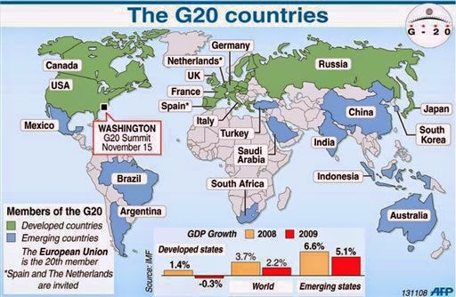

Slide 14
Features of Indian Economy
Fast Growing Economy
India’s economy is well known for high and sustained growth.
It has emerged as the world’s fastest growing economy in the year 2016-17 with the growth rate of 7.1% in GDP next to People’s Republic of China.

Slide 15
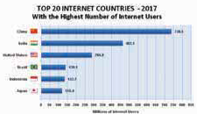
Features of Indian Economy
Fast growing Service Sector
The service sector, contributes a lion’s share of the GDP in India.
There has been a high rise growth in the technical sectors like Information Technology, BPO etc.
These sectors have contributed to the growth of the economy.
The service sectors have helped the country go global and helped in spreading its branches around the world.

Slide 16
Features of Indian Economy
Large Domestic consumption
With the faster growth rate in the economy the standard of living has improved a lot.
This in turn has resulted in rapid increase in domestic consumption in the country.
The standard of living has considerably improved and life style has changed.
Rapid growth of Urban areas
Urbanization is a key ingredient of the growth of any economy.
There has been a rapid growth of urban areas in India after independence.
Transport and communication, education and health have speeded up the pace of urbanization.

Slide 17
Features of Indian Economy
Stable macro economy
The Indian economy has been projected and considered as one of the most stable economies of the world.
The current year’s Economic survey represents the Indian economy to be a “heaven of macroeconomic stability, resilience and optimism.
According to the Economic Survey for the year 2014-15, 8%-plus GDP growth rate has been predicted, with actual growth turning out to be a little less (7.6%). This is a clear indication of a stable macroeconomic growth.

Slide 18
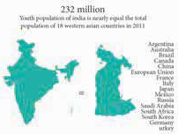
Features of Indian Economy
Demographic dividend
The human capital of India is young.
This means that India is a pride owner of the maximum percentage of youth.
The young population is not only motivated but skilled and trained enough to maximize the growth.
Thus human capital plays a key role in maximizing the growth prospects in the country.
This has invited foreign investments to the country and outsourcing opportunities too.

Slide 19
Weakness of Indian Economy
Large Population
India stands second in terms of size of population next to China and our country is likely to overtake china in near future.
Population growth rate of India is very high and this is always a hurdle to growth rate.
The population growth rate in India is as high as 1.7 per 1000.
The annual addition of population equals the total population of Australia.

Slide 20
Weakness of Indian Economy
Inequality and poverty
There exists a huge economic disparity in the Indian economy.
The proportion of income and assets owned by top 10% of Indians goes on increasing.
This has led to an increase in the poverty level in the society and still a higher percentage of individuals are living Below Poverty Line (BPL).
As a result of unequal distribution of the rich becomes richer and poor becomes poorer.

Slide 21
Weakness of Indian Economy
Increasing Prices of Essential Goods
Even though there has been a constant growth in the GDP and growth opportunities in the Indian economy, there have been steady increase in the prices of essential goods.
The continuous rise in prices erodes the purchasing power and adversely affects the poor people, whose income is not protected.

Slide 22
Weakness of Indian Economy
Weak Infrastructure
There has been a gradual improvement in the infrastructural development in the past few decades.
But still there is a scarcity of the basic infrastructure like power, transport, storage etc.
Inadequate employment generation
With growing youth population, there is a huge need of the employment opportunities.
The growth in production is not accompanied by creation of job.
The Indian economy is characterized by ‘jobless growth’.

Slide 23
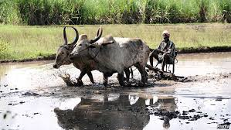
Weakness of Indian Economy
Outdated technology
The level of technology in agriculture and small scale industries is still outdated and obsolete.
small scale industries
agriculture

Slide 24
Demographic trends in India
Scientific study of the characteristics of population is known as Demography.
The various aspects of demographic trends in India are
Size of population
Rate of growth
Birth and death rates
Density of population
Sex-ratio
Life-expectancy at birth
Literacy ratio

Slide 25
Size of Population
Over a period of 100 years, India has quadrupled its population size.
In terms of, size of population, India ranks 2nd in the world after China.
India has only about 2.4% of the world’s geographical area and contributes less than 1.2% of the world’s income, but accommodates about 17.5% of the world’s population.
In other words, every 6th person in the world is an Indian.

Slide 26
Infact, the combined population of just two states namely, Uttar Pradesh and Maharashtra is more than the population of United States of America, the third most populous country of the world.
Some of the states in India have larger population than many countries in the world. The negative growth during 1911-21 was due to rapid and frequent occurrence of epidemics like cholera, plague and influenza and also famines.
The year 1921 is known as the ‘Year of Great Divide’ for India’s population as population starts increasing.
During 1951, population growth rate has come down from 1.33% to 1.25%. Hence it is known as ‘Year of Small divide’.
In 1961, population of India started increasing at the rate of 1.96% i.e, 2%. Hence 1961 is known as ‘Year of Population Explosion’.
In the year 2001,the Population of India crossed one billion (100 crore) mark.
The 2011 census reveals growth of youth population which is described as ‘demographic transition’.

Slide 27
Birth rate and death rate
Birth rate was 39.9 in 1951; it fell to 21.8 in 2011.
The death rate has declined from 27.4 in 1951 to 7.1 in 2011. from the data it is clear that the fall in birth rates is less than that of death rates.
Crude Birth rate | It refers to the number of births per thousand of population.
Crude Death rate | It refers to the number of deaths per thousand of population.
Kerala has the lowest birth rate (14.7) and Uttar Pradesh has the highest birth rate (29.5).
West Bengal has the lowest death rate (6.3) and Orissa (9.2) has the highest.
Among States Bihar has the highest decadal (2001-11) growth rate of population, while Kerala has the lowest growth rate.
The four states Bihar, Madhya Pradesh, Rajasthan and Uttar Pradesh called BIMARU states have very high population.

Slide 28
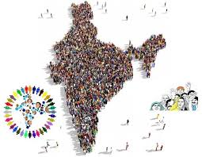
Density of population
It refers to the average number of persons residing per square kilometre.
It represents the man- land ratio. As the total land area remains the same, an increase in population causes density of population to rise.
Density of population
Total population
Land area of the region
=

Slide 29
Just before Independence, the density of population was less than 100.
But after independence, it has increased rapidly from 117 in 1951 to 325 in 2001.
According to 2011 census, the present Density of population is 382.
The pressure of population on land has been rising.
Kerala, West Bengal, Bihar and Uttar Pradesh have density higher than the India’s average density.
Bihar is the most densely populated state in the country with 1,102 persons living per sq.km followed by West Bengal with 880.
Arunachal Pradesh has low density of population of only 17 persons.

Slide 30
Sex ratio
It refers to the number of females per 1,000 males.
It is an important indicator to measure the extent of prevailing equity between males and females at a given point of time.
In India, the sex ratio is more favourable to males than to females.
In Kerala, the adult sex ratio is 1084 as in 2011.
Haryana has the lowest sex ratio of 877 (2011)
Kerala provides better status to women as compared to other States with 1084 females per 1000 males

Slide 31
Life expectancy at birth
It refers to the mean expectation of life at birth.
Life expectancy has improved over the years.
Life expectancy is low when death rate is high.
On the other hand, life expectancy is high when death rate is low and / or instances of early death are low.
During 1901 – 11, life expectancy was just 23 years.
It increased to 63.5 years in 2011.
A considerable fall in death rate is responsible for improvement in the life expectancy at birth.
However the life expectancy in India is very low compared to that of developed countries.

Slide 32
Literacy ratio
It refers to the number of literates as a percentage of the total population.
In 1951, only one-fourth of the males and one-twelfth of the females were literates.
On an average, only one-sixth of the people of the country were literates.
In 2011, 82% of males and 65.5% of females were literates giving an overall literacy rate of 74.04% (2011).
When compared to other developed countries and even Sri Lanka this rate is very low.
Kerala has the highest literacy ratio (92%)
Bihar has the lowest literacy ratio (53%) in 2011.

Slide 33
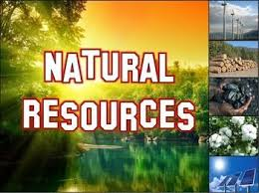
Natural Resources
Any stock or reserve that can be drawn from nature is a Natural Resource.
The major natural resources are - land, forest, water, mineral and energy.
India is rich in natural resources, but majority of the Indians are poor.

Slide 34
Types of Natural resources
Renewable Resources | Non-Renewable Resources
Resources that can be regenerated in a given span of time | Resources that cannot be regenerated.
Forests Wildlife Wind Biomass Tidal Hydro energies etc. | Fossil fuels -coal Petroleum Minerals etc.

Slide 35
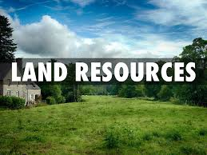
Land Resources
In terms of area India ranks seventh in the world with a total area of 32.8 lakh sq. km.
It accounts for 2.42% of total area of the world.
In absolute terms India is really a big country. However, land- man ratio is not favourable because of the huge population size.
According to Agricultural Census, the area operated by large holdings (10 hectares and above) has declined and area operated under marginal holdings (less than one hectare) has increased.
This indicates that land is being fragmented and become ineconomic.

Slide 36
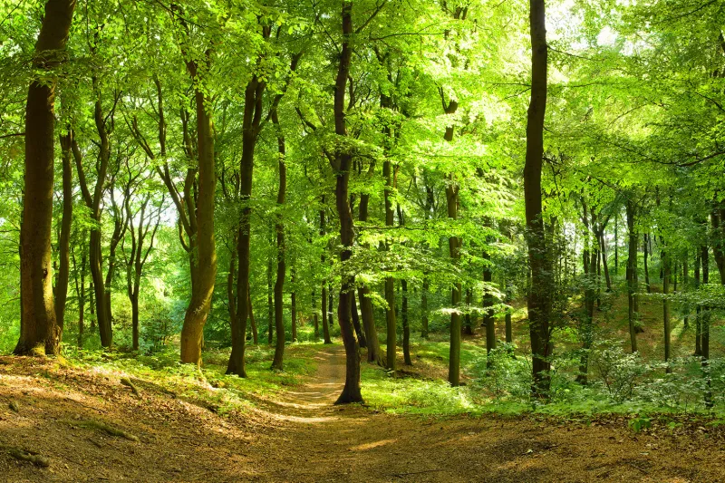
Forest Resources
Forest resources
India’s forest cover in 2007 is 69.09 million hectare.
Of this, 8.35 million hectare is very dense forest.
31.90 million hectare is moderately dense forest.
The rest 28.84 million hectare is open forest.

Slide 37
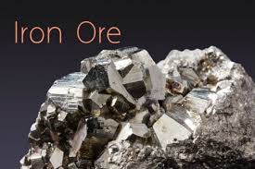
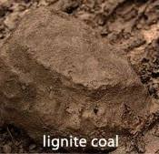
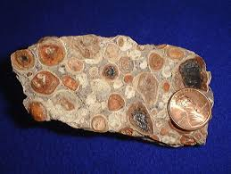
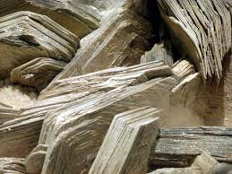
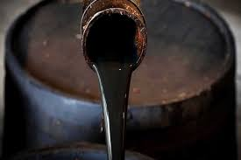
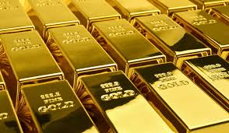
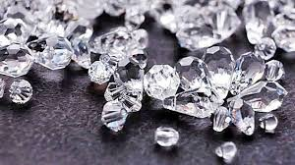
Important Mineral resources
Iron-Ore
Coal and Lignite
Bauxite
Mica
Crude Oil
Gold
Diamond

Slide 38
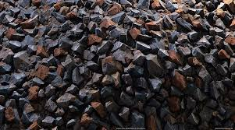
Iron-Ore
India possesses high quality iron-ore in abundance.
The total reserves of iron-ore in the country are about 14.630 million tonnes of haematite and 10,619 million tonnes of magnetite.
Hematite iron is mainly found in Chattisgarh, Jharkhand, Odisha, Goa and Karnataka.
The major deposit of magnetite iron is available at western coast of Karnataka.
Some deposits of iron ore are also found in Kerala, Tamil Nadu and Andhra Pradesh.

Slide 39
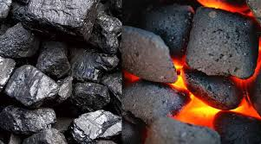
Coal and Lignite
Coal is the largest available mineral resource.
India ranks third in the world after China and USA in coal production.
The main centres of coal in India are the West Bengal, Bihar, Madhya Pradesh, Maharashtra,Odisha and Andhra Pradesh.
Bulk of the coal production comes from Bengal-Jharkhand coalfields.

Slide 40
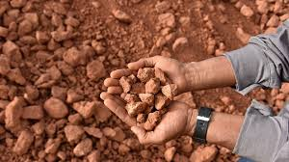
Bauxite
Bauxite is a main source of metal like aluminium.
Major reserves are concentrated in the East Coast, Odisha and Andhra Pradesh.

Slide 41
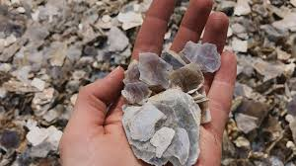
Mica
Mica is a heat resisting mineral which is also a bad conductor of electricity. It is used in electrical equipment's as an insulator.
India stands first in sheet mica production and contributes 60% of mica trade in the world.
The important mica bearing pegmatite is found in Andhra Pradesh, Jharkhand, Bihar and Rajasthan.

Slide 42
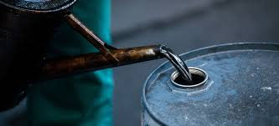
Crude Oil
Oil is being explored in India at many places of Assam and Gujarat.
Oil exploration in India
Digboi, Badarpur, Naharkatia, Kasimpur, Palliaria, Rudrapur, Shivsagar, Mourn
(All in Assam)
Hay of Khambhat, Ankaleshwar and Kalol
(All in Gujarat)

Slide 43
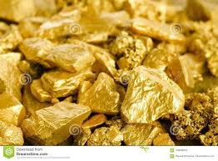
Gold
India possesses only a limited gold reserve.
Three main gold mine regions are
Kolar Goldfield - Kolar district
Hutti Goldfield - Raichur district
Ramgiri Goldfield - Anantpur district

Slide 44
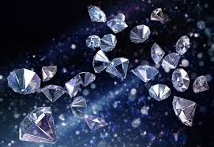
Diamond
As per UNECE the total reserves of diamond is estimated at around 4582, thousand carats
They are mostly available in Panna(Madhya Pradesh), Rammallakota of Kurnur district of Andhra Pradesh and also in the Basin of Krishna River.
The new Kimberlile fields have been discovered in
Raipur and Pastar districts of Chhattisgarh,
Nuapada and Bargarh districts of Odisha,
Narayanpet – Maddur Krishna areas of Andhra Pradesh
Raichur - Gulbarga districts of Karnataka.

Slide 45
Infrastructure
Infrastructural development means the development of many support facilities.
These facilities may be divided into
Economic infrastructure.
Social infrastructure.
Economic infrastructure | Social infrastructure
Ttransport Communication Energy Irrigation Monetary and financial institutions | Education, Training and Research Health Housing and civic amenities

Slide 46
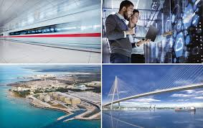
Economic Infrastructure
Economic infrastructure is the support system which helps in facilitating production and distribution.
For instance, railways, trucks, posts and telegraph offices, ports, canals, power plants, banks, insurance companies etc. are all economic infrastructure of an economy.
They help in the production of goods and services.

Slide 47
Transport
For the sustained economic growth of a country, a well-connected and efficient transport system is needed.
India has a good network of rail, road, coastal shipping, and air transport.
The total length of roads in India being over 30 lakh km.
India has one of the largest road networks in the world.
In terms of railroads, India has a broad network of railroad lines, the largest in Asia and the fourth largest in the world.
The total rail route length is about 63,000 km and of this 13,000 km is electrified.
The major Indian ports including Calcutta, Mumbai, Chennai, Vishakhapatnam and Goa handle about 90% of sea- borne trade and are visited by cargo carriers and passenger liners from all parts of the world.
A comprehensive network of air routes connects the major cities and towns of the country.
The domestic air services are being looked after by Indian Airlines and private airlines.
The international airport service is looked after by Air India.

Slide 48
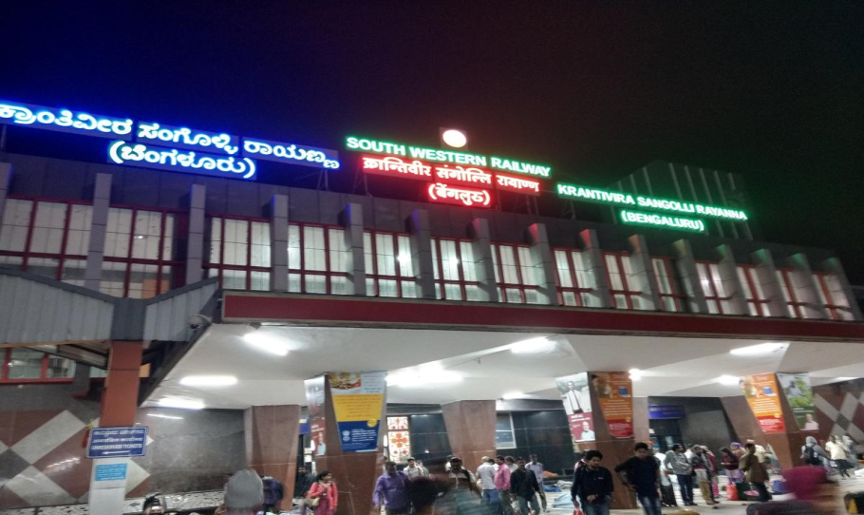
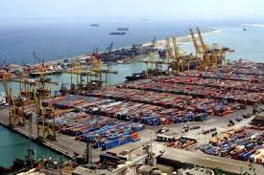
Indian Railways Provide Wi-Fi Facility First in India is Bangalore Railway Station
Air India and Indian Airlines were
merged on August 27, 2007 to from
National Aviation Company of India
Ltd. (NACIL)
The National Harbour board was set up in1950 to advise the Central and State Governments on the management and development of ports, particularly minor ports

Slide 49
Energy
Electrical energy is one of the necessary components of our life.
Without electricity, we cannot survive in this world of technology.
The energy sources are classified under two heads based on the availability of the raw materials used, while generating energy.
Non-renewable energy sources
Renewable energy sources

Slide 50
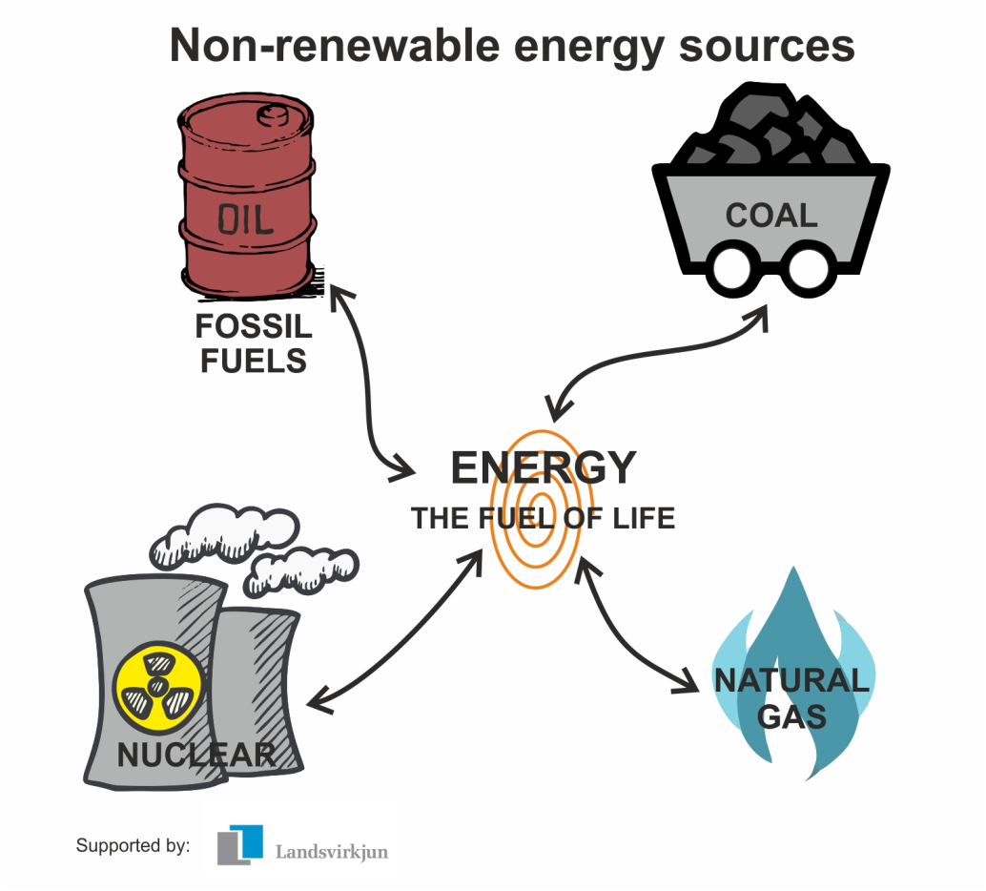
Non-renewable energy sources
The sources of energy which cannot be renewed or re-used are called non-renewable energy sources.
These energy sources will get exhausted over a period of time.
Some of the examples of this kind of resources are coal, oil, gas etc.

Slide 51
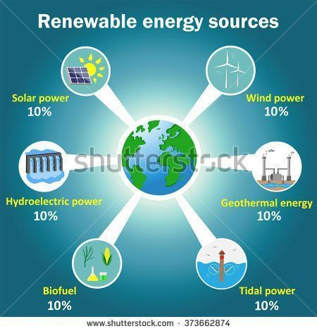
Renewable energy sources
The energy source which can be renewed or reused again and again.
These kinds of materials do not exhaust
Example for this kind include
Solar energy
Wind energy
Tidal energy
Geothermal energy
Biomass energy
Sometimes renewable sources are also called non-conventional sources of energy

Slide 52
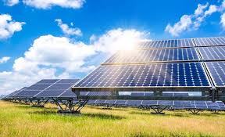
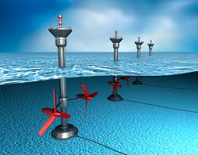
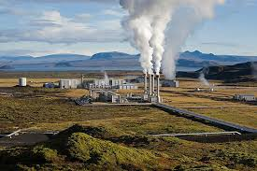
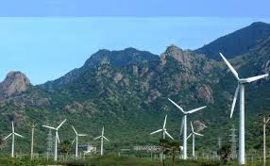
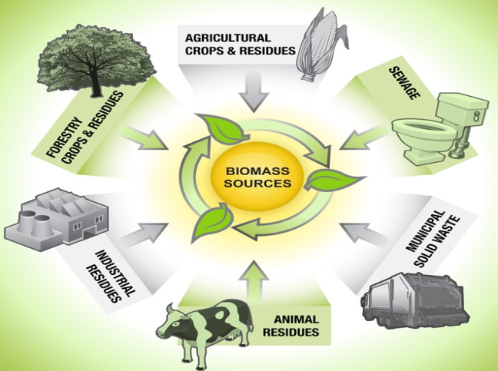
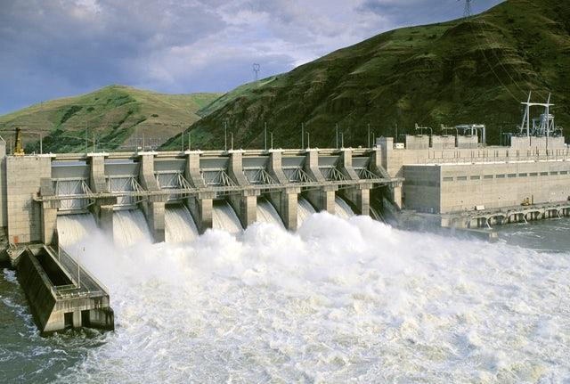
SOLAR ENERGY
Tidal ENERGY
Geothermal ENERGY
wind ENERGY
biomass ENERGY
hydel ENERGY

Slide 54
Social infrastructure
Social infrastructure refers to those structures which are improving the quality of manpower and contribute indirectly towards the growth of an economy.
These structures are outside the system of production and distribution.
The development of these social structures help in increasing the efficiency and productivity of manpower.
For example, schools, colleges, hospitals and other civic amenities.
The status and developments in the social infrastructure in India are
Education
Health

Slide 55
education

Slide 56
Education in India
Imparting education on an organized basis dates back to the days of ‘Gurukul’ in India.
Then the Indian education system has flourished and developed with the growing needs of the economy.
The Ministry & Human Resource Development (MHRD) in India formulates education policy in India
Education system in India
Education in India until 1976 was the responsibility of the State governments.
It was then brought under concurrent list (both Centre and State). The education system in India consists of primarily six levels:
Nursery Class
Primary Class
Secondary Level
Higher Secondary Level
Graduation
Post-Graduation

Slide 57
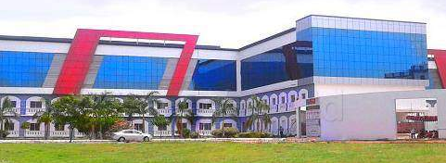
Education Institutions in India
Education in India follows the 10+2 pattern.
For higher education, there are various State run as well as private institutions and universities providing a variety of courses and subjects.
The Education Department consists of various schools, colleges and universities imparting education on fair means for all sections of the society.
The budget share of the education sector is around 3% of GDP.
Of this largest proportion goes for school education.
However, per pupil expenditure is the lowest for school students.

Slide 58
health

Slide 59
Health in India
Health in India is a state government responsibility.
The Central Council Of Health and Welfare formulates the various health care projects and health department reform policies.
The administration of health industry in India as well as the technical needs of the health sector are the responsibility of the Ministry Of Health And Welfare.
Health care in India has many forms.
These are the ayurvedic medicine practice, unani or galenic herbal care, homeopathy, allopathy, yoga, and many more.
Each different healthcare form has its own treatment system and practice patterns.
All medical systems are now under one ministry viz AYUSH.
Health Care Services in India
The health care services in India are mainly the responsibility of the Ministry of Health.
Health status is better in Kerala as compared to other States.
Compared to other developed countries, India’s health status is not satisfactory.
India’s health status is poor compared to Sri Lanka.

Slide 60
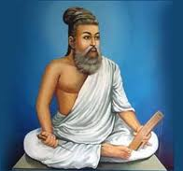
Contributions of Indian Economic Thinkers
Thiruvalluvar
The economic ideas of Thiruvalluvar are found in his immortal work, Thirukkural, a book of ethics.
it is generally believed that, he belongs to the Sangam age in Tamil Nadu around third century A.D.
A large part of Valluvar’s economic ideas are found in the second part of Thirukkural, the porutpal.
It deals with wealth.
Thiruvalluvar is a fundamental thinker.
He believes that rains are the basic support of life.
Since rain provides food, it forms the basis for stable economic life.
“It is rain that both ruins and aids the ruined to rise”.

Slide 61
Thiruvalluvar
Factors of Production
Made many passing references about the factors of production viz., Land, Labour, Capital, Organisation, Time, Technology etc.
He says, “Unfailing harvest, competent body of men, group of men, whose wealth knows no diminution, are the components of an economy”.
எந்த ஒரு நாட்டிலும் திறமையான தொழிலாளிகள் மிகுதியாக இருந்து விவசாயத்தை வீழ்ச்சி அடையாமல் பார்த்துக்கொண்டால் அந்த நாட்டின் செல்வம் ஒரு நாளும் வீழ்ச்சி அடையாது.

Slide 62
Thiruvalluvar
Agriculture
Agriculture is the most fundamental economic activity.
They are the axle-pin of the world, for on their prosperity revolves prosperity of other sectors of the economy.
“The ploughmen alone”, he says “live as the freemen of the soil; the rest are mere slaves that follow on their toil”
Valluvar believes that agriculture is superior to all other occupation.
உழுதுண்டு வாழ்வோரே வாழ்வார் மற்றெல்லாம்
தொழுதுண்டு பின் செல்பவர்

Slide 63
Public Finance
Thiruvalluvar has elaborately explained Public Finance under the headings Public Revenue, Financial administration and Public expenditure.
He has stated these as
Creation of revenue
Collection of revenue
Management of revenue
Public expenditure

Slide 64
Economic Term | Explanation | Relevant Term in Tamil
Public Finance / Creation of Revenue | The Study of Government activities which may include spending, deficits and taxation | பொது நிதி
Public Revenue / Collection of Revenue | It refers to Government revenue (Income) Eg. Taxes, Fees etc | பொது வருவாய்
Financial Administration / Management of Revenue | It is concerned with raising Public revenue, allocating public funds and resources and managing public asset | நிதி நிர்வாகம்
Public Expenditure | It is the spending made by the Government of a country on Collective needs and wants. Eg. Pension | பொது செலவு

Slide 65
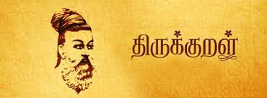
Public Expenditure
Valluvar has recommended a balanced budget.
“ It is not a great misfortune for a state if its revenues are limited, provided the expenditure is kept within bounds.”
He has given certain guidelines for a budgetary policy.
“Budget for a surplus, if possible, balances the budget at other times, but never budget for a deficit.”
Valluvar advocates the following main items of public expenditure:
Defence
Public Works
Social Services.

Slide 66
Economic Term | Explanation | Relevant Term in Tamil
Budget | Estimation of Revenue and expenditure of a Government over a specific period of time | வரவு செலவு
Balanced Budget | Revenue (Income) = Expenditure | சமநிதி நிலை
Surplus Budget | Revenue is greater than the expenditure | உபரிநிதி நிலை
Deficit Budget | Expenditure is greater than the revenue | பற்றாக்குறை நிலை

Slide 67
External Assistance
Valluvar was against seeking external assistance.
According to Kural No. 739, countries taking external assistance are not to be considered as countries at all.
நாடென்ப நாடா வனத்தன நாடல்ல
நாட வளந்தரு நாடு
In other words, he advocated a self-sufficient economy.

Slide 68
Poverty and Begging
Valluvar considers freedom from hunger as one of the fundamental freedoms that should be enjoyed by every citizen.
According to him ‘poverty’ is the root cause of all other evils which would lead to ever-lasting sufferings.
It is to be noted that the number of people living below poverty line, begging, sleeping on the roadsides and rag picking in India has been increasing.

Slide 69
Wealth
Valluvar has regarded wealth as only a means and not an end.
He said, “Acquire a great fortune by noble and honorable means.”
He condemned hoarding and described hoarded wealth as profitless richness.
To him industry is real wealth and labour is the greatest resource.
Welfare State
Thiruvalluvar is for a welfare state.
The important elements of a welfare state are
Perfect health of the people without disease
Abundant wealth
Good crop
Prosperity and happiness
Full security for the people
69

Slide 70
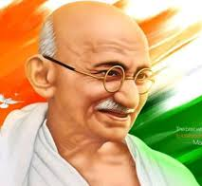
Mahatma Gandhi
Gandhian Economics
is based on ethical
foundations.
In 1921, Gandhi
wrote, “Economics
that hurts the moral
well-being of an
individual or a nation
is immoral, and
therefore, sinful.”

Slide 71
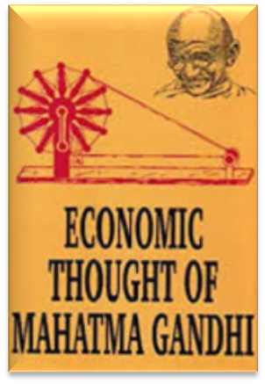
Salient Features of Gandhian Economic Thought
Village Republics
According To Gandhi, India lives in villages. He was interested in developing the villages as self sufficient units. He opposed extensive use of machinery, urbanization and industrialization.
On Machinery
Gandhi described machinery as ‘Great sin’.
He said that “Books could be written to demonstrate its evils… it is necessary to realize that machinery is bad.
Instead of welcoming machinery as a boon, we should look upon it as an evil.

Slide 72
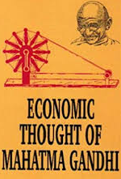
Industrialism
Gandhi considered industrialism as a curse on mankind. He thought industrialism depended entirely on a country’s capacity to exploit.
Decentralization
He advocated a decentralized economy, i.e., production at a large number of places on a small scale or production in the people’s homes.
Village Sarvodaya
According to Gandhi, “Real India was to be found in villages and not in towns or cities.”
So he suggested the development of self sufficient, self-dependent villages.

Slide 73
Bread Labour
Gandhi realized the dignity of human labour.
He believed that God created man to eat his bread by the sweat of his brow.
Bread labour or body labour was the expression that Gandhi used to mean manual labour.
The Doctrine of Trusteeship
Trusteeship provides a means of transforming the present capitalist order of society into an egalitarian one.
It gives no quarter to capitalism.
Now India experiences both casino capitalism and crony capitalism.

Slide 74
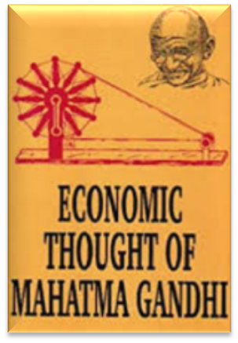
On the Food Problem
Gandhi was against any sort of food controls.
He thought such controls only created artificial scarcity.
Once India was begging for food grain, but now India tops the world with very large production of food grains, fruits, vegetables, milk, egg, meat etc.,
On Population
Gandhi opposed the method of population control .
He was, however, in favour of birth control through Brahmacharya or self control.
He considered self-control as a sovereign remedy to the problem of over-population.
On Prohibition
Gandhi advocated cent per cent prohibition.
He regarded the use of liquor as a disease rather than a vice.
He felt that it was better for India to be poor than to have thousands of drunkards.
But ,now many states depend on revenue from liquor sales.

Slide 75
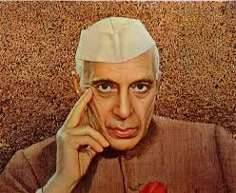
Jawaharlal Nehru
Jawaharlal Nehru was the first Prime Minister of Independent India and he was there in that post till his death in 1964.
He was a great patriot, thinker and statesman.
His views on economics and social problems are found in the innumerable speeches he made and in the books he wrote.

Slide 76
Democracy and Secularism
Jawaharlal Nehru was a firm believer in democracy.
He believed in free speech, civil liberty, adult franchise, the Rule of Law and Parliamentary democracy.
Secularism, is another contribution of Nehru to India.
In our country, there are many religions - Hinduism, Islam, Christianity, Buddhism, Jainism, Zoroastrianism, Sikhism and so on.
Secularism means equal respect for all religions.

Slide 77
Planning
Jawaharlal Nehru was responsible for the introduction of planning in our country.
To Jawaharlal Nehru, the Plan was essentially an integrated approach for development.
In the Lok Sabha in May 1956, Nehru spoke on the theme of planning. He said, “the essence of planning is to find the best way to utilize all resources of manpower, of money and so on.” Planning for Nehru was essentially linked up with industrialization and eventual self-reliance for the country’s economic growth on a self- accelerating growth.
Nehru’s contribution to the advancement of science, research, technology and industrial development cannot be forgotten.
It was during his period, many IITs and Research Institutions were established. He always in insisted on “scientific temper”.

Slide 78
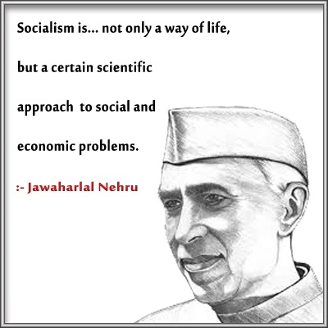
Democratic Socialism
Socialism is another contribution of Nehru to India.
He put the country on the road towards a socialistic pattern of society.
But Nehru’s socialism is democratic socialism.

Slide 79
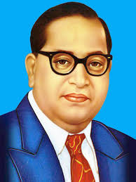
B. R. Ambedkar
B. R. Ambedkar (1891- 1956) was a versatile personality.
He was the architect of the Indian Constitution, a custodian of social justice and a champion of socialism and state planning.
Ambedkar’s writings included “Ancient Indian Commerce” (a thesis submitted to the Columbia University for the award of the Mater of Arts Degree in 1915),
National Dividend of India: A Historical and Analytical Study (a thesis for which he was awarded Ph.D).
Ambedkar’s thesis on “Provincial Decentralization of Imperial Finance in British India” was accepted for the M. Sc degree in 1921.
His thesis “ The Problem of the Rupee” was accepted for the award of the D.Sc degree by the London School of Economics in 1923.

Slide 80
The main economic ideas of Ambedkar may be studied under four broad headings
Financial Economics
Agricultural Economics
Economics of Caste
Economics of Socialism

Slide 81
Financial Economics
Much of the work done by Ambedkar during his stay abroad mostly during the period 1913-1923, was in the field of Finance Economics.
Ambedkar divided the evolution of provisional finance into three stages:
Budget by Assignment (1871 - 72 to 1876 - 77)
Budget by Assigned Revenue (1877 - 78 to 1881 - 82)
Budget by Shared Revenues (1882 - 83 to 1920 - 21)
Agricultural Economics
In 1918, Ambedkar published a paper “Small Holding in India and their Remedies”. Citing Adam Smith’s ‘Wealth of Nations”, he made a fine distinction between “Consolidation of Holdings” and “Enlargement of Holdings”.

Slide 82
Economics of Caste
Ambedkar believed that caste was an obstacle to social mobility.
It resulted in social stratification.
He was of the firm view that individuals must be free to change their occupations.
The caste system caused social tensions.
The caste system has resulted in the absence of social democracy in India as distinct from political democracy.
Economics of Socialism
Ambedkar was a socialist.
He was a champion of state socialism.
He was for state monopoly of insurance business.
He advocated compulsory insurance for every citizen.
There is no doubt that Ambedkar was a great economist.
But his academic work as an economist was clipsed by his greater contributions in the field of law and politics. Above all he was a great social reformer.

Slide 83
J. C. Kumarappa
Joseph Chelladurai Kumarappa was born on 4 January 1892 in Tanjavur, Tamil Nadu.
Kumarappa is credited for developing economic theories based on Gandhism
He coined “Gandhian Economics”.

Slide 84
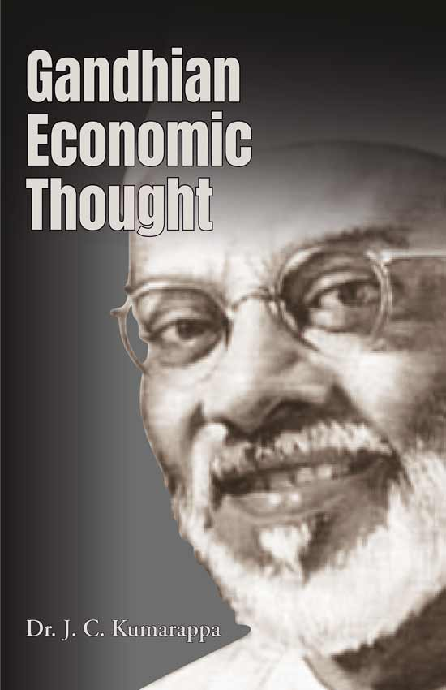
Gandhian Economics

Slide 85
J.C.Kumarappa strongly supported Gandhi’s notion of village industries and promoted Village Industries.
Kumarappa worked to combine Christian and Gandhian values of “trusteeship”, non-violence and a focus on human dignity and development in place of materialism.
Gandhi and Kumarappa envisioned an economy focused on satisfying human needs and challenges.
Kumarappa worked as a Professor of economics at the Gujarat Vidyapith in Ahmedabad, while serving as the editor of Young India during the Salt Satyagraha.
He founded the All India Village Industries Association in 1935.
He was imprisoned for more than a year during the Quit India movement.
Kumarappa took the lead in a number of relevant books in the 1930s and 1940s.
Historian Ramachandra Guha calls Kumarappa, “The Green Gandhian,”
Kumarappa worked for the Planning Commission of India and the Indian National Congress to develop national policies for agriculture and rural development.
He also travelled to China, Eastern Europe and Japan on diplomatic assignments and to study their rural economic systems.

Slide 86
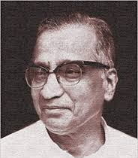
V.K.R.V. Rao
V.K.R.V: Rao was a prolific writer.
V.K.R.V: Rao was deeply interested in three large themes.
They were
National Income
Food, nutrition and the distribution of good
Employment and occupational distributions.

Slide 87
National Income Methodology
As an applied economist, Rao’s name is remembered for his pioneering work on the enumeration of national income of India.
Rao was a pupil of J.M. Keynes and he worked with Colin Clark.
H.W Singer considered V.K.R.V Rao as “ the best equipped of all Keynes’ pupils.
He attempted
to develop the national income concepts suited to India and developing countries generally
to analyze the concepts of investment, saving and the multipliers in an underdeveloped economy
to study the compatibility of the national incomes of industrialized and underdeveloped countries
Rao’s paper on “Full Employment and Economic Development” was one of the earliest contributions in the field of development towards employment.

Slide 88
International Food Aid
Rao was influential in creating ideas and shaping policy in the international attack on world poverty, not only through his contributions to the question of international aid and improved flows of external resources, but also through his activities in the field of food aid.

Slide 89
Support for Socialism
During the early phases of planning in India, Rao supported the case of a socialist India, where the state would control the commanding heights of the economy and the public sector would play a dominant role in economic development.

Slide 90
Rao’s Views on Industrialization
Rao gave the following reasons for low per capita income and low levels of per capita nutrition in India.
Uneconomic holdings with subdivisions and fragmentation
Low levels of water availability for crops
Excess population pressure on agriculture due to the absence of a large industrial sector
Absence of capital
Absence of autonomy in currency policy, and in general in monetary matters encouraging holding of gold

Slide 91
Village Clusters
Rao felt that rural communities had to be given a viable base.
Therefore he suggested that a cluster of villages should form a unit for rural development, so that both social and economic interactions between villages could develop, and they could effectively generate and fashion their own development with a more meaningful participation by people.

Slide 92
Investment, Income and Multiplier
Rao’s examination of the “interrelation between investment, income and multiplier in an under developed economy” (1952) was his major contribution to macroeconomic theory.
As a thinker, teacher, economic adviser and direct policy maker, V.K.R.V. Rao followed the footsteps of his great teacher, John Maynard Keynes.

Slide 93
Institution Builder
He founded three national level research institutes namely
Delhi School of Economics
Institute of Economic Growth (both at Delhi)
Institute for Social and Economic Change (Bangalore)

Slide 94
Amartya Kumar Sen
The Nobel citation refers to Sen’s contributions to
Social choice theory
Development economics
Study on poverty and famines
Concept of entitlements
Capability development (1998)

Slide 95
Poverty and Famines
Sen's Poverty and Famines: An Essay on “Entitlement and Deprivation” (1981) is both a theoretical and an applied work. In the book, several famines have been studied in the working of a general theoretical framework from an original angle. He examined various meanings of poverty and drew attention to the incidence of absolute and relative deprivation.

Slide 96
Poverty and Inequality
Sen has carried out massive work on poverty and inequality in India. Sen’s major point has been that the distribution of income/ consumption among the persons below the poverty line is to be taken into account.

Slide 97
The Concept of Capability
The concept of capabilities developed by Sen has been cited as a better index of wellbeing than commodities or utilities. Capability, as defined by Sen, is the ability to transform Rawlsian primary goods to the achievement of wellbeing.

Slide 98
Entitlement
Sen has included the concept of entitlement items like nutrition, food, medical and health care, employment, security of food supply in times of famine etc. He considered famine as arising out of the failure of establishing a system of entitlements.

Slide 99
Choice of Technique
Sen’s ‘Choice of Technique ‘ was a research work where he argued that in a labour surplus economy, generation of employment cannot be increased at the initial stage by the adaptation of capital- intensive technique.
Conclusively, Amartyasen, more than just an economist, is an ethical philosopher. He is a lover of freedom and a humanist. He has focused on the poor, viewing them not as objects of pity requiring charitable hand–outs, but as disempowered folkneeding empowerment, education,health, nutrition, gender equality,safety net in times of distress; all are needed to empower people.

Slide 100
Conclusion
This lesson mainly focused on some of the aspects of the Indian Economy and its resources, infrastructure facilities and energy, It also discussed the principles of Indian Economic thinkers to motivate the students to read good books on Economics Written by the great economists.

