Slide 1
AUDIO VISUAL SMART CLASS PROGRAM
1

Slide 2
www.Padasalai.Net
Prepared by
K . Shanthi
Vice Principal
Alpha Matric Higher Secondary School
Puducherry

Slide 3
www.Padasalai.Net

Slide 4
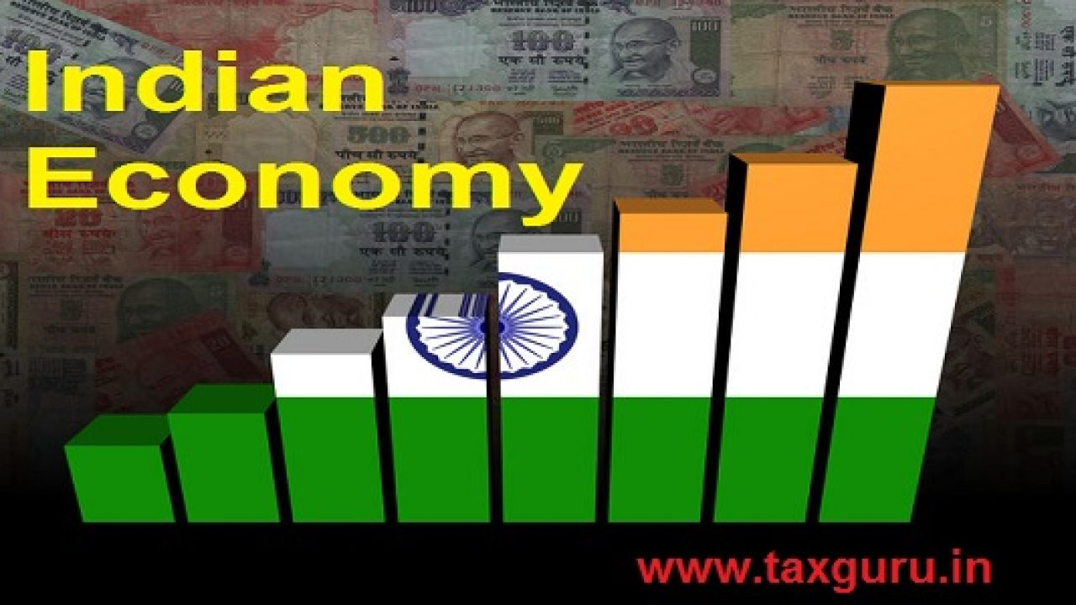
Indian Economy Before and After Independence

Slide 5
LEARNING OBJECTIVES
To understand the experience of India during British Rule
To appreciate the efforts taken by the Government of India after Independence

Slide 6
Introduction
This chapter discusses the major events that took place in India before and after Independence.
India was a colony for long.
Colonialism refers to a system of political and social relations between two countries, of which one is the ruler and the other is its colony.
Thus, the people living in a colony cannot take independent decisions in respect of utilisation of the country’s resources and important economic activities.

Slide 7
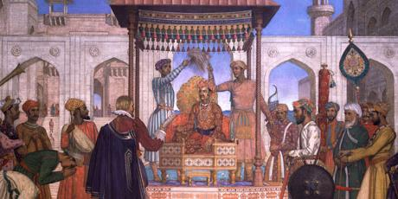
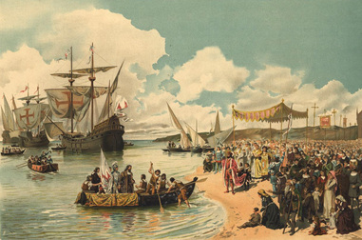
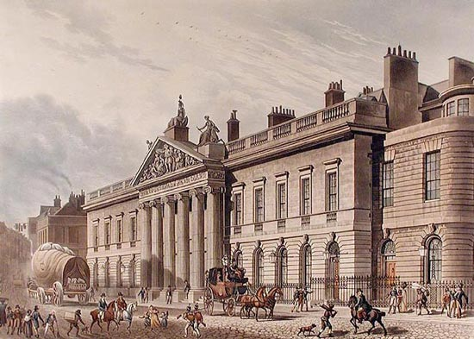
Indian Economy during the British period
Indian’s sea route trade to Europe started only after the arrival of Vasco da Gama in Calicut, India on May 20, 1498.
The Portuguese had traded in Goa as early as 1510.
In 1601 the East India Company was chartered.
In 1614 Sir Thomas Roe was successful in getting permission from Jahangir for setting up factories and slowly moved all parts of India.

Slide 8
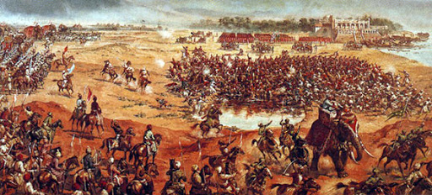
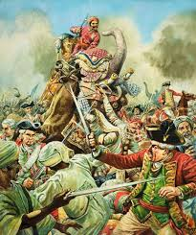
Hundred years after Battle of Plassey, the rule of the East India Company finally did come to an end.
In 1858, British Parliament passed a law through which the power for governance of India was transferred from the East India Company (EIC) to the British crown.
Britain had exploited India over a period of two centuries of its colonial rule.
On the basis of the form of colonial exploitation, economic historians have divided the whole period into three phases:
The period of merchant capital
The period of industrial capital
The period of finance capital

Slide 9
Period of Merchant Capital
The period of merchant capital was from 1757 to 1813.
The only aim of the East India Company was to earn profit by establishing monopoly trade.
India became the best hunting ground for capital by the East Indian company.
When Bengal and South India came under political shake of the East India company in 1750s and 1760s, the objective of monopoly trade was fulfilled.
The company administration succeeded in generating huge surpluses which were repatriated to England.
The Indian leaders linked this problem of land revenue with that of the drain.
Above all, the officers of the company were unscrupulous and corrupt.

Slide 10
Period of Industrial Capital
The period of Industrial capital was from 1813 to 1858.
During this period, India had become a market for British textiles.
India’s raw materials were exported to England at low price and imported finished textile commodities to India at high price. In this way, Indians were exploited.
India’s traditional handicrafts were thrown out of gear.

Slide 11
Period of Finance Capital
The third phase was the period of finance capital starting from the closing years of the 19th century and continuing till independence.
During this period, finance imperialism began to entrench itself through the managing agency firms, export – import firms, exchange banks and some export of capital.
Britain decided to make massive investments in various fields (rail, road, postal system irrigation, European banking system, and a limited field of education etc) in India by plundering Indian capital.
Railway construction policy of the British led to unimaginable as well as uneconomic. The poor Indian taxpayers had been compelled to finance for the construction of railways. The political power was handed over to the British Government by the East India Company in 1858.

Slide 12
Decline of Indian Handicrafts
The Indian handicrafts products had a worldwide market. Indian exports consisted chiefly of hand weaved cotton and silk fabrics, calicoes, artistic wares, wood carving etc
Through discriminatory tariff policy, the British Government purposefully destroyed the handicrafts.
With the disappearance of nawabs and kings, There was no one to protect Indian handicrafts.
Indian handicraft products could not compete with machine-made products.
The introduction of railways in India increased the domestic market for the British goods.

Slide 13
The Land Tenure Systems in India
Land Tenure refers to the system of land ownership and management.
The features that distinguish a land tenure system from the others relate to the following
Who owns the land
Who cultivates the land
Who is responsible for paying the land revenue to the government
Three different types of land tenure existed in India before Independence.
They were Zamindari system, Mahalwari system and Ryotwari system.

Slide 14
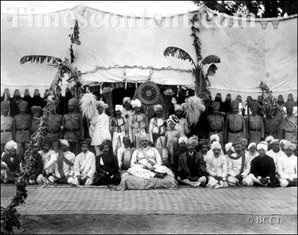
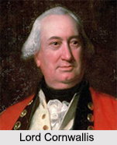
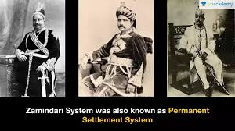
Zamindari System or the Land lord-Tenant System
This system was created by the British East India Company, when in 1793.
LordCornwallis introduced ‘Permanent Settlement Act’.
Under this system the landlords or the Zamindars were declared as the owners of the land and they were responsible to pay the land revenue to the government.
The share of the government in total rent collected was fixed at 10/11th.
The balance going to the Zamindars as remuneration.

Slide 15
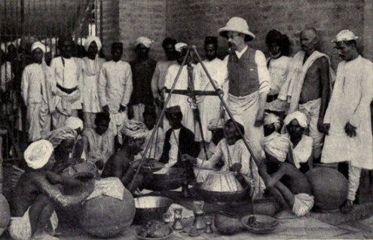
Mahalwari System or Communal System of Farming
After introduction of this system, it was later extended to Madhya Pradesh and Punjab.
The ownership of the land was maintained by the collective body usually the villagers which served as a unit of management.
They distributed land among the peasants and collected revenue from them and pay it to the state.

Slide 16
Ryotwari System or The Owner-Cultivator System
This system was initially introduced in Tamil Nadu and later extended to Maharashtra, Gujarat, Assam, Coorg, East Punjab and Madhya Pradesh.
Under this system the ownership rights of use and control of land were held by the tiller himself.
There was the direct relationship between owners.
This system was the least oppressive system before Independence.

Slide 17
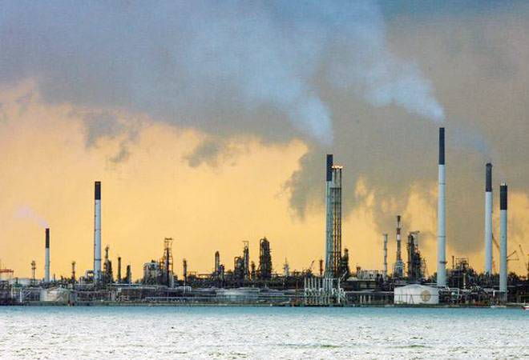
Process of Industrial Transition and Colonial Capitalism
This process of industrial transition in India during the British period can be broadly classified into two
Industrial growth during the 19th century
Industrial progress during the 20th century

Slide 18
Industrial growth during the 19th century
British investors started to pioneer industrial enterprises in India.
British enterprises also received maximum state support.
Britishers initiated industrialisation process in the 19th century.
They were primarily interested in making profit and not in accelerating the economic growth.
At the end of 19th century, there were about 36 jute mills, 194 cotton mills and a good number of plantation industries.
The production of coal had risen to over 6 million tonnes per annum.

Slide 19
Industrial progress during the 20th century
The first part of 20th century, Swadeshi movement stimulated the industrialisation process in India.
The existing industries and new industries had maintained a slow but steady growth
Till 1914 this time more than 70 cotton mills and 30 jute mills were set up.
Coal production was doubled.
The foundation of iron and steel industry was laid. Railway network was extended.
During the period 1924-39, various major industries like iron and steel, cotton textiles, jute, matches, sugar, paper and pulp industry etc. were brought under protection scheme.
These protected industries captured the entire Indian market and eliminated foreign competition totally.
British rule tried to transform the Indian economy as the the producer of industrial raw materials and tried to capture Indian market
British capitalists gradually developed various industries like, jute, tea, coffee, cotton and textiles, paper and paper pulp, sugar etc, in India and exploited Indian labourers extensively.

Slide 20
Problems of British Rule
The British rule stunted the growth of Indian enterprise.
The economic policies of British checked and retarded capital formation in India.
The drain of wealth financed capital development in Britain.
Indian agricultural sector became stagnant and deteriorated
The British rule in India led the collapse of handicraft industries
Some efforts by the colonial British regime in developing the plantations, mines, jute mills, banking and shipping, mainly promoted a system of capitalist firms that were managed by foreigners.

Slide 21
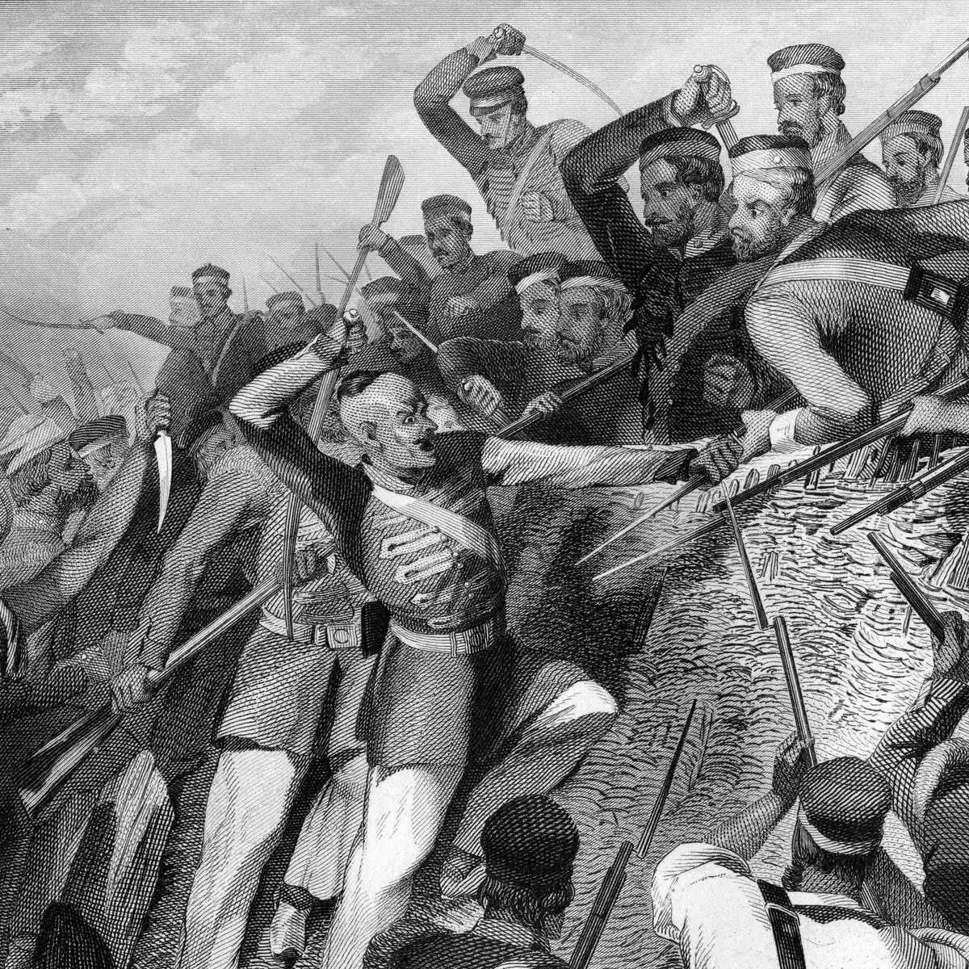
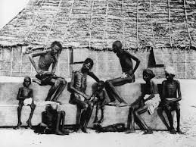
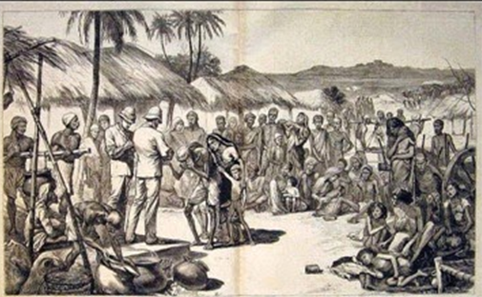
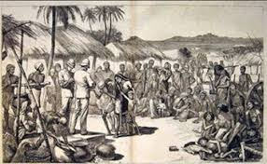
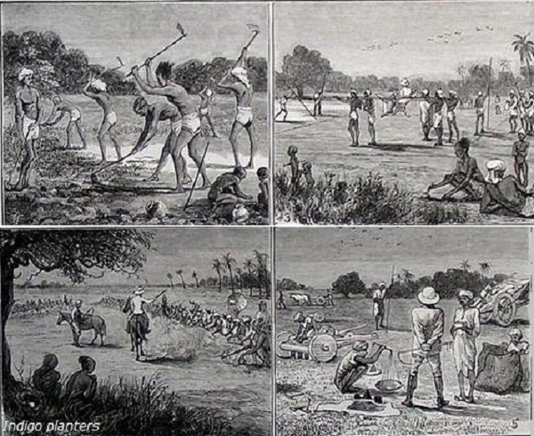
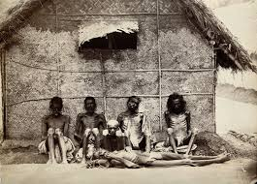
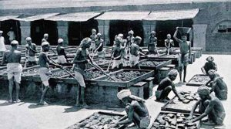
Problems of
British
Rule

Slide 22
Important Industrial Policies Prior to 1991
India is the Asia’s third largest economy. The 70 years of Independence have brought a remarkable change in the socio – economic landscape of India.
Economic development of a country particularly depends on the process of industrialisation.
At the time of Independence, India inherited a weak and shallow industrial base.
During the post–Independence period, the Government of India took special emphasis on the development of a solid industrial base.
The Industrial Policy Resolutions of 1948 and 1956 clearly stated the need for developing both small scale industries and large scale industries.

Slide 23
Industrial Policy resolutions 1948
The Government of India declared its first Industrial Policy on 6th April 1948.
The main importance of this policy was that it ushered in India the system of mixed economy.
Industries were classified into four groupssuch as public sector (strategic industries), public–cum –private Sector (key industries), controlled private sector, private and co-operative sectors.
This policy endeavoured to protect cottage and small scale industries.
The central and state governments had a virtual monopoly in rail roads and exclusive rights to develop minerals, iron ore etc.
The Government encouraged the significance of foreign capital for industrialization.

Slide 24
Industrial Policy resolutions 1956
The Industrial Policy of 1956 sought to give a dominant role to public sector.
The Government would support and encourage cottage and small scale enterprises by restricting volume of production in the large scale sector
This industrial policy emphasized the necessity of reducing the regional disparities in levels of development.
The Government recognized the need for foreign capital for progressive Indianisation of foreign concerns.

Slide 25
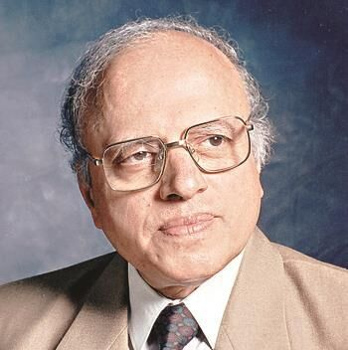
Green Revolution
The term Green Revolution refers to the technological breakthrough in of agricultural practices.
During 1960’s the traditional agricultural practices were gradually replaced by modern technology and agricultural practices in India.
Initially the new technology was tried in 1960-61 as a pilot project in seven districts.
It was called as the High Yielding Varieties Programme (HYVP).
M.S.SWAMINATHAN

Slide 26
Achievement of Green Revolution
The major achievement of the new strategy was to boost the production of major cereals viz., wheat and rice.
India was depending on the US for the food grain.
Indians were waiting for the ships to sip their food.
On the other hand, India lost lots of minerals.
The US exploited Indian mineral resources at cheapest price for manufacturing missiles and weapons.
But now India is food surplus, exporting food grains to the European countries.
The Green revolution was confined only to High Yielding Varieties (HYV) cereals, mainly rice, wheat, maize and jowar.

Slide 27
This Strategy was mainly directed to increase the production of commercial crops or cash crops such as sugarcane, cotton, jute, oilseeds and potatoes.
Per hectare productivity of all crops had increased due to better seeds.
Green Revolution had positive effect on development of industries, which manufactured agricultural tools like tractors, engines, threshers and pumping sets.
Green Revolution had brought prosperity to rural people. Increased production had generated employment opportunities for rural masses. Due to this, their standard of living had increased.
Due to multiple cropping and more use of chemical fertilizers, the demand for labour increased.
Financial resources were provided by banks and co-operative societies. These banks provided loans to farmer on easy terms.

Slide 28
Weaknesses of Green Revolution
Indian Agriculture was still a gamble of the monsoons.
This strategy needed heavy investment in seeds, fertilizers, pesticides and water.
The income gap between large, marginal and small farmers had increased. Gap between irrigated and rain fed areas had widened.
Farm mechanization had created widespread unemployment among agricultural labourers in the rural areas.
Larger chemical use and inorganic materials reduced the soil fertility and spoiled human health. Now organic farming is encouraged.

Slide 29
Second Green Revolution
The Government of India had implemented ‘Second Green revolution’ to achieve higher agricultural growth.
The target of Second Green Revolution was to increase 400 million tons of food grain production as against about 214 million tons in 2006-07.
This is to be achieved by 2020. In agricultural sector, the growth rate of 5% to 6% has to be maintained over next 15 years.

Slide 30
Requirements of Second Green Revolution
Introduction of Genetically Modified (GM) seeds which double the per acreage production.
Contribution of private sector to market the usage of GM foods.
Government can play a key role in expediting irrigation schemes and managing water resources.
Linking of rivers to transfer surplus water to deficient areas.

Slide 31
Large Scale Industries
The term “Large scale industries” refers to those industries which require huge infrastructure, man-power and a have influx of capital assets.
The heavy industries of India like the iron and steel industry, textile industry, automobile manufacturing industry fall under the large scale industrial arena.
In recent years IT industry can also be included within the jurisdiction of the large scale industrial sector.
Indian economy is heavily dependent on these large industries for its economic growth, generation of foreign currency and for providing job opportunities to millions of Indians.
The major large scale industries in India.

Slide 32
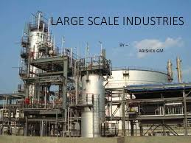
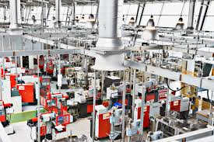
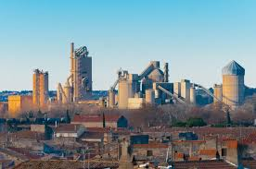
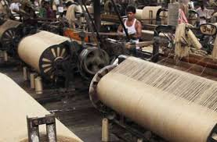
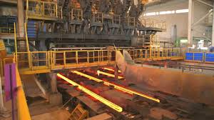
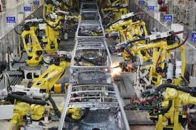
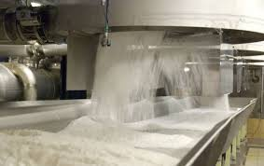
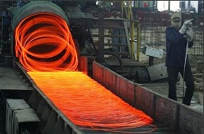
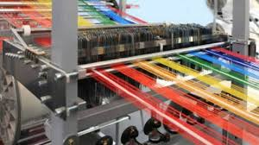
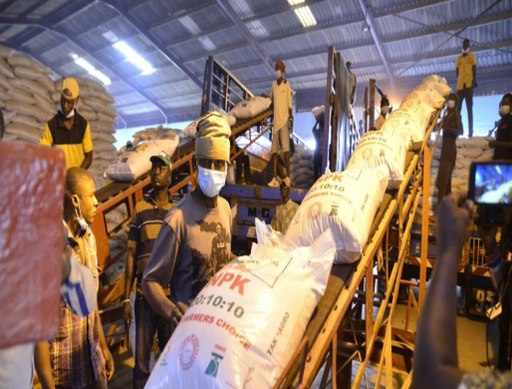
LARGE SCALE INDUSTRIES

Slide 33
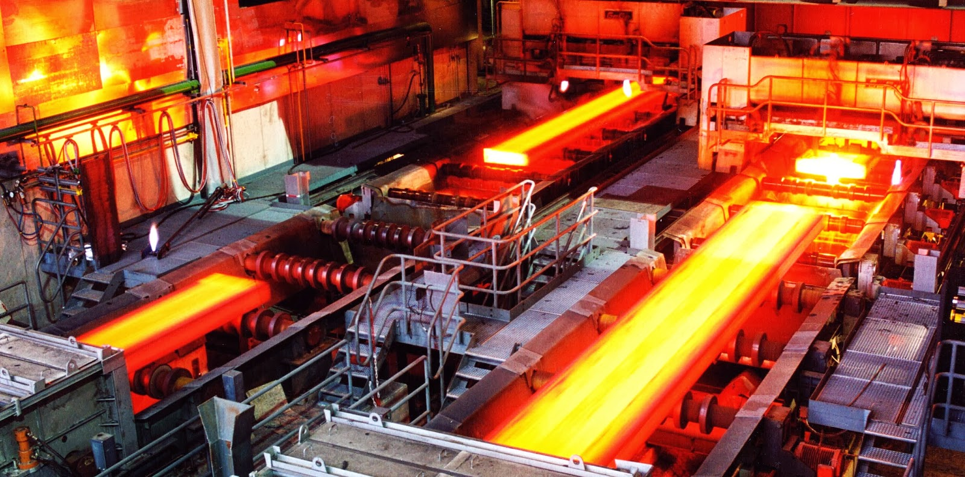
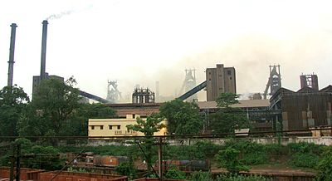
Iron and steel industry
First steel industry at Kulti, Near Jharia, West Bengal - Bengal iron works company in 1870.
First large scale steal plant TISCO at Jamshedpur in 1907 followed by IISCO at Burnpur in 1919. Both belonged to private sector.
The first public sector unit was “Vishveshvaraya Iron and Steel works” at Bhadrawati.
All these are managed by SAIL (at present all important steel plants except TISCO, are under public sector)
Steel Authority of India Ltd (SAIL) was established in 1974 and was made responsible for the development of the steel industry.
Presently India is the eighth largest steel producing country in the world.

Slide 34
Public sector steel plants
Location | Assistance
Rourkela (Odissa) | Germany
Bhilai (MP) | Russia
Durgapur (WB) | UK
Bokaro (Jharkhand) | Russia
Burnpur (WB) | Acquired from private sector in 1976
Vishakhapattnam (AP) | Russia
Salem (Tamil Nadu) | Government of India (No external assistance)
Vijai Nagar (Karnataka) | Government of India
Bhadrawati (Karnataka) | Nationalisation of Vishveshvarayya Iron and Steel Ltd (owned by Centre and State government)

Slide 35
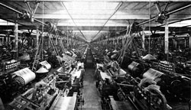
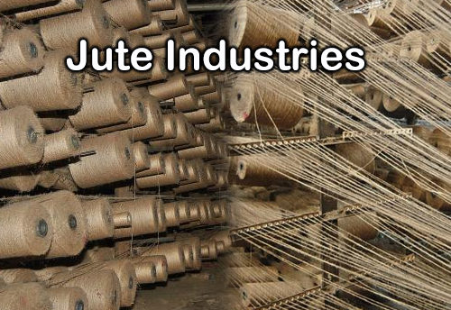
Jute industry
Jute industry is an important industry for a country like India, not only it earns foreign exchange but also provides substantial employment opportunities in agriculture and industrial sectors.
Its first modernised industrial unit was established at Reshra in West Bengal in 1855.
The jute industry in the country is traditionally export oriented.
India ranks number one in the raw jute and jute goods production and number two in export of jute goods in the world.

Slide 36
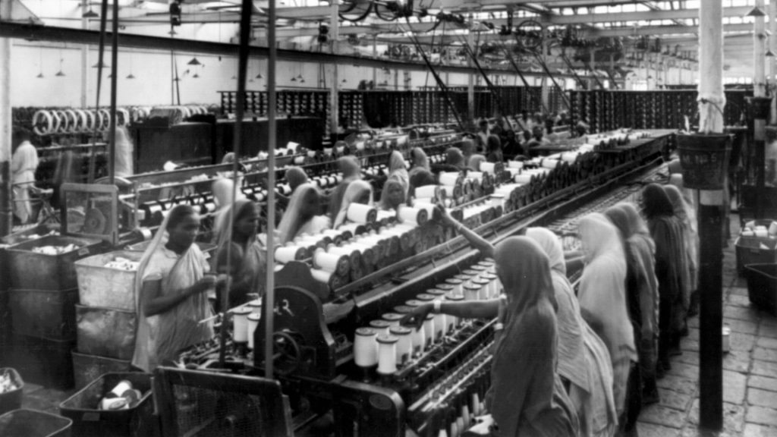
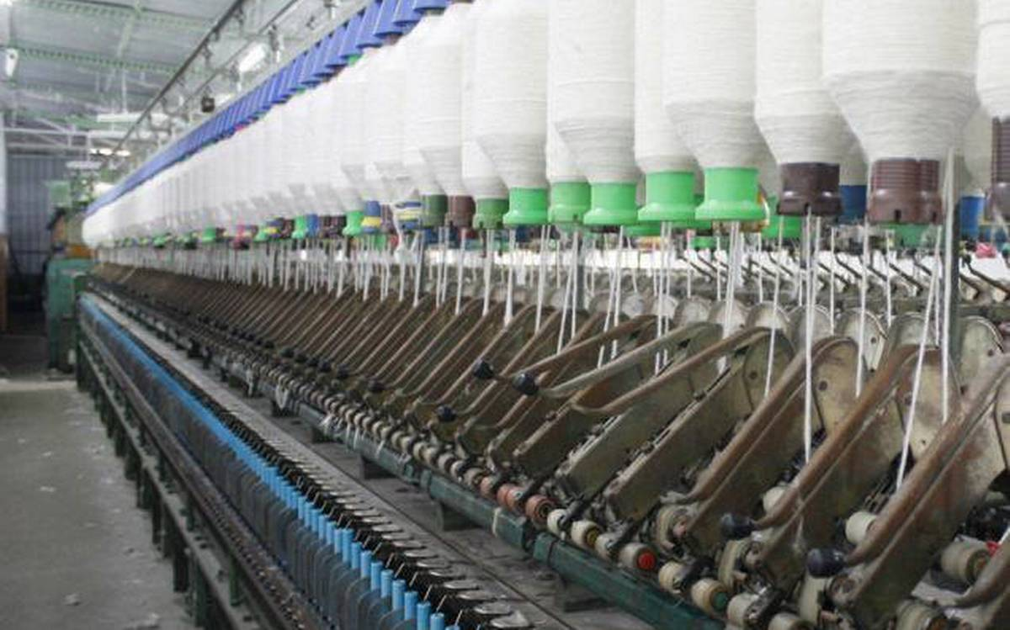
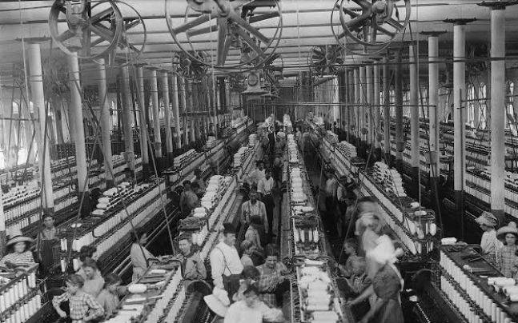
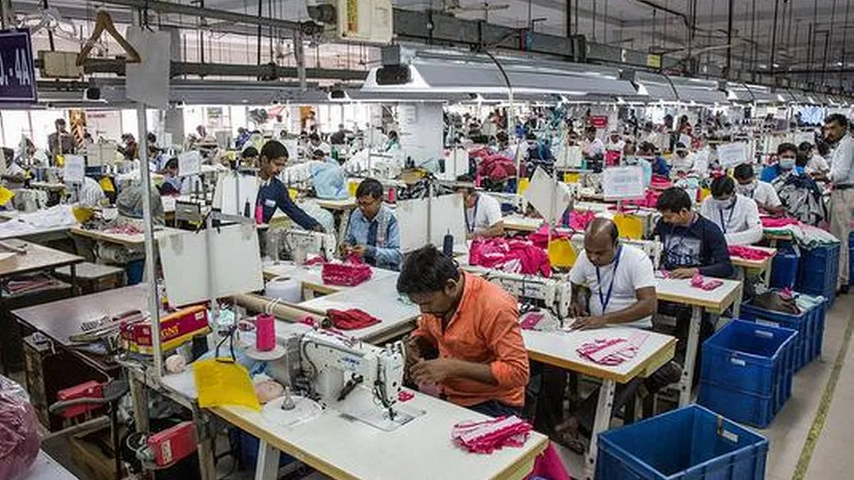
Cotton and textile industry
Oldest industry of India, and employs largest number of workers.
It is the largest organised and broadbased industry which accounts for 4% of GDP, 20% of manufacturing value-added and one third of total export earnings.
The first Indian modernised cotton cloth mill was established in 1818 at Fort Gloaster near Calcutta. But this mill was not successful. The second mill named “Mumbai’s Spinning and Weaving Co.” was established in 1854 at Bombay by KGN Daber.

Slide 37
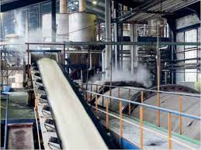
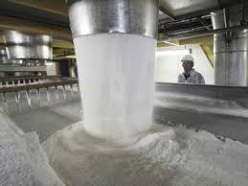
Sugar industry
Sugar industry is the second largest industry among agriculture-based industries in India.
India is now the largest producer and consumer of sugar in the world. Maharashtra contributes over one third of the Indian total sugar output, followed closely by Uttar Pradesh.

Slide 38
Fertiliser industry
India is the third largest producer of nitrogenous fertilisers in the world.

Slide 39
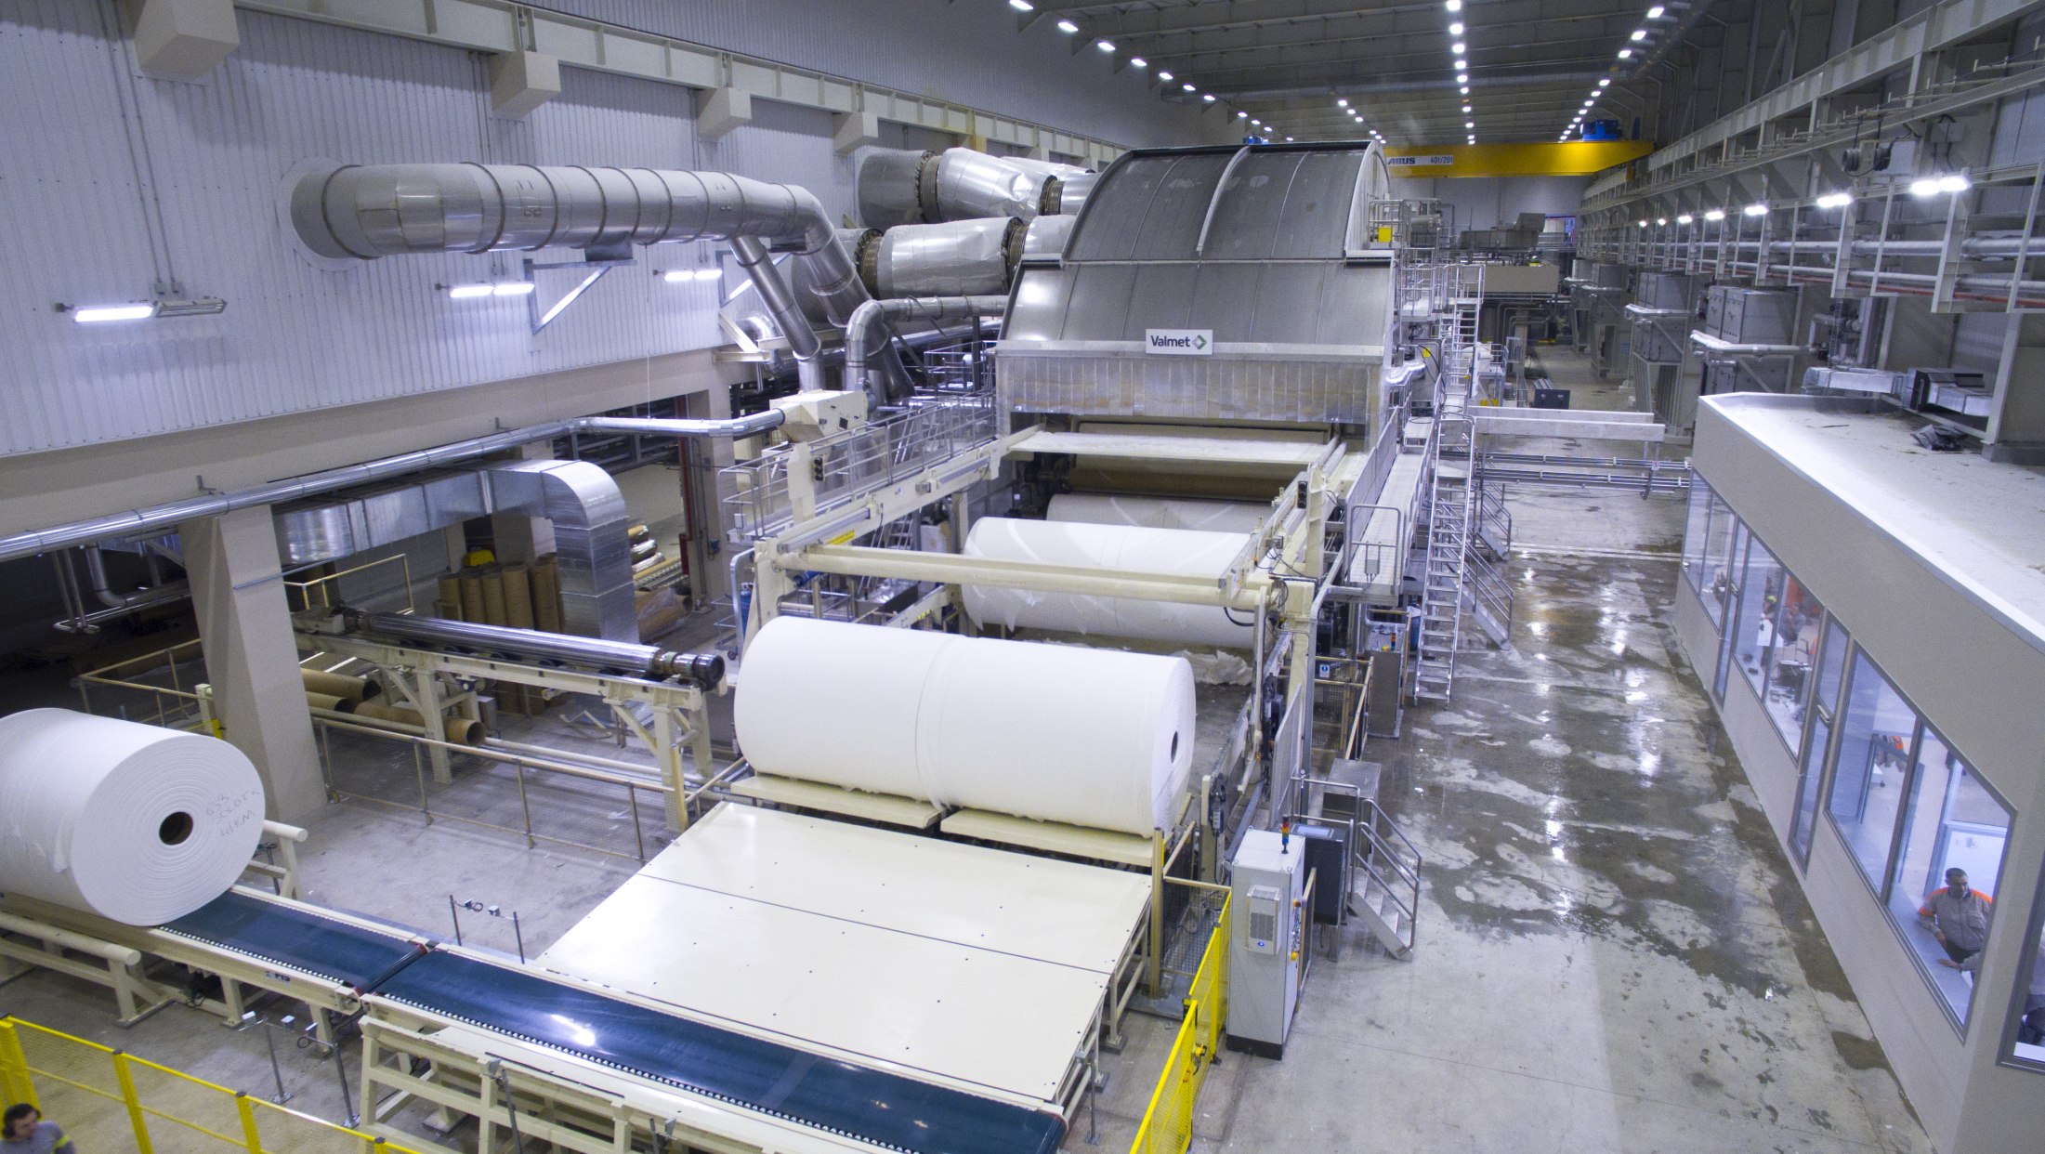
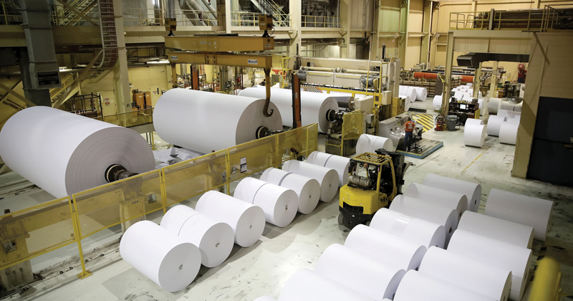
Paper industry
The first mechanised paper mill was set up in 1812 at Serampur in West Bengal.
The paper industry in India is ranked among the 15 top global paper industries.

Slide 40
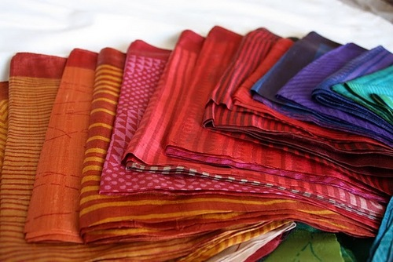
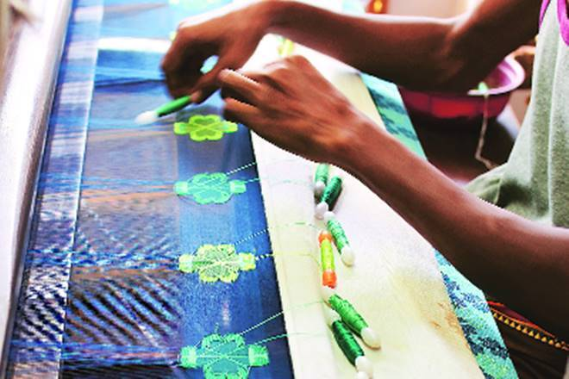
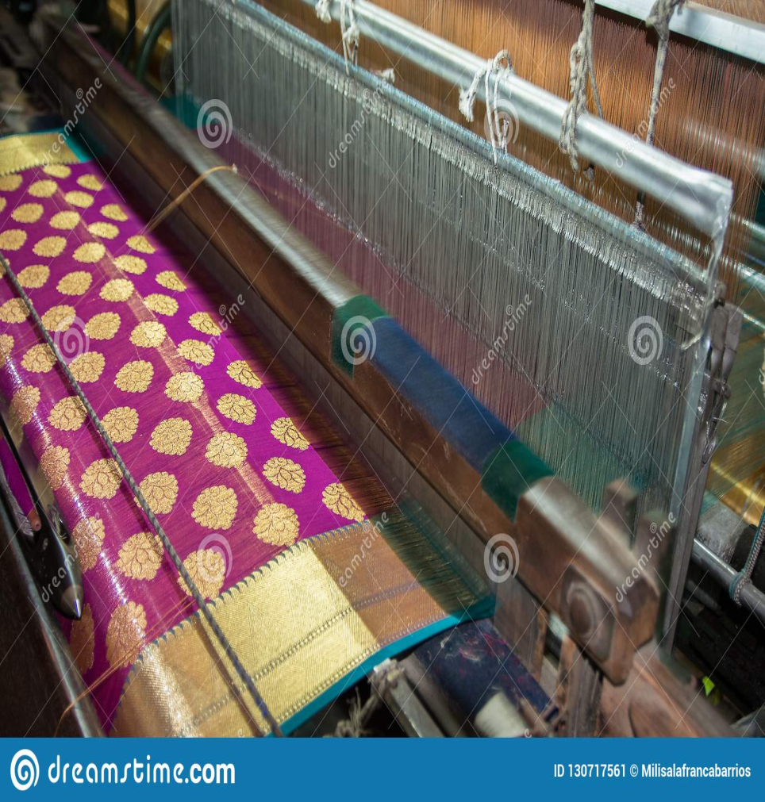
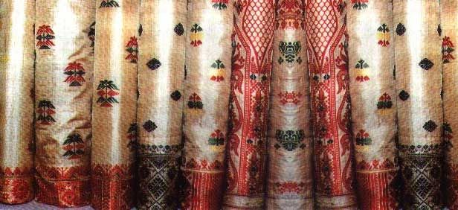
Silk industry
India is the second-largest (first being China) country in the world in producing natural silk. At present, India produces about 16% silk of the world.
India enjoys the distinction of being the only country producing all the five known commercial varieties of silk viz Mulberry, Tropical Tussar, Oak Tussar, Eri and Muga.

Slide 41
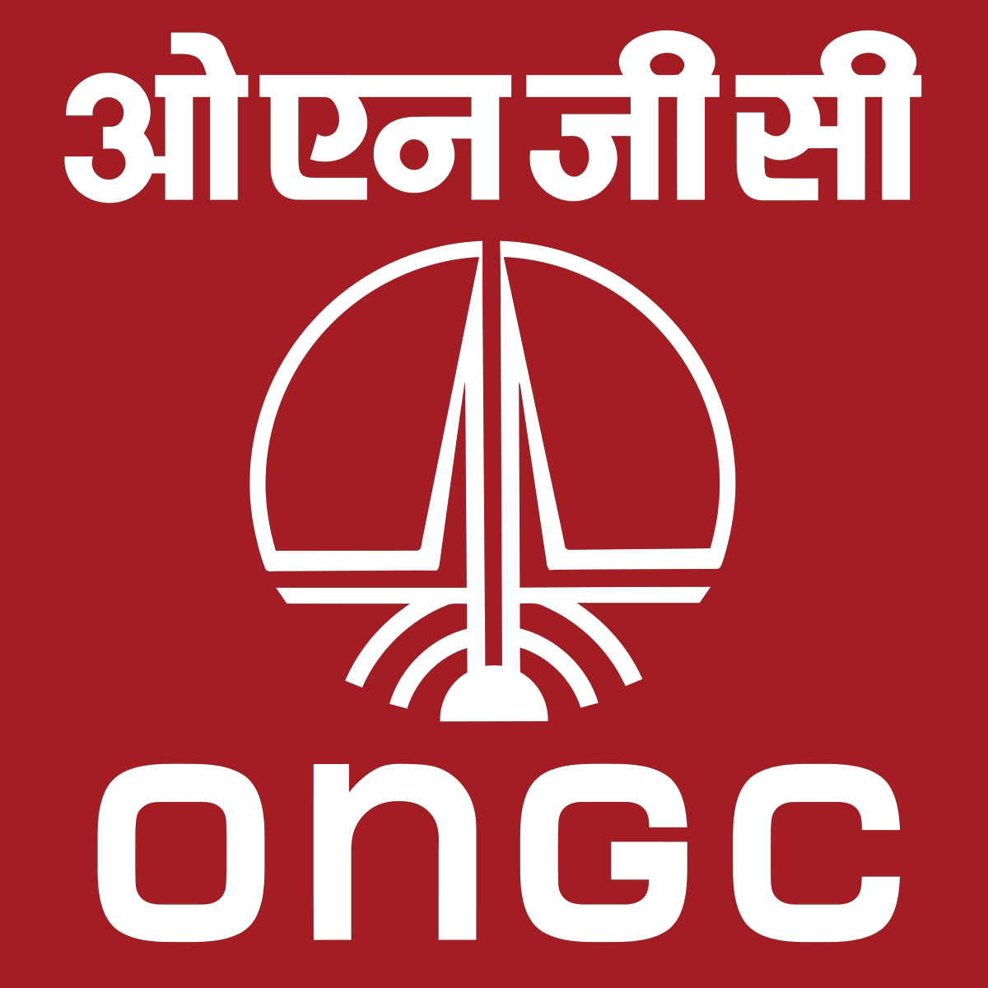
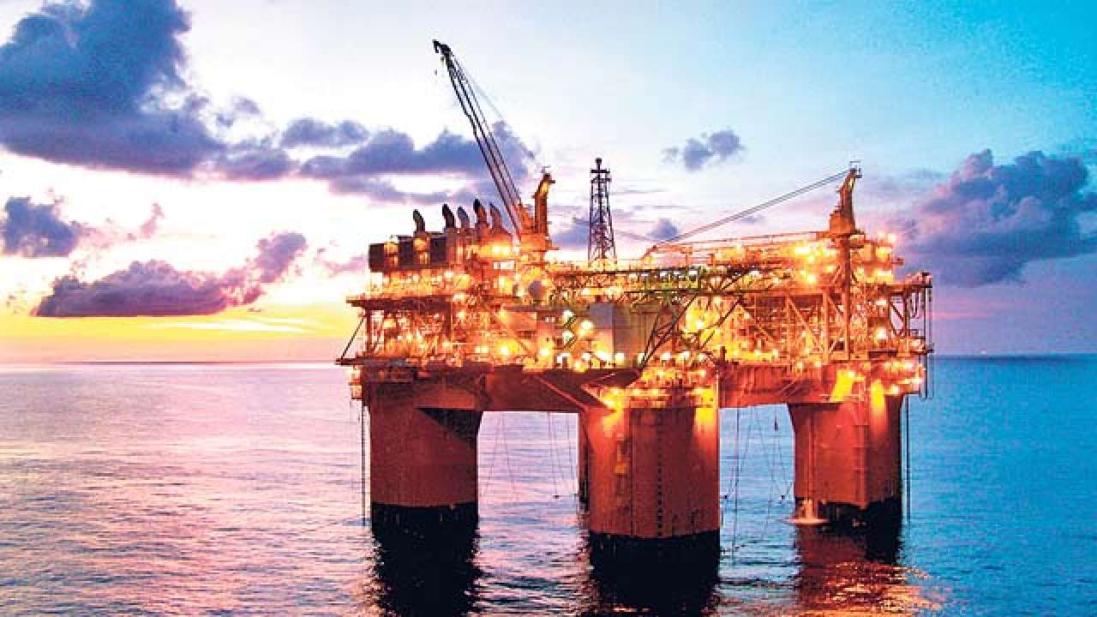
Petroleum and natural gas
First successful Oil well was dug in India in 1889 at Digboi, Assam.
At present a number of regions with oil reserves have been identified and oil is being extracted in these regions.
For exploration purpose, Oil and Natural Gas Commission (ONGC) was established in 1956 at Dehradun, Uttarakhand

Slide 42
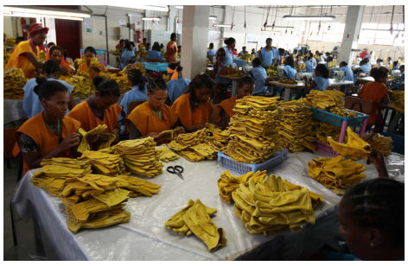
Small Scale Industries
Small scale industries play an important role for the development of Indian economy in many ways.
Many of the big businesses today were all started small and then nurtured into big businesses.

Slide 43
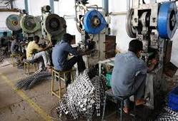
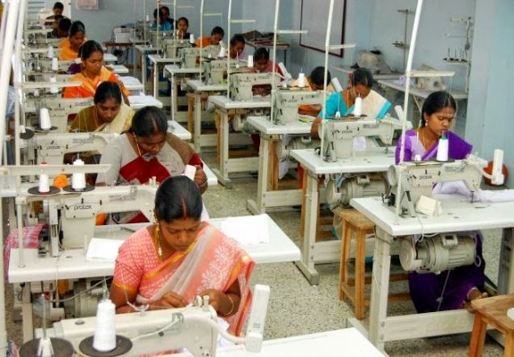
SMALL SCALE INDUSTRIES

Slide 44
Role of SSIs in Economic Development
Provide Employment
Bring Balanced Regional Development
Help in Mobilization of Local Resources
Pave for Optimisation of Capital
Promote Exports
Complement Large Scale Industries
Meet Consumer Demands
Develop Entrepreneurship

Slide 45
Provide Employment
SSIs use labour intensive techniques. Hence, they provide employment opportunities to a large number of people.
SSIs provide employment to artisans, technically qualified persons and professionals, people engaged in traditional arts, people in villages and unorganized sectors.
The employment-capital ratio is high for the SSIs.

Slide 46
Bring Balanced Regional Development
SSIs promote decentralized development of industries as most of the SSIs are set up in backward and rural areas.
They remove regional disparities by industrializing rural and backward areas and bring balanced regional development.
They help to reduce the problems of congestion, slums, sanitation and pollution in cities. They are mostly found in outside city limits.
They help in improving the standard of living of people residing in suburban and rural areas in India.
The entrepreneurial talent is tapped in different regions and the income is also distributed instead of being concentrated in the hands of a few individuals or business families.

Slide 47
Help in Mobilization of Local Resources
SSIs help to mobilize and utilize local resources like small savings, entrepreneurial talent etc
They pave way for promoting traditional family skills and handicrafts. There is a great demand for handicraft goods in developed countries.
They help to improve the growth of local entrepreneurs and self employed professionals in small towns and villages in India.

Slide 48
Pave for Optimisation of Capital
SSIs require less capital per unit of output. They provide quick return on investment due to shorter gestation period.
SSIs function as a stabilizing force by providing high output-capital ratio as well as high employment capital ratio.
They encourage the people living in rural areas and small towns to mobilize savings and channelize them into industrial activities.

Slide 49
Promote Exports
SSIs do not require sophisticated machinery.
So import of machines from abroad is not necessary.
There is a great demand for goods produced by SSIs. Thus they reduce the pressure on the country’s balance of payments.
Recent past large scale industries are able to borrow large funds with low interest rate and spend large sums on advertisements.
Hence SSSs are gradually vanishing.
SSIs earn valuable foreign exchange through exports from India.

Slide 50
Complement Large Scale Industries
SSIs play a complementary role to large scale sector and support the large scale industries.
SSIs provide parts, components, accessories to large scale industries and meet the requirements of large scale industries through setting up units near the large scale units.
SSIs serve as ancillaries to large scale units.

Slide 51
Meet Consumer Demands
SSIs produce wide range of products required by consumers in India.
Hence, they serves as an antiinflationary force by providing goods of daily use.

Slide 52
Develop Entrepreneurship
SSIs help to develop a class of entrepreneurs in the society. They help the job seekers to become job givers.
They promote self-employment and spirit of self-reliance in the society.
SSIs help to increase the per capita income of India in various ways.
They facilitate development of backward areas and weaker sections of the society.
SSIs are adept in distributing national income in more efficient and equitable manner among the various participants of the society.

Slide 53
Micro, Small and Medium Enterprises (MSMEs)
Manufacturing Enterprises | Service Enterprises
Micro Manufacturing Enterprises: The investment in plant and machinery does not exceed Rs.25 lakhs. | Micro Service Enterprises: The investment in equipment does not exceed ₹.10 lakhs.
Small Manufacturing Enterprises: The investment in plant and machinery is more than twenty five lakh rupees but does not exceed Rs.5 crores. | Small Service Industries: The investment in equipment is more than ₹.10 lakhs but does not exceed ₹.2 crores.
Medium Manufacturing Enterprises: The investment in plant and machinery is more than Rs.5 crores but not exceeding Rs.10 crores. | Medium Service Enterprises: The investment in equipment is more than ₹.2 crores but does not exceed ₹.5 crores.

Slide 54
Public Sector
and
Private sector banks

Slide 55
Public Sector Banks
Public sector bank is a bank in which the government holds a major portion of the shares.
SBI is public sector bank, the government holding in this bank is 58.60%.
PNB is a public sector bank, the government holds a stake of 58.87%.
Usually, in public sector banks, government holdings are more than 50 percent.
Public sector banks are classified into two categories:
Nationalised Banks
State Bank and its Associates.
In case of nationalized banks, the government controls and regulates the functioning of the banking entity.
Some examples are SBI, PNB, BOB, OBC, Allahabad Bank etc.
The government keeps reducing the stake in PSU banks as and when they sell shares.
To that extent they can also become minority shareholders in these banks.
This is in accordance with the privatization policy.

Slide 57
Private Sector Banks
In these banks, most of the equity is owned by private bodies, corporations, institutions or individuals rather than government.
These banks are managed and controlled by private promoters.
Of the total banking industry in India, public sector banks constitute 72.9% share while the rest is covered by private players.
There are 27 public sector banks and 22 private sector banks.
RBI, the apex banking body, has given license to Payments Bank and Small Finance Banks (SFBs).
This is an attempt to boost the government’s Financial Inclusion drive.
As a result, Airtel Payments Bank and Paytm Payments Bank Limited have come up.

Slide 59
Nationalisation of Banks
After Independence, the Government of India adopted planned economic development.
Five Year Plans came into existence since 1951. The main objective of the economic planning aimed at social welfare.
Before Independence commercial banks were in the private sector.
These commercial banks failed in helping the Government to achieve social objectives of planning.
So the government decided to nationalize 14 major commercial banks on 19 July 1969.
In 1980, again the government took over another 6 commercial banks.

Slide 60
Objectives of Nationalization
The Government of India nationalized the commercial banks to achieve the following objectives.
The main objective of nationalization was to attain social welfare.
Sectors such as agriculture, small and village industries were in need of funds for their expansion and further economic development.
Nationalisation of banks helped to curb private monopolies in order to ensure a smooth supply of credit to socially desirable sections.
In India, nearly 70% of population lived in rural areas. Therefore it was needed to encourage the banking habit among the rural population.

Slide 61
To reduce the regional imbalances where the banking facilities were not available.
Before Independence, the numbers of banks were certainly inadequate. After nationalization, new bank branches were opened in both rural and urban areas.
Banks created credit facilities mainly to the agriculture sector and its allied activities after nationalization.
After New Economic Policy 1991, the Indian banking industry has been facingthe new horizons of competitions, efficiency and productivity.
With all these developments people in villages and slums depend largely on local money lenders for their credit need.

Slide 62
Performance of India’s Five Year Plans
Economic planning is the process in which the limited natural resources are used skillfully so as to achieve the desired goals.
The concept of economic planning in India or five year plan is derived from Russia (then USSR).
India has launched 12 five year plans so far.
Twelfth five year plan will be the last one.
The government of India has decided to stop the launching of five year plans and it was replaced by NITI Aayog.

Slide 63
First Five Year Plan (1951-1956)
It was based on the Harrod - Domar Model.
Its main focus was on the agricultural development of the country.
This plan was successful and achieved the GDP growth rate of 3.6% (more than its target)

Slide 64
Second Five Year Plan (1956-1961)
It was based on the P.C. Mahalanobis Model.
Its main focus was on the industrial development of the country.
This plan was successful and achieved the growth rate of 4.1%

Slide 65
Third Five Year Plan (1961-1966)
This plan was called ‘Gadgil Yojana’ also.
The main target of this plan was to make the economy independent and to reach self prpalled position or take off.
Due to Indo - China war, this plan could not achieve its growth target of 5.6%

Slide 66
Plan Holiday (1966 - 1969)
The main reason behind the plan holiday was the Indo - Pakistan war & failure of third plan.
During this plan, annual plans were made and equal priority was given to agriculture, its allied sectors and the industry sector.

Slide 67
Fourth Five Year Plan (1969-1974)
There are two main objectives of this plan i.e. growth with stability and progressive achievement of self reliance.
This plan failed and could achieve growth rate of 3.3% only, against the target of 5.7%.

Slide 68
Fifth Five Year Plan (1974-1979)
In this plan top priority was given to agriculture, next came industry and mines.
Overall this plan was successful, which achieved the growth rate of 4.8% against the target of 4.4%.
The draft of this plan was prepared and launched by D.P. Dhar. This plan was terminated in 1978.
D.P.DHAR

Slide 69
Rolling Plan
This plan was started with an annual plan for 1978-79 and as a continuation of the terminated fifth year plan.

Slide 70
Sixth Five Year Plan (1980-1985)
The basic objective of this plan was poverty eradication and technological self reliance. Garibi-Hatao was the motto.
It was based on investment yojana.
Its growth target was 5.2% but it achieved 5.7%.

Slide 71
Seventh Five Year Plan (1985-1990)
Objectives of this plan included the establishment of the self sufficient economy and opportunities for productive employment.
For the first time, due to the pressure from private sector the private sector got the priority over public sector.
Its growth target was 5.0% but it achieved 6.0%.

Slide 72
Annual Plans
Eighth five year Plan could not take place due to volatile political situation at the centre.
So two annual programmes are formed in 1990-91& 1991-92.

Slide 73
Eighth Five Year Plan (1992-1997)
In this plan the top priority was given to development of the human resources i.e. employment, education and public health.
During this plan, New Economic Policy of India was introduced.
This plan was successful and got annual growth rate of 6.8% against the target of 5.6%.

Slide 74
Ninth Five Year Plan (1997-2002)
The main focus of this plan was “growth with justice and equity”.
This plan failed to achieve the growth target of 7% and Indian economy grew only at the rate of 5.6%.

Slide 75
Tenth Five Year Plan (2002-2007)
This plan aimed to double the per capita income of India in the next 10 years.
It aimed to reduce the poverty ratio to 15% by 2012.
Its growth target was 8.0% but it achieved only 7.2%.

Slide 76
Eleventh Five Year Plan (2007-2012)
Its main theme was “faster and more inclusive growth”.
Its growth rate target was 8.1% but it achieved only 7.9%

Slide 77
Twelfth Five Year Plan (2012-2017)
Its main theme is “Faster, More Inclusive and Sustainable Growth”.
Its growth rate target is 8%.
These plans had guided the Government as to how it should utilise scarce resources so that maximum benefits can be gained.
It is worthy to mention here that Indian Government adopted the concept of five year plans from Russia.

Slide 78
The Planning Commission has been replaced by the NITI Aayog on 1st January, 2015. NITI (National Institution for Transforming India) Aayog will monitor, coordinate and ensure implementation of the accepted sustainable development goals.
NITI Aayog serves as a knowledge hub and monitors progress in the implementation of policies and programmes of the Government of India.
It includes the matters of national and international importance on the economic front, dissemination of best practices from within the country and from other nations, the infusion of new policy ideas and specific issue-based support.
In order to understand the achievements of the NITI Aayog, researches need to be done then and there.

Slide 79
Development Indicators
Human Development
Index
(HDI)
Physical Quality of Life
Index
(PQLI)

Slide 80
Human Development Index (HDI)
HDI was developed by the Pakistani Economist Mahbub ul Haq and the Indian Economist Amartya Kumar Sen in 1990 and was published by the United Nations Development Programme (UNDP). It is constructed based on Life Expectancy Index, Education Index and GDP Per Capita.

Slide 82
HDI is based on the following three indicators
Longevity is measured by life expectancy at birth.
Educational attainments.
Standard of living, measured by real GDP per capita (PPP$).
Top three countries of HDI
Norway (0.949)
Australia (0.939)
Switzerland (0.939)

Slide 83
Before calculating HDI, the fixed minimum and maximum values of each indicator are chosen.
The performance in each dimension is expressed as a value between 0 and 1 by applying the following formula
Dimension Index = (Actual value – Minimum value) / (Maximum value - Minimum value)
According to Planning Commission’s National Human Development Report 2011, HDI has improved significantly between 1980 and 2011.
As per latest Human Development Report (2016) by the United Nations Development Programme (UNDP), India has been ranked 131st out of 188 countries.
Out of 188 countries, India lies in Medium Human Development bracket.
The other nations such as Bangladesh, Bhutan, Pakistan, Kenya, Myanmar and Nepal attained the medium human development.
The HDR 2016 stated that regional disparities in education, health and living standards within India has caused India’s downfall to 27 % on HDI score.
Biswajeet Guha has stated that the calculation of HDI neglected many important aspects of human development.
He has created four indices of HDI as HDI1, HDI2, HDI3, and HDI4. HDI1 is based on UNDP methodology as given in Human Development Report.
Various countries including India are continuously making efforts to improve and enlarge the scope of available statistical information.

Slide 84
Physical Quality of Life Index (PQLI)
Morris D Morris developed the Physical Quality of Life Index (PQLI).
The PQLI is a measure to calculate the quality of life
He included three indicators such as life expectancy, infant mortality rate and literacy rate.
A scale of each indicator ranges from the number 1 to 100.
Number 1 represents the worst performance by any country. 100 is the best performance.
For example, in case of life expectancy, the upper limit of 100. This was assigned to 77 years which was achieved by Sweden in 1973.
The lower limit of 1 was assigned to 28 years which was achieved by Guinea-Bissau in 1960.
The main difference between the two is the inclusion of income in HDI and exclusion of income from PQLI. HDI represents both physical and financial attributes of development and PQLI has only the physical aspects of life.

Slide 85
HDI | PQLI
Human Development Index (HDI) | Physical Quality of Life Index (PQLI)
It is a composite statistic of life expectancy | It is a measure to calculate the quality of life. (well being of a country)
It includes income | It excludes income
It represents both physical and financial attributes of development. | It has only the physical aspects of life.
Difference
Between
HDI and PQLI

Slide 86
Conclusion
The British were more focused on the money from Indians than good governance.
Some positive things happened during British Rule.
They eradicated systems like ‘sati’, introduced railway services, English language and education, infrastructure and basic principle of capitalist economy.
After Independence, the Government of India formulated many policies with the help of Five year plans to achieve the growth target.
Among the other things, the major challenges that still continue are: poor health standard, female foeticide, declining child sex ratio, open defecation, social & economic inequalities, increasing slumming, urban congestion and declining qualities of basic environmental resources namely air, land and water.

