Slide 1
ALPHA MATRIC HR.SEC.SCHOOL
www.Padasalai.Net
PUDUCHERRY

Slide 2
LESSON .10

Slide 3
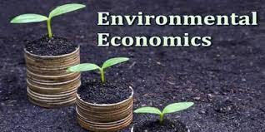

Slide 4
Meaning
Environmental Economics is an area of economics that studies the financial impact of environmental policies. Environmental economists perform studies to determine the theoretical or empirical effects of environmental policies on the Economy

Slide 5
DEFINITION
“Environmental problems are really social problems. They begin with the people as the cause and end with people as victims”.
SIR EDMUND HILLARY

Slide 6
LEARNING OBJECTIVES
To understand the link between economy and environment
To describe the various types of environmental pollution and their effects ; and
To understand the importance of sustainable development.

Slide 7
INTRODUCTION
Environmental Economics is the study of interactions between human economic activity and the natural environment.
Environmental Economics is the subset of economics that is concerned with the efficient allocation of environmental resources.
The key objective of EE is to identify those particular tools or policy alternative that will move the market towards the most efficient allocation of natural resources.

Slide 8
MEANING OF ENVIRONMENT
The term environment has been derived from a French word “Environia” means to surround
Environment means “all the conditions circumstances and influences surrounding and affecting the development of an organism or group of organism”
It also means that the complex of physical, chemical and biotic factors that act upon an organism or an ecological community ultimately determine its form and survival.

Slide 9
MEANING OF ENIVIRONMENTAL ECONOMICS.
Environmental Economics is an area of economics that studies the financial impact of environmental issues and policies.
E.E involves theoretical and empirical studies of the economic effects of national or local environmental policies around the world.

Slide 10
ECO SYSTEM
An Eco System includes all living things (plants, animals and organisms) in a given area, interacting with each other and also with their non living environments (weather, earth, sun, soil, climate, atmosphere)
Eco systems are the foundations of the Biosphere and they determine the health of the entire earth system.

Slide 11
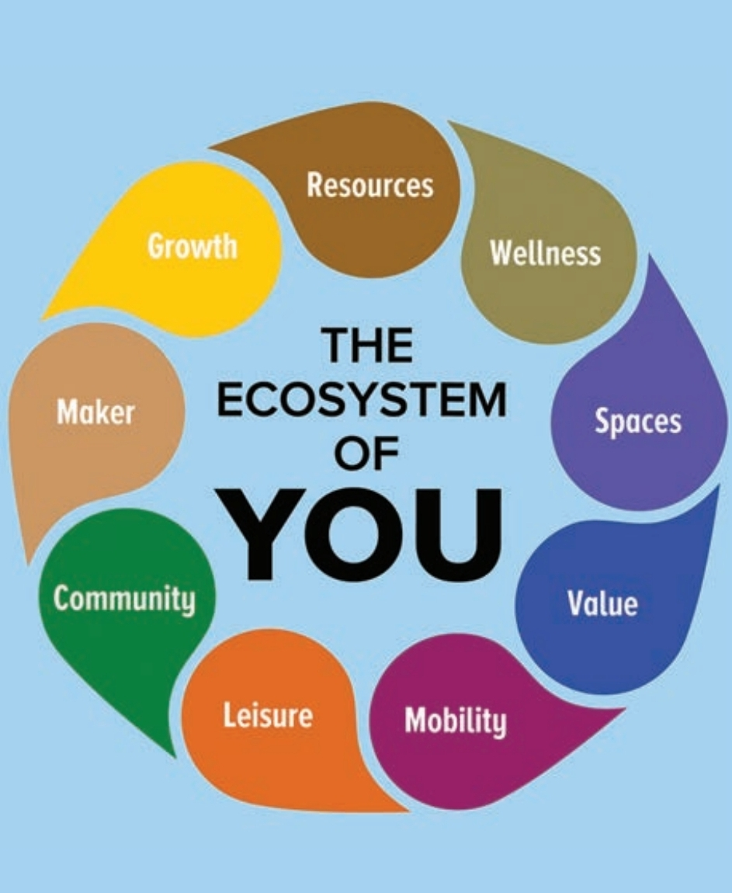

Slide 12
LINKAGE BETWEEN ECONOMY AND ENVIRONMENT
Man’s life is interconnected with various other living and non living things.
The life also depends on social, political, ethical, philosophical and other aspects of economic system.
The life of human beings is shaped by his living environment.
The relationship between the economy and environment is generally explained in the form of a “Material Balance Model” developed by Alen Kneese and R.V. Ayres.

Slide 13
EXPLANATION
Law of Conservation of matter and Energy, emphasizes that in any production system “What goes in must come out”.
This is known as Material Balance Approach or Material Balance Principle.
The diagram implies that mass inputs must equal mass outputs for every process.
All resources extracted from the environment eventually become unwanted wastes and pollutants.
Material and energy are drawn from environment used for production and consumption activities and returned back to the environment as wastes.

Slide 14
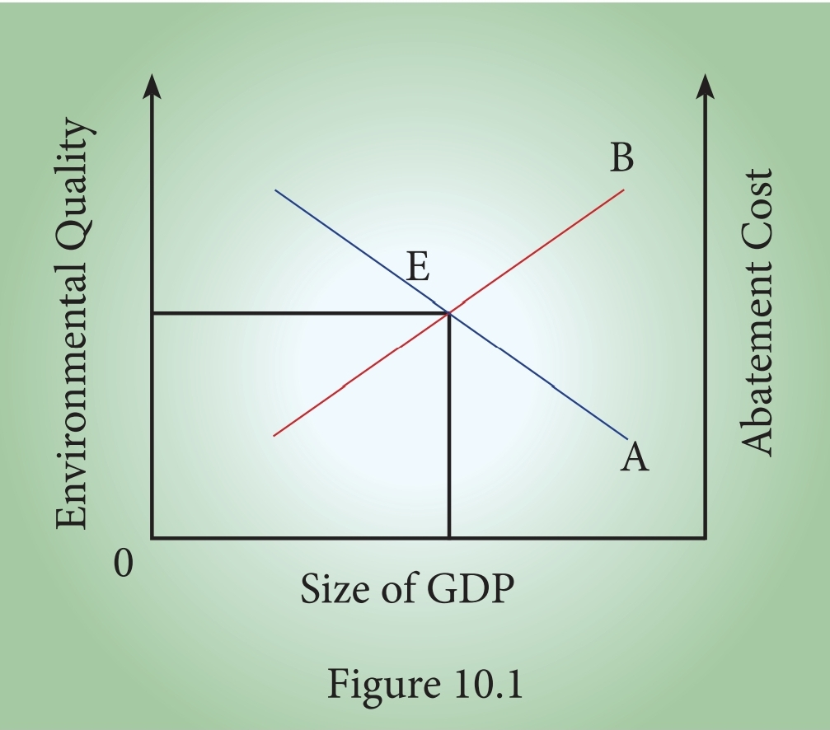

Slide 15
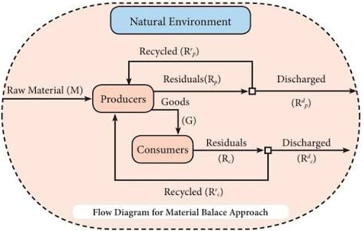
MATERIAL BALANCE MODEL
Flow Diagram for Material Balance Approach

Slide 16
EQUATION FORM OF MATERIAL BALANCE MODEL
p
p

Slide 18
EXPLANATION
Environment is the supplier of all forms of resources like renewable & non renewable.
Household and firms are connected to environment and they are interconnected.
Household and firms depend on nature for resources.
Both household and firms send out residuals of consumption and production respectively to nature.
Nature has the power to assimilate all forms of waste. But the power is conditional
There is a limit for everything.
The earth has reached the saturation point and it is unable to cleanup several forms of waste.
Remember the earth can also non co-operate.

Slide 19
ENVIRONMENTAL GOODS
Typically non market goods including clear air, clean water, landscape, green transport infrastructure (footpaths, cycle ways, greenways etc., ) public parks, urban parks, rivers, mountains, forests and beaches.

Slide 20
ENVIRONMENTAL QUALITY
It is a set of properties and characteristics of the environment either generalized or local as they impinge on human beings and other organisms.
Environmental quality has been continuously declining due to Capitalistic mode of functioning.
Environment is a pure public good that can be consumed simultaneously by everyone and from which no one can be excluded.
Pure public goods pose a free rider problem.
Resources are depleted.
Contribution of nature to GDP as well as depletion of natural resources are not accounted in the present system of National Income enumeration.

Slide 21
EXTERNALITIES MEANING
Externalities refer to external effects or spill over effects resulting from the act of production or consumption on the third parties. It arises due to interdependence between economic units.

Slide 22
DEFINITION
“the cost or benefit imposed by the consumption and production activities of the individuals on the rest of the society not directly involved in these activity and towards which no payment is made.”
Beneficial externalities are called ‘positive externalities’ and adverse ones are called ‘negative externalities’

Slide 23
EXTERNALITIES AND THE ENVIRONMENT
INTRODUCTION
In EE, one of the most important market failure is caused by negative externalities arising from production and consumption of goods and services.
Externalities are third party effects arising from production and consumption of goods and services.
Externalities occur outside the market.

Slide 24
CLASSIFICATION OF EXTERNALITIES

Slide 25
CLASSIFICATION OF EXTERNALITIES
Positive consumption Externality.
Negative consumption Externality.
Positive production Externality
Negative production Externality.

Slide 26
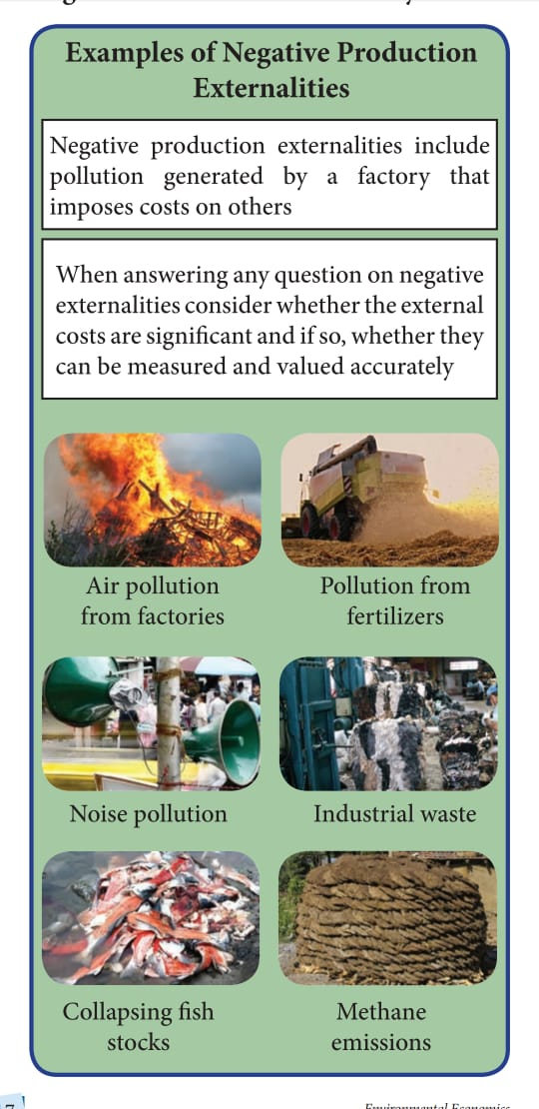

Slide 27
POLLUTION - MEANING
Pollution is the introduction of contaminants into the natural environment that causes adverse change, in the form of killing of life, toxicity of environment, damage to ecosystem and aesthetics of our surroundings.

Slide 28
TYPES OF POLLUTION
Air Pollution.
Water Pollution.
Noise Pollution.
Land Pollution .

Slide 29
AIR POLLUTION DEFENITION
“Air Pollution is the presence of any solid, liquid or gaseous substance in the atmosphere in such concentration as may be or tend to be injurious to human beings or other living creatures or plants or property or environment”.

Slide 30
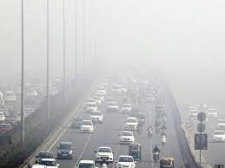
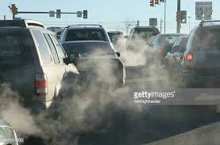
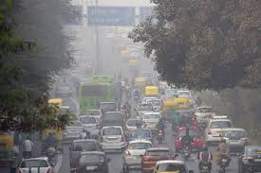
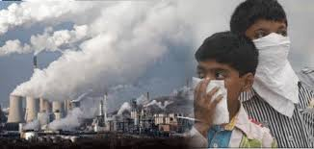
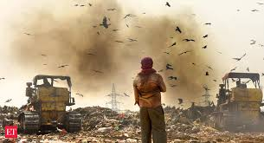
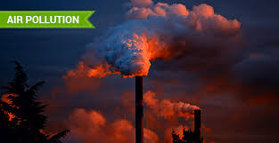
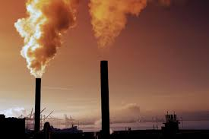
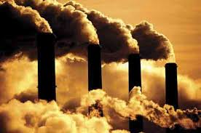
AIR POLLUTION IMAGES

Slide 31
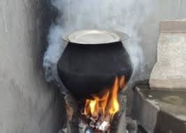
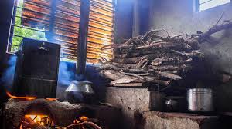
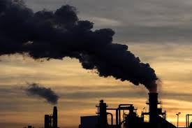
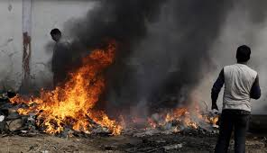
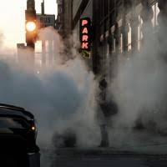
TYPES OF AIR POLLUTION
INDOOR AIR POLLUTION
OUT DOOR AIR POLLUTION.

Slide 32
Causes of Air Pollution
Vehicles exhaust smoke.
Fossil fuel based power plants
Exhaust from industrial plants and factories.
Construction and Agricultural activities.
Natural causes
Household activities.

Slide 33
Effects of Air Pollution
Respiratory and heart problem
Global warming
Acid Rain
Eutrophication
Effect on wildlife
Depletion of ozone layer
Human Health

Slide 34
NOTE
Every day about 93% of the world’s Children under the age of 15 breath polluted air that puts their health and development at serious risks - WHO

Slide 35
Remedial measures to control Air Pollution
Setting up of industries away from the towns and cities.
Increasing the length of chimney’s in the industries.
Growing more plants and trees.
Use of non conventional fuels like Biogas, CNG, and LPG.
Use of Mass Transit system (Public transport)

Slide 36
WATER POLLUTION DEFINITION
The introduction (directly or indirectly) of substances or energy into the marine environment (including estuaries) results in deleterious effects to living resources, hazards to human health, hindrance to marine activities”

Slide 37
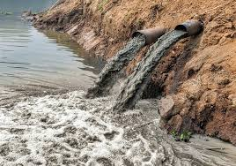
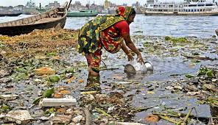

Slide 38
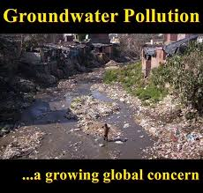
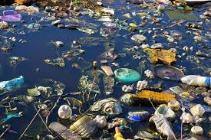
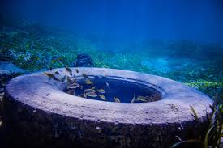
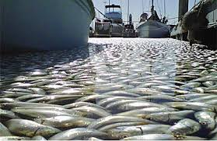
TYPES OF WATER POLLUTION
Surface water pollution
Groundwater pollution
Microbiological pollution
Oxygen depletion pollution.
Surface water pollution
Microbiological pollution
Oxygen depletion pollution.

Slide 39
Causes of Water pollution
Discharge of Sewage and Waste Water.
Dumping of Solid Wastes.
Discharge of industrial waste.
Oil Spill
Acid Rain
Global Warming
Eutrophication

Slide 40
Effects of Water pollution
Death of aquatic animals
Disruption of food chains
Diseases
Destruction of Ecosystem

Slide 41
Remedial measures to Control Water Pollution
Comprehensive Water management plan
Construction of proper storm drains and settling ponds.
Maintenance of drain line
Effluent and sewage treatment plant.
Regular monitoring of water and waste water
Severe actions towards illegal dumping of waste into the water bodies.

Slide 42
NOISE POLLUTION DEFINITION
“Noise Pollution is unwanted or excessive sound that can have deleterious effects on human health and environmental quality. Noise pollution is commonly generated by many factories. It also comes from highways, railway and airplane traffic and from outdoor construction activities”

Slide 43
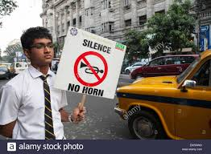
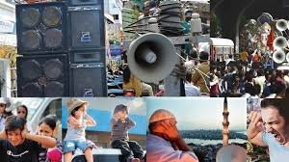
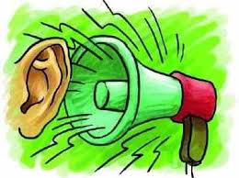
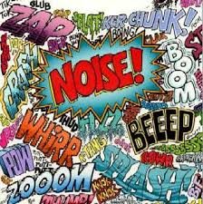

Slide 44
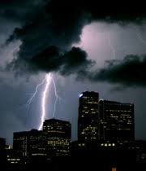
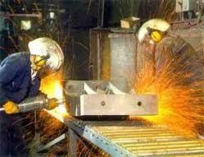
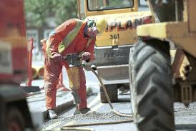
TYPES OF NOISE POLLUTION
Atmospheric Noise
Industrial Noise
Man Made Noise
Atmospheric Noise
Industrial Noise
Man Made Noise

Slide 45
Causes of Noise Pollution
Poor Urban planning
Sounds from motor vehicles
Crackers
Factory machinery

Slide 46
Effects of Noise Pollution
Hearing Loss
Damage health
Cardio Vascular effects
Effect on animals and aquatic life
Effects on wildlife and aquatic animals.

Slide 47
Noise Pollution – Remedial Measures
Use of noise barriers
Newer roadway for surface transport
Traffic control
Regulating time for heavy vehicles
Installations of noise barriers in the work place.
Regulating of Loudspeakers.

Slide 48
LAND POLLUTION DEFINITION
The Land pollution is defined as “the degradation of land because of the disposal of waste on the land”. Any substance that is discharged, emitted or deposited in the environment in such a way that it alters the environment causes land pollution.

Slide 49
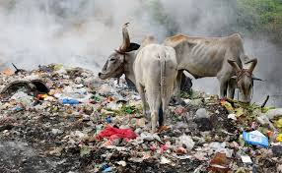
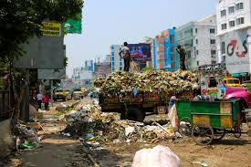
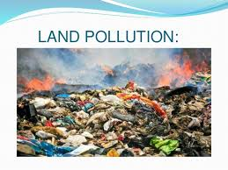
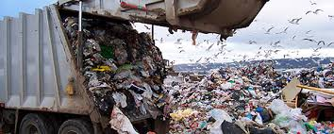
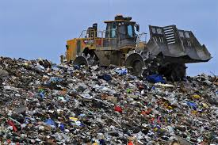

Slide 50
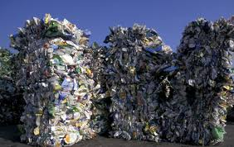
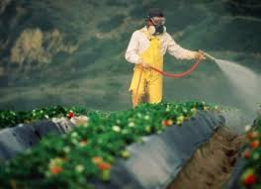
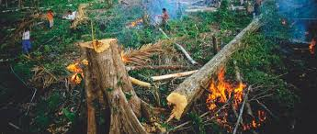
TYPES OF LAND POLLUTION
Solid Waste
Pesticides and Fertilizers
Deforestation
Solid Waste
Pesticides and Fertilizers
Deforestation

Slide 51
Causes of Land Pollution
Deforestation and Soil erosion
Agricultural activities
Mining Activities
Landfills
Industrialization
Construction Activities
Nuclear Waste

Slide 52
Effects of Land Pollution
Soil Pollution
Health Impact
Causes for Air Pollution
Effect on wildlife

Slide 53
Remedial measures to control Land Pollution
Making people aware about the concept of a Reduce, Recycle and Reuse (3R).
Reduce - Reduce the amount of materials and goods you consume.
Recycle – Using trash to make new goods, that can be sold again.
Reuse – Finding a new way to use trash so that we don’t have
to throw it out.
Buying biodegradable products.
Minimizing the usage of pesticides.
Shifting cultivation.
Disposing unwanted garbage properly either by burning or by burying under the soil.
Minimizing the usage of plastics.

Slide 54
GLOBAL WARMING
It is the current increase in temperature of the Earth’s surface as well as its atmosphere. Average temperature around the world have risen by 0.75° since 1975.
Gases like carbon dioxide, methane, Chlorofluro carbon, nitrous oxide are the green house gases warming the earth’s surface.
CO₂ Contributes 50%.
Adversely affects – agriculture, horticulture and eco system.
Reduced rainfall higher temperature and increased pest growth hamper farming.
Threats to health - malaria, dengue, fever, encephalitis and yellow fever.
Increase in temperature will bring about alarming changes in rainfall patterns and climatic conditions.

Slide 55
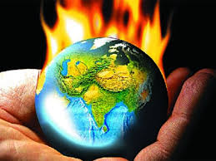
GLOBAL WARMING

Slide 56
CLIMATE CHANGE
It refers to seasonal changes over a long period with respect to the growing accumulation of green house gases in the atmosphere.
Industrial revolution led to increase in CO₂ in the atmosphere
Increased from 280 parts per million to 402 parts per million in 2016 led to global warming.
Several parts of the world experiencing
1. Warming of coastal waters.
2. High Temperature
3. Change in rainfall pattern
4. Increased intensity of storms
5. Rise in Sea level and temperature

Slide 57
ACID RAIN
One of the consequences of air pollution.
It occurs when emissions from factories, cars or heating boilers contact with water in the atmosphere.
Emissions contain nitrogen oxides, sulphur dioxide and sulphur trioxide.
Mixing with water it becomes sulfurous acid, nitric acid and sulfuric acid.
Through nature volcanic eruptions.
Harmful effects on plants, aquatic animals and infrastructure.

Slide 58
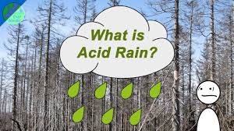
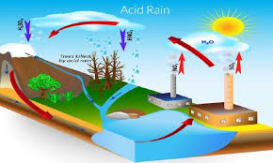

Slide 59
e-Wastes
Electronic waste – “e waste” new byproduct of the Info Tech Society.
Physical waste – Old discarded life of electronics
Broad range of electronic devices from refrigerators, air conditioners, cellular phones, computers and other electronic goods.
E-Waste can be defined as the result when consumes, business and household devices are disposed or sent for re-cycling.
Examples – T.V. Computers, audio equipments, VCR, DVD, telephone, Video games etc.,

Slide 60
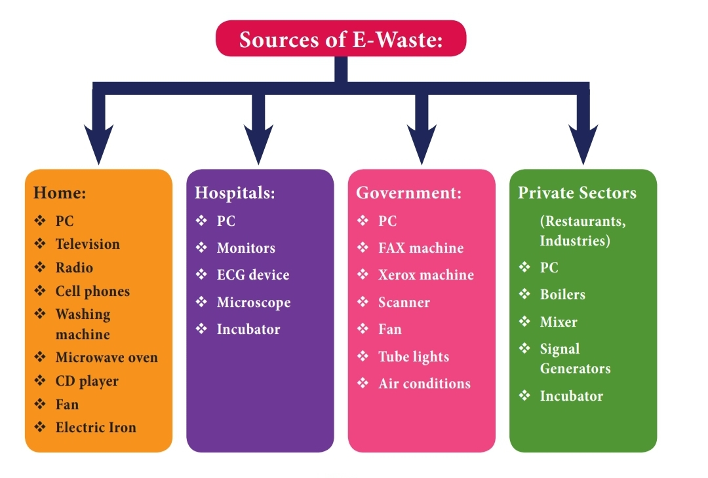

Slide 61
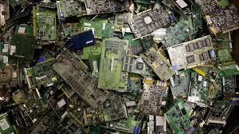
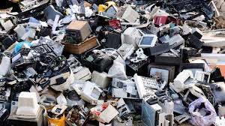
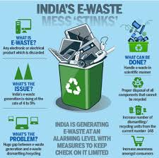
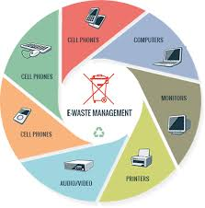

Slide 62
Solid Waste
It is the discharge of useless and unwanted materials as a result of human activity.
They are composed of solids, semisolids or liquids.
Consists of the discards of the household, hospital refuse, dead animals, agriculture waste, industrial waste etc.,
Cause public health hazard if wastes, are not removed from the street.

Slide 63
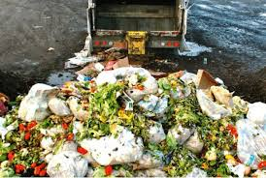
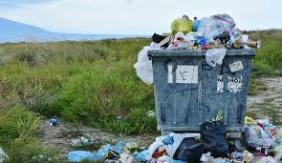
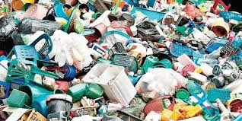

Slide 64
SUSTAINABLE DEVELOPMENT
Meaning
It is concerned with the welfare of not only present generation but also future generation.
Aims at
1. luxury wants of the upper class
2. The necessities of the poor too.
The present generation should not exhaust the resources left by the past generation but should leave the same for the sake of future generation.
This is called inter generational equity.
Definitions
“Sustainable development is development that meets the needs of the present without compromising the ability of future generations to meet their own needs

Slide 65
SUSTAINABLE DEVELOPMENT GOALS
It is crucial to harmonize three core elements such as
Economic Growth
Social Inclusion
Environmental protection.
A set of 17 goals for the world’s future can be achieved before 2030 with 3 unanimous principles fixed by U.N such as universality, Integration and transformation.

Slide 66
End Poverty in all its forms everywhere
End hunger, achieve food security and improved nutrition and promote sustainable agriculture
Ensure healthy lives and promote well-being for all at all ages
Ensure inclusive and quality education for all and promote lifelong learning
Achieve gender equality and empower women and girls
Ensure access to water and sanitation for all
Ensure access to affordable, reliable, sustainable and modern energy for all
Promote inclusive and sustainable economic growth, employment and decent work for all
Build resilient infrastructure, promote sustainable industrialization and foster innovation.
Reduce inequality within and among countries
Make cities inclusive, safe, resilient and sustainable
Ensure sustainable consumption and production pattern
Take urgent action to combat climate change and its impacts
Conserve and sustainably use the oceans, seas and marine resources
Sustainably manage forests, combat desertification, halt and reverse land degradation, halt biodiversity loss
Promote justice, peaceful and inclusive societies
Revitalize the global partnership for sustainable development

Slide 68
Green Initiatives
Number of organizations, businesses and people across the globe are striving for sustainability and more eco friendly life style.
Passionate towards protecting the earth.
Bring in change through political lobbying citizen action and consumer pressure.
Take action to promote the fragile planet.
Globe Warming – globe problem.
Developed countries to pay for the pollution control efforts.

Slide 69
FARMING
GREEN

Slide 70
ORGANIC FARMING
System of agricultural production which relies on animal manure, organic waste, crop rotation, legumes and biological pest control.
Avoids Synthetic fertilizer, pesticides and livestock additives.
Principal goal - Develop enterprises that are sustainable and harmonious with environment

Slide 72
Principles -Organic Farming
Protect the environment.
Minimize soil erosion & degradation.
Optimize biological productivity
Sound state of health
Maintain long term fertility.
Maintain biological diversity.
Recycle materials and resources to the greatest extent possible.
Provide attentive care that promotes the health.
Prepare organic products
Depend on renewable resources in locally organized agricultural system

Slide 74
TREE PLANTATION

Slide 75
TREE PLANTATION
Trees contribute to their environment by
1) Providing oxygen
2) Improving Air quality
3) Climate amelioration
4) Conserving water
5) Preserving soil and
6) Supporting wildlife
During the process of photosynthesis trees take in carbon dioxide and produce the oxygen we breathe
Trees are considered to be lungs of the earth.
Natural forests and tree plantation improve the water cycle in diminishing run off and improve the replenishment of the water table.

Slide 76
Seed Ball
It is a seed wrapped in soil materials, usually a mixture of clay and compost and then dried.
The seed is ‘pre planted’ and can be sown by depositing the seed ball anywhere suitable for the species, keeping it safely until the proper germination window arises.
It is an easy way to cultivate plants that provides a larger window of time when the sowing can occur.

Slide 77
S
A pile of seed balls
A seed ball before the storm

Slide 78
Conclusion
Environmental economics concept, Linkage between economy and environment – Material balance Model.
Types of Pollutions – Air, Water, Noise, land (Cause, effects, Remedies)
Aspects of global warming, acid rain, climate change, e-waste, Solid waste etc.,
Sustainable Development Goals, Green Initiatives.
Organic Farming, Seed ball and tree plantation.

