Slide 1
Alpha Matric Higher Secondary School
www.Padasalai.Net
PUDUCHERRY
AUDIO VISUAL SMART CLASS PROGRAM
2020

Slide 2
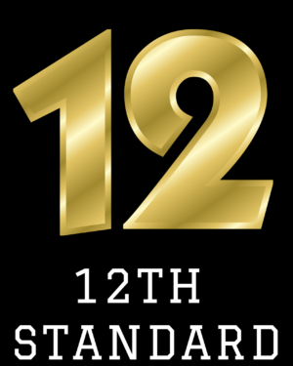
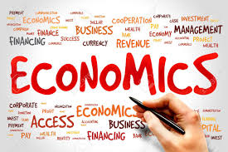

Slide 3
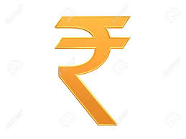
LESSON 11
LESSON 11

Slide 5
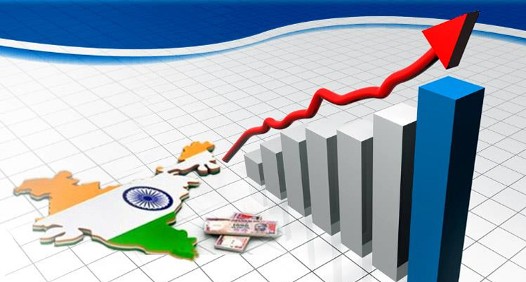
Development
Development means “improvement in country's economic and social conditions”. More specially , it refers to improvements in way of managing an area’s natural and human resources in order to create wealth and improve people’s lives.
Why do we need development ? Development is good for people to enjoy basic human welfare such as clean water, accessible to health care facilities, sewage collection and disposal. People living in a developed country usually have a longer life expectancy, than the people living in UDC.

Slide 6
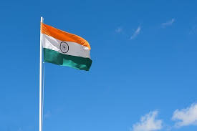
Planning
Planning is the process of thinking about the activities required to achieve a desired goal. It is the first and foremost activity to achieve desired results.
The major objectives of planning in India are 1. Economic Growth. 2. Attaining Economic Equality and Social justice. 3. Achieving full Employment. 4. Attaining economic self reliance. 5. Modernisation of various sectors. 6. Redressing imbalances in the economy

Slide 7
A good plan may fail due to faulty implementation. But a faulty plan cannot succeed through good implementation.

Slide 8
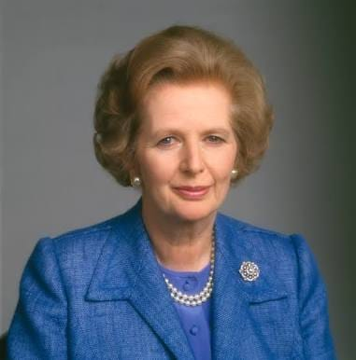
“Plan Your work for today and everyday, then work your plan”
- Margaret Thatcher
She was a states woman who served as a Prime Minister of United Kingdom from 1979 to 1990.

Slide 9
LEARNING OBJECTIVES
To understand the process, features and determinants of economic development.
To study the case for and against planning and to compare the various types of planning.
To describe the functions of NITI Aayog.

Slide 10
MEANING OF DEVELOPMENT AND UNDERDEVELOPMENT
The concept “development” refers to the structural changes towards betterment.
Until II world war, interest was rarely shown on the problems of the present day third world countries.
After II world war economist started devoting their attention towards analyzing the problems of underdeveloped countries.
The under Developed countries were once the colonies of England and other European Countries.
After becoming free, there was an awakening to march towards economic development.

Slide 11
APPROACHES TO ECONOMIC DEVELOPMENT
Traditional approach
New welfare oriented approach

Slide 12
TRADITIONAL APPROACH
It defines development strictly in economic terms.
GNP increase is accompanied by
1) Decline in agriculture and employment
2) Increase in manufacturing and service.
Emphasizes on the importance of industrialization.
Growth in GNP per capita – trickle down to people at the bottom.

Slide 13
NEW WELFARE ORIENTED APPROACH
In 1970’s economic development was redefined in terms of reduction of poverty, inequality and unemployment with in the context of growing economy.
Michael P Todaro,
“Development must, therefore, be conceived as a multidimensional process involving major changes in social structures, popular attitudes and national institutions as well as the acceleration of growth, the reduction of inequality and the eradication of absolute poverty”
Slogan – ‘Redistribution with growth

Slide 14
UNDER DEVELOPMENT
UDC’s are Characterized By
Agriculture
Low per capita income
Wide spread poverty
Inequality in distribution of income and wealth
Over population
Low rate of capital formation.
High rate of unemployment
Technological backwardness
Dualism

Slide 15
UNDERDEVELOPMENT MEANING
Underdevelopment refers to the low level of development characterized by
Low per capita income
Wide spread poverty
Lower level of literacy
Low life expectancy
Under utilization of resources.
Underdeveloped economy fails to provide acceptable levels of living to a large fraction of its population, thus resulting into misery.

Slide 16
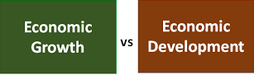

Slide 18
ECONOMIC GROWTH VS ECONOMIC DEVELOPMENT
Economic Growth
It is an increase in the capacity of an economy to produce goods and services compared from one period of time to another. It can be measured in real terms.
Economic Development
It is the growth of the standard of living of a nations people from a low income economy to a high income economy.

Slide 20
MEASUREMENT OF ECONOMIC DEVELOPMENT
It is measured on the basis of 4 Criteria.
Criteria | Description
Gross National Product | Total Market value of all goods and services produced within a nation in a particular year + income earned by its citizens – income of non residents located in that country.
GNP per capita | It relates to increase in the per capita real income of the economy over the long period. The rate of increase in real per capita income should be higher than the growth rate of population.
Welfare | Economic development is regarded as a process whereby there is an increase in the consumption of goods and service by individual. Improvement in health, literacy and standard of living.
Social Indicators | It is referred to as basic and collective needs of the people. Basic needs such as health, education, food, water, sanitation and housing facilities check social backwardness.

Slide 21
Determinants of Economic Development
Economic Development depends on following factors
Economic
Social
Political
Religious

Slide 23
ECONOMIC FACTORS
Natural Resource
Capital Formation
Size of the Market
Structural change
Financial System
Marketable surplus
Foreign Trade
Economic System

Slide 24
NON ECONOMIC FACTORS
Human Resources
Technical Know-how
Political Freedom
Social Orgnization
Corruption free administration
Desire for development
Moral, ethical and social values
Casino Capitalism
Patrimonial Capitalism

Slide 26
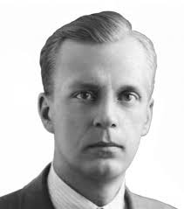
VICIOUS CIRCLE OF POVERTY
There are circular relationships known as the ‘Vicious circle of poverty’ that perpetuate the low level of development in less developed countries.
Nurkse Explains
“It implies a circular constellation of forces tending to act and react upon one another in such poverty. For example a poor man may not have enough to eat, being underfed, his health may be weak, being physically weak, his working capacity is low which means that he is poor, which in turn means that he will not have enough to eat and so on. A situation of this sort relating to a country as a whole can be poor because the country is poor”.

Slide 27
The vicious circle of poverty operates both on the demand side and the supply side.
LOW LEVEL INCOME
LOW SAVING
LOW INVESTMENT
LOW LEVEL PRODUCTIVITY
ON THE SUPPLY SIDE

Slide 28
LOW LEVEL INCOME
LOW DEMAND
LOW INVESTMENT
LOW LEVEL PRODUCTIVITY
ON THE DEMAND SIDE

Slide 29
Breaking the vicious circle of poverty
Supply Side - associated with low rate of saving and investment
UDC - rate of investment and capital formation stepped up without reduction in consumption (Marginal rate of savings is to be greater than average rate of savings)
Nurkse Suggested
“If investment is made in several industries simultaneously the workers employed in various industries will become consumers of each other’s products and will create demand for one another. The balanced growth (i.e) simultaneous investment in large number of industries creates mutual demand” Thus the vicious circle of poverty operating on the demand side of capital formation can be broken.

Slide 31
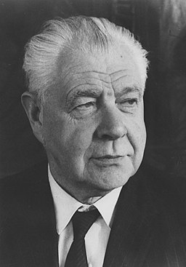
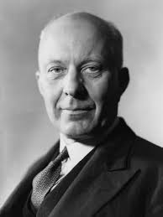
DEFINITIONS
“Economic planning is “ collective control or suppression of private activities of production and exchange”
- Robbins
“Economic planning in the widest sense is the deliberate direction by person in charge of large resources of economic activity towards chosen ends”
- Dalton

Slide 32
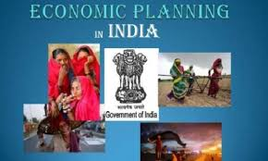
ECONOMIC PLANNING IN INDIA
The current thinking of economic planning is fairly new somewhat rooted in Marxist socialism.
In the 20th century intellectuals, theorists, thinkers from Europe put forward the idea of state involvement to stop capitalism and the inequality of society.
Soviet union adopted planning in 1928 that enabled the country to turn into an industrial superpower
After independence in 1948, a declaration of industrial policy was announced. The policy suggested the creation of a national planning commission and the elaboration of the policy of a mixed economic system.
Planning commission started in March 15, 1950 and the plan era began on April 1st 1951 (First five year plan (1951 – 56)

Slide 33
EVOLUTION OF PLANNING IN INDIA
Sl.No | Planners | Year | Description
1. | Sir M.Vishveshwaraya | 1934 | It was a 10 years plan Laid foundation through his book “Planned Economy”
2. | Jawaharlal Nehru | 1938 | Setup “National planning commission” by a committee. It did not materialize due to the changes in political era and II world war.
3. | Bombay plan | 1940 | Presented by 8 industrialist of Bombay. It was a 15 year Investment plan.
4. | S.N.Agarwal | 1944 | It is a “Gandhian Plan” Focusing on the agricultural and rural economy
5. | M.N.Roy | 1945 | It is “People’s Plan” Aimed at mechanization of agricultural production and distribution by the state only
6. | J.P Narayanan | 1950 | “Sarvodya Plan” inspired by “Gandhian Plan” gave Importance only for agriculture but encouraged small and cottage industries

Slide 34
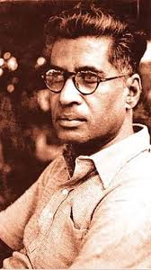
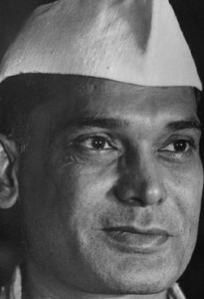
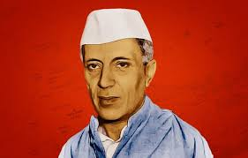
SIR.M.VISHVESWARAYA
M.N.ROY
J.P.NARAYANAN
BOMBAY PLAN
JAWAHARLAL NEHRU
GANDHIAN PLAN

Slide 35
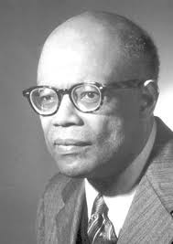
CASE OF PLANNING
The Economic Planning is justified on the following grounds.
To accelerate and strengthen market mechanism.
To remove unemployment.
To achieve balanced development.
1) Development of Agriculture and Industrial sectors.
2) Development of Infrastructure.
3) Development of Money and capital Markets.
To remove poverty and inequalities.
ARTHUR LEWIS SAYS
“Planning is more necessary in backward countries
to devise ways and means and to make concerted efforts
to raise national income”

Slide 36
CASE AGAINST PLANNING
* The prime goals of economic planning are
* Stabilzation in Developed Countries.
* Growth in Less Developed Countries.
* The arguments against planning are
* Loss of freedom.
* Elimination of Initiative.
* High cost of Management.
* Difficulty in advance calculations.

Slide 37
TYPES OF PLANNING
Democratic Vs Totalitarian
Direction Vs Inducement.
Short , Medium and Long term
Functional Vs Structural
Centralised Vs Decentralised
Indicative Vs Imperative
Financial Vs Physical
Comprehensive Vs Partial

Slide 39
Democratic Vs Totalitarian
Planning with democracy | There is a central control
People are associated in the formation and implementation | Consumption, production, exchange and distribution are all controlled by the state.
Consulted with various state Governments and private enterprises | Planning authority is the supreme body
Not accepted as such Can be accepted or modified or rejected by the parliament. | Decides about the targets, schemes, allocation and implementation of the plan

Slide 40
Centralised Vs Decentralised
Planning process is under a central planning authority | Local organizations and institutions formulate, adopt and supervise the plan
It formulates a central plan, fixes objectives, targets | No interference by the central authorities
It is also called “planning from above” | It is also called “Planning from below “

Slide 41
Direction Vs Inducement
Central authority plans, directs and orders the execution of the plan with pre-determined targets and priorities
People are induced to act in a certain way through various monetary and fiscal measures
It can give subsidy to the firm to encourage the production
Able to achieve the same result as direction planning, but with less sacrifice of individual liberty

Slide 42
Indicative Vs Imperative
It is peculiar to the mixed economies It is in practice in France since the Monnet plan of 1947 -50 Planning outline is prepared by the Govt Then discussed with the representatives of private management, trade unions, consumer groups and other experts All facilities are provided to the private sector Private sector fulfills the targets and priorities The state do not force the private sector but fix the targets | State is powerful in preparation and implementation U.S.S.R President Stalin used to say “Our plans are our instructions” No consumer sovereignty Policies and procedure are rigid China and Russia follow this

Slide 43
Short Term | Medium | Long
Also known as controlling plans Encompass the period of one year So they are also known as “Annual Plans” | Lasts for the period of 3 to 7 years Normally for 5 years only Related to the allocation of financial resources and physical resources | Lasts for the period of 10 to 30 years Also known as “Perspective Plans” Basic philosophy is to bring structural changes

Slide 44
Financial Vs Physical
Resources are allocated in terms of money | Resources are allocated in terms of men, materials and machinery

Slide 45
Functional Vs Structural
It seeks to remove economic difficulties by directing all the planning activities within the existing economic and social structure | It refers to a good deal of changes in the framework of the country Mostly adopted in underdeveloped countries.

Slide 46
Comprehensive Vs Partial
It concerns itself with the major issues for the whole economy | It considers only the few important sectors of the economy.

Slide 47
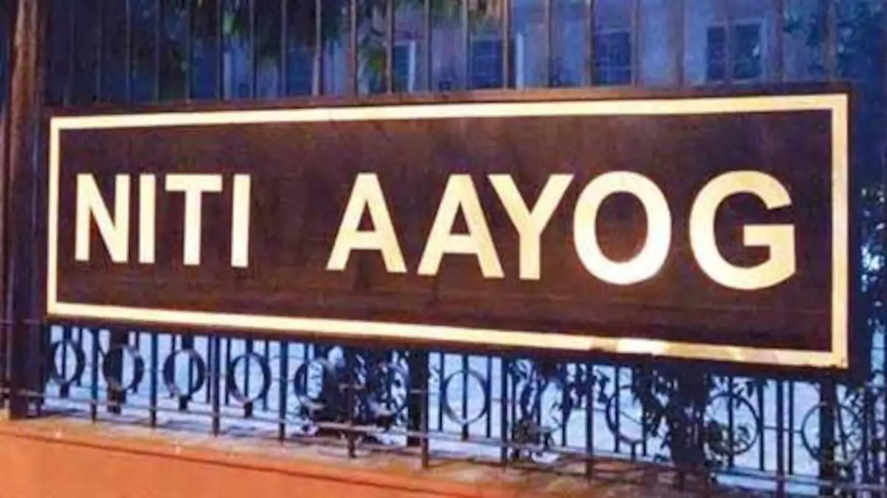

Slide 48
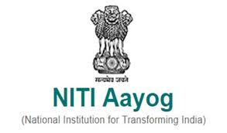
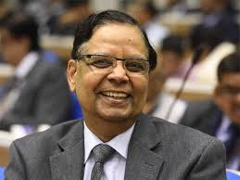
NITI Aayog (National Institution for Transforming India)
It was formed on January 1 - 2015 through a Union Cabinet resolution.
It is a policy think tank of the Government of India.
It replaced the planning commission from 13th August 2014.
The Prime Minister is the Chairperson and the Union Ministers will be Ex Officio members.
The Vice Chairman is the functional head. The Vice Chairman was Arvind Panangariya

Slide 50
Functions of NITI Aayog
Co-operative and Competitive Federalism
Shared National Agenda
Decentralized Planning.
Vision and Scenario planning
Network of Expertise
Harmonization
Conflict resolution
Coordinating interface with the world
Internal consultancy
Capacity building
Monitoring and Evaluation.

Slide 51
CONCLUSION
Concept of Developed & Underdeveloped
Concept of Development & Growth
Vicious circle of Poverty
Economic factors for development
Non Economic Factors for development
Planning – Types /For and / Against planning
NITI Aayog and its functions.

Slide 52
Prepared by.
K. Shanthi MA .MED
Vice Principal
Alpha matric higher secondary school,
Pondicherry

