Slide 1
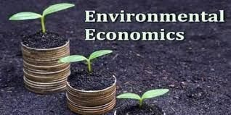
www.Padasalai.Net
“Environmental problems are really social problem….They begin with the people as the cause and with people as victims”
-Sir Edmund Hillary

Slide 2
INTRODUCTION:
Environmental Economics (EE) is the study of interactions between human economic activity and the natural environment.
EE is the subset of economics that is concerned with the efficient allocation of environmental resources.
EE takes into consideration issues such as the conservation and valuation of natural resources, pollution control, waste management and recycling.

Slide 3
MEANING OF ENVIRONMENT
❏
The term environment has been derived from a French word “Environia”means to surround
MEANING OF ENVIRONMENT ECONOMICS
It is a different branch of economics that recognizes the value of both the environment and economic activity and makes choices based on those values
Environmental Economics is an area of economics that studies the financial impact of environmental issues and policies.
Environmental Economics involves theoretical and empirical studies of the economic effects of national or local environmental policies around the world.

Slide 4
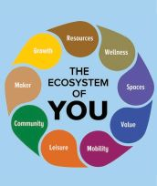
ECO SYSTEM
An ecosystem includes all living things (plants, animals and organisms) in a given area, interacting with each other,and also with their nonliving environments (weather, earth, sun, soil, climate, atmosphere).
Ecosystems are the foundations of the Biosphere and they determine the health of the entire earth system.

Slide 5
LINKAGE BETWEEN ECONOMY AND ENVIRONMENT
Man’s life is interconnected with various other living and non-living things.
The relationship between the economy and the environment is generally explained in the form of a Material Balance Model” developed by Alen Knees and R.V.Ayres.

Slide 6
❏ The interdependence of economics and environment is given below with ﬂow diagram
E
B
EalnQviuroanlimtyent
Abatement cost
A
0
Size of GDP

Slide 7
❏ The first law of thermodynamics, I.e .the law of conservation of matter and energy, emphasizes that in any production system “what goes in must come out”.
This is known as The Material Balance Approach or Material Balance Principle.
The material flow diagram implies that mass inputs must equal mass outputs for every process.
In short, material and energy are drawn from environment, used for production and consumption activities and returned back to the environment as wastes.

Slide 8
❏ In its simple form the Material Balance Approach can be put in form equation.
Natural Environment
r
Recycled (R_{p} )
Raw Material (M)
Residuals(Rp)
Discharged (R ^{d})
p
Producers
Goods (G)
Residuals (R_{c})
Consumers
Discharged (R ^{d})
p
Recycled (R^{r} )
c

Slide 9
M = G–R – R + R^{r} + R^{r} =R^{d} + R^{d}
C P P c p c
Environment is the supplier of all forms of resources like renewable and non-renewable, and it is also acting as a sink for cleaning up of wastes.
Households and firms are connected to environment, and they are interconnected too.
❏ Households and firms depend on nature for households and firms send out residuals of
resources. Both consumption and
production respectively to nature.

Slide 10
ENVIRONMENTAL GOODS
Environmental goods are typically non-market goods ,including clear air,clean water, landscape, green transport infrastructure (footpaths, cycle ways ,greenways, etc.) ,public parks ,urban parks, rivers, mountains, forests, and beaches.

Slide 11
ENVIRONMENTAL QUALITY
Environmental quality is a set of properties and characteristics of the environment either generalized or local, as they impinge on human beings and other organisms.
Environment is a pure public good that can be consumed simultaneously by everyone and from which no one can be excluded.
A pure public good is one for which consumption is non-revival and from which it is impossible to exclude a consumer.

Slide 12
EXTERNALITIES & ENVIRONMENT
INTRODUCTION
In Environmental Economics, one of the most important market failures is caused by negative externalities arising from production and consumption of goods and services.
Externalities are third party effects arising from production and consumption of goods and services for which no appropriate compensation is paid.
Externalities occur outside of the market i.e. they affect people not directly involved in the production and consumption of a good or service. They are also known as spill-overeffects .

Slide 13
MEANING
Externalities refer to external effects or spillover effects resulting from the act of production or consumption on the third parties. Externalities arise due to interdependence between economic units.

Slide 14
DEFINITION
Externality may be defined as “the cost or benefit imposed by the consumption and production activities of the individuals on the rest of the society not directly involved in these activity and towards which no payment is made”.
Beneficial externalities are called “positive externalities” and adverse ones are called “negative externalities”.

Slide 15
CLASSIFICATION OF EXTERNALITIES
Consumption
Production
Positive
Negative
Positive
Negative
Private security Public safety
Loud Speaker Noise Pollution
Beehives Pollination
Factory emission

Slide 16
NEGATIVE CONSUMPTION EXTERNALITY
POSITIVE CONSUMPTION EXTERNALITY
When some residents of a locality hire a private security agency to patrol their area, the other residents of the area also benefit from better security without bearing cost.
A person smoking cigarette gets may gives satisfaction to that person, but this act causes hardship (dissatisfaction) to the non-smokers who are driven to passive smoking.

Slide 17
POSITIVE PRODUCTION EXTERNALITY
❏ While bees make honey, they also help in the pollination of apple
blossoms. The benefits accrue to both
This is called ‘reciprocal
producers untraded
(honeyaswellasapple). interdependency .
❏ Suppose training is given for the workers in a company. If those trained workers leave the company to join some other company, the later company gets the benefit of skilled workers without incurring the cost of training.

Slide 18
NEGATIVE PRODUCTION EXTERNALITIES
❏ Negative production externalities include pollution generated by a factory that imposes on others.
❏ When answering any question on negative externalities consider whether the external cost are significant and if so, whether they can be measured and valued accurately.
❏ The emissions and effluents of a factory cause air and water pollution. Water becomes contaminated and unfit for drinking e.g. Tanneries. The innocent community bears the external cost for which it is not compensated.

Slide 19
POLLUTION
Pollution is the introduction of contaminants in to the natural environment that causes adverse change, in the form of killing of life, toxicity of environment, damage to ecosystem and aesthetics of our surrounding.

Slide 20
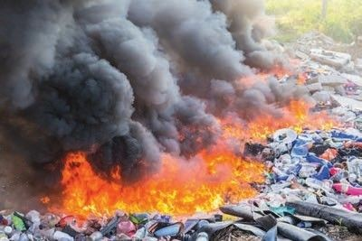


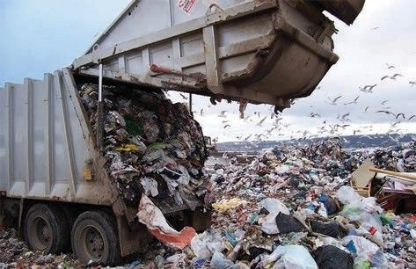
TYPES OF POLLUTION
Air Pollution
Water Pollution Noise Pollution Land Pollution

Slide 21
AIR POLLUTION
Air pollution is the presence of any solid, liquid, or gaseous substance in the atmosphere in such concentration as may be or tend to be injurious to human beings or other living creatures or plants or property or environment”.
https://youtu.be/eR-NJg99MTg
-The Air (Prevention and Control of Pollution) Act, 1981

Slide 22
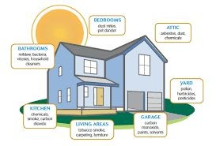
TYPES OF AIR POLLUTION
Indoor Air Pollution
It refers to toxic contaminants that we encounter in our daily lives in our homes, schools and workplaces.

Slide 23
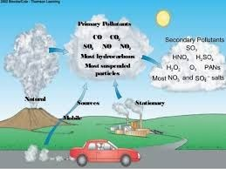
Outdoor Air Pollution
It refers to ambient air. The common sources of outdoor air pollution are caused by combustion processes from motor vehicles, solid fuel burning and industry.

Slide 24
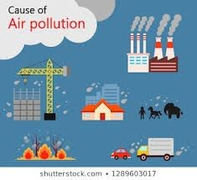
CAUSES OF AIR POLLUTION
Vehicle exhaust smoke
Fossil fuel based power plants
Exhaust from industrial plants and factories Construction and agricultural activities Natural causes
Household activities

Slide 25
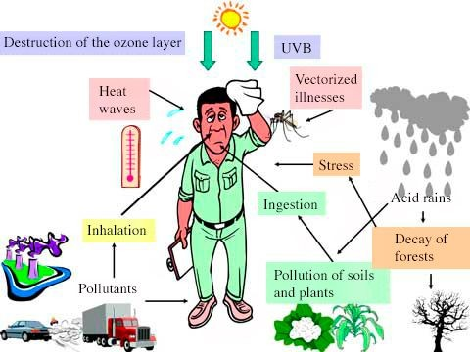
EFFECTS OF AIR POLLUTION
Respiratory and heart problems
Global warming Acid rain Eutrophication Effect on wildlife
Depletion of Ozone layer Human health

Slide 26
MEASURES TO CONTROL AIR POLLUTION
Establishment of industries away from the towns and cities
Increasing the length of the Chimneys in industries
Growing more plants and trees
Use of non-conventional fuels like Biogas,CNG and LPG.
Use of Mass Transit System (Public Transport)

Slide 27
WATER POLLUTION
The introduction (directly or indirectly) of substances or energy into the marine environment (including estuaries) results in deleterious effects to living resources, hazards to human health,hindrance to marine activities.
-United Nations,19

Slide 28
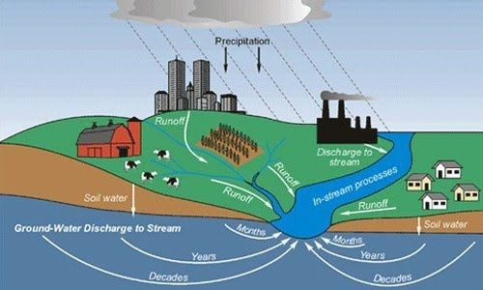
TYPES OF WATER POLLUTION
Surface water Pollution
Groundwater Pollution Microbiological Pollution Oxygen depletion Pollution

Slide 29
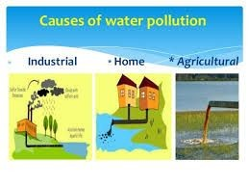
CAUSES OF WATER POLLUTION
Discharge of sewage and waste water.
Dumping of solid waste Discharge of Industrial waste Oil spill
Acid rain Global warming Eutrophication

Slide 30
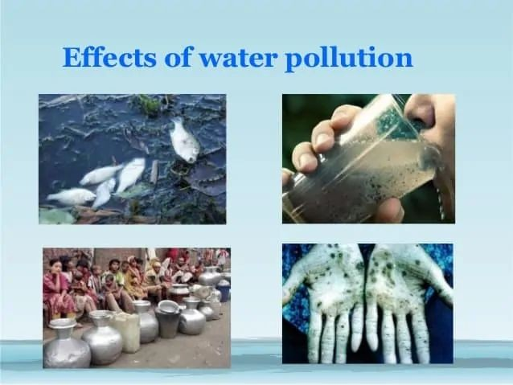
EFFECTS OF WATER POLLUTION
Death of aquatic animals
Disruption of food-chains Diseases
Destruction of Ecosystem

Slide 31
MEASURES TO CONTROL WATER POLLUTION
Comprehensive water management plan.
Construction of proper storm drains and settling ponds.
Maintenance of drainline.
Effluent and sewage treatment plant.
Regular monitoring of water and waste water.
Stringent actions towards illegal dumping of waste into the water bodies.

Slide 32

NOISE POLLUTION
Noise pollution is unwanted or
excessive sound that can
have health Noise
deleterious effects on human
and environmental quality.
pollution is commonly generated by many factories. It also comes from highway, railway and airplane traffic and from outdoor construction activities.

Slide 33
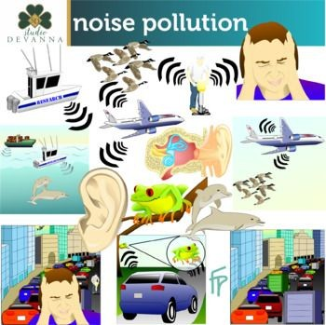
TYPES OF NOISE POLLUTION
Atmospheric Noise
Industrial Noise Man made Noise

Slide 34
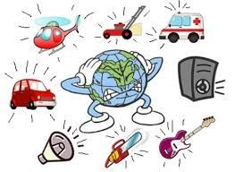
CAUSES OF NOISE POLLUTION
Poor urban Planning
Sounds from motor vehicles Crackers
Factory machinery

Slide 35
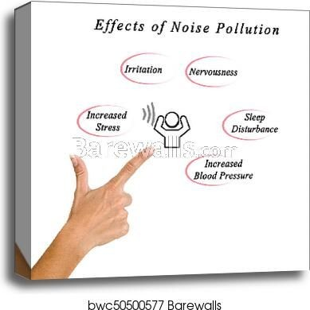
EFFECTS OF NOISE POLLUTION
Hearing loss
Damage physiological and psychological health Cardiovascular effects
Detrimental on animals and aquatic life Effects on wildlife and aquatic animals

Slide 36
MEASURES TO CONTROL NOISE POLLUTION
Use of noise barriers
Newer roadway for surface transport
Traffic control
Regulating times for heavy vehicles
Installations of noise barriers in the workplace
Regulation of Loudspeakers

Slide 37
LAND POLLUTION
The land pollution is defined as, “the degradation of land because of the disposal of waste on the land”.Any substance (solid, liquid or gaseous) that is discharged, emitted or deposited in the environment in such a way that it alters the environment causes land pollution
-Protection of the Environment Operations
Act 1997

Slide 38
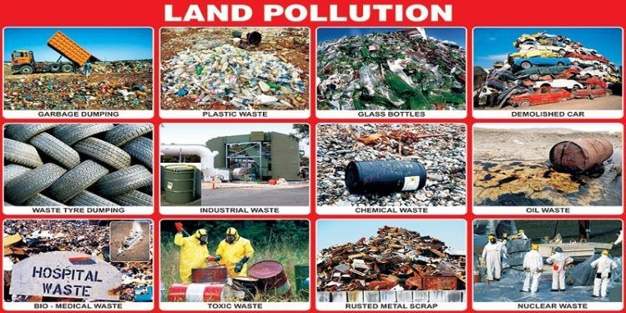
TYPES OF LAND POLLUTION
Solid waste
Pesticides and fertilizers Deforestation

Slide 39
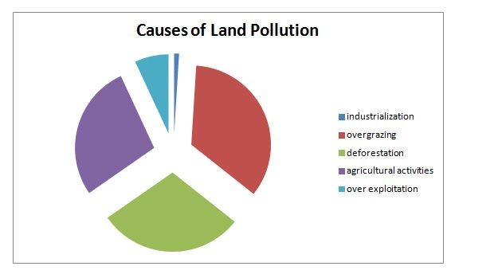
CAUSES OF LAND POLLUTION
Deforestation and soil erosion Agricultural activities
Mining activities Landfills Industrialization Construction activities

Slide 40
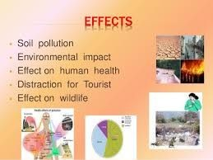
EFFECTS OF LAND POLLUTION
Soil pollution Health impact
Causes of air pollution Effect on wildlife

Slide 41
MEASURES TO CONTROL LAND POLLUTION
Reuse
Buying biodegradable products
Minimizing the usage of pesticides
Shifting cultivation
Disposing unwanted garbage either by burning or by burying under the soil.
Minimizing the usage of plastics.

Slide 42
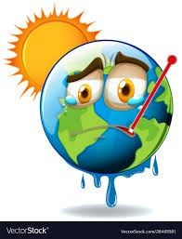
GLOBAL WARMING
Global warming is the current increase in temperature of the Earth’s surface (both land and water )
Carbon dioxide, methane, Chlorofluoro Carbon, nitrous oxides are the green house gases warming the earth’s surface.
So it is also called greenhouse effect. The CO2 is the most important of the green house gases contributing to 50% of global warming.
Global warming adversely affects agriculture, horticulture and ecosystem

Slide 43
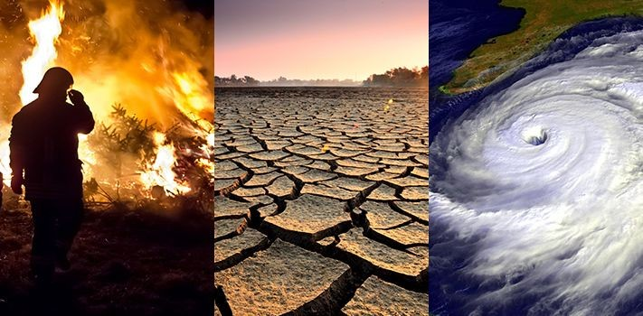
CLIMATE CHANGE
❏ The climate change
refers to seasonal
changes over a long period with respect to the growing accumulation of greenhouse gases in the atmosphere.
Several parts of the world have already experienced the warming of coastal waters, high temperatures, a marked change in rainfall patterns, and an increased intensity and frequency of storms.
Sea levels and temperatures are expected to be rising.

Slide 44
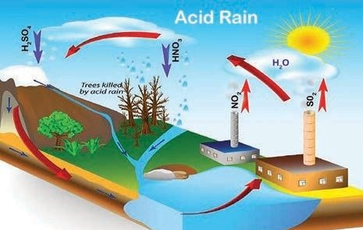
ACID RAIN
❏ Acid rain is one of the consequences of air pollution. It occurs when emissions From factories, cars or heating boilers contact with the water in the atmosphere.
❏ These emissions contain
nitrogen sulphur
oxides,sulphur dioxide and trioxide
❏ which when mixed with water becomes sulfurous acid, nitric acid and sulfuric acid.

Slide 45
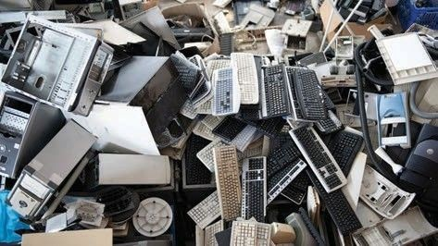
E-WASTE
❏ Electronic
waste which is commonly
referred as “e-waste” is the new by product of the Info Tech society.
❏ It includes a broad and growing range of electronic devices from large household appliances such as refrigerators, air conditioners, cellular phones, computers and other electronic goods"

Slide 46
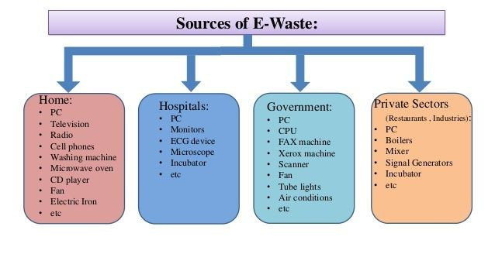

Slide 47
SOLID WASTE
Solid Waste is basically discharge of useless and unwarranted materials as a result of human activity.
Solid wastes consist of the discards of households, hospital refuse, dead animals, debris from construction site, ashes,agricultural wastes and industrial wastes etc.
When waste is not removed from the streets and public places in time it poses severe public-health and hygiene hazards

Slide 48
SUSTAINABLE DEVELOPMENT
MEANING
Sustainable development is concerned with the welfare of not only present generation but also future generation.
The present generation should not exhaust the resources left by the past generation, but it should leave the same for the sake of future generation.
This is called inter–generational equity.

Slide 49
DEFINITIONS
“Sustainable development is development that meets the needs of the present without compromising the ability of future generations to meet their own needs ”
-World Commission on Environment and Development, 1987-
“The alternative approach (to sustainable development) is to focus on natural capital assets and suggest that they should not decline through time.”
-Pearce,Markandya and Barbier,1989-

Slide 50
SUSTAINABLE DEVELOPMENT GOALS
It is crucial to harmonize three core elements such as economic Growth, social inclusion and environmental protection.
A set of 17 goals for the World’s future can be achieved before 2030 with three unanimous principles fixed by United Nations such as Universality, Integration and Transformation.

Slide 51
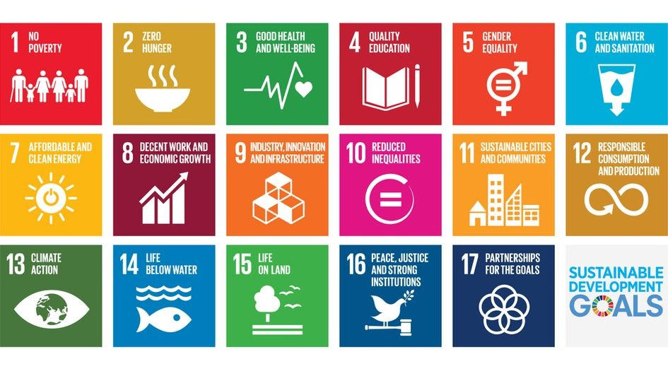

Slide 52
GREEN INITIATIVES
Today, number of organizations, businesses and people across the globe that are striving for sustainability and more eco-friendly lifestyles is increasing.

Slide 53
ORGANIC FARMING
Organic farming is a system of agricultural production which relies on animal manure, organic waste, crop rotation, legumes and biological pest control
Organic production is a holistic system designed to optimize the productivity and fitness of diverse communities within the agro-ecosystem, including soil organisms, plants,livestock and people.

Slide 54
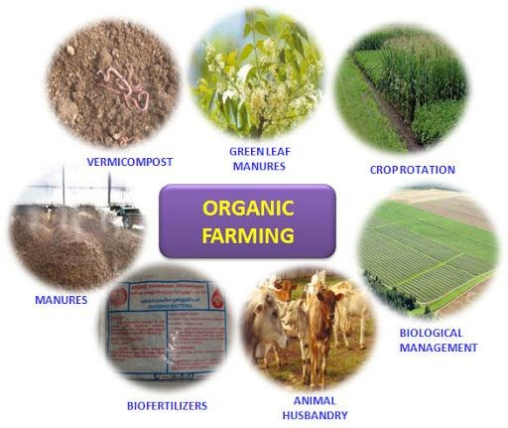
PRINCIPLES OF ORGANIC FARMING
Protect the environment
Maintain long-term soil fertility
Maintain biological diversity
Recycle materials and resources to greatest extent

Slide 55
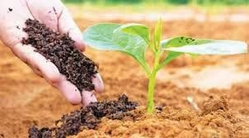
TREE PLANTATION
Trees contribute to their environment by providing oxygen, improving air quality, climate amelioration, conserving water, preserving soil and supporting wildlife
Natural forests and tree plantations improve the water cycle in diminishing runoff and improving the replenishment of the water table.

Slide 56
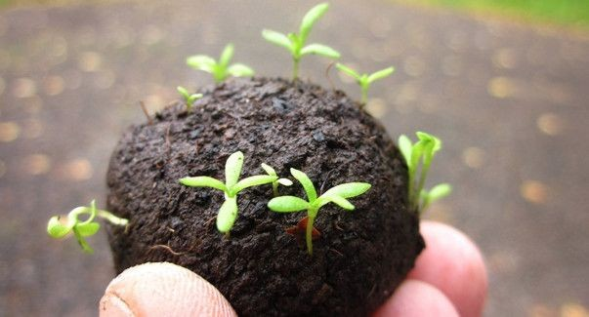
SEED BALL
A seed ball (or seed bomb) is a seed that has been wrapped in soil materials, usually a mixture of clay and compost, and then dried
Seed balls are an easy and sustainable way to cultivate plants that provide a larger window of time when the sowing can occur.

