Slide 1
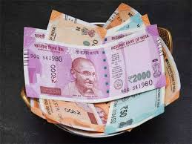
monetary ECONOMICS
www.Padasalai.Net
V. KRISHNAVENI
PGT IN ECONOMICS
VALLUVAR GURUKULAM HR.SEC SCHOOL

Slide 2
SYNOPSIS
INTRODUCTION OF MONETARY ECONOMICS
MEANING AND DEFINITIONS OF MONEY
EVOLUTION OF MONEY
FUNCTIONS OF MONEY
SUPPLY OF MONEY
QUANTITY THEORIES OF MONEY
INFLATION
DEFALTION
TRADE CYCLE

Slide 3
INTRODUCTION OF MONETARY ECONOMICS
Monetary economics is a branch of economics.
It provides a framework for analyzing money
Its functions as - medium of exchange
- store of value
- unit of account

Slide 4
MEANING AND DEFINITIONS OF MONEY
Money is anything that is generally accepted as payment for goods and services and repayment of debt and it serves as a medium of exchange.
“Money is, what money does “ – Walker
“Money can be anything that is generally acceptable as a means of exchange and at the same time acts as a measure and store of value”- Crowther

Slide 5
EVOLUTION OF MONEY
Gold standard
Metallic standard
Crypto
currency
Plastic money
Paper currency
Silver standard
Barter system

Slide 9
BARTER SYSTEM
Barter system was introduced by Mesopotamia tribes.
Before money invented , exchange took place by barter.
Commodities and services were directly exchanged for other commodities and services.
Exchange goods for goods was known as Barter Exchange or Barter system
Eg . Furs, skins, rice, salt ,wheat , ,utensils, weapons etc.
Both buyers and sellers faced so many problems

Slide 10
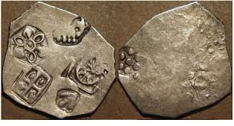
METALLIC STANDARD
After barter system modern money system evolved
It is the premier one.
Either gold or silver is used to determine the standard value on the money.
Standard coins made out of metals.
They have full bodied or full weighted legal tender.

Slide 11
GOLD STANDARD
It is a system in which the value of the monetary unit or the standard currency is directly with gold.
The purchasing power of a unit of money is maintained equal to the value of a fixed weight of gold.

Slide 12
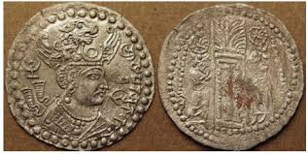
SILVER STANDARD
Standard economic unit is a fixed weight of silver.
In which a country’s Government allows conversion of its currency in to fixed amount of silver.

Slide 13
PAPER CURRENCY
It refers to the monetary system in which the paper currency notes issued by Treasury or central bank or both circulate unlimited tender.
It is not convertible in to any metal
It is also known as managed currency standard
The quantity of money in circulation is controlled by monetary authority to maintain price stability.

Slide 14
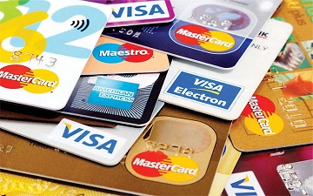
PLASTIC MONEY
Plastic money is one of the most evolved form of financial products.
It is an alternative to the cash or the standard “money”
Eg : cash cards, credit cards, debit cards, prepaid cash cards , store cards, forex cards and smart cards

Slide 15
CRYPTO CURRENCY
A digital currency in which encryption techniques are used to regulate the generation of units of currency and verify the transfer of funds, operating independently of a central bank.

Slide 16
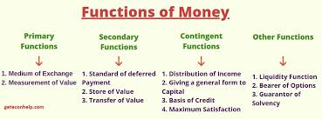
Functions of money

Slide 17
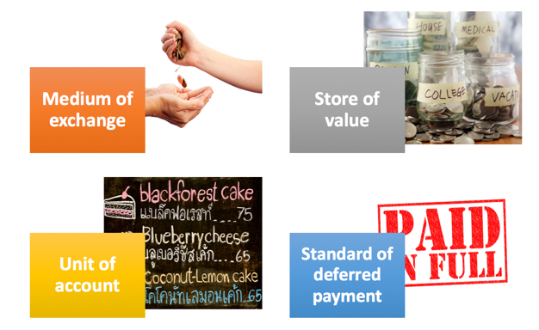
PRIMARY FUNCTION
MONEY AS A MEDIUM OF EXCHANGE:
Money has the quality of general acceptability and all exchanges take place in terms of money.
Transaction divided in to two parts
1. Money is obtained through sale of G&S. This is known as SALE.
2. Money is obtained to buy G&S. This is known as PURCHASE.

Slide 18
MONEY AS A MEASURE OF VALUE:
Second important function of money is that it measure the value of G&S.
The prices of all goods and services are expressed in terms of money.
money is thus looked upon the collective measure of value.
SECONDARY FUNCTION:
MONEY AS A SRTORE OF VALUE:
Money serves as an excellent store of value..
It can be easily converted in to other marketable assets like land, machinery, plant etc.,

Slide 19
MONEY AS A STANDARD OF DEFERRED PAYMENTS:
Under barter economy borrowing and lending were difficult problems.
But the modern money economy has greatly facilitated the borrowing and lending process. Now money act as a standard of deferred payment.
MONEY AS A MEANS OF TRANSFERRING PURCHASING POWER:
Exchange also went extending with growing economic development.
So it is necessary to transfer purchasing power from one place to another.

Slide 20
CONTINGENT FUNCTION
BASIS OF THE CREDIT SYSTEM:
Money is the basis for credit system.
Business transaction are either in cash or on credit.
For eg : A depositor make use of cheque only when there are sufficient funds in his account.
MONEY FACILITIES DISTRIBUTION OF NATIONAL INCOME:
Intervention of money facilitated the distribution of income like rent, wages, interest and profit.

Slide 21
MONEY HELPS TO EQUALIZE MARGINAL UTILITIES AND MARGINAL PRODUCTIVITY:
Money plays a important role because the prices of the commodities are expressed in terms of money. So its helps to equalize the marginal productivities .
MONEY INCREASES PRODUCTIVITY OF CAPITAL:
Money is a most liquid form of capital..
Capital can be transferred from less to more productive uses.

Slide 22
OTHER FUNCTIONS
Money helps to maintain repayment capacity. Every firm has to keep the assets in the form of liquid cash..
Even banks insurance companies and government has to keep the liquid money
Money represent generalized purchasing power.
money is the most liquid form of capital. So it can be put to any use.

Slide 23
SUPPLY OF MONEY
Money supply means the total amount of money circulation in the economy at any given time.
It plays a crucial role in the determination of price level and interest rates.
It is viewed at the given point of time it is a stock.
Over a period of time it is a flow.
In India CURRENCY NOTES are issued by RBI.
COINS are issued by MINISTRY OF FINANCE,GOVERNMENT OF INDIA (GOI)
The currency notes are also called FIAT MONEY and LEGAL TENDER.

Slide 24
MONEY SUPPLY IS A STOCK VARIABLE
RBI publishes four alternative measures of money supply.
M1, M2, M3 and M4
M1 = currency, coins and demand deposits
M2 = M1 + Savings deposits with post office savings banks.
M3 = M2 + Time deposits of all commercial and cooperative banks.
M4 = M3 + Total deposits with post -offices.
M1& M2 are known as narrow money
M3 & M4 are known as broad money

Slide 25
DETERMINANTS OF MONEY SUPPLY
CURRENCY DEPOSIT RATIO (CDR): its is the ratio of money that should be hold in the bank deposits.
RESERVE DEPOSIT RATIO (RDR): it consist of two things a) vault cash in banks b) deposits of commercial bank with RBI.
CASH RESERVE RATIO (CRR): it is a fraction of deposits the banks must keep with RBI.
STATUTORY LIQUIDITY RATO(SLR): it is the fraction of total demand and time deposits of the commercial banks in the form of specified liquid assets.

Slide 26
QUANTITY THEORIES OF MONEY
It is the relation between the quantity of money and value of money.
Two approaches of quantity theory of money
CAMBRIDGE CASH BALANCE APPROACH
FISHER’S TRANSACTION APPROACH

Slide 27
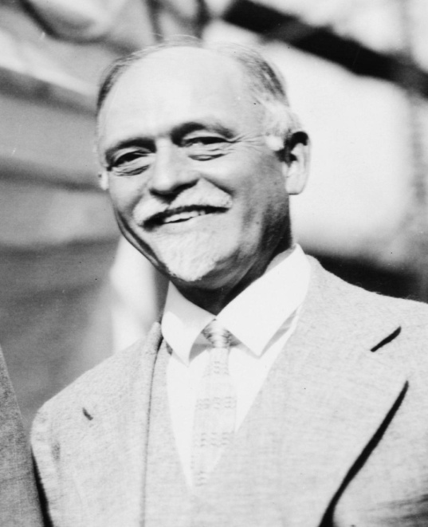
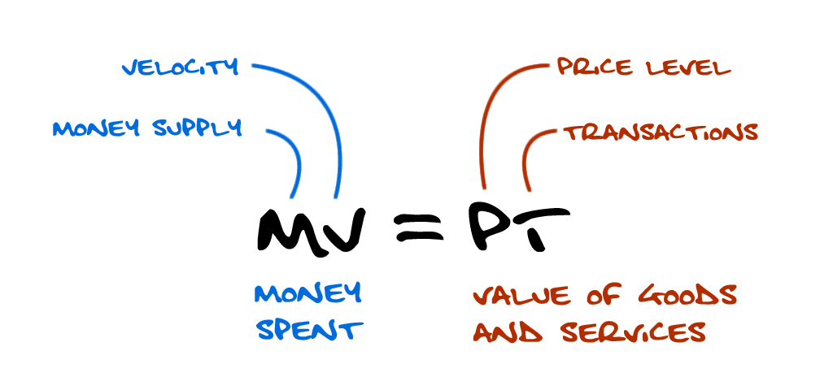
FISHER’S QUANTITY THEORY OF MONEY
It is a old theory.
It was propounded in1588 by an Italian economist, DAVANZATTI.
But , the theory was popularized by American economist IRVING FISHER.
His book “the purchasing power of money “ in1911.

Slide 28
DIAGRAMMATIC ILLUSTRATION
PT =MV+ M₁V₁
P = MV + M₁V₁
T

Slide 29
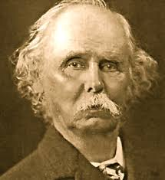
CAMBRIDGE APPORACH
MARSHALL’S EQUATION:
M= KPY
M = Quantity of money
Y = aggregate real income of the community
P = Purchasing power of money
K Represents the fraction of the real income which the public desires to hold in the form of money
P = M/KY

Slide 30
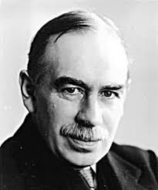
KEYNES’S EQUATION
KEYNES EQAUTION IS EXPREESED AS :
n = pk (or) p = n/k
n = Total supply of money
P = General price level of consumption goods
k = Total quantity of consumption units the people decide to keep in the form of cash
KEYENS EXTENDED HIS EQUATION IN THE FOLLOEING FORM :
n = pk ( k = rk’ ) or p = n/( k= rk’)

Slide 32
INFLATION
MEANING:
Inflation is the rate which the general level of prices for goods and services is rising and consequently the purchasing power of currency is falling
DEFINITION:
“Too much of money chasing too few goods”
“ A state of abnormal decreases in the quantity of purchasing power”
https://youtu.be/26tIbP6LGVo ( you tube video if you need you see)

Slide 33
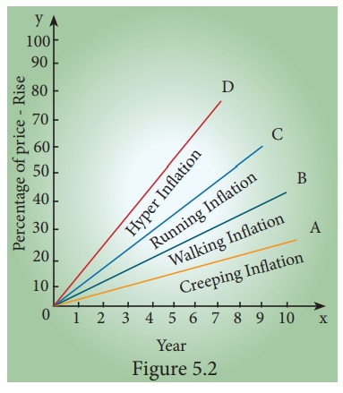
TYPES OF INFLATION
ON THE BASIS OF SPEED

Slide 34
CREEPING INFLATION :
Creeping inflation is slow-moving and very mild.
This type of inflation is no way dangerous to the economy.
This is also known as mid inflation or moderate inflation.
,.
WALKING INFLATION:
When prices rise moderately and the annual inflation rate
is a single digit ( 3% - 9% ).

Slide 36
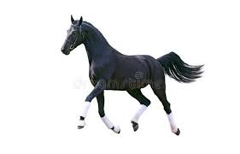
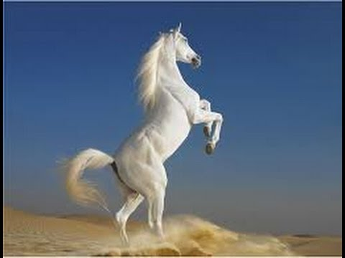
RUNNING INFLATION :
When prices rise rapidly like the running horse
at a rate of speed of 10% - 20% per annum.
GALLOPING INFLATION :
It is otherwise known as hyper inflation.
It points out to unmanageably high inflation.
rates that run in two or three digits ( 20% - 100% ).

Slide 37
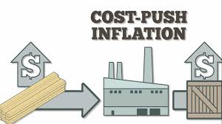
DEMAND – PULL VS COST - PUSH INFLATION
DE MAND PULL INFLATION:
Demand and supply play a crucial role in deciding the
inflation levels in the society at all points of time.
COST PUSH INFLATION:
when the cost of raw materials and other inputs rises
inflation results. Increase in wages.

Slide 38
ON THE BASIS OF INDUCEMENT :
Currency inflation: the excess supply of money in circulation causes rise in price level.
Credit inflation: when banks are liberal in lending credit, the money supply increases and thereby rising prices.
Deficit induced inflation: It is generally financed through printing of currency by the central bank. As a result, prices rise
Profit induced inflation: when the firms aim at higher point, they fix the price with higher margin. So prices go up
Scarcity induced inflation: scarcity of goods happens either due to fall in production or due to hoarding and black marketing
Tax induced inflation: Increase in indirect taxes like excise duty, custom duty and sales tax may lead to rise in price. This is also called taxflation.
.

Slide 39
CAUSES OF INFLATION:
INCREASE IN MONEY SUPPLY : it leads to increase in aggregate demand . Higher the money supply, higher is the rate of inflation
INCREASE IN DISPOSABLE INCOME: increase in disposable income it raises their demand for goods and services
INCREASE IN PUBLIC EXPENDITURE : Govt activities have been expanding due to developmental activities and social welfare programmes. This also cause for price rise
INCREASE IN CONSUMER SPENDING :The demand for goods and services increases when they are given credit to buy goods on hire purchase and installment basis.

Slide 40
CHEAP MONEY POLICY: the policy of credit expansion also leads to increase in the money supply which raises the demand for goods and services in the economy.
DEFICIT FINANCING : in order to meet its mounting expenses the govt resorts to deficit financing by borrowing from public and even by more notes.
BLACK ASSETS, ACTIVITIES AND MONEY :This increase the aggregate demand. Black marketing and hording reduces the supply of goods.
REPAYMENT OF PUBLIC DEBT : the govt repays the past internal debt to the public that will lead to increase in money supply
INCREASE IN EXPORTS : when exports are encouraged, domestic supply of goods decline . So prices rise.

Slide 41
EFFECTS OF INFLATION:
The effects of inflation can be classified into two :
Effects on production Effects on distribution
Effects on production:
when the inflation is very moderate, it acts as an incentive to traders and producers.
Effects on distribution:
Debtors and creditors : During inflation debtors are gainers while the creditors are loser.
Fixed income groups: these people are the worst hit. Eg. Wages, salary, pension
Entrepreneurs : inflation is the boon to the entrepreneurs. They experience windfall gains.
Investors :investors invest in fixed interest yielding bonds and securities have much to lose during inflation

Slide 42
EFFECTS ON PRODUCTION
Higher inflation results in a serious depreciation of the value of money and it discourages saving on the part of the public.
The value of money undergoes considerable depreciation, this may even drain out foreign capital already invested in the economy.
Inflation also leads to hoarding of essential goods both by the traders as well as the consumers and thus leading to still higher inflation rate.
Inflation encourages investment in speculative activities rather than productive purposes.

Slide 43
EFFECTS ON DISTRIBUTION

Slide 44
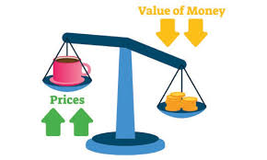
MEASURES TO CONTROL INFLATION :
Keynes and Milton fried man together suggested three measures to prevent and control of inflation
Monetary measures
Fiscal measures
Other measures
MONETARY MEASURES :
These measures are adopted by the central bank of the country.
They are i ) Increase in bank rate ii) Sales of government securities in open market iii)CRR&SLR iv) Consumer credit control v)Higher margin requirement vi)Higher Repo rate and Reserved repo rate.

Slide 45
FISCAL MEASURES:
Fiscal policy is now recognized as an important instrument to tackle an inflationary situation.
Reduction of government expenditure
Public borrowing
Enhancing taxation
OTHER MEASURES:
Short term measures.
Long term measures

Slide 46
DEFLATION :
It is falling price, reduced money supply and unemployment.
DISINFLATION :
It is a process of reversing inflation without creating unemployment or reducing output in the economy
STAGFLATION :
It is an combination of stagnant economic
growth, high unemployment and high inflation.

Slide 48
TRADE CYCLE
The economic activity in a capitalist economy will have its periodic ups and downs.
The study of these ups and downs is called the study of business cycle or trade cycle or industrial fluctuation.
It refers to the oscillations in aggregate economic activity particularly in an employment, output ,income ,etc.
DEFINITION :
“A trade cycle is composed of periods of good trade characterized by rising prices and low unemployment percentages altering with periods of bad trade characterized by falling prices and high unemployment percentages .”
J.M.KEYNES

Slide 49
PHASES OF TRADE CYCLE

Slide 50
BOOM OR PROSPERITY PHASE:
The full employment and the movement of the economy beyond full employment is characterized as Boom period.
During this period there is hectic activity in economy.
Money wages rise profit increase and interest rates go up.
RECESSION :
The turning point from boom condition is called Recession.
The failure of a company or bank burst the boom and brings a phase of recession.
There is panic in the stock market and business activity show signs of dullness.

Slide 51
DEPRESSION :
During depression the level of economic activity becomes extremely low.
Firms incur losses and closure of business becomes a common feature and the ultimate result is unemployment.
Extreme point of depression is called “trough”.
RECOVERY :
This is the turning point from depression to revival towards upswing.
It begins with the revival of demand for capital goods.
Recovery may be initiated by innovation or investment or by government expenditure.

