Slide 1
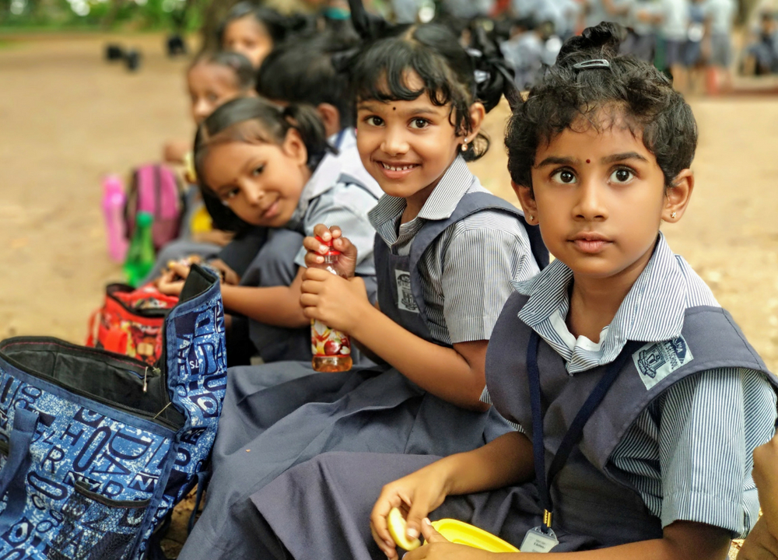

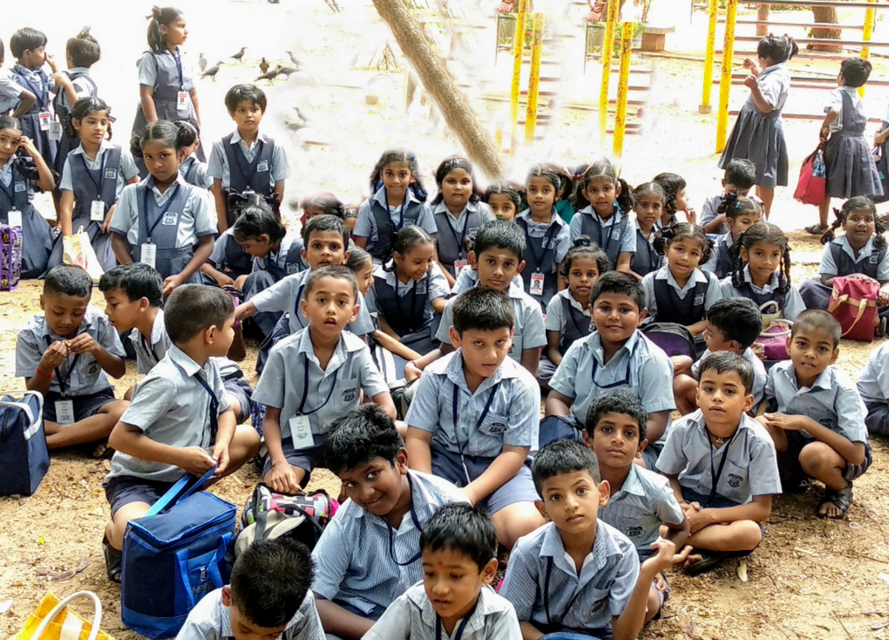
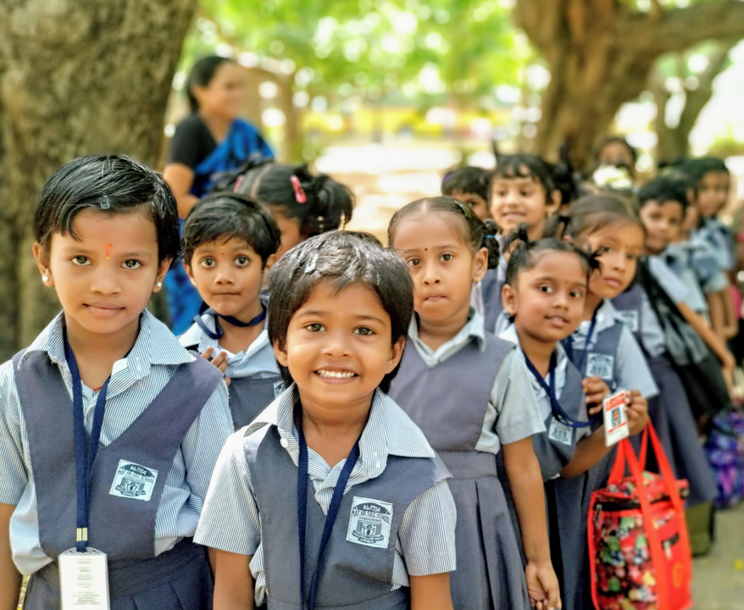
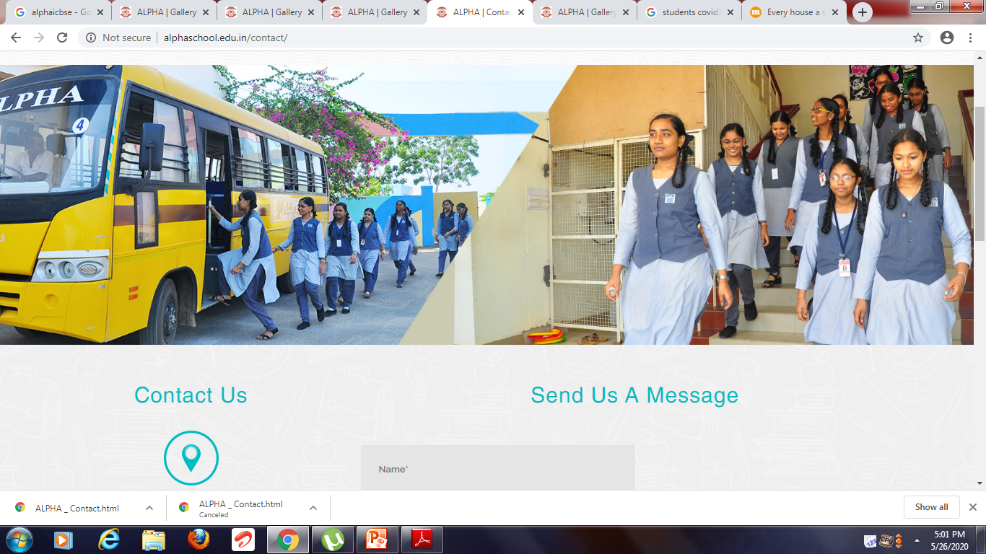
AUDIO VISUAL SMART CLASS PROGRAM

Slide 2
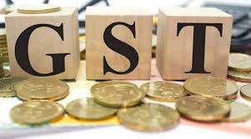
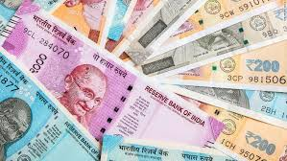
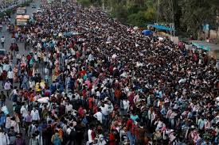
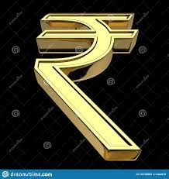
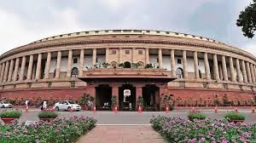
Lesson 9

Slide 3
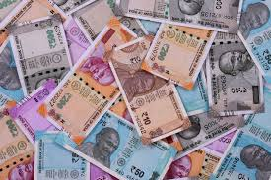
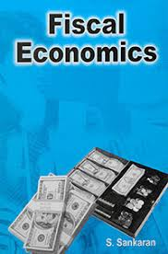

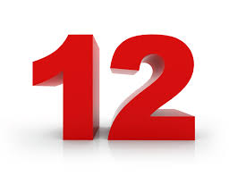
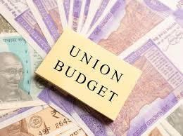
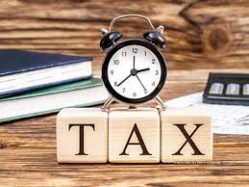

Slide 4
www.Padasalai.Net
  The Old name for Fiscal Economics was “Public Finance”
  It is the study of finance related to government entities. It revolves around the role of government income and expenditure in the economy.

Slide 5

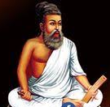
THIRUKURAL NO : 478
“Incomings may be scant; but yet, no failures there,
If in expenditure you rightly learn to spare”.
ஆகாறு அளவிட்டி தாயினுங் கேடில்லை
போகாறு அகலாக் கடை
English Meaning
Even though the income be small, it will not cause his ruin, if his outgoings be not larger than his income.
Tamil Meaning
வருமானம் அளவில் சிறிது என்றாலும் செலவினம் பெரிதாகாத போது கேடு இல்லை

Slide 6
Learning Objectives
To understand the meaning and subject matter of Public Finance.
To understand the direct and indirect taxes.
To describe the functions of finance commission.

Slide 7
Introduction
The term “Fiscal Economics” is a new one; the old and popular term is “Public Finance”
It is related to the financing of the state activities and the financial operation of the Government treasury.
It is derived from the Greek word which means ‘Basket’
The Modern State is a welfare state.
The state activities have increased extensively and intensively.
To perform these activities the state needs funds.
This chapter deals with Public Revenue, Public Expenditure, Public Debt, Budget, Federal Finance and Local Finance.

Slide 8
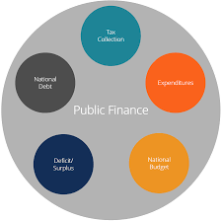
Meaning – Public Finance
  Public Finance is a study of the financial aspects of Government.
  It is concerned with the revenue and expenditure of the public authorities. and with adjustments of the one to the other.

Slide 9
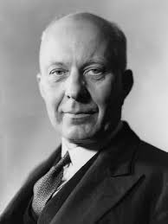
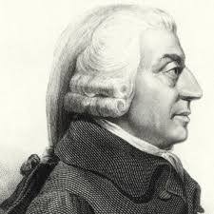
Definition – Public Finance
  “Public Finance is one of those subjects that lie on the border line between Economics and Politics. It is concerned with income and expenditure of Public authorities and with the adjustments of one to the other”
  - Huge Dalton
  “Public Finance is an investigation into the nature and principles of the state revenue and expenditure”
  - Adam Smith

Slide 10
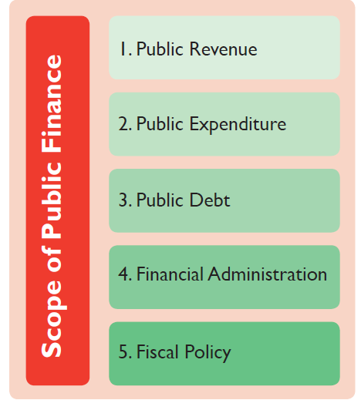
Scope of Public Finance
Public Finance includes five major sub divisions. They are
1) Public Revenue
2) Public Expenditure
3) Public Debt
4) Financial Administration
5) Fiscal Policy

Slide 11
Explanation
S.No. | Scope of PF | Description
1. | Public Revenue | It deals with the method of raising Public revenue such as tax and non-tax, the principles of taxation, rates of taxation, impact, incidence and shifting of taxes and their effects
2. | Public Expenditure | It studies the fundamental principles that govern the Government expenditure, effects of Public expenditure and control of Public expenditure
3. | Public Debt | It deals with the methods of raising loans from internal and external sources. The burden, effects and redemption fall under this head.
4. | Financial Administration | It deals with the study of different aspects of Public budget. The various objectives and steps in preparing a public budget fall under this head
5. | Fiscal Policy | Its instruments are tax subsidies, public debt and public expenditure.

Slide 12
Public Finance Vs Private Finance
Public Finance
  It deals with study of income, expenditure, borrowing and financial administration of the Government.
  Private Finance
  It deals with the study of income, expenditure, borrowing and financial administration of the individual or private enterprises.
  Both Public and private finance are fundamentally similar in nature but different from each other on various aspects.

Slide 13
Similarities between
Public Finance and Private Finance
S. No. | Features | Description
1. | Rationality | Both Finance are based on rationality. Both aim for maximization of welfare.
2. | Limit to borrowing | Both have their own limit with regard to borrowing. There is a limit for the state side also to deficit financing.
3. | Resource Utilization | Both the sectors have limited resources at their disposal. So both attempt to make optimum use of resources.
4. | Administration | The efficiency of both the sectors depends on the administrative machinery. If the administrative machinery is inefficient and corrupt it will result in wastages.

Slide 14
Dissimilarities Between Public
& Private finance
S.No. | Features | Description
1. | Income and Expenditure Adjustment | The Government adjust income to the expenditure while individuals adjust expenditure to the income.
2. | Borrowing | The Government can borrow from the people by issuing bonds. But an individual cannot borrow from himself.
3. | Right to print currency | The Government can print currency. The private sector cannot create currency.
4. | Present Vs future decisions | Public Finance makes long term decisions and build schools, hospitals and infrastructure. Private finance makes short term financial decision.
5. | Objective | Public – to provide social benefit in the economy. Private - aims to maximize profit.
6. | Coercion to get revenue | The source of income of a Government is wide. The Government can use its power and authority. The Source of income of a private individual is limited.
7. | Ability to make huge and deliberate changes | Public Finance has the ability to make big decision on income. But individuals cannot make such massive decisions.

Slide 15
FUNCTIONS OF A GOVERNMENT

Slide 16
Functions of Modern State
The Modern State is a welfare state and not police state.
The various functions are
1. Defence
2. Judiciary
3. Enterprises
4. Social Welfare
5. Infrastructure
6. Macro Economic policy
7. Social Justice
8. Control of Monopoly

Slide 17
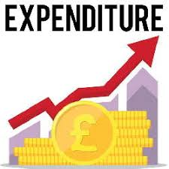

Public Expenditure
Meaning
It refers to Government spending incurred by central, state and local governments of a country.

Slide 18

Public Expenditure
  Definition
  It can be defined as, “The expenditure incurred by Public authorities like central, state and local governments to satisfy the collective social wants of the people is known as public expenditure”.

Slide 19
Classification of Public Expenditure
On the basis of benefit | On the basis of functions
Cohn and Plehn classified the Public expenditure on the basis of benefits into 4 | Adam smith Classified this expenditure types into 3
(a) Public Expenditure benefitting the entire society Eg: Defence, Education, Health, transport | (a) Protection Functions Expenditure incurred on the security of the citizens to protect from external invasion and internal disorders.
(b) Public Expenditure conferring a special benefit on certain people and at the same time common benefit for entire common unit Eg: Administration of justice | (b) Commercial Functions Public Expenditure incurred on the development of trade and commerce. Eg: Development of means of transport and communication
(c) Public Expenditure directly benefiting particular group of person and indirectly the entire society Eg: Pension, unemployment relief etc., | (C) Development Function This group includes public expenditure incurred for the development of infrastructure and industries.
(d) Public Expenditure conferring a special benefit on some individuals. (Eg: Subsidy granted to a particular industry.

Slide 20



Causes for the increase in Government Expenditure
Population Growth
1) The population of India has increased from 36.1 crore in 1951 to 121 crore in 2011.
2) The growth in population requires huge investment in health and education, law and order etc.,
3) Young population requires expenditure on education and youth services.
4) Aging population requires expenditure on old age pension, health facilities and social security.
Defence Growth
1) The defence expenditure increased tremendously due to modernisation of defence equipment.
1990 – 91 Rs. 10,874 crores 2018 – 19 Rs. 2,95,511 crores

Slide 21
Government Subsidies
* Indian Government is providing more subsidies to a number of items such as food, fertilizers, exports, education etc., So the public expenditure has increased to a greater extent.
Debt Servicing
* Government is borrowing heavily from both internal and external sources.
* So the government is paying huge amount of repayment towards debt.
1990 – 91 - Rs. 9581 Crores. 2018 – 19 - Rs. 2,29,715.67 Crores . Corporate Sector receives – More than 5 lakhs crores.
Interest Payment . 1990 – 91 - Rs. 21,500 Crores. 2018 – 19 - Rs. 5, 75, 794 Crores .

Slide 22
Development Projects
* Government is undertaking various development projects such as irrigation, iron and steel, heavy machinery, power, telecommunications etc.,
* These projects requires huge investment
Urbanisation
* Urbanisation process is increasing day by day.
* It increased from 17% to 43%.
* 54 Cities in India are more than 1 million population.
* Increase in urbanisation requires heavy expenditure.

Slide 23
Industrialisation
  * Setting up of industries requires huge investment and a long gestation period.
  * Underdeveloped countries need a strong infrastructure like transport, communication, power, fuel etc.,
  Increase in grants in aid to State and U.T
  * Grants are given to the State and Union Territories during the time of natural disasters.

Slide 24
Public revenue meaning
The Income of the Government through all sources is called public income or public revenue. Some of the sources are taxes, fees, fines, donations etc.,
CLASSIFICATION OF PUBLIC REVENUE
SOURCES OF PUBLIC REVENUES
TAX REVENUE
NON – TAX REVENUE

Slide 25

Tax Revenue
MEANING
Tax is a compulsory payment by the citizens to the government to meet the Public expenditure. It is legally imposed by the Government on the tax payee and in no case tax payer can refuse to pay taxes to the government.

Slide 26

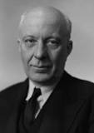
TAX REVENUE - DEFINITION
“ A tax is a compulsory payment made by a person or a firm to
a government without reference to any benefit the payer may
derive from the Government” - Anatol Murad
“A Tax is a compulsory contribution imposed by public authority,
irrespective of the exact amount of service rendered to the tax
payer in return and not imposed as a penalty for any legal Offence.” - Dalton

Slide 27
Characteristics of Tax
1) It is a compulsory payment made to the Government.
2) People on whom a tax is imposed must pay the tax.
3) Refusing to pay is a punishable offence.
4) There is no quid pro quo between a tax payer and public authorities.
5) Every tax involves some sacrifice on part of the tax payer.
It is not levied as a fine or penalty for breaking law.
SOURCES OF TAX REVENUE
                INCOME TAX
                CORPORATE TAX
                SALES TAX
                SURCHARGE AND
                CESS

Slide 28

Non Tax Revenue
The Revenue obtained by the Government from sources other than tax is called Non Tax Revenue
Sources | Description
Fees | 1) It is charged by Public authorities for rendering a service to the citizens. 2) There is no compulsion to pay fees. 3) The Government provides certain services and charges certain fees for them (Eg) Fees are charged for issuing of passports, driving licenses etc.,
Fine | It is a penalty imposed on an individual for violating the law. (eg) i) Violation of traffic rules 2) Payment of taxes after the stipulated time
Earnings from Public Enterprises | Some of the public Sector enterprises make a good amount of profit These profits gained by the Government can be utilized for public expenditure.

Slide 29
Sources | Description
Special Assessment of betterment levy | It is a special charge levied on certain members of the community who are benefited by the government projects. Eg. Due to the Public park or due to the construction of road, people in that locality experience that benefits .
Gifts, Grants and Aids | Grant from one Government to another is an important source of revenue in modern days. Centre → State → Local Government Developing countries receive military aid, food aid and technological aid from other countries.
Escheats | It refers to the claim of the state to property of persons who die without legal heirs or documented will

Slide 31
Canons of Taxation
  The Characteristics or qualities which a good tax should posses are described as canons of Taxation. According to Adam smith there are 4 canons of Taxation.
Canons | Description
Ability | 1) The Government should impose the tax in such a way that the people have to pay taxes according to their ability 2) Rich person should pay more tax when compared to the middle class and poor people
Certainty | 1) The Government should ensure that there is no uncertainty regarding the rate of tax or the time of payment. 2) If the tax is collected arbitrarily then it will affect the efficiency of the people
Convenience | 1) The method and time of tax collection should suit the convenience of the people. 2) Steps should be taken by the Government for all the tax payers to pay the tax without difficulty.
Economy | 1) The Government has to spend money for collecting taxes. For example salaries are given to the persons who are responsible for collecting taxes. 2) According to smith, Government should impose those taxes whose collection costs are very less and cheap

Slide 32
Direct Tax and Indirect Tax
Direct Tax
It is a tax levied on person’s income and wealth and is paid directly to the government.
The burden of such tax cannot be shifted.
The tax is progressive in nature.
It is levied according to the paying capacity of the person. (ie) more from the rich and less from the poor people.
Taxes are being recommended by the Central Board of Direct Taxes (CBDT) which is under the Ministry of Finance, Government of India.
Income tax is the best example for direct tax.

Slide 34
Merits of Direct Taxes
S. No | Merits | Description
1. | Equity | Direct Taxes are progressive (ie) rate of tax varies according to tax. Ex. Income Tax satisfies the canon of Equity
2. | Certainty | Canon of Certainty can be ensured by taxes. Ex. An income tax payer knows when and at what rate he has to pay income tax.
3. | Elasticity | Canon of Elasticity also is ensured by the Direct Tax. It is income elastic in nature
4. | Economy | The collection cost is relatively low. Tax payers pay the tax directly to the state.

Slide 35
Demerits of Direct Taxes
S. No | Demerits | Description
1. | Unpopular | It is generally unpopular It is inconvenient It is less flexible
2. | Productivity affected | It adversely affect productivity Citizens are not willing to earn more income because in that case they have to pay more tax.
3. | Inconvenient | The tax payers find it inconvenient to maintain accounts, submit returns and pay tax in lump sum.
4. | Tax Evasion | The burden is so heavy that tax payers always try to evade taxes. This leads to the generation of black money

Slide 36
Indirect Tax
It is referred to as a tax charged on a person who purchases the goods and services and it is paid indirectly to the Government.
The tax burden can be easily shifted to another persons.
It is equally levied on all persons whether rich or poor.

Slide 37
Types of Indirect Taxes
1. | Excise Duty | Payable by the manufacture who shifts the tax burden to retailers and wholesalers.
2. | Sales Tax | Paid by a shop keeper or retailers who then shifts the burden to customers by charging sales tax on goods and services.
3. | Custom Duty | Tax levied on goods from outside the country, ultimately paid by consumers and retailers.
4. | Entertainment Tax | Burden is on the Cinema theatre owners, who transfers the burden to Cinema goers.
5. | Service Tax | Charged on services like telephone bill, insurance premium such as food bill in a restaurant etc.,

Slide 38
Merits of Indirect Taxes
S. No | Merits | Description
1. | Wider Goverage | All the Consumers, whether they are rich or poor have to pay indirect taxes. Indirect taxes cover more people than the direct taxes.
2. | Equitable | Indirect tax satisfy the canon of equity. Higher tax is imposed on luxuries used by rich people
3. | Economical | collection cost is less, as produces and retailers collect tax and pay to the Government
4. | Checks harmful consumption | Taxes are imposed on those commodities which are harmful to health. Eg Tobacco, liquor etc., It is also known as Sin taxes.
5. | Convenient | It is levied on commodities and services. Consumers pay tax along with the price. They do not feel the burden of paying the tax.

Slide 39
Demerits of Indirect Tax
S. No | Demerits | Description
1. | Highest Cost of Collection | The Cost of Collection is higher than the direct taxes. Huge money has to spend to collect the taxes.
2. | Inelastic | It is less elastic compared to direct taxes.
3. | Regressive | It is regressive in nature Both rich and poor persons have to pay same amount of taxes irrespective of their income
4. | Uncertainty | The rise in tax increase the price and reduces the demand for goods. So the expected revenue from collection is uncertain.
5. | No Civic Consciousness | Since the tax is hidden in price the Consumers are not aware of paying tax.

Slide 40
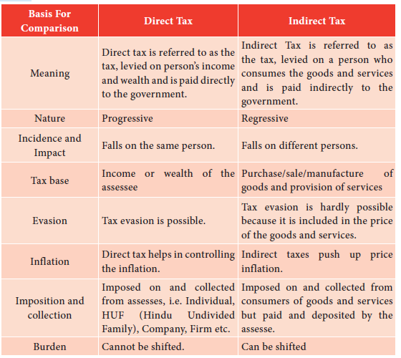

Slide 41
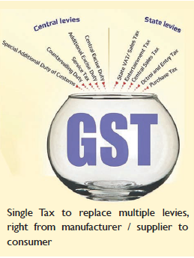
GST (Goods and Service Tax)
GST is an Indirect Tax which has replaced many Indirect Taxes in India.
It was passed in the parliament on 29th March 2017.
It came into effect on 1st July 2017.
GST is an indirect tax levied on the supply of goods and services.
GST is one indirect tax for the entire country.
In GST, the tax will be levied at the final point of sale.
In case of intra - state sales, central GST and State GST will be charged.
Inter- State sales will be chargeable to Integrated GST.
DESTINATION BASED.
If goods are manufactured in Tamilnadu and are sold in Karnataka, then the entire tax revenue will go to Karnataka and not Tamilnadu.

Slide 42
Components of GST
S. No | Types | Description
1. | CGST (Central Goods and Service Tax) | Collected by the Central Government on an Intra State Sale. Eg. Within State /Union Territory
2. | SGST (State Goods and Service Tax) | Collected by the State Government on an Intra State Sale. Eg. Within State/Union Territory
3. | IGST (Integrated goods and service Tax) | Collected by the Central Government for Inter State Sale. Eg. Maharashtra to Tamilnadu.

Slide 43
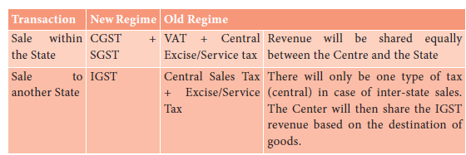
THE TAX STRUCTURE UNDER THE NEW REGIME

Slide 44
Nature of Sales Tax, VAT and GST
Cascading Effect : It means a tax on tax. It is a situation wherein a consumer has to bear the load of tax on tax and inflationary prices as a result.
Sales Tax | VAT | GST
It is a multipoint tax with Cascading effect | It was a multipoint tax without cascading effect | It is one point tax without cascading effect

Slide 45
Advantages of GST
GST will mainly remove the cascading effect on the sale of goods and services.
Removal of cascading effect will directly impact the cost of goods.
Since tax on tax is eliminated here, the cost of goods decreases.
GST is also technologically driven
All activities like registration, return filling, application for refund and response filling, application for refund and response to notice need to be done online on the GST portal.

Slide 46

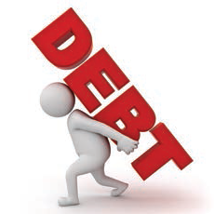
PUBLIC DEBT
Meaning
Public debt is the total amount borrowed by the Government of a country.
Since 20th Century there has been enormous increase in the responsibilities of the state.
Hence the state has to supplement the traditional revenue sources with borrowing from individuals and institutions within and outside the country.
This borrowing is more in under developed countries to finance development activity.
The debt burden is a big problem and most of the countries are in a debt trap.

Slide 47
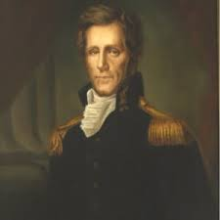
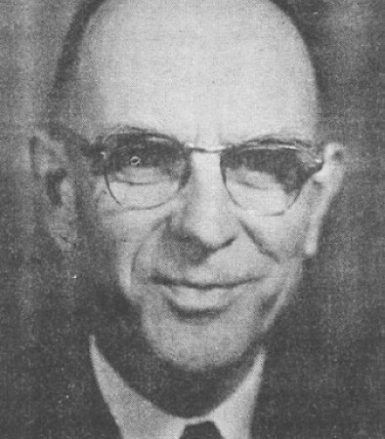
Definitions
“The debt is the form of promises by the Treasury to pay to the holders of these promises a principal sum and in most instances interest on the principal. Borrowing is resorted to in order to provide funds for financing a current deficit.”
– Philip E.Taylor
“The receipt from the sale of financial instruments by the government to individuals or firms in the private sector, to induce the private sector to release manpower and real resources and to finance the purchase of these resources or to make welfare payments or subsidies”.
.
– Carl S.Shoup

Slide 48
Types of Public Debt
Internal Public Debt
An internal public debt is a loan taken by the Government from the citizens or from different institutions within the country. It involves only transfer of wealth. Main sources are selling bonds to individuals to private & public banks
External Public Debt
An external public debt is a loan taken from an international organisations. The main sources are IMF, world Bank, IDA and ADB etc.,

Slide 49
Causes for the increase in Public Debt
S.No. | Causes | Description
1. | War and preparation of War. | In Modern times, the preparation for war and nuclear defence programmes takes away the major share of the Governments revenue. So it incurs debt.
2. | Social obligation | Many social Obligations, like health, sanitation, education, insurance, transport and communication etc are undertaken by the Government. To finance these, the state is incurring heavy debt
3. | Economic development and deficit | Projects like railway construction, power projects, irrigation projects, heavy industries are undertaken by the Govt for development process . Due to heavy expenditure, the Government always faces deficit budget. Such deficit is adjusted only through borrowing
4. | Employment | To solve the unemployment problem and to fight recession the Government has to make huge expenditure and thereby borrows money.
5. | Controlling Inflation | The Government can withdraw excess money from circulation by raising public debt and prevent inflation.
6. | Fighting Depression | During depression private investment lacks. The Govt borrows from internal and external sources and face the public spending.

Slide 51
Methods of Redemption of Public Debt
The Process of repaying a public debt is called Redemption of Public Debt.
The following methods are adopted for debt redemption
Sinking Fund
a) The Government credits every year a fixed amount of money to this fund.
b) By the time the debt matures, the fund accumulates enough to pay off the principal and the interest.
Conversion
a) It means that an old loan is converted into a new loan.
b) High interest Public debt is converted into a low interest Public debt.
c) Conversion relaxes the debt burden.
Budgetary Surplus
a) When the Government presents surplus budget, it can be utilized for repaying the debt.
b) When revenue is more than the expenditure surplus occurs.
Terminal Annuity
a) This is the easiest way of paying debt.
b) The Government pays off the public debt on the terminal annuity in equal annual installments.

Slide 52
5) Repudiation
a) It is the easiest way for the Government to get rid of the burden of payment of a loan.
b) The Government does not recognize its obligation to repay the loan.
c) It is not certainly paying off a loan but destroying.
Reduction in Rate of Interest
a) It is the compulsory reduction in the rate of interest, during the time of financial crisis.
Capital Levy
  a) The Govt imposes levy on the capital assets croned by an individual or any institution, it is called capital levy.
  b) The fund so collected is used by the Government to repay war time debt obligation.
  c) This is the most controversial method of debt repayment.

Slide 53
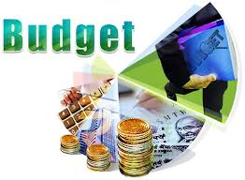
Budget meaning
The Word ‘Budget’ is originated from the French word. ‘Bougett’ which refers to a “small leather bag”.
It is an annual financial statement which shows the estimated income and expenditure of the Government for the forthcoming financial year.

Slide 54
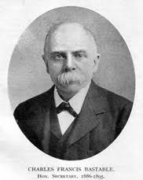
Budget definition
“It is a document containing a preliminary approved plan of public revenue and expenditure”.
-Reney Stourn.
“The budget has come to mean the financial arrangements of a given period, with the usual implication that they have been submitted to the legislature for approval”.
- Bastabale

Slide 56
Types of Budget
S. No. | Types | Description
1. | Revenue Budget | It consists of Revenue receipts and Revenue expenditure. Revenue Receipts – Tax & Non Tax Revenue Expenditure – Plan & Non plan
2. | Capital Budget | It consists of capital receipts and Capital expenditure. Main Sources of capital receipts are loans, advances etc., Capital expenditure – Plan & Non Plan
3. | Supplementary Budget | During the time of war and natural calamities like Tsunami, flood etc. the allotted expenditure are not always enough. Under these circumstances, a supplementary budget can be presented by the Government

Slide 57
4. | Vote - on - Account | Usually budget are presented in the middle of the year. The reason may be political in Nature The existing Government may or may not continue for the year. On account of the fact that elections are due then the Government places a ‘lame duck budget’. This is called Vote on Budget. The Government gets permission from the parliament to incur expenditure on necessary items. (from both the houses) The budget is sanctioned for not more than two months..
5. | Zero base Budget | The Indian Government presented this in 1987 – 88 It was initiated in the Department of science and Technology in 1983. It is a method of budgeting in which all expenses must be justified for each new period. Every function is analyzed for its needs and costs
6. | Performance Budget | When the outcome of any activity is taken as the base of any budget such budget is known as performance budget It was made first by USA The Government should tell ’What is done’ how much done’ for the betterment of the people. It is also known as ‘outcome budget’

Slide 58
BALANCED VS UNBALANCED BUDGET
BUDGET
BALANCED
It is a situation in which estimated revenue of the Government during the Year is equal to its anticipated expenditure
UNBALANCED
The Budget in which revenue and expenditure are not equal to each other is known as unbalanced budget
SURPLUS
The estimated revenues of the year are greater than anticipated expenditure
DEFICIT
The estimated Government expenditure is more than expected revenue

Slide 59
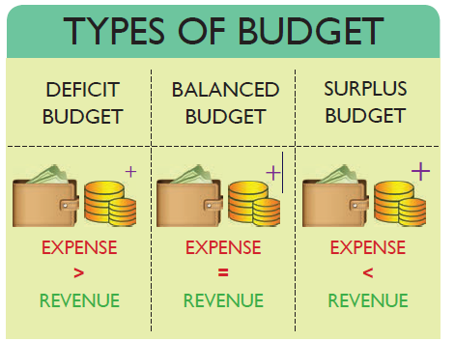

Slide 60
Budgetary Procedure
It refers to the system through which the budget is prepared, enacted and executed.
It is 3 in number.
They are
1) Preparation of the Budget
2) Presentation of the Budget
3) Execution of the Budget

Slide 61
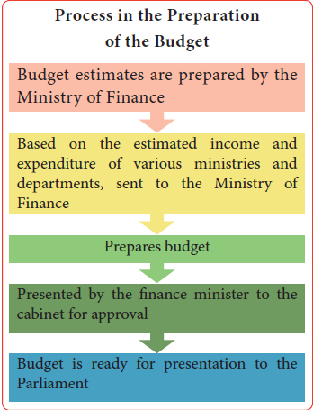
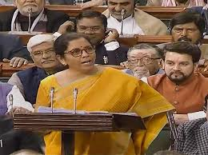
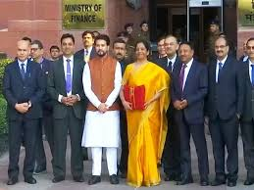

Slide 62
Preparation of the Budget | Presentation of the Budget
The Ministry of Finance preparers the budget every year (Centre level) | The Hon’ble Minister of Finance places the Union budget before parliament
The finance department is responsible for Annual State Budget | The Finance Minister of respective state Govts Places the state budget before the state Legislative
While preparing the following points are taken into account. Macro Economic targets to be achieved within a plan period. The basic strategy of the budget. Financial requirement of different projects. Estimates of revenue expenditure Estimates of Capital expenditure Estimates of revenue receipts Estimates of Capital receipts Estimates of gap between revenue receipts & revenue expenditure Estimates of fiscal & deficit primary deficit and revenue deficit | According to our constitution all the money bills are first placed before the Lok Sabha at the centre and before Vidhan Sabha at the State level
 | The demands of various tax proposals are included in the budget.
 | After the finance bill is passed an appropriation bill is presented to give legal effect to the voted demands and to authorise the expenditure as per the budget.
 | In this way budget are enacted in India.

Slide 63
Execution of the Budget
1) The budget is mainly executed by different departments of the Government.
2) Proper execution of the budget is essential for the efficient utilization of the allocated funds.
Parliamentary Control over the Budget
In India all the Government accounts are maintained in 3 parts.
1) Consolidated Fund
2) Contingency Fund
3) Public Accounts
Two parliament Committees
1) The Public Accounts Committee
2) The Estimates committee
These committees keep a constant vigil on the expenditure so that no ministry exceeds the amount sanctioned to it.

Slide 64
Budgetary Deficit
It is a situation where budget receipts are less than budget expenditure. This situation is also known as Government deficit. It is divided into 4 types Revenue Deficit, Budget deficit, Fiscal Deficit and Primary Deficit.
REVENUE
Total Revenue RD = RE – RR Total Revenue = Total Revenue Expenditure – Total Revenue Receipts
BUDGET
Budget Deficit = Total Expenditure – Total Revenue
FISCAL
FISCAL DEFICIT = BUDGET DEFICIT + GOVERNMENTS MARKET BORROWINGS AND LIABILITIES
PRIMARY
Primary Deficit = Fiscal Deficit – Interest Payment (IP)

Slide 65
Federal Finance
Federal finance refers to the system of assigning the source of revenue to the central as well as state Government for the efficient discharge of their respective functions.
Clear cut division is made regarding the allocation of resources of revenue between the central and state authorities.
There are three lists enumerated in the seventh schedule of constitution.
The Union List | It consist of 100 subjects of national importance such as Defence, Railways, post and Telegraph etc.,
The State List | It consists of 61 subjects of local interest such as public health, Police etc.,
The Concurrent List | It has 52 subjects important to both the union and the state such as electricity, Trade union, Economic and Social Planning etc.,

Slide 66
Central - State
Financial Relationship
Union Source
1. Corporation tax
2. Currency, coinage and legal tender, foreign exchange.
3. Duties of customs including export duties.
4. Duties of excise on tobacco and certain goods manufactured or produced in India.
5. Estate duty in respect of property other than agricultural land.
6. Fees in respect of any of the matters in the Union List, but not including any fees taken in any Court.
7. Foreign Loans.
8. Lotteries organized by the Government of India or the Government of a State.
9. Post Office Savings Bank.
10. Posts and Telegraphs, telephones, wireless, Broadcasting and other forms of communication.
11. Property of the Union.
12. Public Debt of the Union.
13. Railways.
14. Rates of stamp duty in respect of Bills of Exchange, Cheques, Promissory Notes, etc.
15. Reserve Bank of India.
16. Taxes on income other than agricultural income.
17. Taxes on the capital value of the assets, exclusive of agricultural land of individuals and companies.
18. Taxes other than stamp duties on transactions in stock exchanges and future markets.
19. Taxes on the sale or purchase of newspapers and on advertisements published therein.
20. Terminal taxes on goods or passengers, carried by railways, sea or air.

Slide 67
STATE SOURCE
1. Capitation tax
2. Duties in respect of succession to agricultural land.
3. Duties of excise on certain goods produced or manufactured in the State, such as alcoholic liquids, opium, etc.
4. Estate duty in respect of agricultural land.
5. Fees in respect of any of the matters in the State List, but not including fees taken in any Court.
6. Land Revenue.
7. Rates of stamp duty in respect of documents other than those specified in the Union List.
8. Taxes on agricultural income.
9. Taxes on land and buildings.
10. Taxes on mineral rights, subject to limitations impose by Parliament relating to mineral development.
11. Taxes on the consumption or sale of electricity.
12. Taxes on the entry of goods into a local area for consumption, use or sale therein.
13. Taxes on the sale and purchase of goods other than newspapers.
14. Taxes on the advertisements other than those published in newspapers.
15. Taxes on goods and passengers carried by road or on inland waterways.
16. Taxes on vehicles.
17. Taxes on animals and boats.
18. Taxes on professions, trades, callings and employments.
19. Taxes on luxuries, including taxes on entertainments, amusements, betting and gambling.
20. Tolls.

Slide 68
Taxes levied and collected by the Union but assigned to the States.
1. Duties in respect of succession to property other than agricultural land.
2. Estate duty in respect of property other than agricultural land.
3. Taxes on railway fares and freights.
4. Taxes other than stamp duties on transactions in stock exchanges and future markets.
5. Taxes on the sale or purchase of newspapers and on advertisements published therein
6. Terminal taxes on goods or passengers carried by railways, sea or air.
7. Taxes on the sale or purchase of goods other than newspapers where such sale or purchase taxes place in the course of Inter – State trade or Commerce.

Slide 69
Duties levied by the Union but collected
and appropriated by the States.
Stamp duties and duties of excise on medicinal and toilet preparation (those mentioned in the Union List) shall be levied by the Government of India but shall be collected.
In the case where such duties are leviable within any Union territory, by the Government of India.
In other cases, by the States within which such duties are respectively leviable.

Slide 70

Taxes which are levied and collected by the union and distributed between union and states
Taxes on income other than agricultural income.
Union duties of excise on medicinal and toilet preparations as are mentioned in the Union list and collected by the Government of India.

Slide 71
Principles of Federal Finance
Principle of Independence
Principle of Equity
Principle of uniformity
Principle of Adequacy
Principle of Fiscal Access
Principle of Integration and Co-ordination
Principle of Efficiency
Principle of Administrative Economy
Principle of Accountability

Slide 72
Principles of Federal Finance
S. No | Principles | Description
1. | Independence | The Government Should be autonomous and free It means each Government should have separate sources of revenue, authority to levy taxes, to borrow money and to meet the expenditure.
2. | Equity | The resources (Revenue) should be distributed among the different states so that each state receives a fair share of revenue
3. | Uniformity | Each State Should contribute equal tax payments for federal finance. This cannot be followed in practice because the taxable capacity of each unit is not of the same.
4. | Adequacy of Resources | It means that the central and state should be adequate to carry out its functions effectively. Adequacy must be decided with reference to both current as well as future needs. The resources should be elastic in order to meet the growing needs and unforeseen expenditure like war, floods etc.,
5. | Fiscal Access | There should be possibility for the central and state Government to develop new source of revenue within their prescribed fields to meet the growing financial needs

Slide 73
6 | Integration and Co-ordination | It should be well integrated There should be perfect Co-ordination among different layers of the financial system This should be done to promote the overall economic development of the country.
7 | Efficiency | The Financial system should be well organized and efficiently administered. There should be no scope for evasion and fraud. Double taxation should be avoided.
8 | Administrative Economy | It is the very important criteria The Cost of Collection should be at the minimum level and the major portion of the revenue should be made available for the other expenditure of the Government.
9 | Accountability | Each Government should be accountable to its own legislature for its financial decision. (i.e) Central to the parliament . State to the Assembly.

Slide 74
History of Finance Commission
It was set up in 1951, by the President of India to define the fiscal relationship framework between the centre and the state.
It reduces financial imbalance between the centre and the state.
It is a temporary body. It is set up once in 5 years.
The 14th Finance commission was set up in 2013.
The 15th Finance Commission was set up in 2017.
Its recommendations will be implemented starting 1st April 2020.

Slide 76
Functions of Finance Commission of India
The Distribution between the union and the states of the net proceeds of the taxes, which may be divided between them
To determin the quantum of grants-in-aid to be given by the centre to states.
Any other matter referred to the commission by the president of India in the interest of sound finance. Several issues like debt relief, financing of calamity relief of states, additional excise duty have been referred to the commission invoking this clause.

Slide 77
Local Finance
It refers to the finance of local bodies in India. The four main local bodies which are functioning today in our country
1. Village Panchayats
2. District Board or Zilla Parishads
3. Municipalities
4. Municipal Corporations
VILLAGE PANCHAYAT
Establishment | Functions | Sources of Revenue
The Jurisdiction of Panchayat is usually confined to one village. In some cases two or more small villages are grouped under one Panchayat Panchayat Raj is the avowed policy of most states in India | The Functions range over a wide area including civil, economic and so on. Roads, Primary schools, , Village dispensaries are managed by Panchayat Supply of water, both for drinking and irrigation, farming, marketing, storage comes under this category | General property tax Taxes on land Profession tax Tax on animals and vehicles . Other taxes include service tax, theatre tax, pilgrim tax, tax on marriage, tax on birth & death and labour tax. Taxes are levied by the panchayat only.

Slide 78
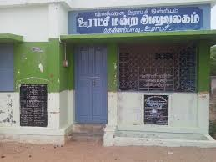
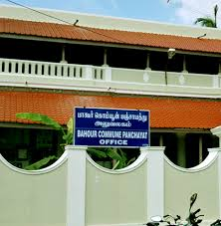
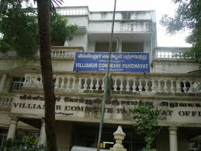
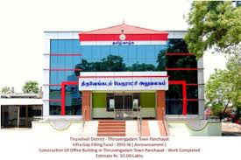
Pictures
Village Panchayat Offices

Slide 79
District Board or Zila Parishads
Establishment | Functions | Sources of Revenue
It was established at district level The territorial jurisdiction of a district board is generally a revenue district | It is a co-ordinating body which exercises general supervision over the working of panchayat samities and advices them on implementation of Development schemes | Grants-in-aid Land Cesses Toll, fees etc., Income from property & loans Income from fairs and exhibitions Property Tax

Slide 80
District Board

Slide 81
Municipalities
Establishment | Functions | Sources of Revenue
It was established in Urban areas for looking after local affairs. | Looks after sanitation public health, local roads, lighting, water supply, cleaning of streets, maintaining parks & Gardens, Hospitals , dispensaries, drainage, education, fair and exhibition etc., | Taxes on property Taxes on goods, particularly octroi and terminal tax Personal taxes, taxes on profession, trades and employment Taxes on vehicles and animals Theatre or show tax, and Grants-in-aid from state government.

Slide 82
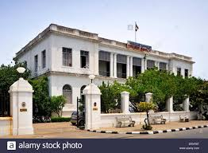
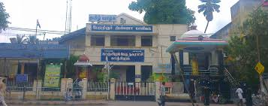
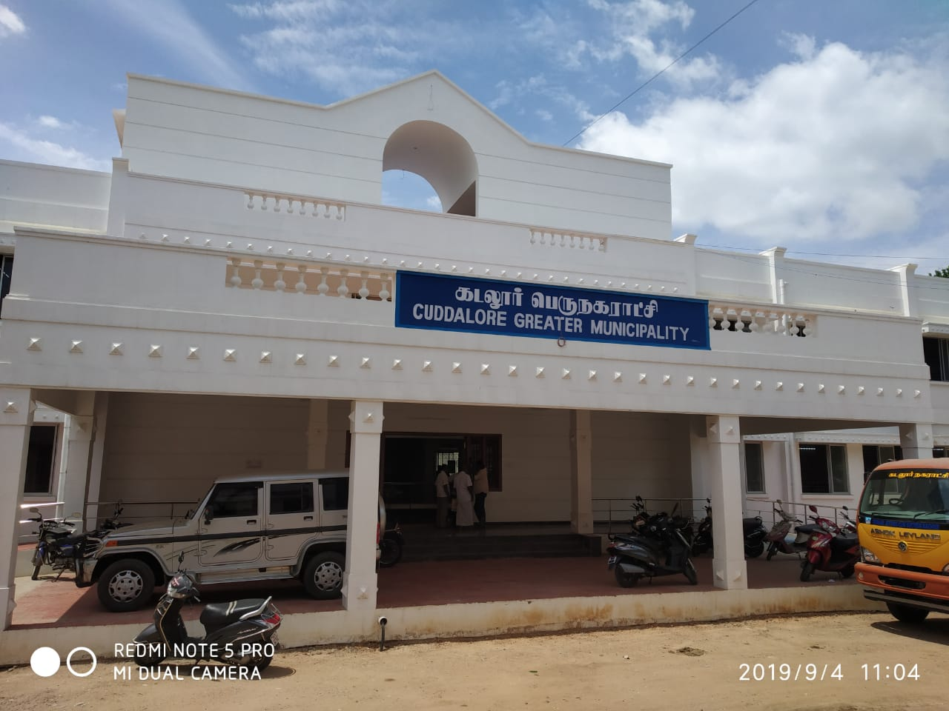
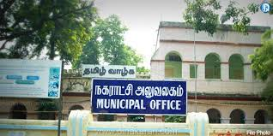
Pictures Municpallities

Slide 83
Municipal Corporation
Establishment | Functions | Sources of Revenue
The Municipal corporation have wide powers and enjoy greater freedom as compared to municipalities | Water supply & drainage lighting, roads, slum clearance, housing and town planning etc., | Tax on property, Tax on vehicles and animals, Tax on trades, calling and employment, Theatre and show tax, Taxes on goods brought into the cities for sale, Taxes on advertisements, Octroi and terminal tax etc.

Slide 84
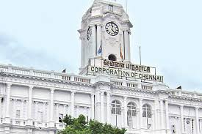
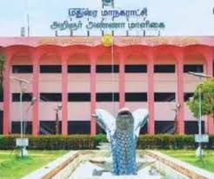
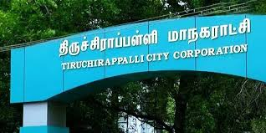
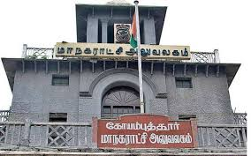
corporation

Slide 85

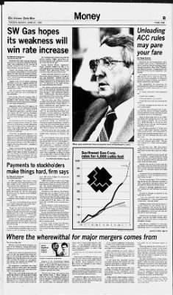
Fiscal Policy
Meaning
In common parlance fiscal policy means the budgetary manipulations affecting the macro economic variables
Definitions
“The term fiscal policy refers to a policy under which the Government uses its expenditure and revenue programmes to produce desirable effects and avoid undesirable effects on the national income, production and employment”
– Arthur Smithies
“By fiscal policy is meant the use of public finance or expenditure, taxes, borrowing and financial administration to further our national economic objectives”
– Buehler

Slide 86
Fiscal Instruments
Instrument | Description
Taxation | It transfer income from the people to Govt. It may be either direct or indirect Increase in Tax reduces disposable income To control inflation, taxation should be raised
Public Expenditure | It raises wages and salaries of the employees and thereby the aggregate demand for goods and services It is raised to fight recession and control inflation.
Public Debt | When the Government borrows by floating a loan, there is transfer of funds from the public to the Government. At the time of interest Payment and repayment of Public debt funds are transferred from Government to Public

Slide 88
Objectives of Fiscal Policy
Full Employment
Price Stability
Economic Growth
Equitable distribution
External stability
Capital formation
Regional balance

Slide 89
S.No. | Objectives | Descriptions
1. | Full Employment | It is the common objective in both developed & developing countries It helps to create employment opportunities Rural employment programmes like MGNREGS is aimed at employment generation
2. | Price stability | it is caused by mismatch between aggregate demand and aggregate supply Inflation is due to excess demand for goods. Taxation of income is the best measure if excess demand is due to private spending. To fight depression the Government needs to increase its spending & reduce taxation
3. | Economic Growth | It is used to increase the productive capacity of the economy Tax holidays and tax rebates for new industries stimulates investment Public sectors investments are to be increased to fill the gap left by private investment.
4. | Equitable distribution | Progressive rates in taxation help to reduce the gap between rich and poor. Public expenditure through welfare schemes such as free education, noon meal for school children and subsidies promote the living standard of people
5. | Exchanges stability | Tax concession & subsidy to export oriented units help to boost exports Customs duty on import help to cut import bill The reduction in import duty on import enables reduction in cost and make the exports competitive
6. | Capital formation | It is essential for economic development Tax relief, increase disposable income, savings and thereby capital formation Govt expenditure on infra structure encourages private investment.
7. | Regional balance | Fiscal incentives for industries help to narrow down regional imbalances. Public expenditure helps to start industrial estates in backward region and stimulates it

Slide 90
Conclusion
Revenue and expenditure of the centre, state and local Government.
Public Revenue, Public expenditure. Public Debt, fiscal administration & Fiscal policy – Objectives & function.
Budget and its types
Local bodies – establishment, function and source of income .
Taxes – Types, need, evasion, sources etc.,
There is a close association between government spending, private investment, interest rate, consumption and income growth.

Slide 91

Prepared by.
K. Shanthi MA .MED
Vice Principal
Alpha Matric Higher Secondary School,
Pondicherry

Slide 92





