Slide 1
www.Padasalai.Net
TIGHT CORNERS
BY
E.V.LUCAS

Slide 2
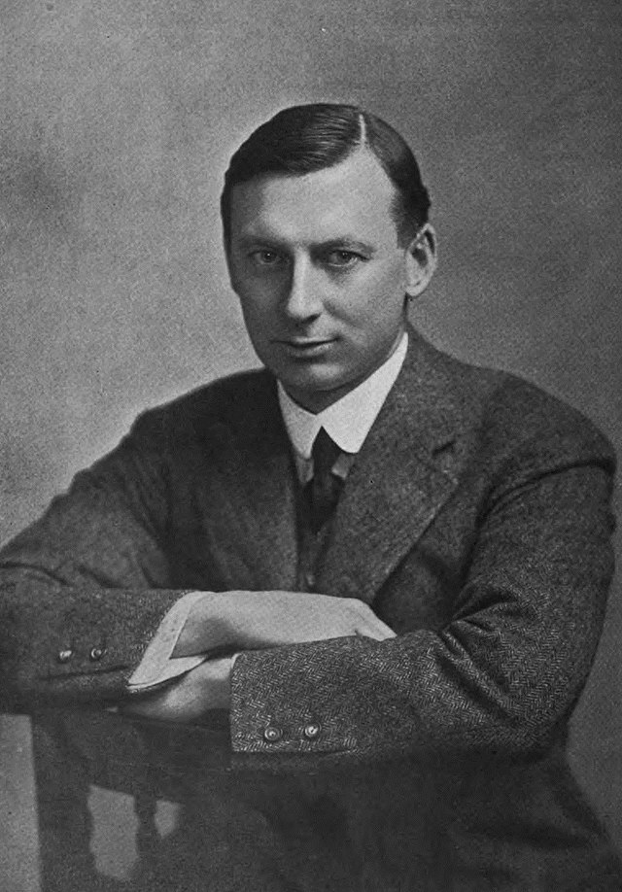
Edward Verrall Lucas, (1868 – 1938) was an English humourist, essayist, playwright, biographer, publisher, poet, novelist, short story writer and editor. Born to a Quaker family on the fringes of London, Lucas began work at the age of sixteen, apprenticed to a bookseller. After that he turned to journalism, and worked on a local paper in Brighton and then on a London evening paper. He was commissioned to write a biography of Bernard Barton, the Quaker poet. This led to further commissions, including the editing of the works of Charles Lamb. Lucas joined the staff of the humorous magazine Punch in 1904, and remained there for the rest of his life. He was a prolific writer, most celebrated for his short essays, but he also produced verses, novels and plays.

Slide 3
www.Padasalai.Net
In ‘Tight Corners’, E.V. Lucas narrates
the story of how he was rescued from
humiliation at an auction house, by a
sudden stroke of luck. Let’s read on and
get to know how he got himself in a tight
corner and found his way out of that
situation.

Slide 4
The talk was running of the critical situations in which they had found themselves

Slide 5
One man had been caught by the tide in Brittany and escaped by the skin of his teeth

Slide 6
Another had been on an elephant when a wounded tiger charged at it.

Slide 7
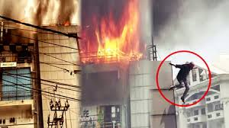
A third had been on the top storey of a burning building

Slide 8
A fourth one was torpedoed in the war

Slide 9
The narrator told that tight corners can be tighter when they are mental.And he started to tell his experience at Christie’s

Slide 10
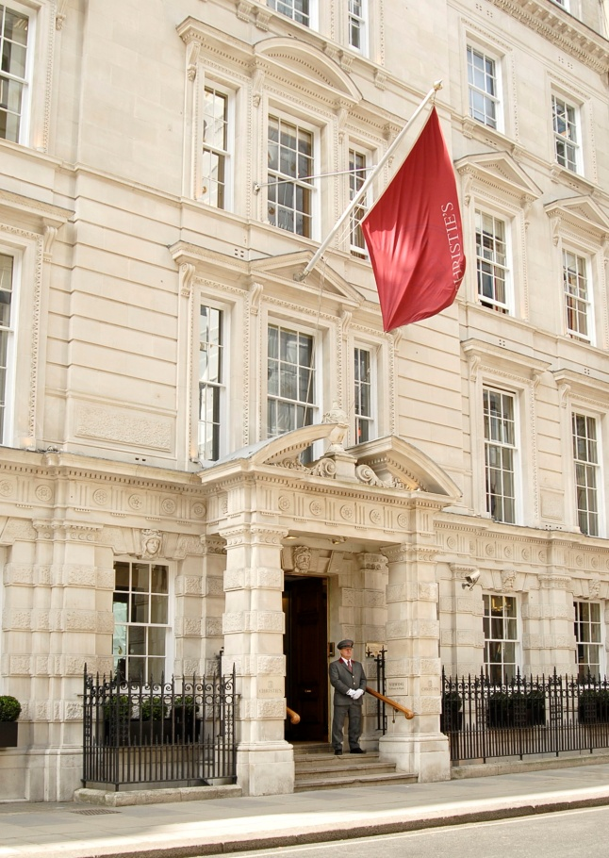
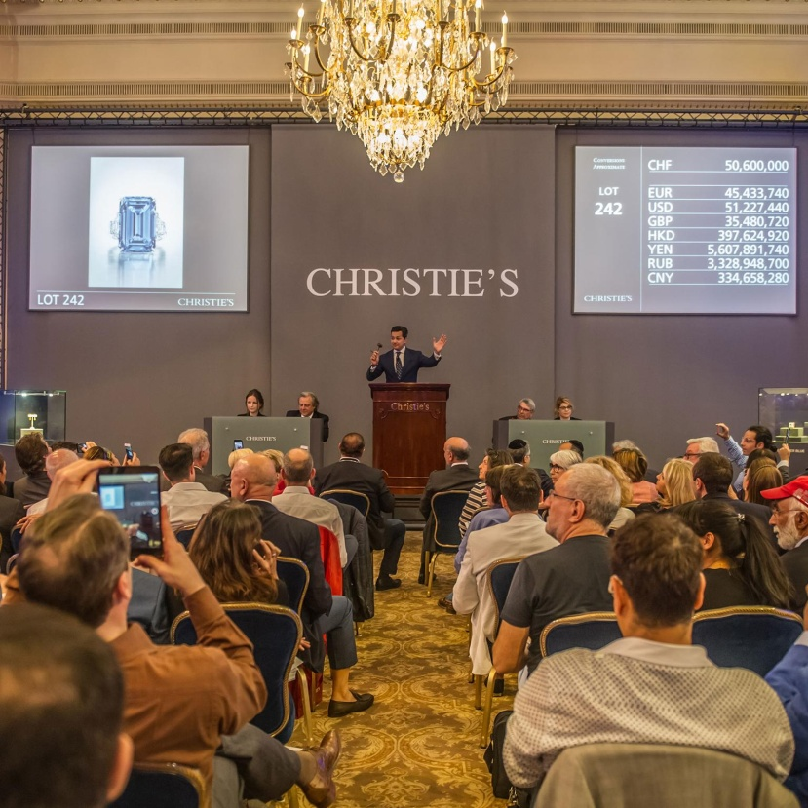
The narrator entered Christie’s as his friend persuaded him to visit the sale - room

Slide 11
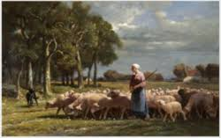
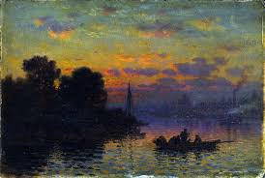
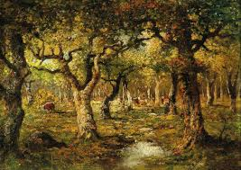
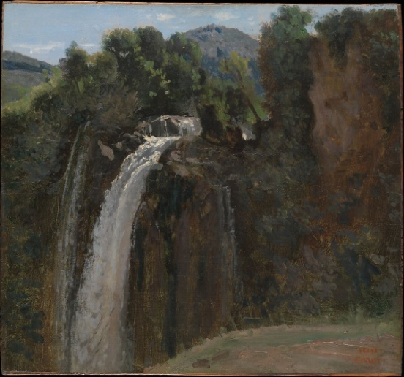
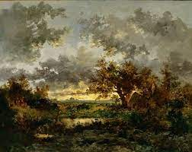
They were selling Barbizon pictures, and getting tremendous sum for each

Slide 12
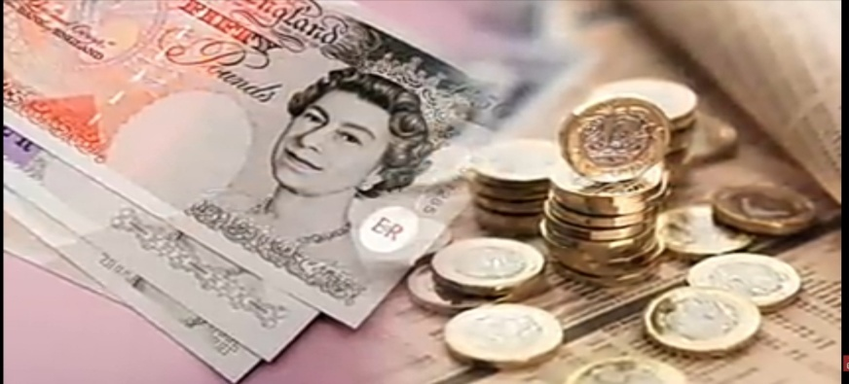
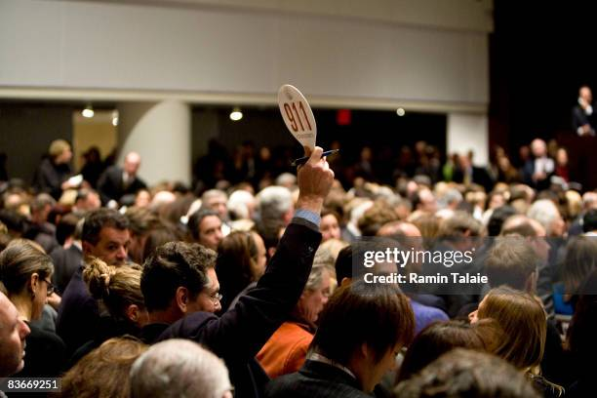
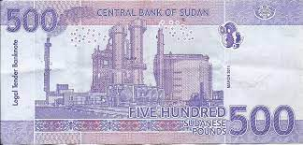
The narrator found himself bidding too just for fun. He had sixty – three pounds in the bank and not enough securities to borrow even five hundred pounds.

Slide 13
His friend warned him that he would get caught. The narrator told that he was not going to run any risks.

Slide 14
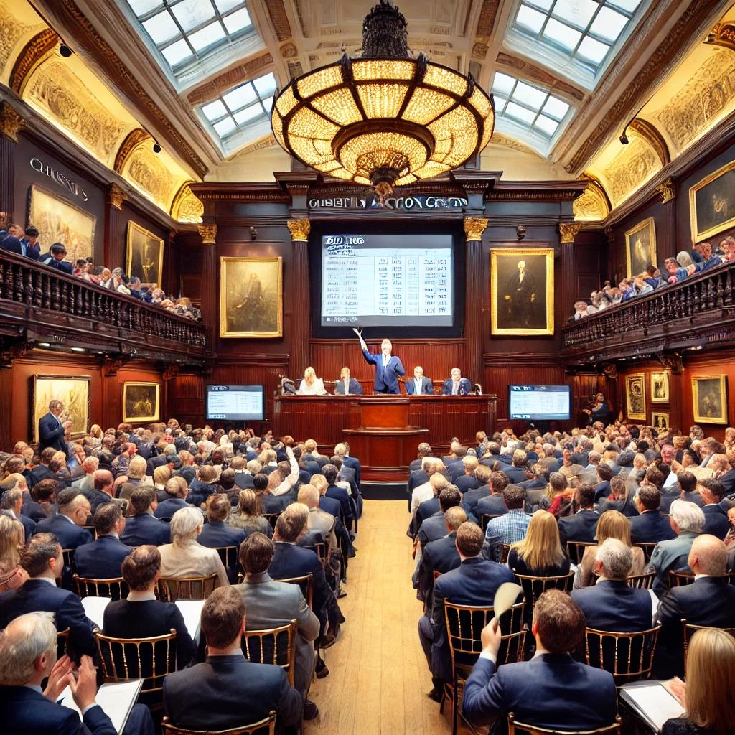
Everytime, someone else made a higher bid and the narrator was not caught.

Slide 15
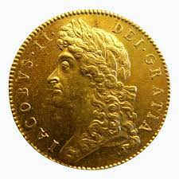
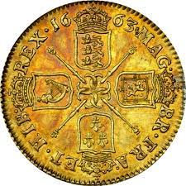
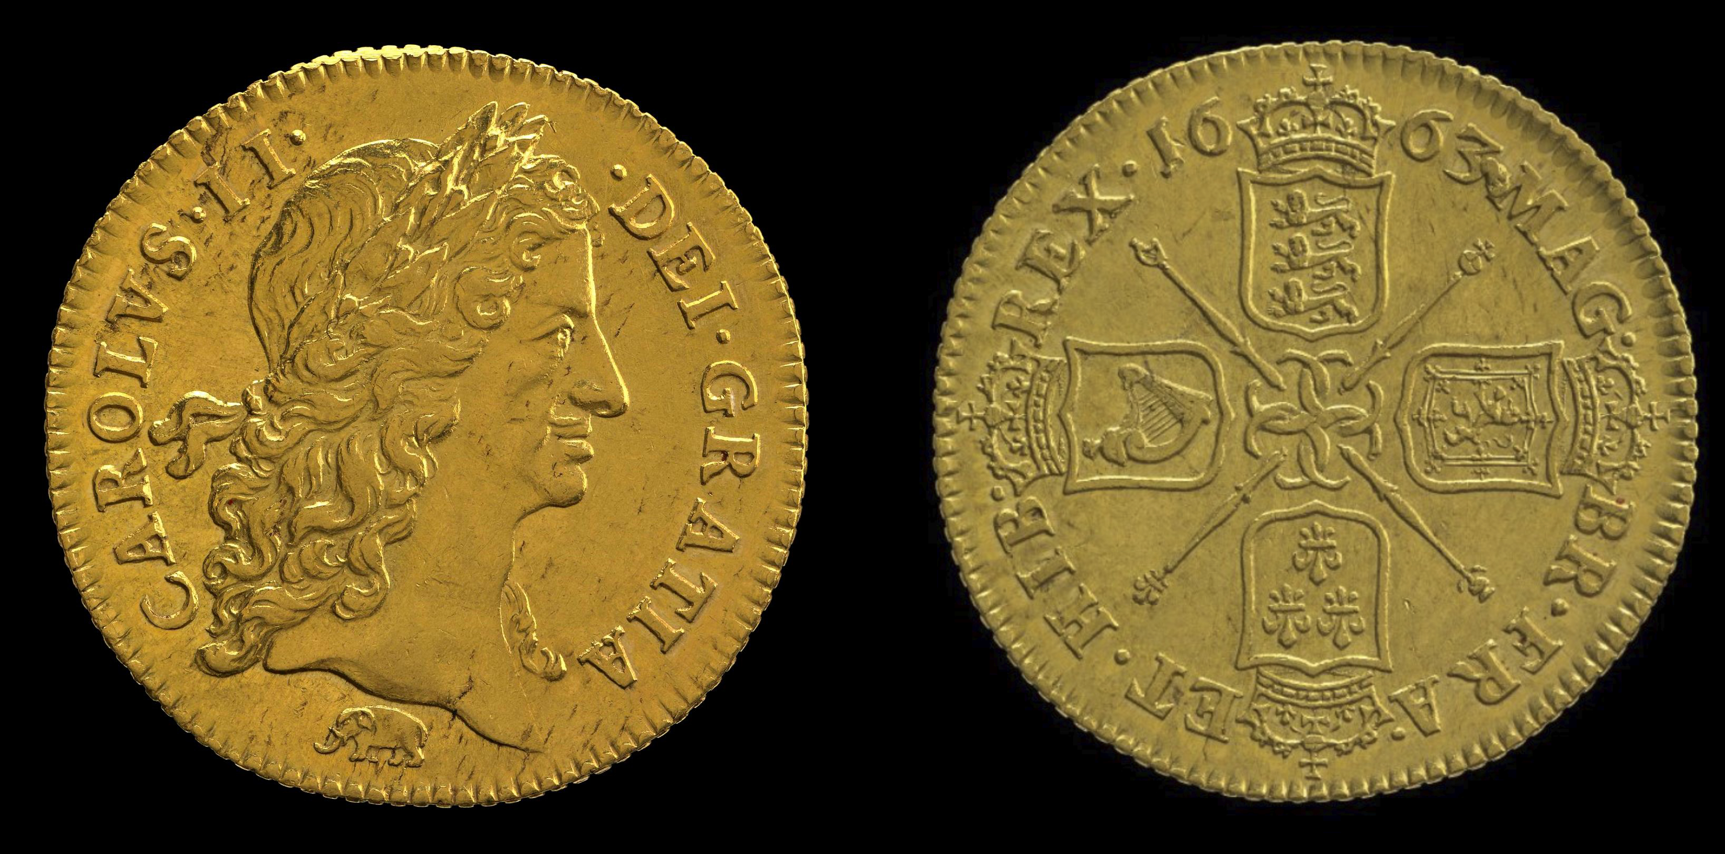
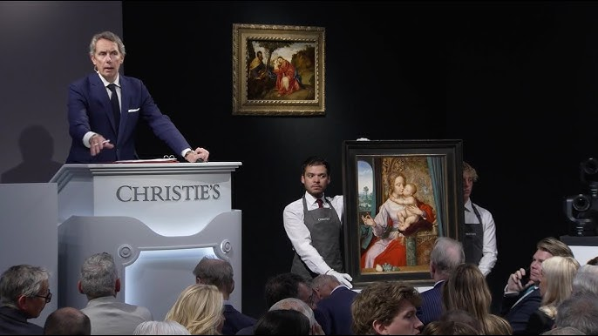
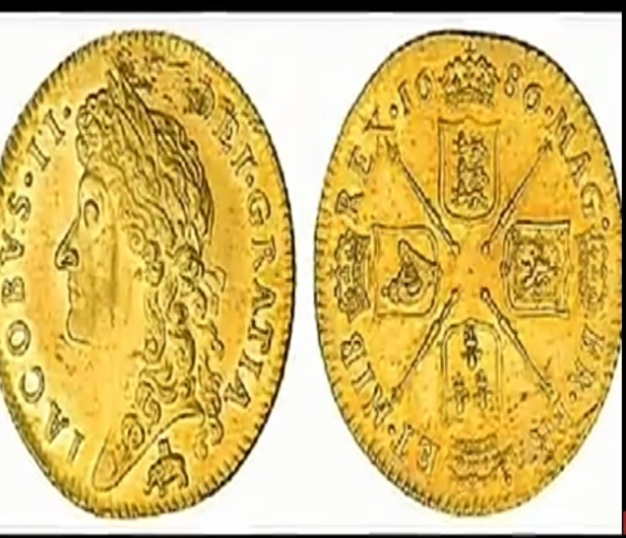
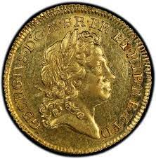
After sometime, a picture was put up and a bid for 4000 guineas was raised

Slide 16
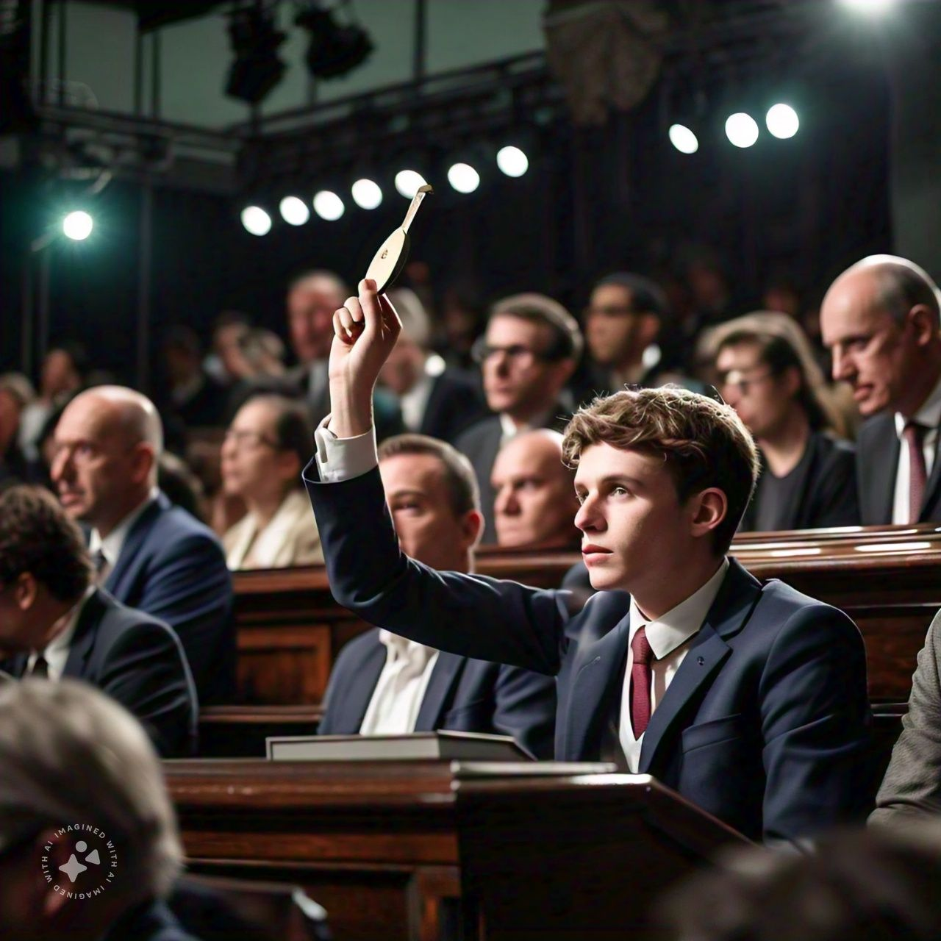
The narrator on a sudden impulse added 50 more guineas, to the amount offered

Slide 17
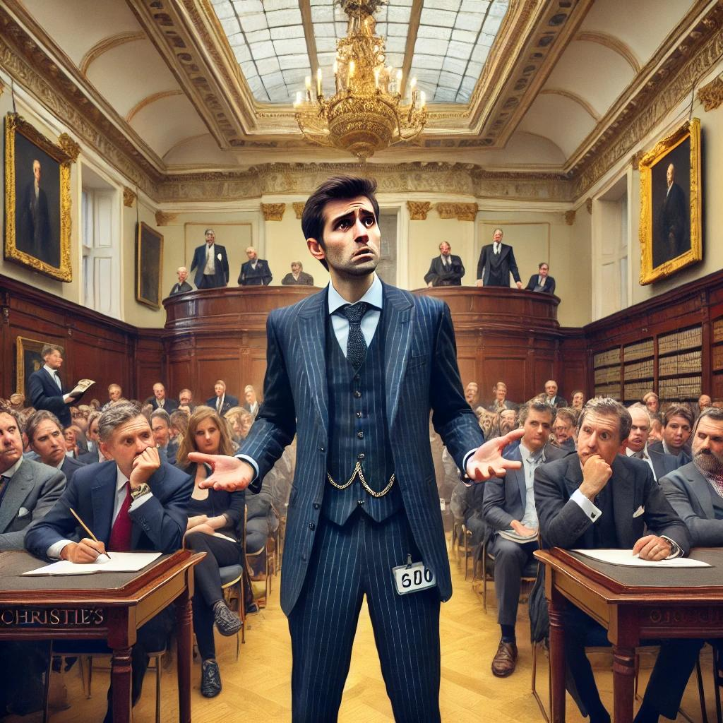
Unfortunately he had made the highest bid

Slide 18
The picture was declared sold to the narrator

Slide 19
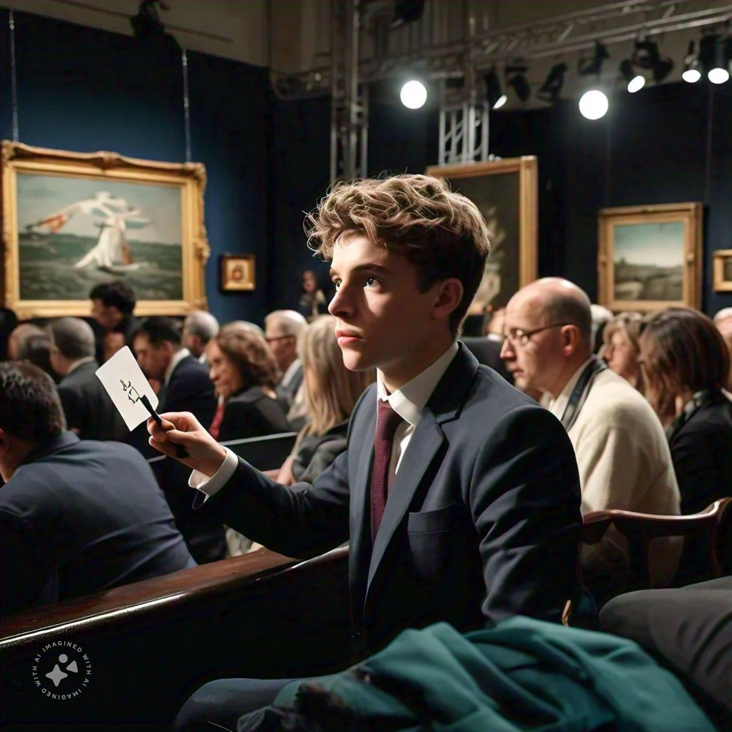
What shall I do now? I have only 63 pounds
The narrator suddenly remembered that he had only sixty three pounds

Slide 20
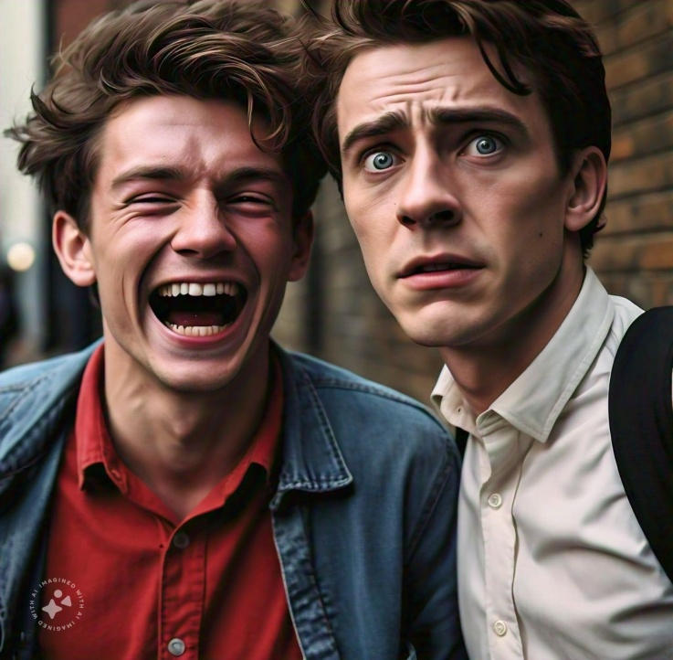
His friend had left the place roaring with laughter at the narrator’s predicament. He left the place in order to find a remote place in which to lean against the hall and laugh.

Slide 21
Who will help me? Friends or relations?
He was running over the names of uncles and other persons from whom it might be possible to borrow, but wasn’t;

Slide 22
Shall I approach private lenders
He was wondering if he could approach a private money lender to get a loan

Slide 23
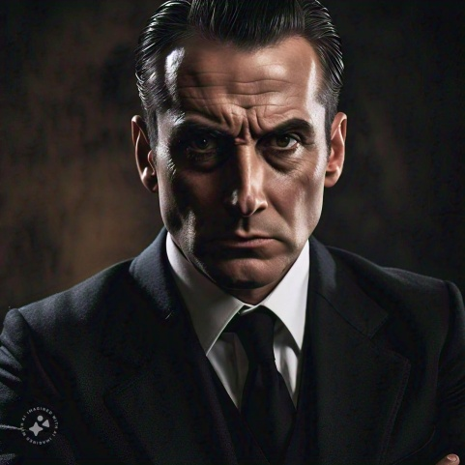
Shall I confess that I have no money ?
He even thought of confessing that he was not so rich. But he was afraid to do so as the staff of Christie looked prosperous and unsympethetic.

Slide 24
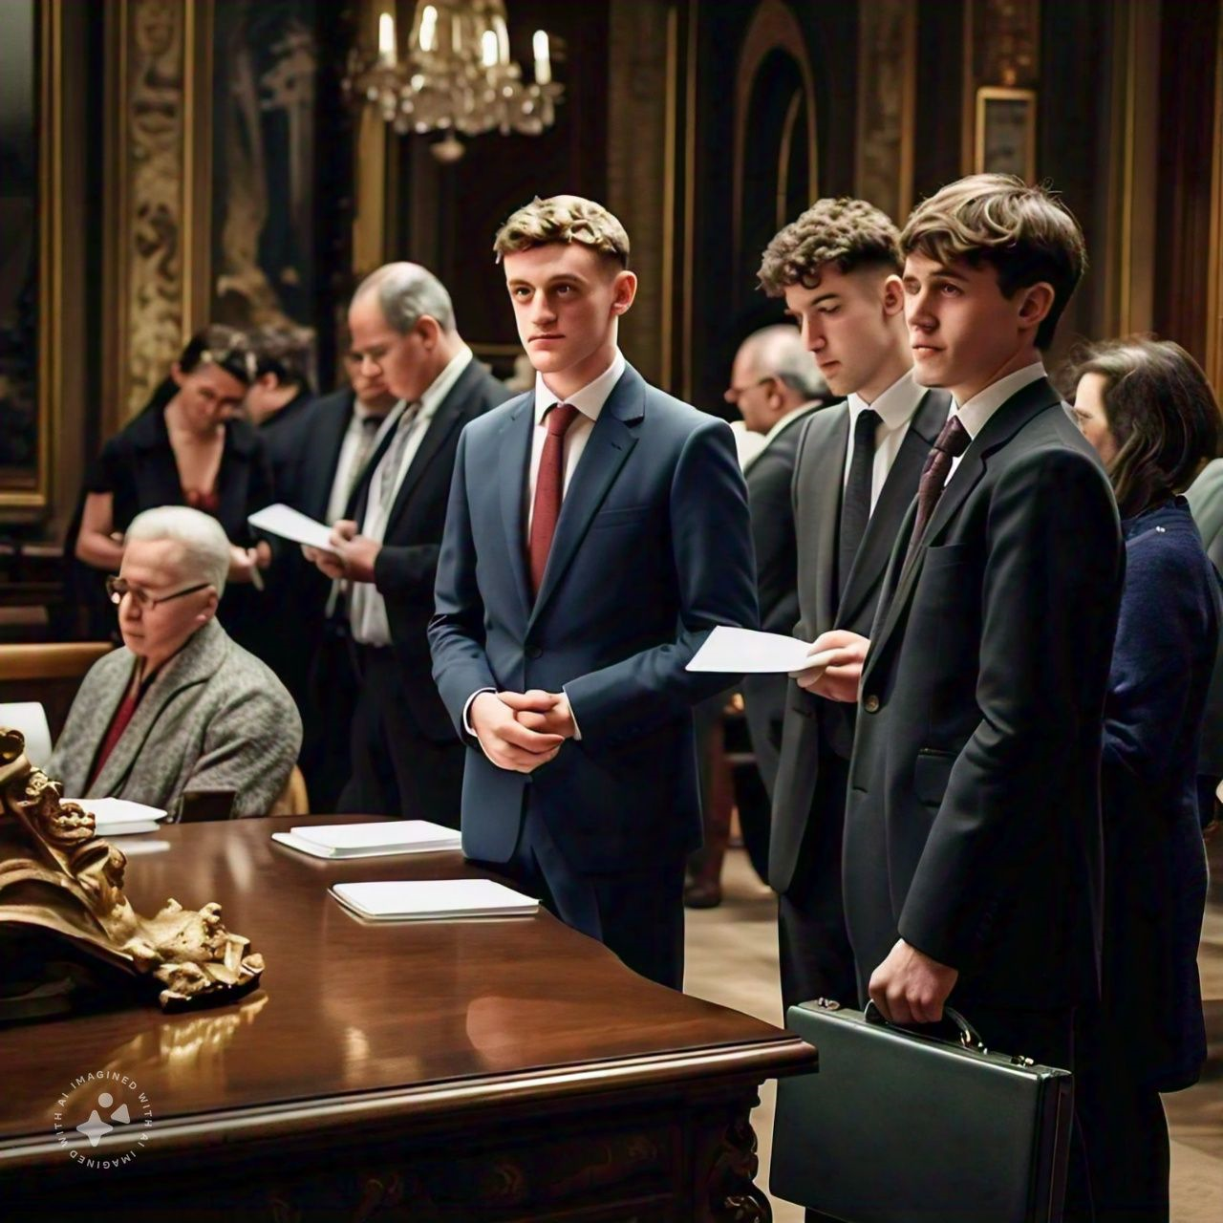
Meanwhile the sale came to an end and the narrator stood on the outskirts of the little knot of buyers round the desk who were writing cheques and giving instructions. Naturally he preferred to be the last

Slide 25
It was there that he was joined by his friend; but only for a moment, for on a look at his face he rammed his handkerchief in his mouth and again disappeared.

Slide 26
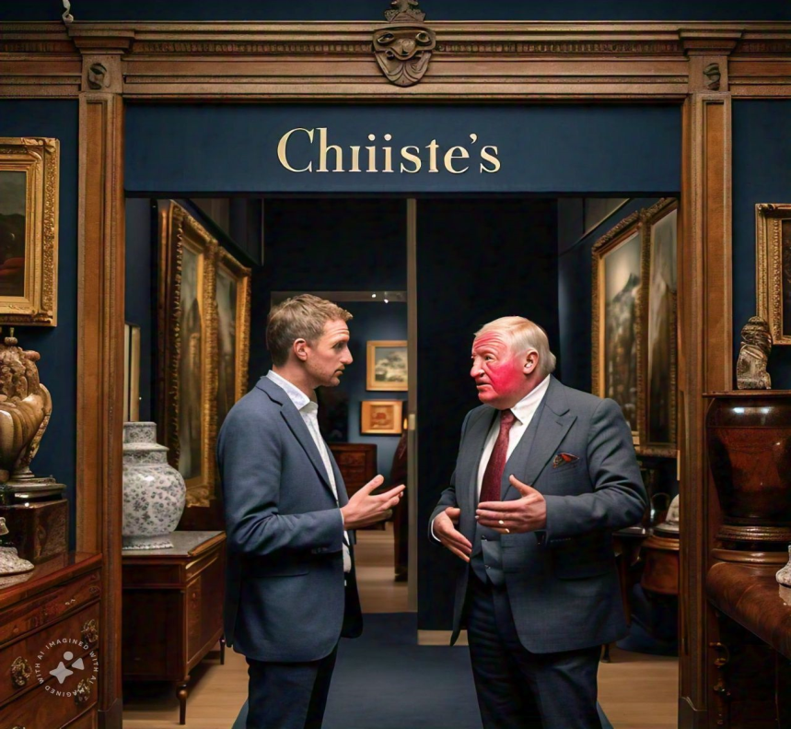
A man approached the narrator and asked if he was the gent who bought the big Daubigny?.
The narrator admitted it.
And then the inexpected happened. The man said that the gent who offered four thousand guineas wants to know if the narrator would take fifty guineas for his bid.”

Slide 27
“Is that the most he would offer?”, the narrator asked with the presence of mind.
“It’s not for me to say,” he replied. “No ‘arm in trying for a bit more, is there?”
“Tell him I’ll take a hundred,” the narrator said. And he got it.

Slide 28
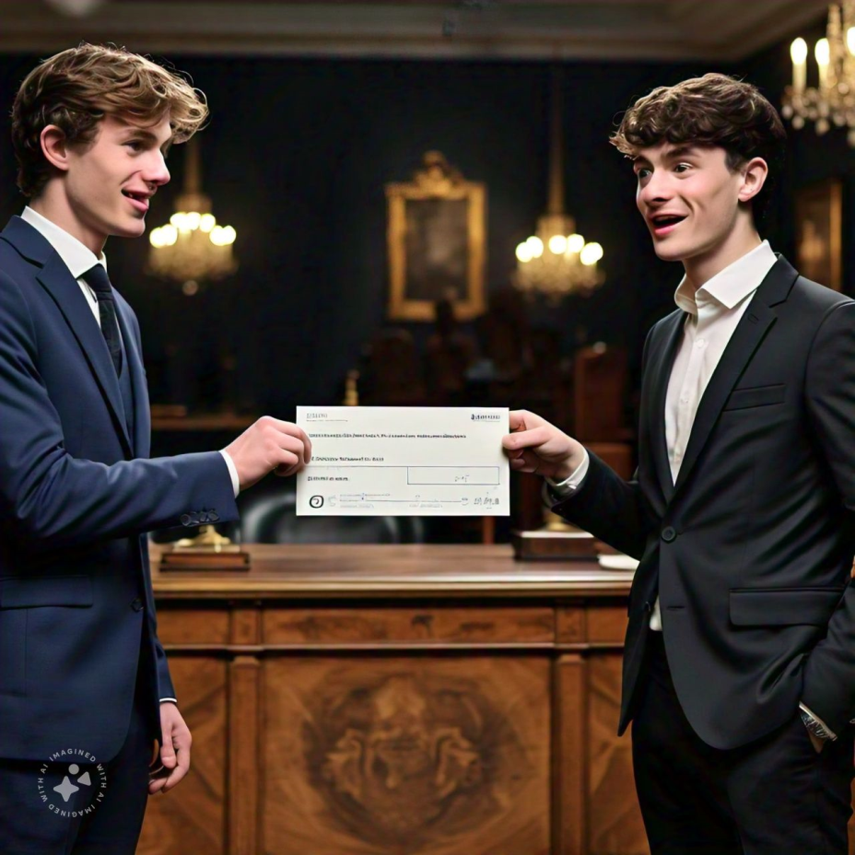
When the narrator found his friend he was laughing too, but he became grave at once on seeing the cheque.
“Well, I’m hanged!” he said. “Of all the luck! Well, I’m hanged!” Then he said, “Don’t forget that if it hadn’t been for me, you wouldn’t have come into Christie’s at all.”
“I shall never forget it,” the narrator said “It is indelibly branded in letters of fire on my heart. My hair hasn’t gone white, has it?”
Thus the narrator got out of a mental tight corner with a sudden stroke of luck.

Slide 29
GLOSSARY
Brittany – a region on the coast of North–West France
St. James’ Street, King Street – well-known commercial streets in London
bloatocrat – a fat and rich person of high station – a term coined by E.V. Lucas by blending the words ‘bloated’ and ‘aristocrat’
electrified – shocked by something unexpected
crescendo – progress towards a climax
congealed – thickened as if frozen (through fear etc.)
smothered – suppressed
nonchalantly – unconcernedly, coolly
glibly – smoothly but not sincerely
note of hand – promissory note
rectitude – honesty, good behaviour
farthing –as low as a paisa
baize –coarse woollen material
guile –cunning, deceit
indelible – cannot be rubbed out or removed

Slide 30
IDIOMS USED IN THE LESSON
1 alarm bells ringing --- a sign of something going wrong
2 back to the wall ---- in serious difficulty
3 grasp /clutch at straws ----- try any method to overcome a crisis
4 saved by the bell ------- help at the last moment rescuing one from a difficult
situation
5. hang out to dry ------- abandoning one who is in difficulty

Slide 31
1.tight corners - critical situation
2.shot his bolt -- to exhaust one’s
Resources too early
3.in a nice pickle - in a difficult situation
4.have cold feet -- too fearful to complete
an action

Slide 32
PRESENTED BY
N.J.GOMATHI,
PG ASSISTANT (ENGLISH)
GGHSS, WALAJAPET,
RANIPET DISTRICT,
6379464189

