Slide 1
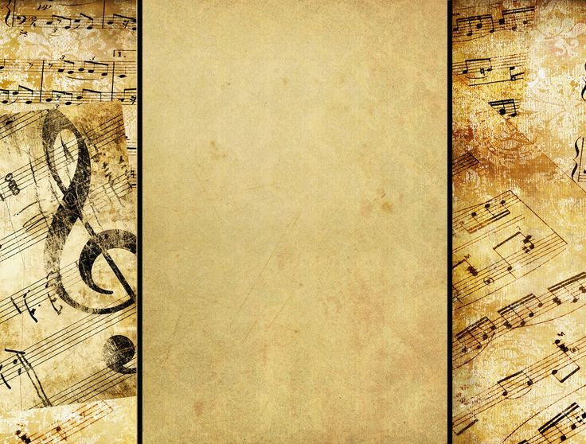
www.Padasalai.Net
THE SINGING LESSON
BY
Kathleen mansfield Murry

Slide 2
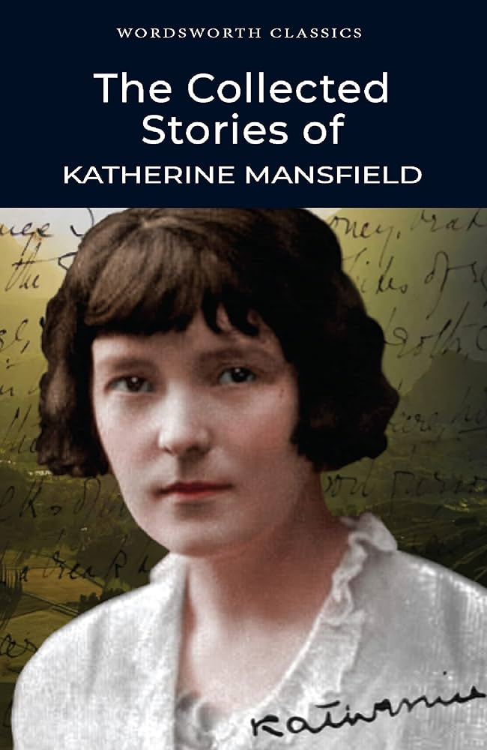
www.Padasalai.Net
Kathleen Mansfield Murry (1888 – 1923) was a New Zealand short story writer who wrote under the pen-name Katherine Mansfield. She left New Zealand at the age of 19 and settled in the United Kingdom where she gained the friendship of great writers such as D.H. Lawrence and Virginia Woolf. Bliss and The Garden Party were collections of short stories written by her. She wrote many poems and her collected letters were a great success

Slide 3
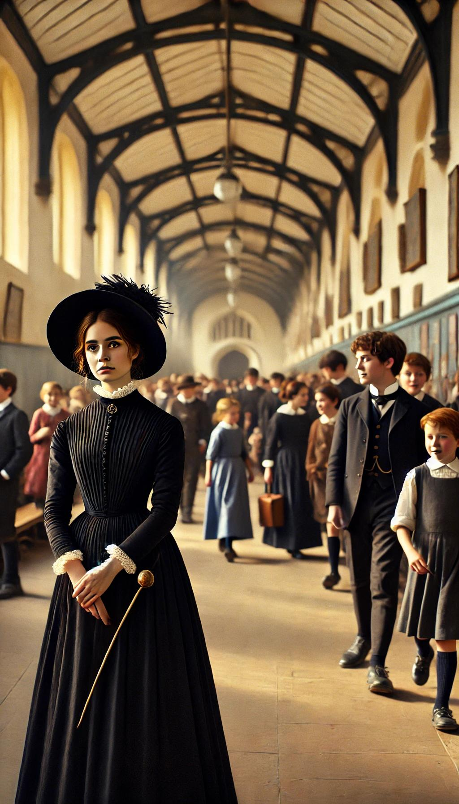
www.Padasalai.Net
The story is about the changing moods of a teacher filled with dismay. Miss Meadows, a music teacher was on her way to the music class. Usually smiling and pleasant looking Miss Meadows was totally disturbed by a letter written by her fiance. He had written that he felt strongly that their marriage would be a mistake. Miss. Meadows was not in her elements due to the letter. She was worried about the disagree she would face

Slide 4
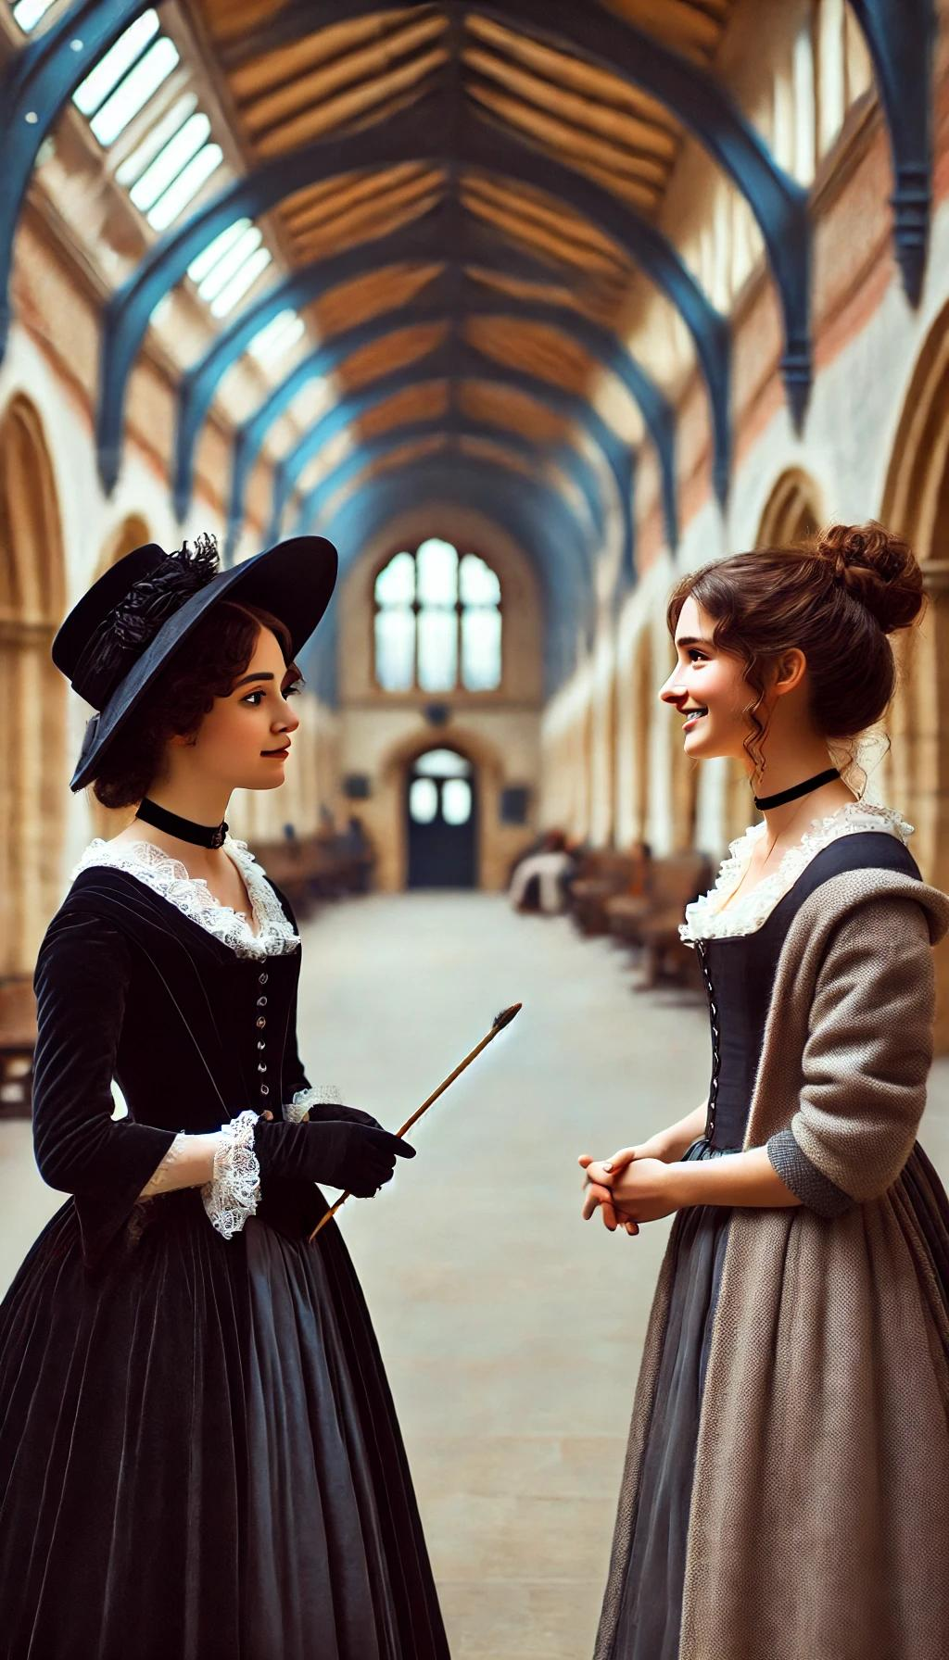
Miss. Meadows was in a gloomy mood. She met the Science mistress on her way to the music class. The Science mistress wished Miss Meadows “Good Morning”. But Miss.Meadows was not in a mood and so she was grim. The science mistress mocked at her.

Slide 5
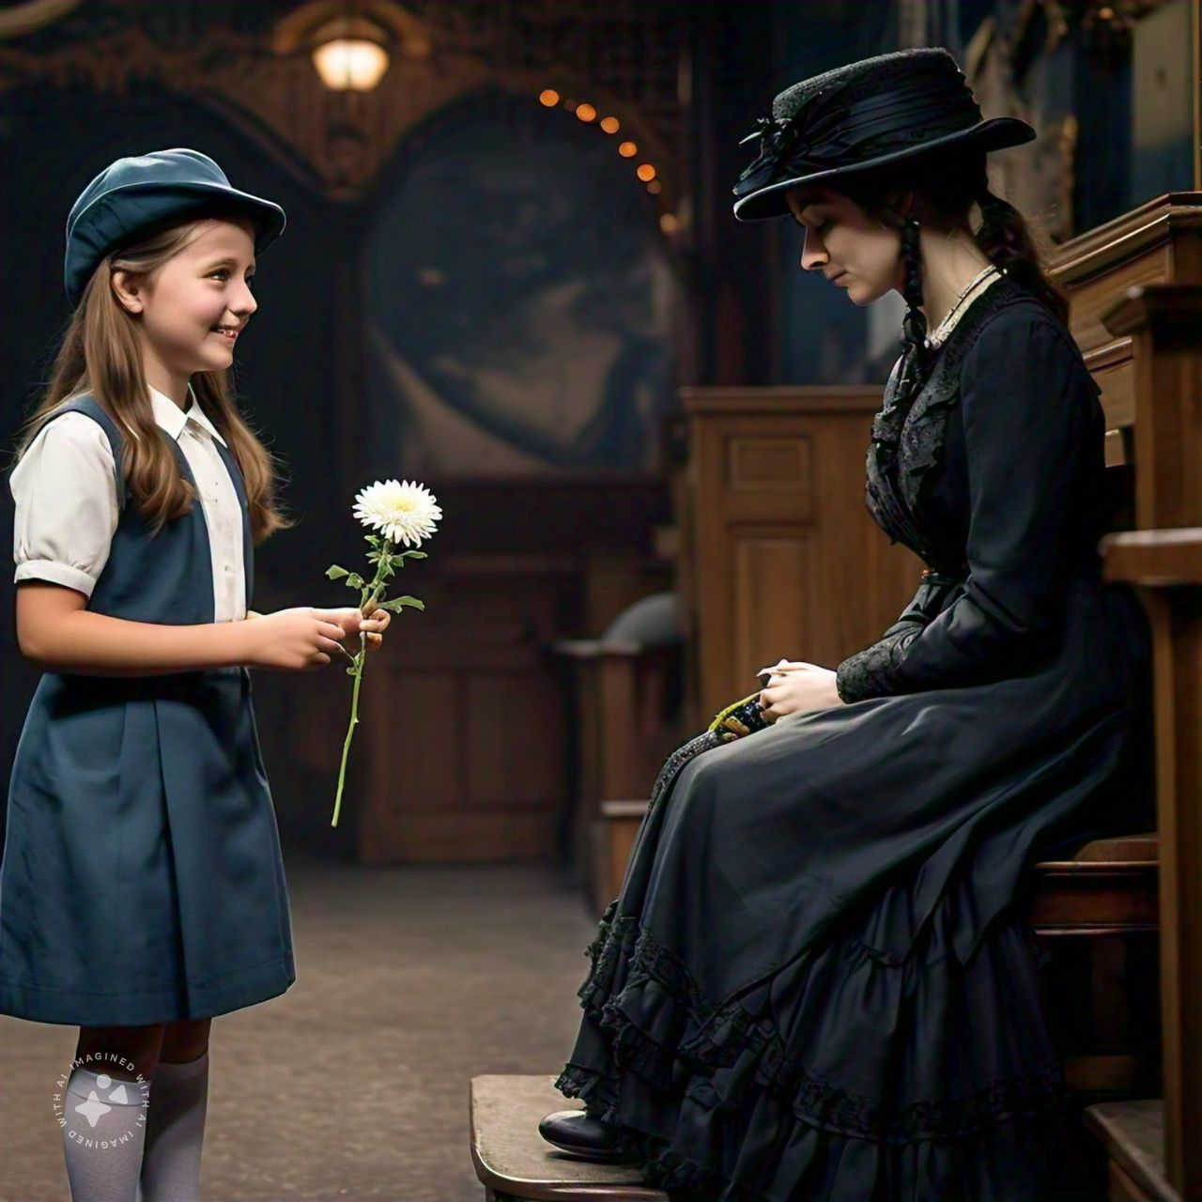
When she enters the class, Mary Beazley who was waiting for her, handed over a beautiful yellow Chrysanthemum. Miss Meadows instead tucking over it into her belt, totally ignored the flower and made reply to her greeting, but said in a voice of ice,” Page forruteen, please and mark the accent.”

Slide 6
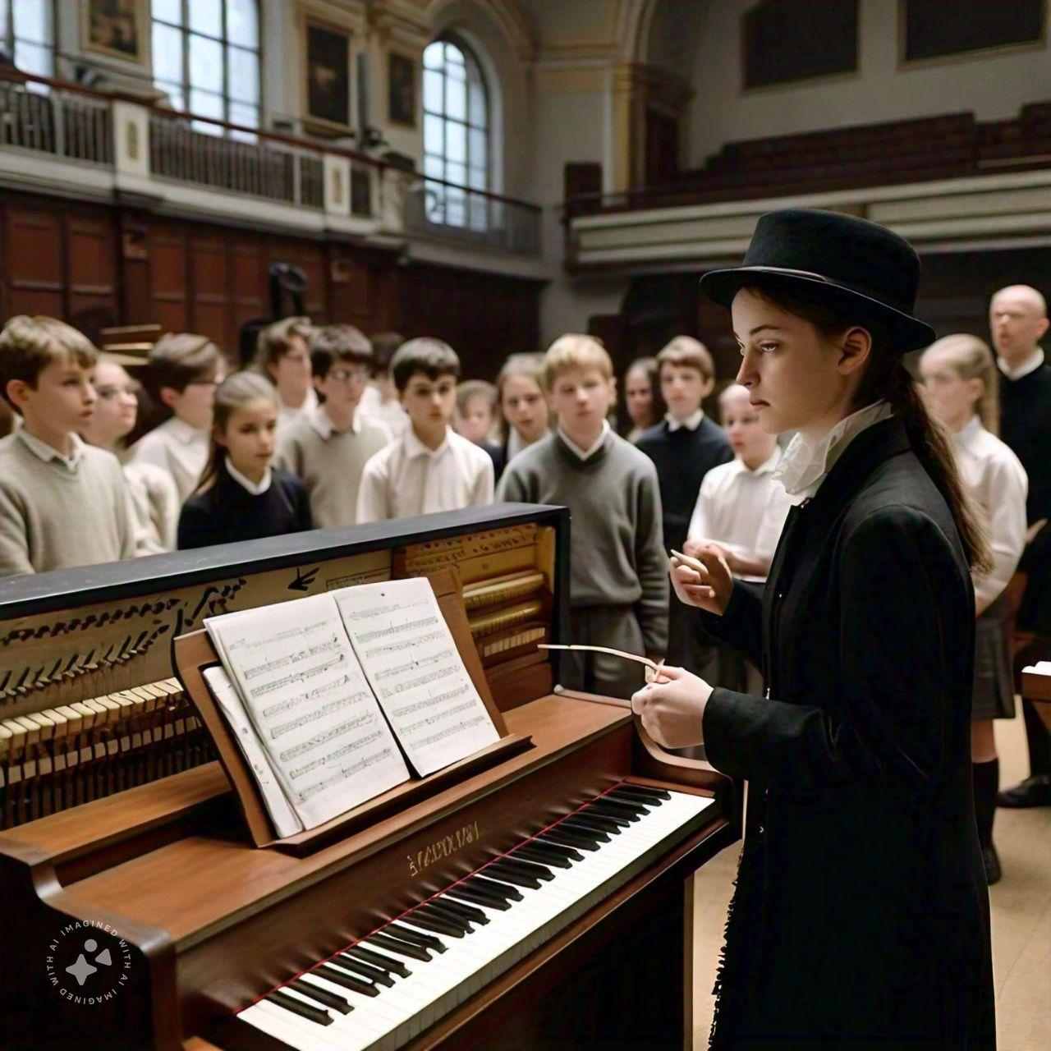
The thoughts of Basil’s change of feeling towards her tormented Miss. Meadows. The happy past memories and unhappy twist haunted her mind. She thought that basil would have been possessed to write such a letter

Slide 7
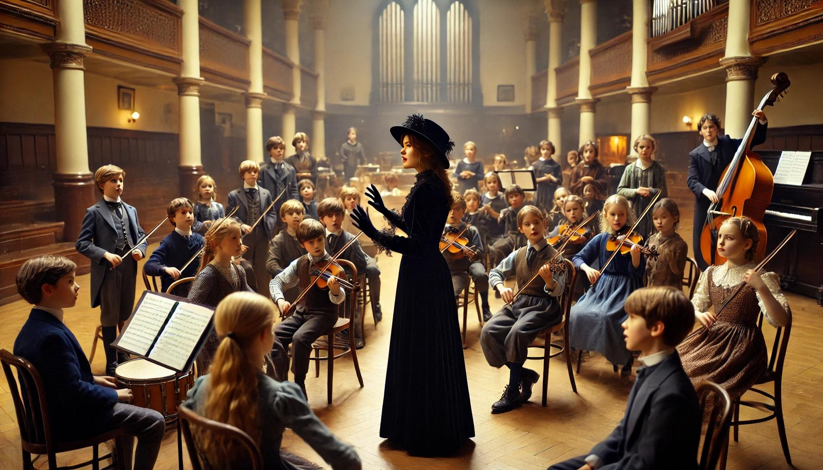
Miss. Meadows lifted her arms in the wide gown and began conducting with both hands. In line with her sad mood, Miss Meadows chose “lament” a sad song. She kept on insisting the children to be more expressive,

Slide 8
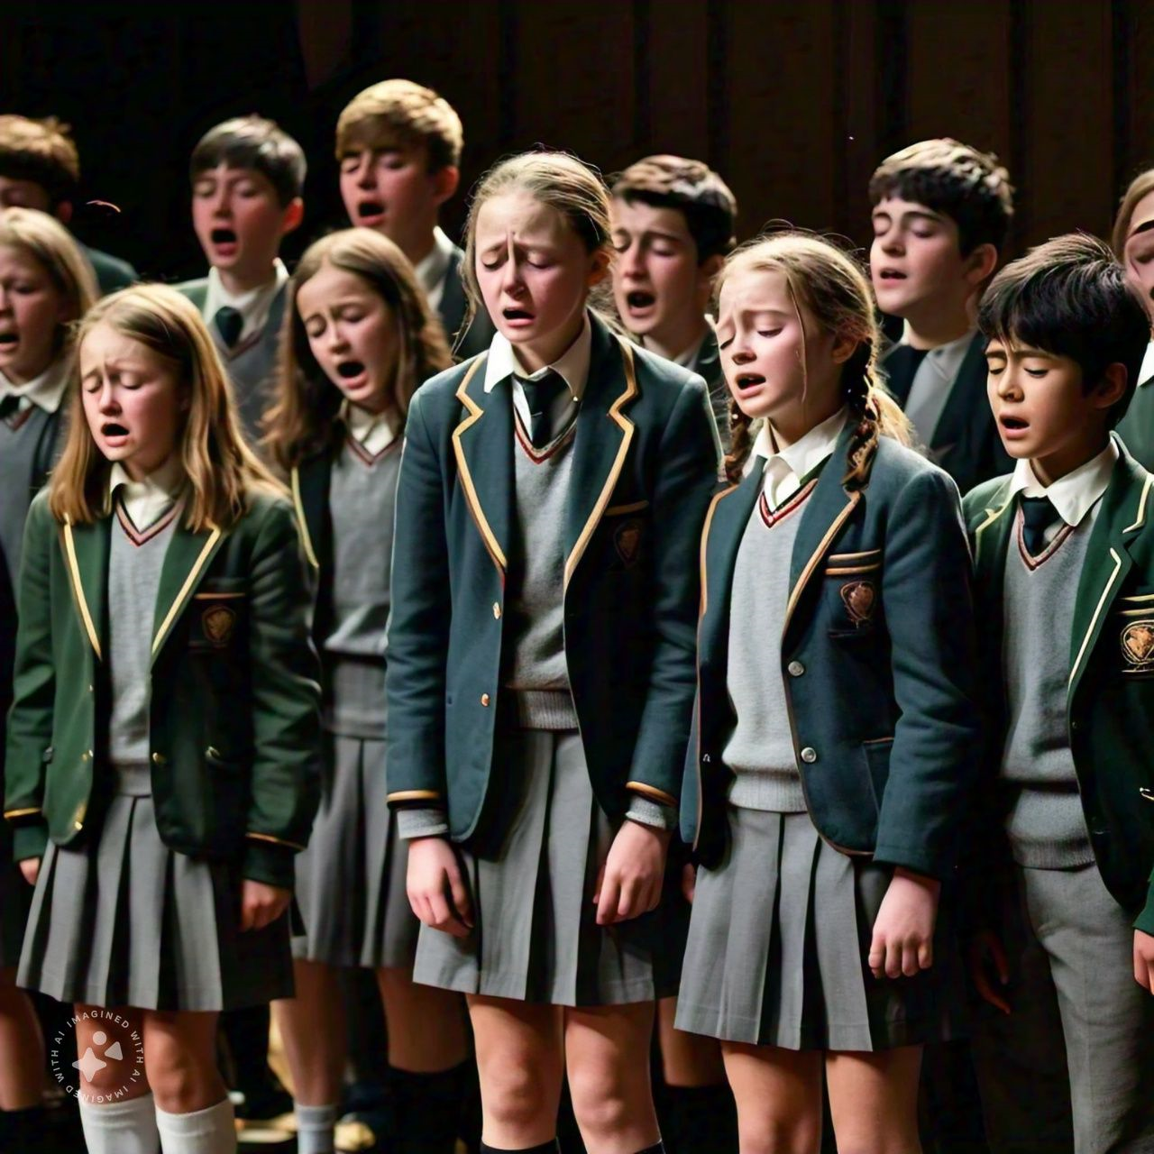
www.Padasalai.Net
She lifted her arms again and said “ fast”. Unable to bear the grief of the song, many children started blowing their noses.

Slide 9
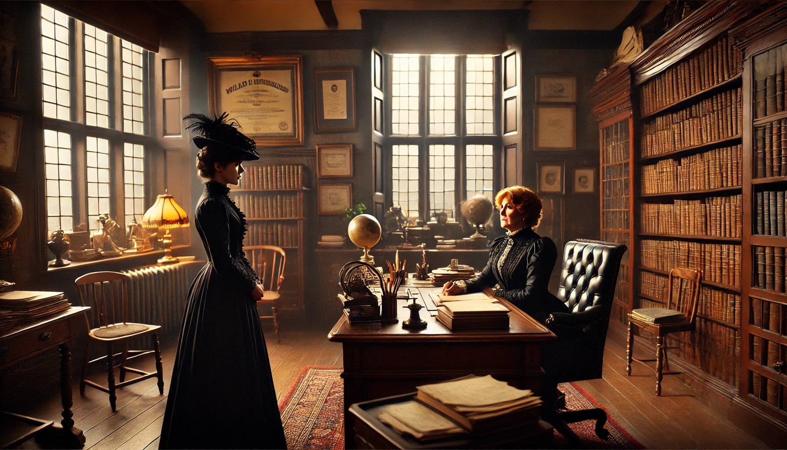
After sometime, she was called by the Head mistress Miss Wyatt.
The Headmistress called Miss. Meadows as she got a telegram.Her hand flew out, but Miss Wyatt held the telegram back a moment. "I hope it's not bad news," she said, so more than kindly. And Miss Meadows tore it open.

Slide 10
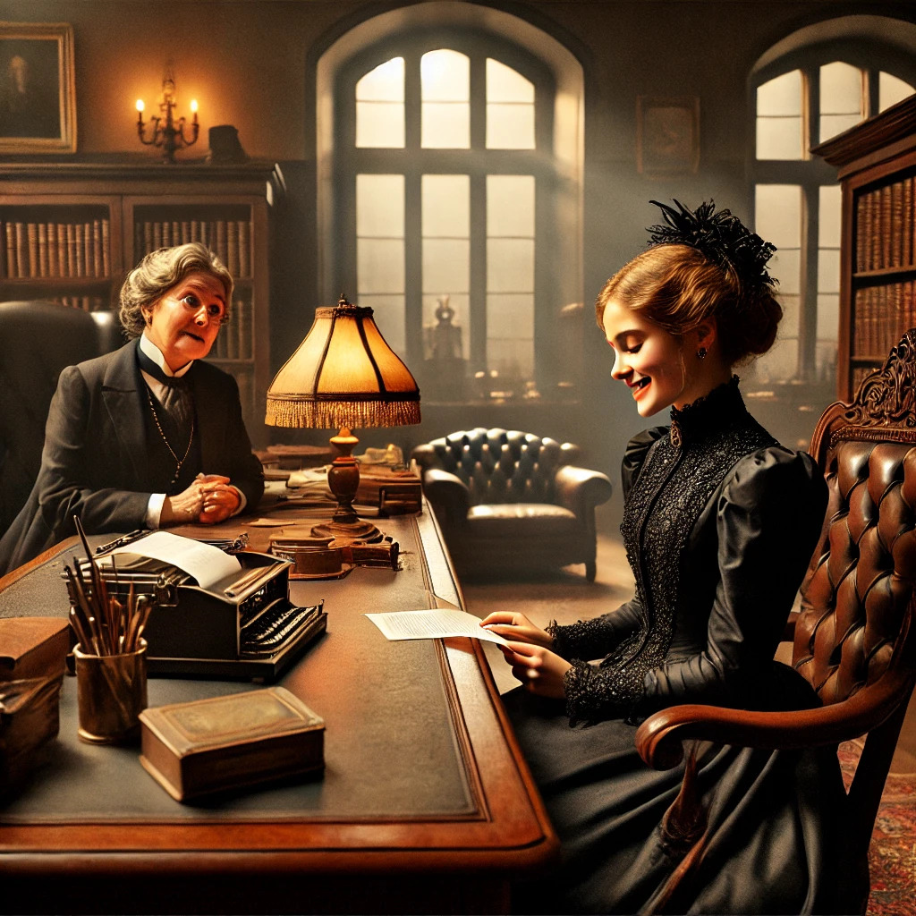
"Pay no attention to letter, must have been mad, bought hat-stand today Basil," she read. She couldn't take her eyes off the telegram.

Slide 11
"I do hope it's nothing very serious," said Miss Wyatt, leaning forward.
"Oh, no, thank you, Miss Wyatt," blushed Miss Meadows. "It's nothing bad at all. It's" – and she gave an apologetic little laugh – "it's from my fiance “

Slide 12
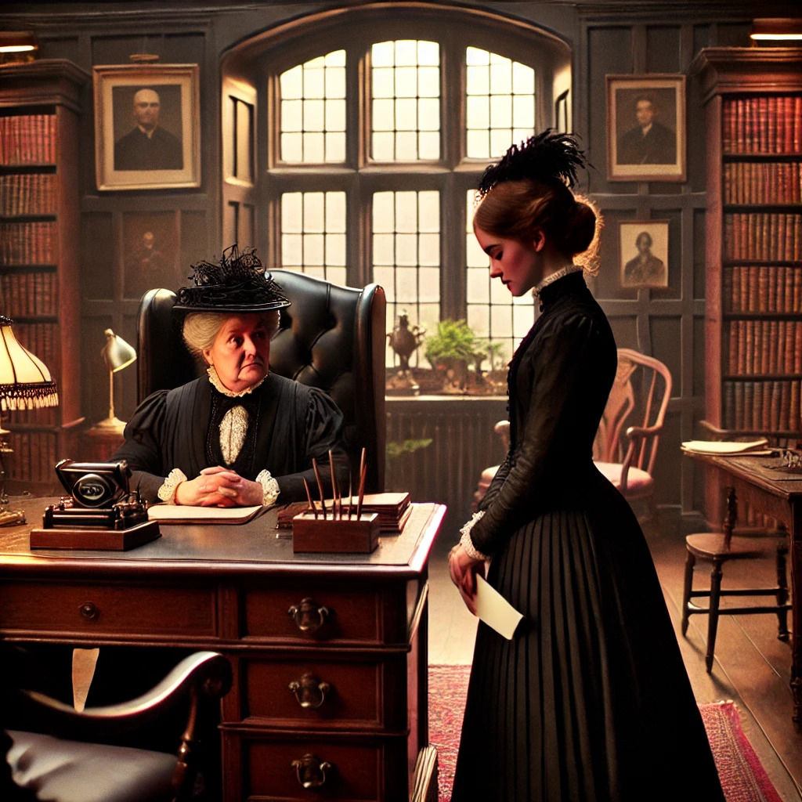
"Oh, just one minute, Miss Meadows," said Miss Wyatt. "I must say I don't approve of my teachers having telegrams sent to them in school hours, unless in case of very bad news, such as death," explained Miss Wyatt, "or a very serious accident, or something to that effect. Good news, Miss Meadows, will always keep, you know."

Slide 13
On the wings of hope, of love, of joy, Miss Meadows sped back to the music hall, up the aisle, up the steps, over to the piano.

Slide 14
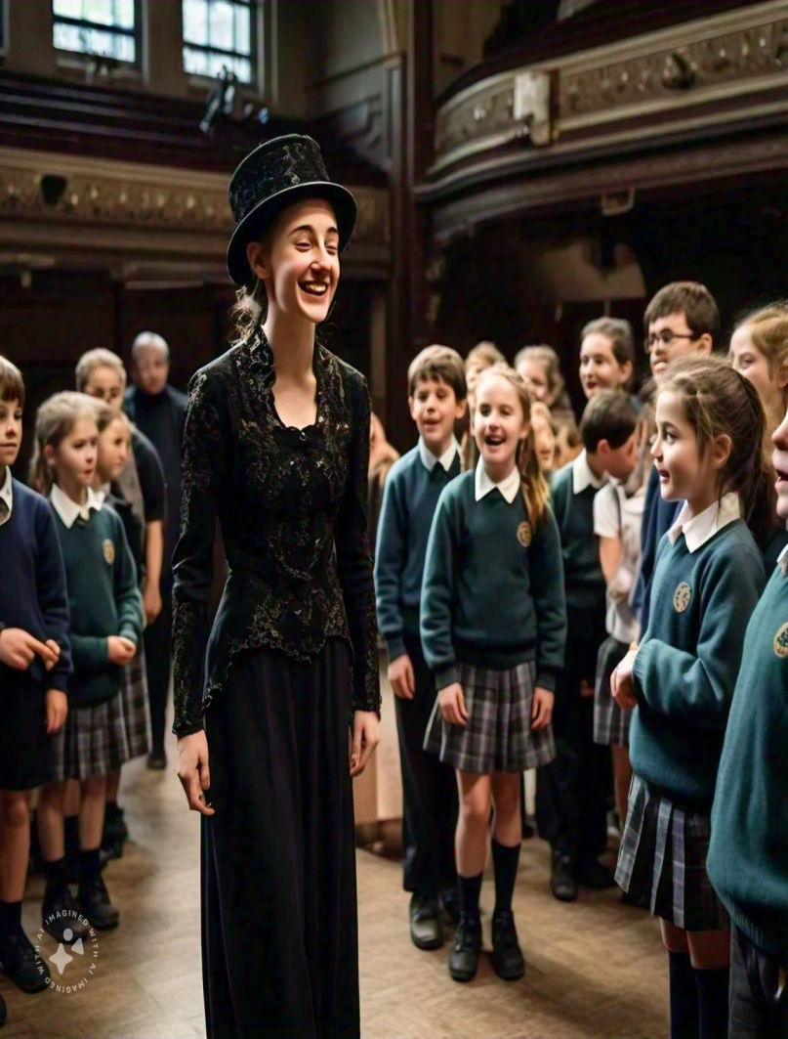
She felt happy and she chose a joyful song for the class.

Slide 15
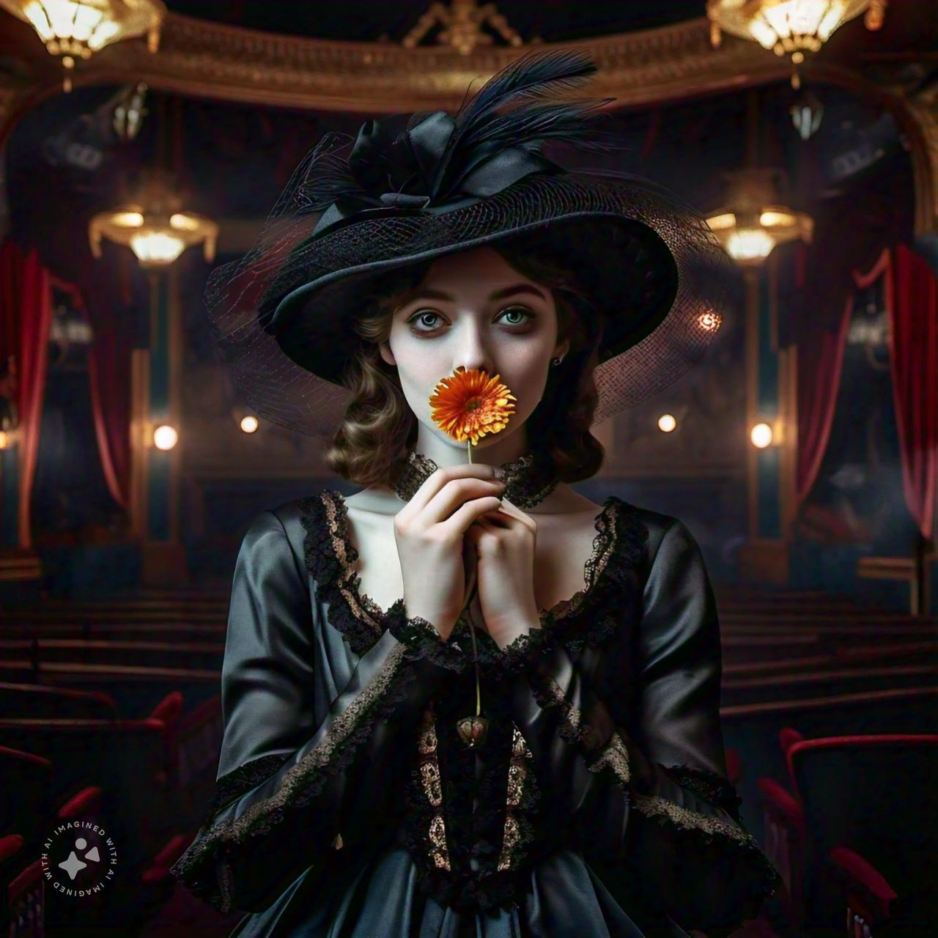
She accepted the yellow chrysanthemum, put it on her lips to hide her smile.

Slide 16
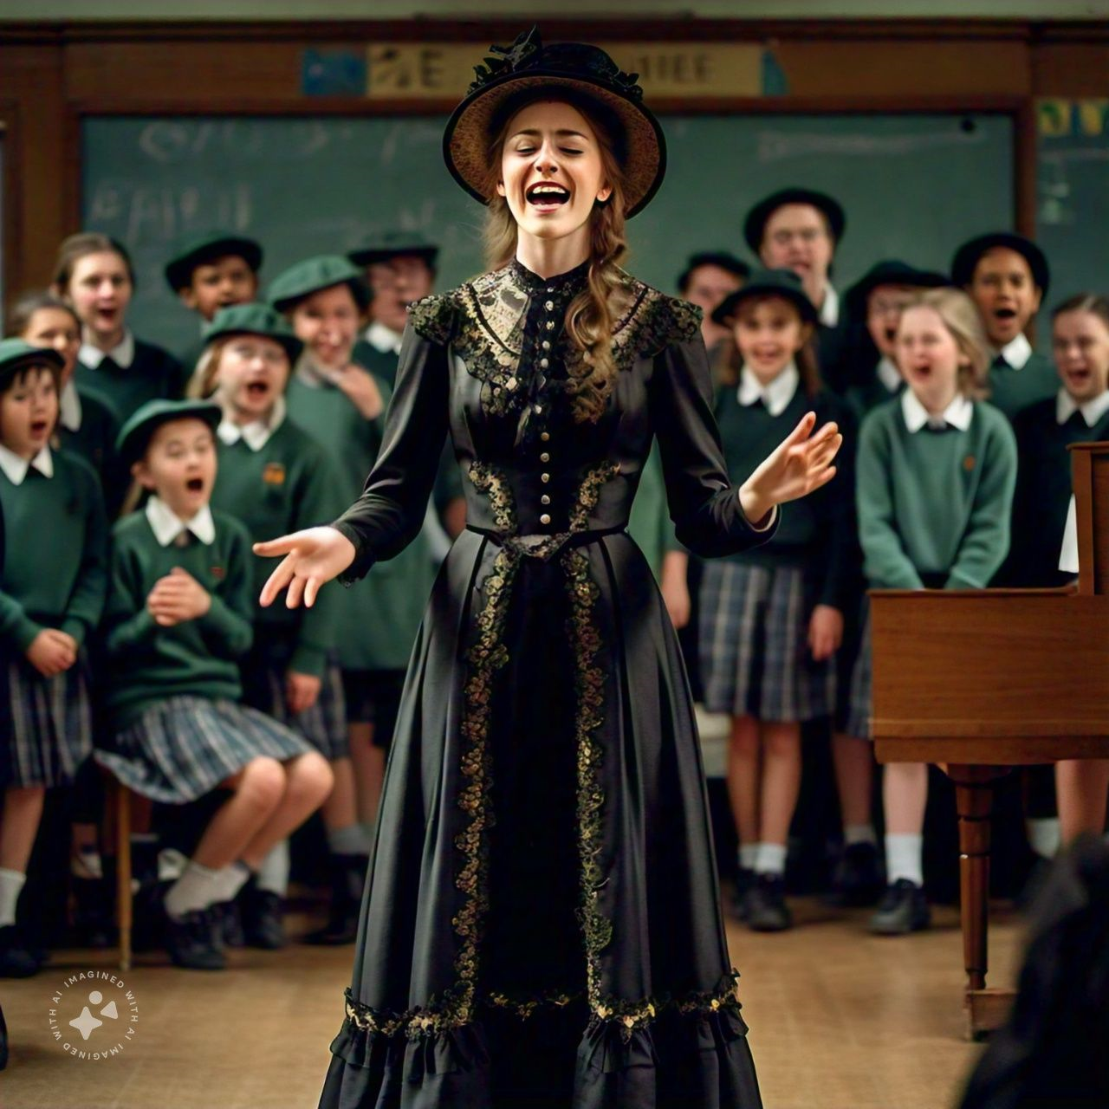
She started singing with vigour and good cheer. But the Children found the transition from grief to joy difficult to emulate.

Slide 17
PRESENTED BY
N.J.GOMATHI,
P.G.ASSISTANT (ENGLISH)
GGHSS, WALAJAPET.
RANIPET DISTRICT
6379464189

