Slide 1
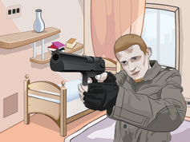
www.Padasalai.Net
THE MID NIGHT
VISITOR

Slide 2
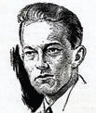
www.Padasalai.Net
ABOUT THE AUTHOR
Robert Jay Arthur Jr. (November 10, 1909 – May 2, 1969) was a writer of speculative fiction and specialised in crime fiction, and mystery fiction. He was known for his work with The Mysterious Traveler radio series and for writing The Three Investigators, a series of young adult novels. Arthur was honoured twice by the Mystery Writers of America with an Edgar Award for Best Radio Drama. He also wrote scripts for television
.

Slide 3
www.Padasalai.Net
Have you ever seen any movies of Secret agent?
What is your impression of a secret agent?

Slide 4
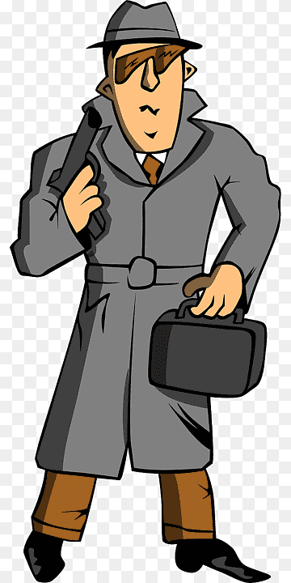
Words to describe secret agents
Intelligent
Handsome
Attractive
Fit
Tall
Holding weapons

Slide 5
Characters of the Play
AUSABLE ----- A Secret agent
Max ----- A Secret agent
Fowler ----- A journalist
Henry ------ Waiter

Slide 6
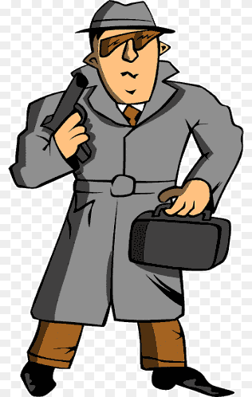
The story is about Ausable, a witty secret agent. He was with a writer named Fowler throughout the evening as Fowler was interested in spending time with a secret agent but when he spends time with Ausable he realizes that he is exactly the opposite of what he had imagined and that he was a bore.
Expectation
Reality
Vs

Slide 7
Ausable did not fit any description of a secret agent Fowler had ever read. Ausable was fat. very fat. Then there was his accent. Though he spoke French and German passably, he had never altogether lost the American accent he had brought to Paris from Boston 20 years ago.

Slide 8
Ausable then told Fowler that he had been thinking wrong and that soon he would be looking at a report that would change the country’s future.

Slide 9
Then Ausable takes Fowler to his room

Slide 10
when they entered the room a guy with a gun named Max was standing in the room. He asked them to be comfortable until the reports about the missiles arrived in 30 minutes as he was there to steal the reports.

Slide 11
This was the first adventure out of many that Fowler had expected when he had thought of meeting a secret agent.

Slide 12
While they were talking, Ausable started with a story about how a guy had entered from the balcony last month below his room. While this talk was going on, a sudden knock was heard at the door.

Slide 13
Ausable said that it must be the police as he wanted them to check on him after sometime because he wanted to make the reports that were coming in extra secure.

Slide 14
Max, pointing his gun towards them, said that he would be waiting in the balcony and that Ausable should send away the police otherwise he would shoot them and even take the risk of being caught by the police.

Slide 15
As the doorknob is turned, Max jumps out of the window and a loud scream is heard.

Slide 16
The door opens and a waiter comes in and says that he has brought the wine that Mr. Ausable had ordered. He keeps the bottle, tray and glasses on the table and leaves. Fowler is surprised and asks him about the police to which Ausable replied that there was no police.

Slide 17
Then Fowler asked what about the person who was waiting in the balcony outside the window to which Ausable replied that the person would not return and that there was no balcony there.

Slide 18
This shows the quick wit of Ausable as he took advantage of the situation and made Max nervous due to which he jumped out of the window without thinking and looking down. He had jumped from the top floor of the hotel and would have possibly died. This is how Ausable outwitted Max and saved himself from a very dangerous situation.

Slide 19
APPEARENCES ARE OFTEN DECEPTIVE

Slide 20
PRESENTED BY
N.J.GOMATHI,
P.G.ASSISTANT (ENGLISH)
GGHSS, WALAJAPET,
RANIPET DISTRICT
6379464189

