Slide 1
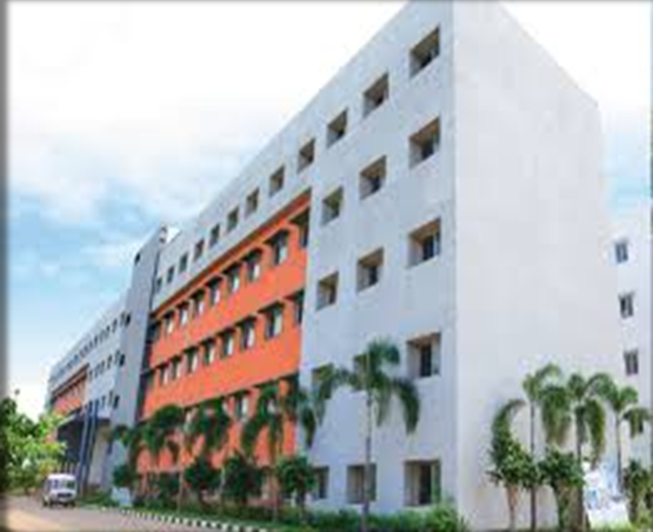
Padasalai.Net

Slide 3
Group 15 (Nitrogen group) elements:
Occurrence:
About 78 % of earth atmosphere contains dinitorgen (N2) gas.
It is also present in earth crust as sodium nitrate (Chile saltpetre) and potassium nitrate (Indian saltpetre).
The 11th most abundant element phosphorus, exists as phosphate (fluroapatite, chloroapatite and hydroxyapatite).
The other elements arsenic, antimony and bismuth are present as sulphides and are not very abundant.

Slide 4
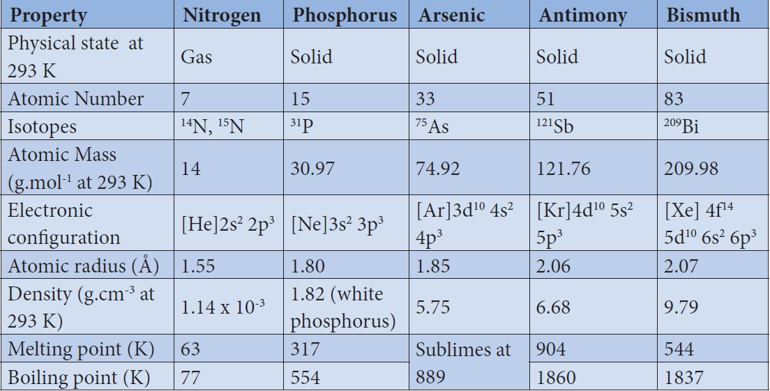
Physical properties:
Some of the physical properties of the group 15 elements are listed below:

Slide 5
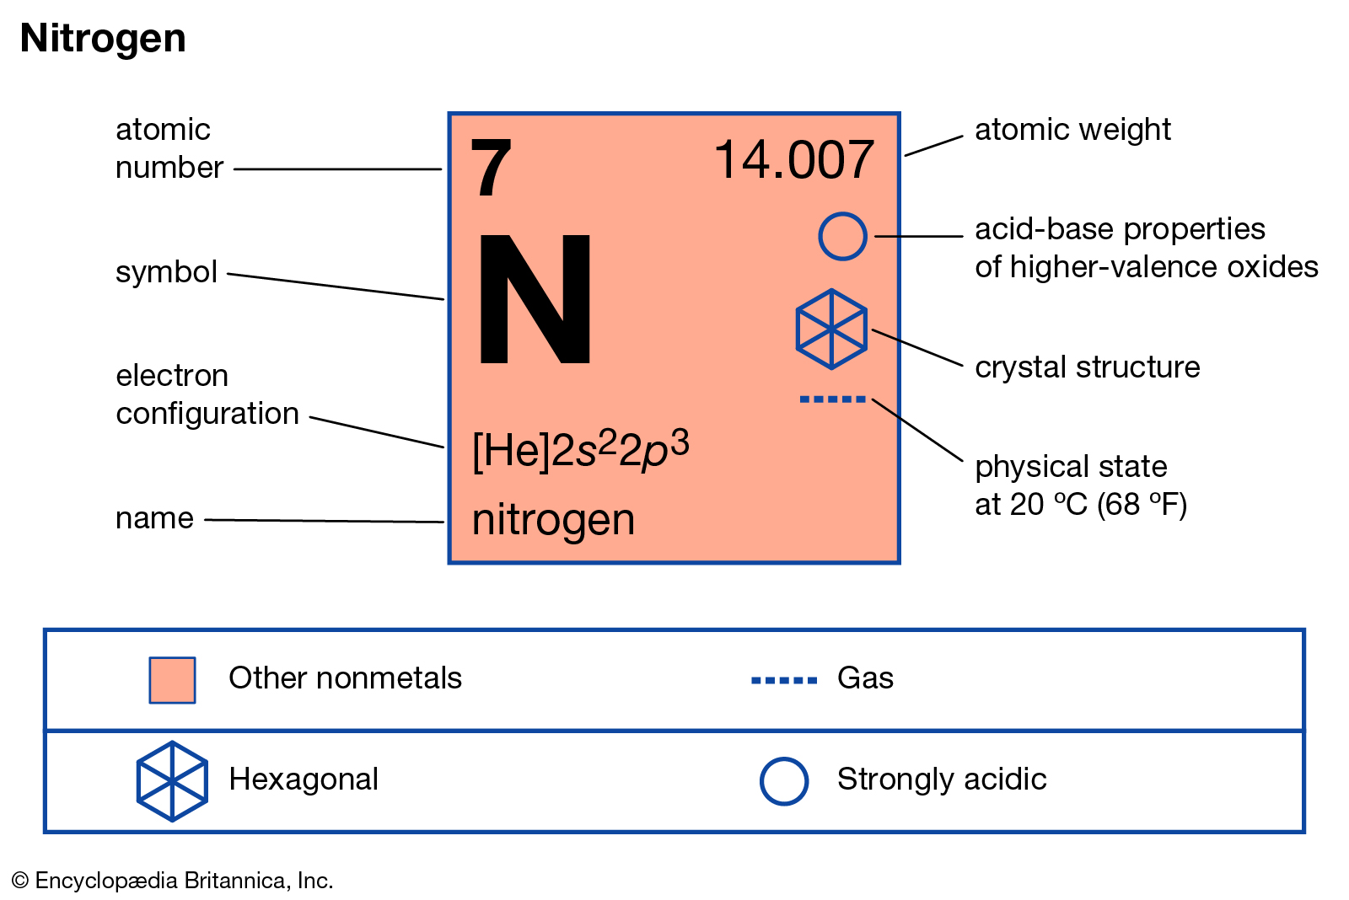
Nitrogen

Slide 6
Preparation of Nitrogen :
Nitrogen, the principal gas of atmosphere (78 % by volume) is separated industrially from liquid air by fractional distillation
Pure nitrogen gas can be obtained by the thermal decomposition of sodium azide about 575 K
It can also be obtained by oxidising ammonia using bromine water

Slide 7
Properties of nitrogen
Nitrogen gas is rather inert.
Terrestrial nitrogen contains 14.5% and 0.4% of nitrogen-14 and nitrogen-15 respectively. The later is used for isotopic labelling.
The chemically inert character of nitrogen is largely due to high bonding energy of the molecules 225 cal mol⁻¹ (946 kJ mol⁻¹ ).
Interestingly the triply bonded species is notable for its less reactivity in comparison with other iso-electronic triply bonded systems such as -C≡C-, C≡O, X-C≡N, X-N≡C, -C≡C-, and -C≡N.
These groups can act as donor where as dinitrogen cannot. However, it can form complexes with metal (M← N≡N) like CO to a less extent.

Slide 8
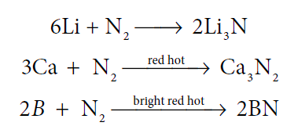
The only reaction of nitrogen at room temperature is with lithium forming Li₃N. With other elements, nitrogen combines only at elevated temperatures. Group 2 metals and Th forms ionic nitrides.
With oxygen, nitrogen produces nitrous oxide at high temperatures. Even at 3473 K nitrous oxide yield is only 4.4%.

Slide 9
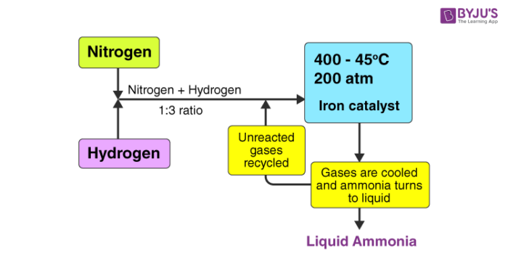
Direct reaction with hydrogen gives ammonia. This reaction is favoured by high pressures and at optimum temperature in presence of iron catalyst. This reaction is the basis of Haber’s process for the synthesis of ammonia.

Slide 10
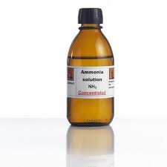
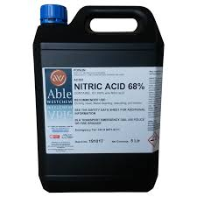
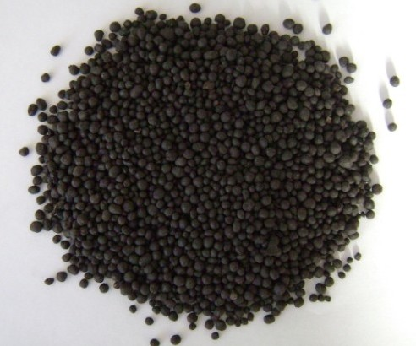
Uses of nitrogen
1. Nitrogen is used for the manufacture of ammonia, nitric acid and calcium cyanamide etc.

Slide 11
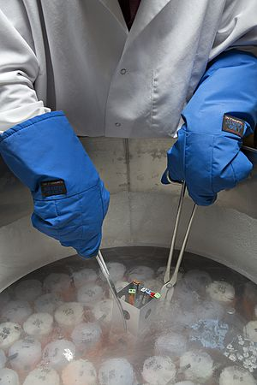
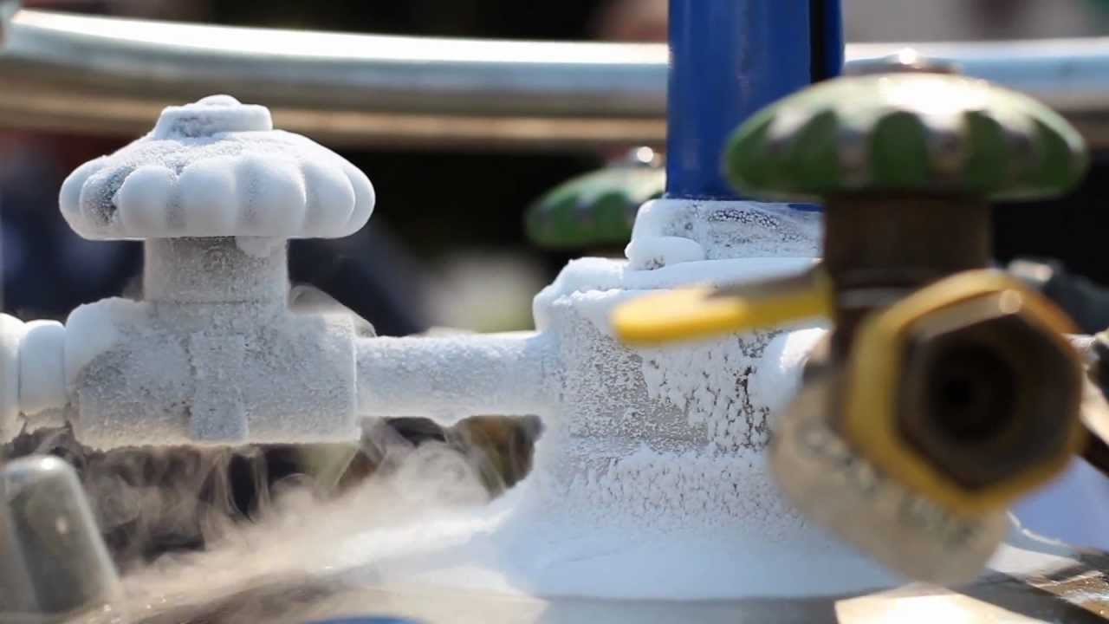
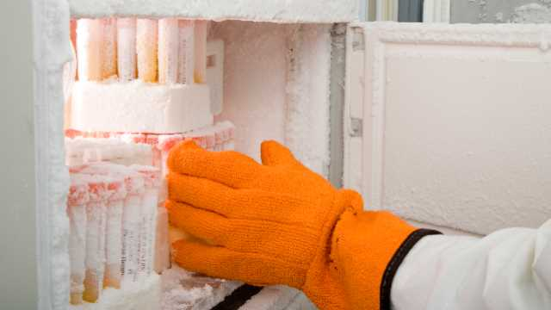
2. Liquid nitrogen is used for producing low temperature required in cryosurgery, and so in biological preservation.

Slide 12
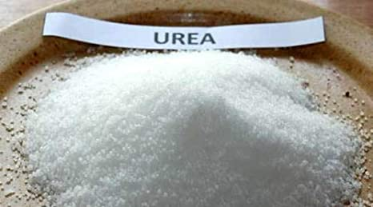
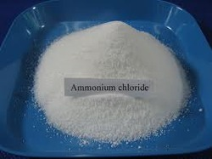
Ammonia (NH 3)
Preparation:
Ammonia is formed by the hydrolysis of urea.
Ammonia is prepared in the laboratory by heating an ammonium salt with a base.

Slide 13
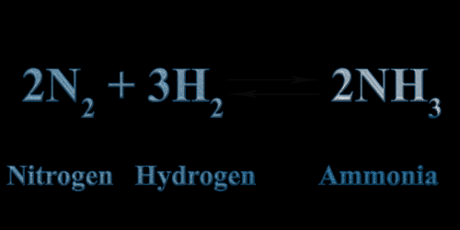
It can also be prepared by heating a metal nitrides such as magnesium nitride with water.
Mg₃N₂
It is industrially manufactured by passing nitrogen and hydrogen over iron catalyst (a small amount of K2O and Al2O3 is also used to increase the rate of attainment of equilibrium) at 750 K at 200 atm pressure. In the actual process the hydrogen required is obtained from water gas and nitrogen from fractional distillation of liquid air.

Slide 14
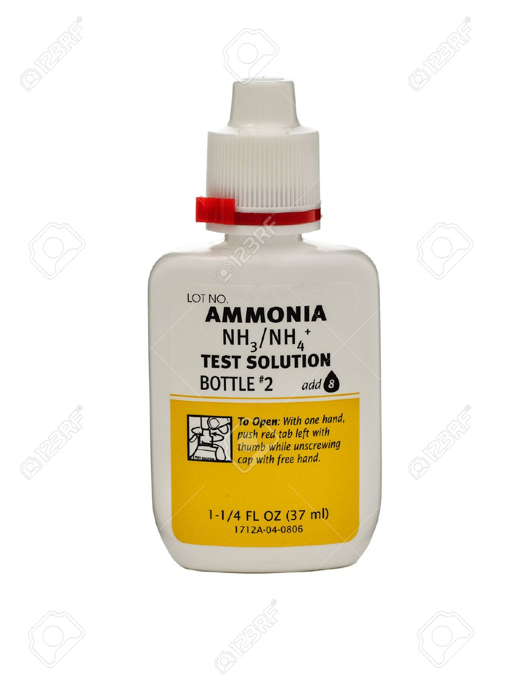
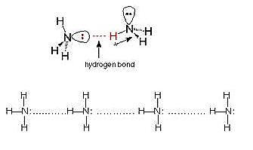
Properties of Ammonia :
Ammonia is a pungent smelling gas and is lighter than air.
It can readily liquefied by at about 9 atmospheric pressure.
The liquid boils at -38.4°C and freezes at -77° C.
Liquid ammonia resembles water in its physical properties. i.e. it is highly associated through strong hydrogen bonding.
Ammonia is extremely soluble in water (702 Volume in 1 Volume of water) at 20°C and 760mm pressure.

Slide 15
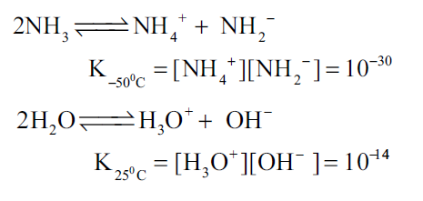
At low temperatures two soluble hydrate NH3.H2O and 2NH3.H2O are isolated. In these molecules ammonia and water are linked by hydrogen bonds. In aqueous solutions also ammonia may be hydrated in a similar manner and we call the same as (NH3.H2O)
The dielectric constant of ammonia is considerably high to make it a fairly good ionizing solvent like water.
Dielectric constant (ε): A measure of a substance's ability to insulate charges from each other. Taken as a measure of solvent polarity, higher ε means higher polarity, and greater ability to stabilize charges. Not the same as dipole moment. Water (ε = 80)

Slide 16
Chemical Properties of Ammonia:
Action of heat: Above 500°C ammonia decomposes into its elements. The decomposition may be accelerated by metallic catalysts like Nickel, Iron. Almost complete dissociation occurs on
continuous sparking.
Reaction with air/oxygen: Ammonia does not burn in air but burns freely in free oxygen with a yellowish flame to give nitrogen and steam.
In presence of catalyst like platinum, it burns to produce nitric oxide. This process is used forthe manufacture of nitric acid and is known as ostwalds process.

Slide 17
Reducing property: Ammonia acts as a reducing agent. It reduces the metal oxides to metal when passed over heated metallic oxide.
Reaction with acids: When treated with acids it forms ammonium salts. This reaction shows that the affinity of ammonia for proton is greater than that of water.

Slide 18
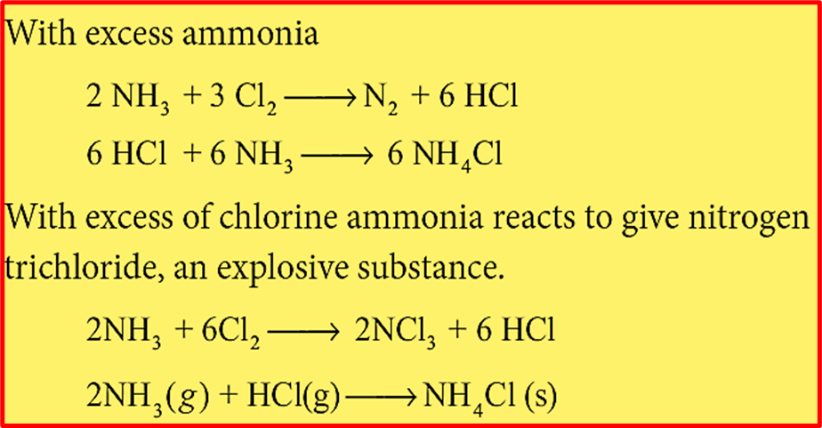
Reaction with chlorine and chlorides:
Ammonia reacts with chlorine and chlorides to give ammonium chloride as a final product. The reactions are different under different conditions as given below.

Slide 19
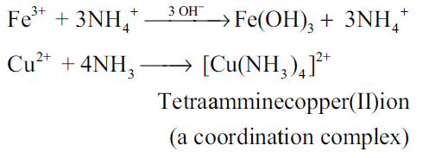
Formation of amides and nitrides:
With strong electro positive metals such as sodium, ammonia forms amides while it forms nitrides with metals like magnesium.
With metallic salts: Ammonia reacts with metallic salts to give metal hydroxides(in case of Fe) or forming complexes (in case Cu)

Slide 20
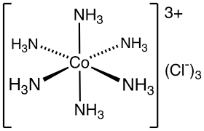
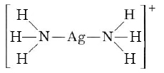
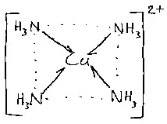
Formation of amines:
Ammonia forms ammonated compounds by ion dipole attraction.
Eg. [CaCl2.8NH3]. In this, the negative ends of ammonia dipole is attracted to Ca²⁺ ion.
It can also act as a ligand and form coordination compounds such as [Co(NH3)6]³⁺ , [Ag(NH3)2] ⁺ .
For example when excess ammonia is added to aqueous solution copper sulphate a deep blue colour compound [Cu(NH3)4]²⁺ is formed.

Slide 21
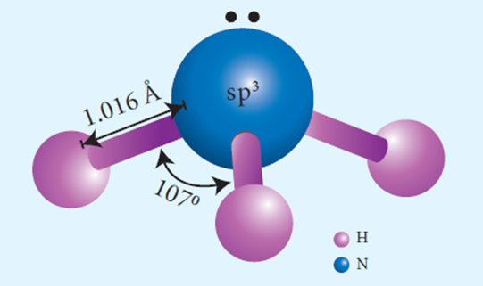
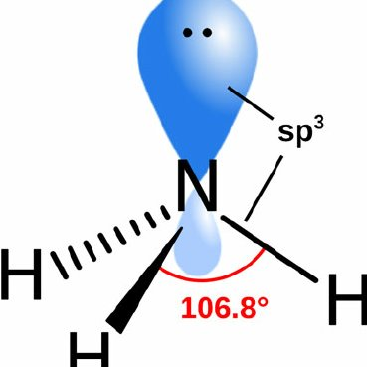
Structure of ammonia
Ammonia molecule is pyramidal in shape.
N-H bond distance is 1.016 A⁰ and a bond angle 107°.
The structure of ammonia may be regarded as a tetrahedral with one lone pair of electrons in one tetrahedral position hence it has a pyramidal shape.

Slide 22
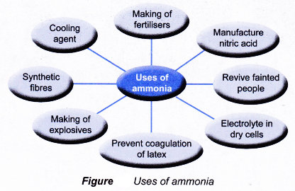
USES OF AMMONIA

Slide 23
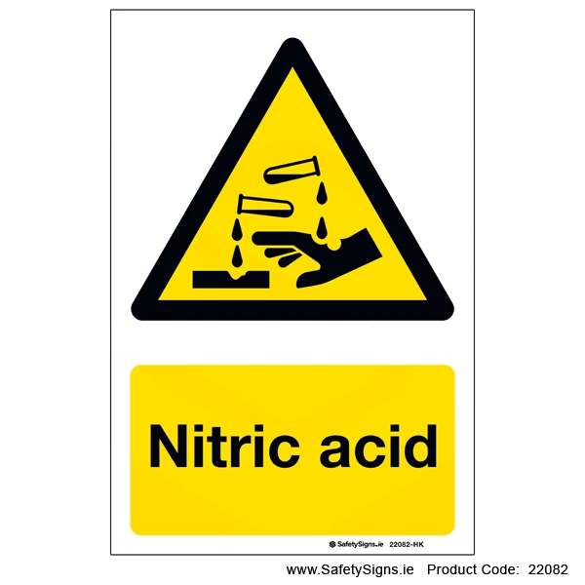
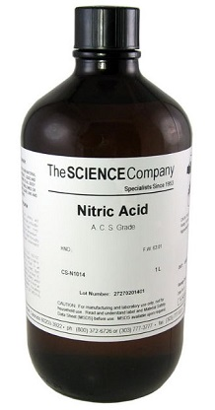
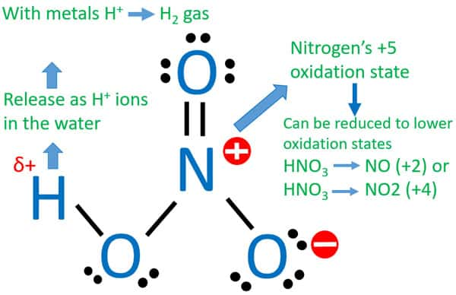
Nitric acid

Slide 24
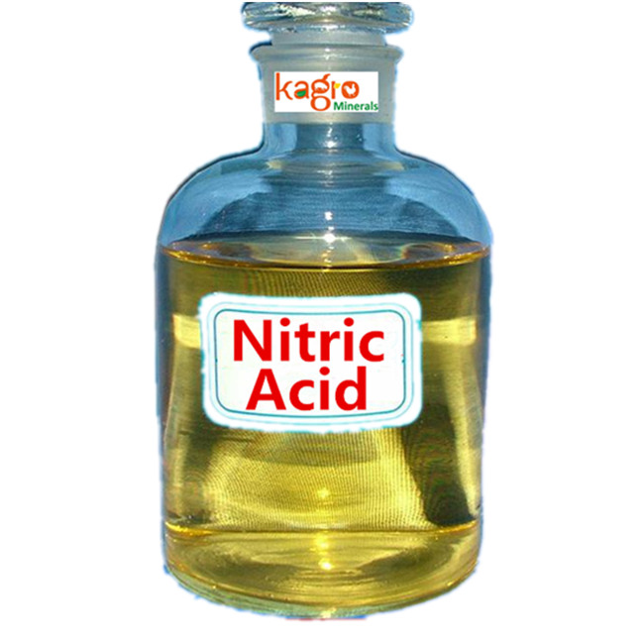
Preparation
Nitric acid is prepared by heating equal amounts of potassium or sodium nitrate with concentrated sulphuric acid.
The temperature is kept as low as possible to avoid decomposition of nitric acid.
The acid condenses to a fuming liquid which is coloured brown by the presence of a little nitrogen dioxide which is formed due to the decomposition of nitric acid.

Slide 25
Commercial method of preparation:
Nitric acid prepared in large scales using Ostwald's process.
In this method ammonia from Haber’s process is mixed about 10 times of air.
This mixture is preheated and passed into the catalyst chamber where they come in contact with platinum gauze.
The temperature rises to about 1275 K and the metallic gauze brings about the rapid catalytic oxidation of ammonia resulting in the formation of NO, which then oxidised to nitrogen dioxide.
The nitrogen dioxide produced is passed through a series of adsorption towers. It reacts with water to give nitric acid. Nitric oxide formed is bleached by blowing air.

Slide 26
Properties:
Pure nitric acid is colourless.
It boils at 86 °C.
The acid is completely miscible with water forming a constant boiling mixture (98% HNO3, Boiling point 120.5 °C).
Fuming nitric acid contains oxides of nitrogen.
It decomposes on exposure to sunlight or on being heated, into nitrogen dioxide, water and oxygen.
Due to this reaction pure acid or its concentrated solution becomes yellow on standing.
In most of the reactions, nitric acid acts as an oxidising agent.
Hence the oxidation state changes from +5 to a lower one.
It doesn’t yield hydrogen in its reaction with metals.
Nitric acid can act as an acid, an oxidizing agent and an nitrating agent.

Slide 27
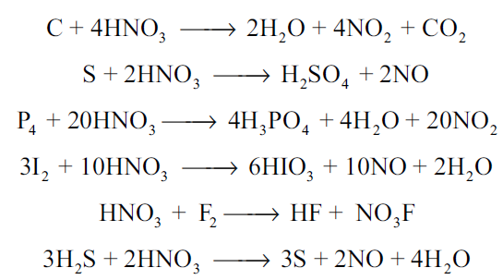
As an acid:
Like other acids it reacts with bases and basic oxides to form salts and water.
As an oxidising agent:
The nonmetals like carbon, sulphur, phosphorus and iodine are oxidised by nitric acid.

Slide 28
As an nitrating agent:
In organic compounds replacement of a –H atom with –NO2 is often
referred as nitration. For example.

Slide 29
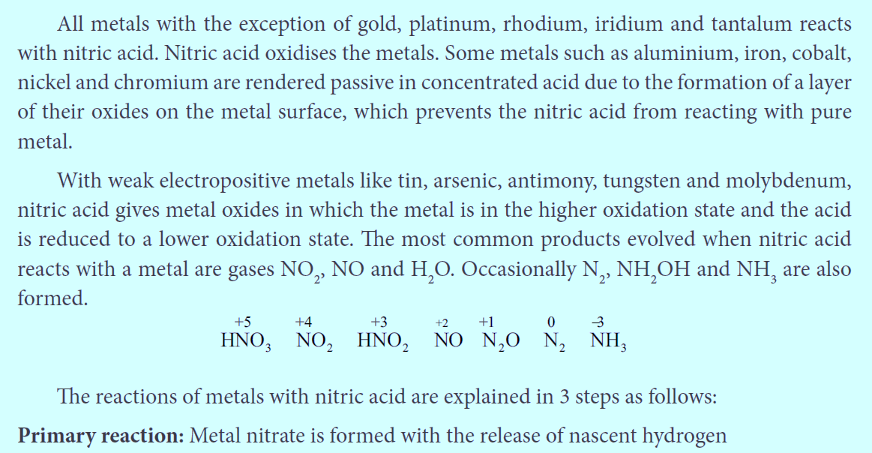
Action of nitric acid on metals

Slide 30
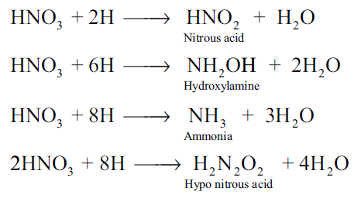
Primary reaction:
Metal nitrate is formed with the release of nascent hydrogen
Secondary reaction:
Nascent hydrogen produces the reduction products of nitric acid.

Slide 31
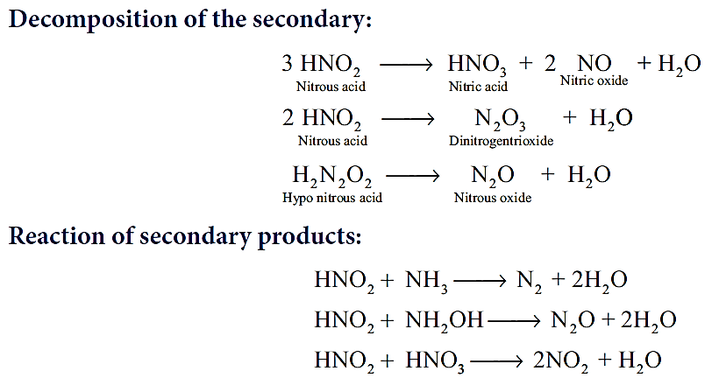
Tertiary reaction:
The secondary products either decompose or react to give final products

Slide 33
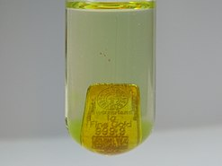
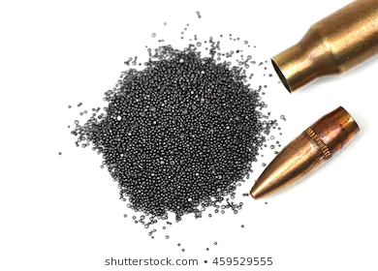
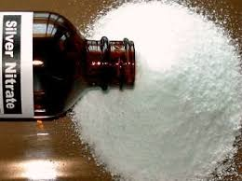
Uses of nitric acid:
Nitric acid is used as a oxidising agent and in the preparation of aquaregia.
Aqua regia is a mixture of nitric acid and hydrochloric acid, optimally in a molar ratio of 1:3. Aqua regia is a yellow-orange fuming liquid, so named by alchemists because it can dissolve the noble metals, gold and platinum, though not all metals.
Salts of nitric acid are used in photography (AgNO₃) and gunpowder for firearms. (NaNO₃)

Slide 34
Oxides and oxoacids of nitrogen

Slide 35
Oxides and oxoacids of nitrogen

Slide 36
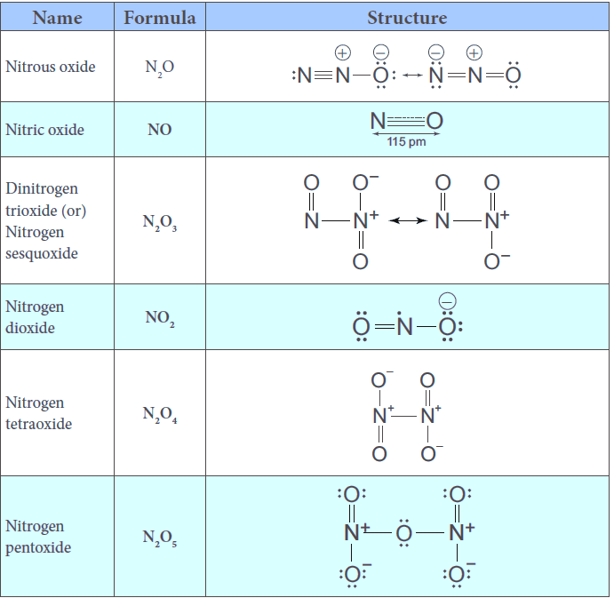
Structures of oxides of nitrogen:

Slide 37
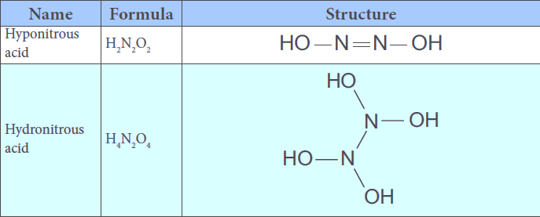
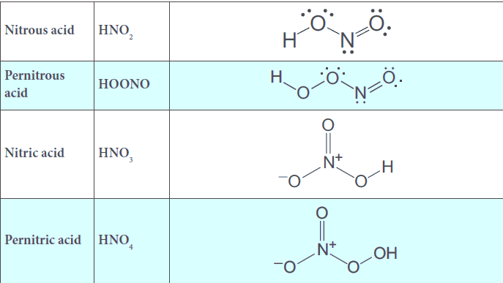
Structures of oxoacids of nitrogen:

Slide 38
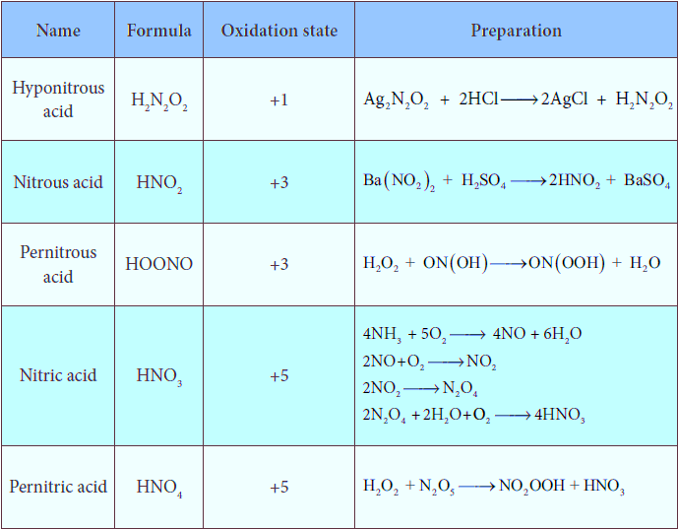
Preparation of oxoacids of nitrogen:

Slide 39
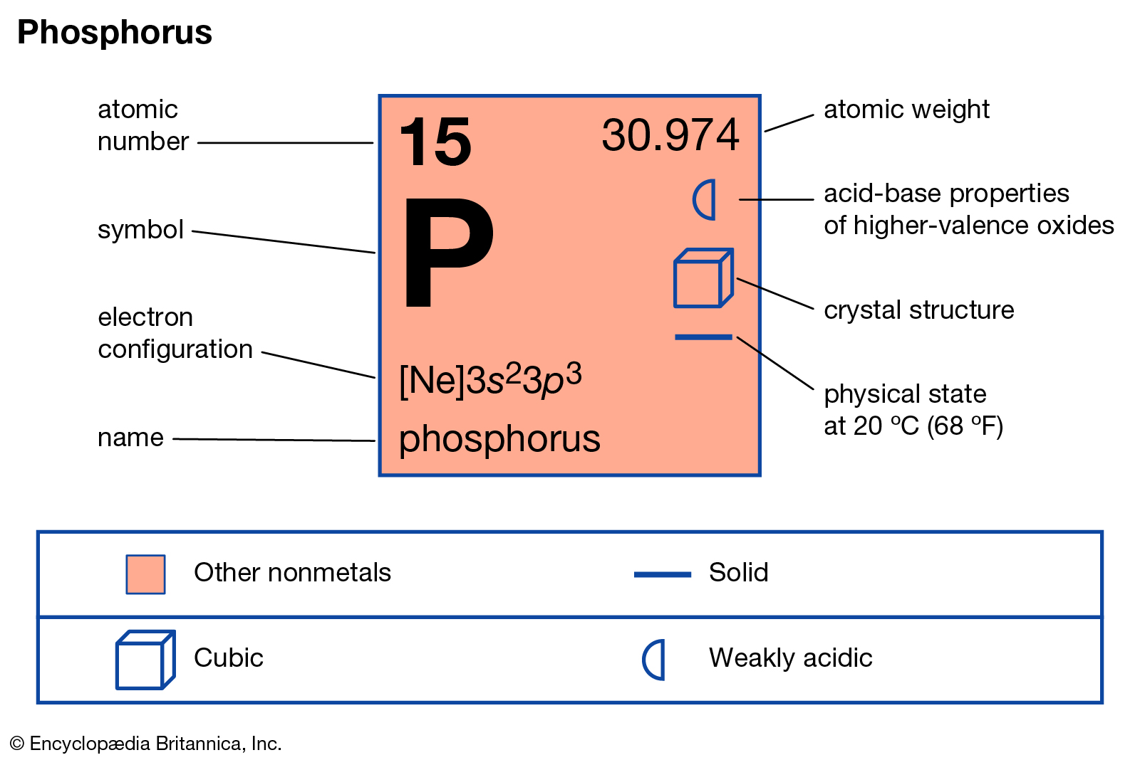

Slide 40
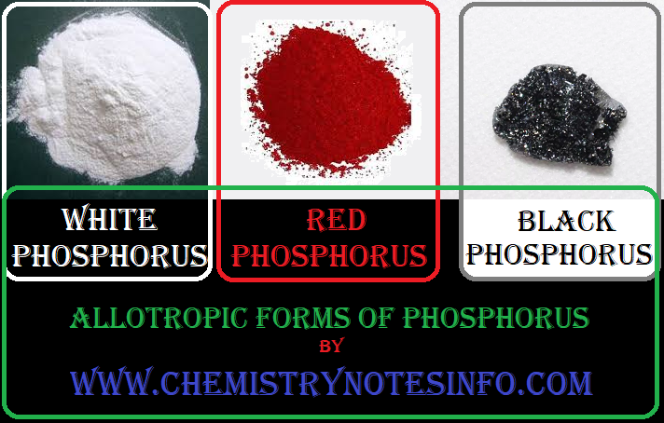
Allotropic forms of phosphorus:
Phosphorus has several allotropic modification of which the three forms namely white, red and black phosphorus are most common.

Slide 41
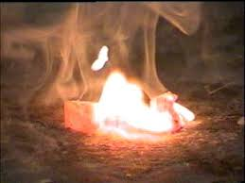
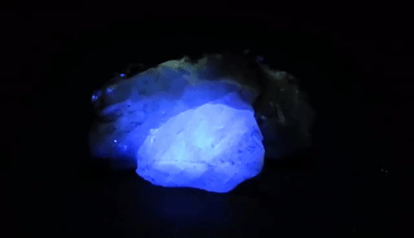
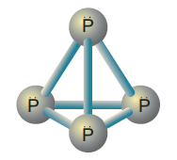
The freshly prepared white phosphorus is colourless but becomes pale yellow due to formation of a layer of red phosphorus upon standing.
Hence it is also known as yellow phosphorus.
It is poisonous in nature and has a characteristic garlic smell.
It glows in the dark due to oxidation which is called phosphorescence.
Its ignition temperature is very low and hence it undergoes spontaneous combustion in air at room temperature to give P2O5.

Slide 42
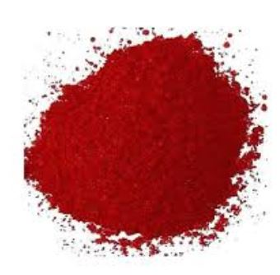
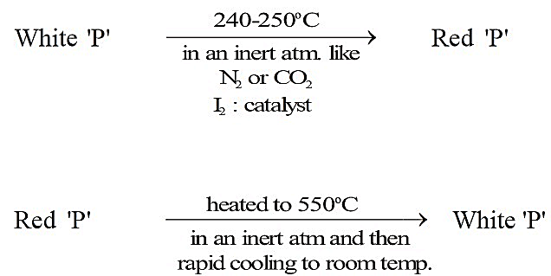
The white phosphorus can be changed into red phosphorus by heating it to 420 ⁰C in the absence of air and light.
Unlike white phosphorus it is not poisonous and does not show Phosphorescence.
It also does not ignite at low temperatures.
The red phosphorus can be converted back into white phosphorus by boiling it in an inert atmosphere and condensing the vapour under water.

Slide 43
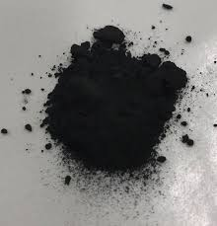
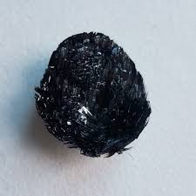
Black phosphorus (phosphorene)

Slide 44
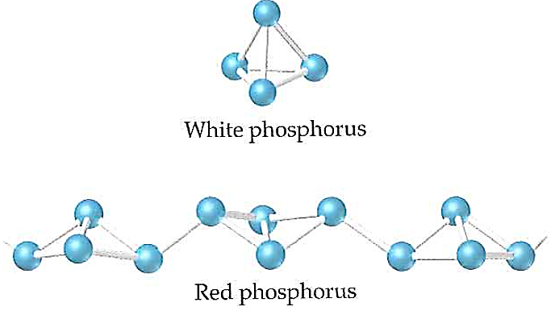
The phosphorus has a layer structure and also acts as a semiconductor.
The four atoms in phosphorus have polymeric structure with chains of P4 linked tetrahedrally.
Unlike nitrogen P≡P is less stable than P-P single bonds.
Hence, phosphorus atoms are linked through single bonds rather than triple bonds.
In addition to the above two more allotropes namely scarlet and violet phosphorus are also known for phosphorus.

Slide 45
Properties of phosphorus
Phosphorus is highly reactive and has the following important chemical properties
Reaction with oxygen:
Yellow phosphorus readily catches fire in air giving dense white fumes of phosphorus pentoxide.
Red phosphorus also reacts with oxygen on heating to give phosphorus trioxide or phosphorus pentoxide.

Slide 46
Reaction with chlorine:
Phosphorus reacts with chlorine to form tri and penta chloride.
Yellow phosphorus reacts violently at room temperature, while red phosphorus reacts on heating.
Reaction with alkali:
Yellow phosphorus reacts with alkali on boiling in an inert atmosphere
liberating phosphine. Here phosphorus act as reducing agent.

Slide 47
Reaction with nitric acid:
When phosphorus is treated with conc. nitric acid it is oxidised to phosphoric acid. This reaction is catalysed by iodine crystals.
Reaction with metals: Phosphorus reacts with metals like Ca and Mg to give phosphides.Metals like sodium and potassium react with phosphorus vigorously.
Uses of phosphorus:
The red phosphorus is used in the match boxes
It is also used for the production of certain alloys such as phosphor bronze

Slide 48
Phosphine (PH3)
Phosphine is the most important hydride of phosphorus
Preparation:
Phosphine is prepared by action of sodium hydroxide with white phosphorus in an inert atmosphere of carbon dioxide or hydrogen.
Phosphine is freed from phosphine dihydride(P2H4) by passing through a freezing mixture. The dihydride condenses while phosphine does not.

Slide 49
Phosphine can also prepared by the hydrolysis of metallic phosphides with water or dilute mineral acids.
Phosphine is prepared in pure form by heating phosphorous acid.
A pure sample of phosphine is prepared by heating phosphonium iodide with caustic soda solution.

Slide 50
Physical properties:
It is colourless, poisonous gas with rotten fish smell.
It is slightly soluble in water and is neutral to litmus test.
It condenses to a colourless liquid at 188 K and freezes to a solid at 139.5 K .
Chemical properties:
Thermal stability:
Phosphine decomposes into its elements when heated in absence of air at 317 K or when electric current is passed through it.
Combustion:
When phosphine is heated with air or oxygen it burns to give meta phosphoric acid.

Slide 51
Basic nature:
Phosphine is weakly basic and forms phosphonium salts with halogen acids.
Reducing property :
Phosphine precipitates some metal from their salt solutions.
It forms coordination compounds with lewis acids such as boron trichloride.

Slide 52
Structure:
In phosphine, phosphorus shows sp³ hybridisation.
Three orbitals are occupied by bond pair and fourth corner is occupied by lone pair of electrons.
Hence, bond angle is reduced to 93.5°.
Phosphine has a pyramidal shape.

Slide 53
Uses of phosphine:
Phosphine is used for producing smoke screen as it gives large smoke.
In a ship, a pierced container with a mixture of calcium carbide and calcium phosphide, liberates phosphine and acetylene when thrown into sea.
The liberated phosphine catches fire and ignites acetylene.
These burning gases serves as a signal to the approaching ships.
This is known as Holmes signal.

Slide 54
Phosphorous trichloride
Preparation:
When a slow stream of chlorine is passed over white phosphorus, phosphorous trichloride is formed. It can also be obtained by treating white phosphorus with thionyl chloride.
Properties
When phosphorous trichloride is hydrolysed with cold water it gives phosphorous acid.

Slide 55
Similar reactions occurs with other molecules that contains alcohols and carboxylic acids.
Uses of phosphorus trichloride:
Phosphorus trichloride is used as a chlorinating agent and for the preparation of H3PO3.
Structure of phosphorus trichloride
The central atom phosphorus is involved in sp³ hybridisation with three bond pairs and one lone pair. It has a trigonal pyramidal shape, owing to the lone pairs on the phosphorus.

Slide 56
Phosphorous pentachloride
Preparation
When PCl3 is treated with excess chlorine, phosphorous pentachloride is obtained.
Chemical properties
On heating phosphorous pentachloride, it decomposes into phosphorus trichloride and chlorine.
Phosphorous pentachloride reacts with water to give phosphoryl chloride and
orthophosphoric acid.

Slide 57
Phosphorous pentachloride reacts with metal to give metal chlorides. It also chlorinates organic compounds similar to phosphorus trichloride.
Uses of phosphorus pentachloride
Phosphorous pentachloride is a chlorinating agent and is useful for replacing hydroxyl groups by chlorine atom.

Slide 58
Structure of oxides and oxoacids of phosphorus
Phosphorous trioxide ( P₂O₃ or P₄ O₆ )
In phosphorous trioxide four phosphorous atoms lie at the corners of a tetrahedron and six oxygen atoms along the edges.
The P-O bond distance is 165.6pm which is shorter than the single bond distance of P-O (184 pm) due to pπ-dπ bonding and results in considerable double bond character.

Slide 59
Phosphorous Penta oxide ( P₂O₅ or P₄ O₁₀ )
In P4O10 each P atoms form three bonds to oxygen atom and also an additional coordinate bond with an oxygen atom.
Terminal P-O bond length is 143 pm, which is less than the expected single bond distance.
This may be due to lateral overlap of filled p orbitals of an oxygen atom with empty d orbital on phosphorous.

Slide 60
Oxoacids of Phosphorous-Structure:

Slide 63
Group 16 (Oxygen group) elements
Occurrence:
Elements belonging group 16 are called chalgogens or ore forming elements as most of the ores are oxides or sulphides.
First element oxygen, the most abundant element, exists in both as dioxygen in air (above 20 % by weight as well as volume) and in combined form as oxides.
Oxygen and sulphur makes up about 46.6 % & 0.034 & of earth crust by weight respectively.
Sulphur exists as sulphates (gypsum, epsom etc...) and sulphide (galena, Zinc blende etc...).
It is also present in the volcanic ashes.
The other elements of this groups are scarce and are often found as selenides, tellurides etc... along with sulphide ores.

Slide 64
Oxygen:
Preparation:
The atmosphere and water contain 23% and 83% by mass of oxygen respectively.
Most of the world’s rock contain combined oxygen.
Industrially oxygen is obtained by fractional distillation of liquefied air.
In the laboratory, oxygen is prepared by one of the following methods.
The decomposition of hydrogen peroxide in the presence of catalyst (MnO2) or by oxidation with potassium permanganate.

Slide 65
The thermal decomposition of certain metallic oxides or oxoanions gives oxygen.
Properties
Under ordinary condition oxygen exists as a diatomic gas.
Oxygen is paramagnetic.
Like nitrogen and fluorine, oxygen form strong hydrogen bonds.
Oxygen exists in two allotropic forms namely dioxygen (O2) and ozone or trioxygen (O3).

Slide 66
OZONE (O₃)
Negligible amounts of ozone occurs at sea level it is formed in the upper atmosphere by the action of ultraviolet light.
In the laboratory ozone is prepared by passing electrical discharge through oxygen.
At a potential of 20,000 V about 10% of oxygen is converted into ozone it gives a mixture known as ozonised oxygen.
Pure ozone is obtained as a pale blue gas by the fractional distillation of liquefied ozonised oxygen.

Slide 67
Chemical properties:
The chemical properties of oxygen and ozone differ vastly.
Oxygen combines with many metals and non-metals to form oxides.
With some elements such as s-block elements combination of oxygen occurs at room temperature.
Some of less reactive metals react when powdered finely and made to react exothermically with oxygen at room temperature but a lump of metal is unaffected under same condition. These finely divided metals are known as pyrophoric and when set the powder on fire, heat is liberated during a reaction.
On the other hand ozone is a powerful oxidising agent and it reacts with many substances under conditions where oxygen will not react.
For example, it oxidises potassium iodide to iodine.
This reaction is quantitative and can be used for estimation of ozone.
Ozone is commonly used for oxidation of organic compounds. In acidic solution ozone exceeds the oxidising power of fluorine and atomic oxygen. The rate of decomposition of ozone drops sharply in alkaline solution.

Slide 68
Uses:
Oxygen is one of the essential component for the survival of living organisms.
It is used in welding (oxyacetylene welding)
Liquid oxygen is used as fuel in rockets etc...

Slide 69
Allotrophic forms of sulphur
Sulphur exists in crystalline as well as amorphous allotrophic forms.
The crystalline form includes rhombic sulphur (α sulphur) and monoclinic sulphur (β sulphur).
Amorphous allotropic form includes plastic sulphur (γ sulphur), milk of sulphur and colloidal sulphur.
Rhombic sulphur also known as α sulphur, is the only thermodynamically stable allotropic form at ordinary temperature and pressure.

Slide 70
The crystals have a characteristic yellow colour and composed of S8 molecules. When heated slowly above 96 ⁰C, it converts into monoclinic sulphur. Upon cooling below 96 ⁰C the β form converts back to α form.
Monoclinic sulphur also contains S8 molecules in addition to small amount of S6 molecules.
It exists as a long needle like prism and is also called as prismatic sulphur. It is stable between 96 ⁰C - 119 ⁰C and slowly changes into rhombic sulphur.
When molten sulphur is poured into cold water a yellow rubbery ribbon of plastic sulphur is produced. They are very soft and can be stretched easily.
On standing (cooling slowly) it slowly becomes hard and changes to stable rhombic sulphur. Sulphur also exists in liquid and gaseous states.
At around 140 ⁰C the monoclinic sulphur melts to form mobile pale yellow liquid called λ sulphur.
vapour over the liquid sulphur consists of 90 % of S8, S7 & S6 and small amount of mixture of S2, S3, S4, S5 molecules.

Slide 71
Sulphur dioxide
Preparation

Slide 72
Properties:
Sulphur dioxide gas is found in volcanic eruptions. A large amount of sulphur dioxide gas is released into atmosphere from power plants using coal and oil and copper melting plants. It is a colourless gas with a suffocating odour. It is highly soluble in water and it is 2.2 times heavier than air. Sulphur dioxide can be liquefied (boiling point 263 K) at 2.5 atmospheric pressure and 288 K.

Slide 73
Chemical properties:

Slide 75
Uses:
1. Sulphur dioxide is used in bleaching hair, silk, wool etc...
2. It can be used for disinfecting crops and plants in agriculture.

Slide 76
Structure of sulphur dioxide:
In sulphur dioxide, sulphur atom undergoes sp² hybridisation.
A double bond arises between S and O is due to pπ- dπ overlapping.

Slide 77
Sulphuric acid: (H₂ SO₄ )

Slide 78
Preparation of H₂SO₄:
Sulphuric acid can be manufactured by lead chamber process, cascade process or contact process.
Here we discuss the contact process.

Slide 79
Contact process

Slide 85
Uses of sulphuric acid:
1. Sulphuric acid is used in the manufacture of fertilisers, ammonium sulphate and super phosphates and other chemicals such as hydrochloric acid, nitric acid etc...
2. It is used as a drying agent and also used in the preparation of pigments, explosives etc..

Slide 86
Test for sulphate/sulphuric acid:
Dilute solution of sulphuric acid/aqueous solution of sulphates gives white precipitate (barium sulphate) with barium chloride solution.
It can also be detected using lead acetate solution.
Here a white precipitate of lead sulphate is obtained.

Slide 87
Structure of oxoacids of sulphur:

Slide 91
Group 17 (Halogen group) elements:
Occurrence:
The halogens are present in combined form as they are highly reactive. The main source
of fluorine is fluorspar or fluorite. The other ores of fluorine are cryolite, fluroapatite. The main source of chlorine is sodium chloride from sea water. Bromides and iodides also occur in sea water.
Physical properties:
The common physical properties of the group 17 elements are listed in the table.

Slide 92
Properties:
Chlorine is highly reactive hence it doesn’t occur free in nature. It is usually distributed as various metal chlorides. The most important chloride is sodium chloride which occurs in sea water.
Preparation:
Chlorine is prepared by the action of conc. sulphuric acid on chlorides in presence of manganese dioxide.

Slide 93
It can also be prepared by oxidising hydrochloric acid using various oxidising agents such as manganese dioxide, lead dioxide, potassium permanganate or dichromate.
When bleaching powder is treated with mineral acids chlorine is liberated

Slide 94
Manufacture of chlorine:
Chlorine is manufactured by the electrolysis of brine in electrolytic process or by oxidation of HCl by air in Deacon’s process.
Electrolytic process:
When a solution of brine (NaCl) is electrolysed, Na ⁺ and Cl⁻ ions are formed. Na+ ion reacts with OH ⁻ ions of water and forms sodium hydroxide. Hydrogen and chlorine are liberated as gases.

Slide 95
Deacon’s process:
In this process a mixture of air and hydrochloric acid is passed up
a chamber containing a number of shelves, pumice stones soaked in cuprous chloride are placed. Hot gases at about 723 K are passed through a jacket that surrounds the chamber.
The chlorine obtained by this method is dilute and is employed for the manufacture of bleaching powder. The catalysed reaction is given below,

Slide 96
Physical properties:
Chlorine is a greenish yellow gas with a pungent irritating odour.
It produces headache when inhaled even in small quantities whereas inhalation of large quantities could be fatal.
It is 2.5 times heavier than air.
Chlorine is soluble in water and its solution is referred as chlorine water.
It deposits greenish yellow crystals of chlorine hydrate (Cl2.8H2O).
It can be converted into liquid (Boiling point – 34.6° C) and yellow crystalline solid (Melting point -102° C)

Slide 97
Chemical properties:
Action with metals and non-metals: It reacts with metals and non metals to give the corresponding chlorides.

Slide 98
Affinity for hydrogen :
When burnt with turpentine it forms carbon and hydrochloric acid.
It forms dioxygen when reacting with water in presence of sunlight. When chlorine in water is exposed to sunlight it loses its colour and smell as the chlorine is converted into hydrochloric acid.
Chlorine reacts with ammonia to give ammonium chloride and other products as shown below:
With excess ammonia,

Slide 99
With excess chlorine,
Chlorine oxidises hydrogen sulphide to sulphur and liberates bromine and iodine from iodides and bromides. However, it doesn't oxidise fluorides

Slide 100
Reaction with alkali:
Chlorine reacts with cold dilute alkali to give chloride and hypochlorite while with hot concentrated alkali chlorides and chlorates are formed.

Slide 101
Oxidising and bleaching action:
Chlorine is a strong oxidising and bleaching agent because of the nascent oxygen.

Slide 102
Preparation of bleaching powder: Bleaching powder is produced by passing chlorine gas through dry slaked lime (calcium hydroxide).
Displacement redox reactions: Chlorine displaces bromine from bromides and iodine from iodide salts.
Formation of addition compounds: Chlorine forms addition products with sulphur
dioxide, carbon monoixde and ethylene. It forms substituted products with alkanes/arenes.

Slide 103
Uses of chlorine:
It is used in
1. Purification of drinking water.
2. Bleaching of cotton textiles, paper and rayon.
3. Extraction of gold and platinum.

Slide 105
Laboratory preparation:
It is prepared by the action of sodium chloride and concentrated sulphuric acid.
Dry hydrochloric acid is obtained by passing the gas through conc. sulphuric acid
Properties:
Hydrogen chloride is a colourless, pungent smelling gas, easily liquefied to a colourless liquid (boiling point 189K) and frozen into a white crystalline solid (melting point 159K). It is extremely soluble in water.

Slide 106
Chemical properties:
Like all acids it liberates hydrogen gas from metals and carbon dioxide from carbonate and bicarbonate salts.
It liberates sulphur dioxide from sodium sulphite
When three parts of concentrated hydrochloric acid and one part of concentrated nitric
acid are mixed, Aquaregia (Royal water) is obtained. This is used for dissolving gold, platinum etc...

Slide 107
Uses of hydrochloric acid:
1. Hydrochloric acid is used for the manufacture of chlorine, ammonium chloride, glucose from corn starch etc.,
2. It is used in the extraction of glue from bone and also for purification of bone black

Slide 108
Hydrogen Halides
Hydrogen halides are diatomic inorganic compounds with the formula HX where X is one of the halogens: fluorine, chlorine, bromine, iodine, or astatine. Hydrogen halides are gases that dissolve in water to give acids which are commonly known as hydrohalic acids.
Preparation:
Direct combination is a useful means of preparing hydrogen chloride.
The reaction between hydrogen and fluorine is violent while the reaction between hydrogen and bromine or hydrogen and iodine are reversible and don’t produce pure forms.

Slide 109
Displacement reactions:
Concentrated sulphuric acid displaces hydrogen chloride from ionic chlorides.
At higher temperatures the hydrogen sulphate formed react with further ionic chloride.
Displacement can be used for the preparation of hydrogen fluorides from ionic fluorides.
Hydrogen bromide and hydrogen iodide are oxidised by concentrated sulphuric acid and can’t be prepared in this method.
Hydrolysis of phosphorus trihalides:
Gaseous hydrogen halides are produced when water is added in drops to phosphorus tri halides except phosphorus trifluoride.

Slide 110
Hydrogen bromide may be obtained by adding bromine dropwise to a paste of red phosphorous and water while hydrogen iodide is conveniently produced by adding water dropwise to a mixture of red phosphorous and iodine.
Any halogen vapours which escapes with the hydrogen halide is removed by passing the gases through a column of moist red phosphorous.
From covalent hydrides:
Halogens are reduced to hydrogen halides by hydrogen sulphide.
Hydrogen chloride is obtained as a by-product of the reactions between hydrocarbon of halogens.

Slide 111
Trends in physical and chemical properties of hydrogen halides:
General Properties:
In line with the decreasing bond dissociation enthalpy, the thermal stability of hydrogen halides decreases from fluoride to iodide.
For example, Hydrogen iodide decomposes at 400° C while hydrogen fluoride and hydrogen chloride are stable at this temperature.
At room temperature, hydrogen halides are gases but hydrogen fluoride can be readily liquefied.
The gases are colourless but, with moist air gives white fumes due to the production of droplets of hydrohalic acid.
In HF, due to the presence of strong hydrogen bond it has high melting and boiling points.
This effect is absent in other hydrogen halides.

Slide 112
Acidic properties:
The hydrogen halides are extremely soluble in water due to the ionisation.
Solutions of hydrogen halides are therefore acidic and known as hydrohalic acids.
Hydrochloric, hydrobromic and hydroiodic acids are almost completely ionised and are therefore strong acids but HF is a weak acid i.e. 0.1M solution is only 10% ionised, but in 5M and 15M solution HF is stronger acid due to the equilibrium.

Slide 113
At high concentration, the equilibrium involves the removal of fluoride ions is important. Since it affects the dissociation of hydrogen fluoride and increases and hydrogen ion concentration Several stable salts NaHF, KHF₂ and NH₄HF₂ are known. The other hydrogen halides do not form hydrogen dihalides.
Hydrohalic acid shows typical acidic properties. They form salts with acids, bases and reacts with metals to give hydrogen. Moist hydrofluoric acid (not dry) rapidly react with silica and glass.
Oxidation:
Hydrogen iodide is readily oxidised to iodine hence it is a reducing agent.
Acidic solution of iodides is readily oxidised. A positive result is shown by liberation of iodine which gives a blue-black colouration with starch.

Slide 114
Hydrogen bromide is more difficult to oxidise than HI. HBr reduces slowly H2SO4 into SO2
But hydrogen iodide and ionic iodides are rapidly reduced by H2SO4 into H2S and not into SO2.
Reducing property of hydrogen iodide can be also explained by using its reaction with alcohols into ethane.
It converts nitric acid into nitrous acid and dinitrogen dioxide into ammonium.
Hydrogen chloride is unaffected by concentrated sulphuric acid but affected by only strong oxidising agents like MnO2, potassium permanganate or potassium chloride.

Slide 115
To summarize the trend,

Slide 116
Inter halogen compounds:
Each halogen combines with other halogens to form a series of compounds called inter halogen compounds.
In the given table of inter halogen compounds a given compound
A is less electronegative than B.

Slide 117
Properties of inter halogen compounds:
The central atom will be the larger one
It can be formed only between two halogen and not more than two halogens.
Fluorine can’t act as a central metal atom being the smallest one
Due to high electronegativity with small size fluorine helps the central atom to attain high coordination number They can undergo the auto ionization.
They are strong oxidizing agents

Slide 118
Reaction with alkali:
When heated with the alkalis, larger halogen form oxyhalogens and the smaller forms halide.
Structure of inter halogen compounds:
The structures of different type of interhalogen compunds can be easily explained using VSEPR theory. The details are given below.

Slide 122
Oxides of halogen
Fluorine reacts readily with oxygen and forms difluorine oxide (F2O) and difluorine dioxide (F2O2) where it has a -1 oxidation state.
Other halogens do not react with oxygen readily.
But the following oxides can be prepared by some indirect methods.
Except fluorine all the other halogens have positive oxidation states.

Slide 123
Oxoacids of halogens:
Chlorine forms four types of oxoacids namely hypochlorus acid, chlorous acid, chloric acid and perchloric acid.
Bromine and iodine forms the similar acids except halous acid.
However, flurine only forms hypofulric acid.
The oxidizing power oxo acids follows theorder:
HOX>HXO₂>HXO₃> HXO₄

Slide 124
Group 18 (Inert gases) elements

Slide 125
Occurrence:
All the noble gases occur in the atmosphere.
Physical properties:
As we move along the noble gas elements, their atomic radius and boiling point increases from helium to radon.
The first ionization energy decreases from helium to radon.
Noble gases have the largest ionisation energy compared to any other elements in a given row as they have completely filled orbital in their outer most shell.
They are extremely stable and have a small tendency to gain or lose electrons.

Slide 126
The common physical properties of the group 18 elements are listed in the Table.

Slide 127
Properties of inert gases:
Physical properties:
Noble gases are monoatomic, odourless, colourless, tasteless, and non-inflammable.
They are highly unreactive.
They are non-metallic in nature.
Chemical Properties:
Only the xenon and krypton show some chemical reactivity. Xenon fluorides are prepared by direct reaction of xenon and fluorine under different conditions as shown below.

Slide 128
When XeF6 is heated at 50 °C in a sealed quartz vessel it forms XeOF4.
When the reaction is continued the following reaction takes place.
On hydrolysis with water vapour XeF6 gives XeO3
When XeF6 reacts with 2.5 M NaOH, sodium per xenate is obtained.

Slide 129
Sodium per xenate is very much known for its strong oxidizing property. For example, it oxidises manganese (II) ion into permanganate ion even in the absence of the catalyst.
Xenon reacts with PtF6 and gave an orange yellow solid [XePtF6] and this is insoluble in CCl4.
Xenon difluoride forms addition compounds XeF2.2SbF5 and XeF2.2TaF5. Xenon hexa fluorides forms compound with boron and alkali metals. Eg : XeF6.BF3, XeF6MF, M-alkali metals.
There is some evidence for existence of xenon dichloride XeCl2.
Krypton form krypton difluoride when an electric discharge is passed through Kr and fluorine at 183° C or when gases are irradiated with SbF5 it forms KrF2.2SbF3.

Slide 130
Structures of compounds of Xenon

Slide 131
Uses of noble gases:
The inertness of noble gases is an important feature of their practical uses.
Helium:
1. Helium and oxygen mixture is used by divers in place of air oxygen mixture. This prevents the painful dangerous condition called bends.
2. Helium is used to provide inert atmosphere in electric arc welding of metals
3. Helium has lowest boiling point hence used in cryogenics
(low temperature science).
4. It is much less denser than air and hence used for filling air balloons

Slide 132
Neon:
Neon is used in advertisement as neon sign and the brilliant red glow is caused by passing electric current through neon gas under low pressure.

Slide 133
Argon:
Argon prevents the oxidation of hot filament and prolongs the life in filament bulbs.

Slide 134
Krypton:
Krypton is used in fluorescent bulbs, flash bulbs etc...
Lamps filed with krypton are used in airports as approaching lights as they can penetrate through dense fog.

Slide 135
Xenon:
Xenon is used in fluorescent bulbs, flash bulbs and lasers.
Xenon emits an intense light in discharge tubes instantly. Due to this it is used in high speed electronic flash bulbs used by photographers

Slide 136
Radon:
Radon is radioactive and used as a source of gamma rays.
Radon gas is sealed as small capsules and implanted in the body to destroy malignant i.e. cancer growth

Slide 137
MR. UTHRAKUMAR
PGT CHEMISTRY
VELAMMAL MATRIC HR SEC SCHOOL, SURAPET, CHENNAI
9790815389

