Slide 1
UNIT 4
TRANSITION AND INNER TRANSITION ELEMENTS
www.Padasalai.Net

Slide 3
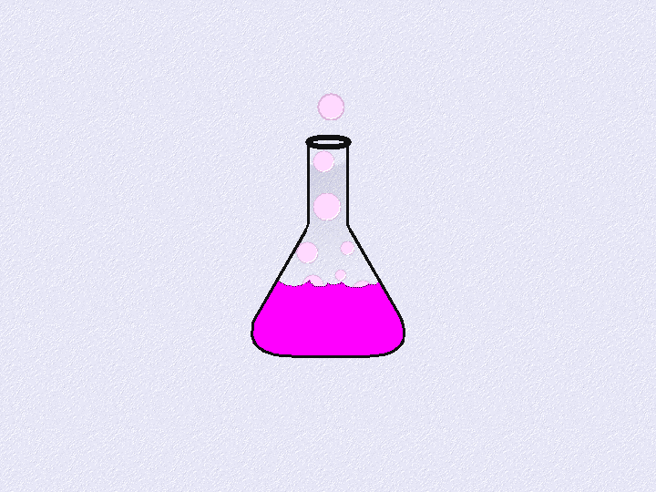
SESSION - 1
OBJECTIVES:
1. Introduction
2. Position of d-block elements in the periodic table
3. Electronic configuration
4. General trend in properties
Metallic behaviour,
Variation of atomic and ionic size.

Slide 4
Introduction:
Generally the metallic elements that have incompletely filled d or f sub shell in the neutral or cationic state are called transition metals. This definition includes lanthanides and actinides.
However, IUPAC defines transition metal as an element whose atom has an incomplete d sub shell or which can give rise to cations with an incomplete d sub shell.
They occupy the central position of the periodic table, between s and p block elements, and their properties are transitional between highly reactive metals of s block and elements of p block which are mostly non metals.
Except group- 11 elements all transition metals are hard and have very high melting point.

Slide 5
Importance of d- block elements:
Transition metals, iron and copper play an important role in the development of human civilization.
Many other transition elements also have important applications such as
Tungsten in light bulb filaments.
Titanium in manufacturing artificial joints.
Molybdenum in boiler plants.
Platinum in catalysis.
They also play vital role in living system, for example iron in
hemoglobin, cobalt in vitamin B₁₂ etc.,

Slide 6
Position of d- block elements in the periodic table:

Slide 7
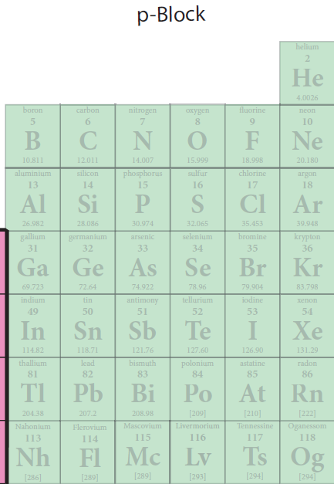
Group 3 to Group 12

Slide 8
d- Block elements composed of
3d series (4th period) Scandium to Zinc ( 10 elements)
4dseries ( 5th period) Yttrium to Cadmium ( 10 elements)
5d series ( 6th period) Lanthanum , Haffinium to mercury.

Slide 10
we know that the group-12 elements Zinc, Cadmium and Mercury do not have partially filled d-orbital either in their elemental state or in their normal oxidation states. However they are treated as transition elements, because their properties are an extension of the properties of the respective transition elements.
As per the IUPAC definition,
The seventh period elements, starting from Ac, Rf to Cn also belong to transition metals. (6d series – in complete)
All of them are radioactive.
Except Actinium; all the remaining elements are synthetically prepared and have very low half life periods

Slide 11
Electronic configuration:

Slide 14
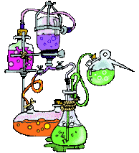

Slide 15
The general electronic configuration of d- block elements can be written as
[Noble gas] (n − )d¹⁻¹⁰ ns ¹⁻² Here, n = 4 to 7 .
In periods 6 and 7, (except La and Ac) the configuration includes ((n −2) f orbital
[Noble gas] (n −2)f¹⁴ (n −1)d¹⁻¹⁰ns¹⁻²

Slide 16
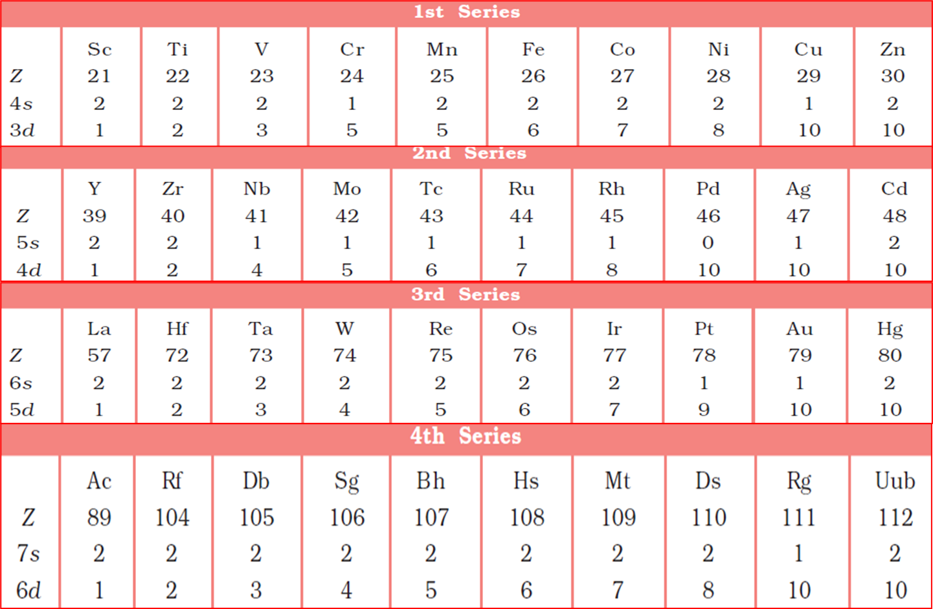
Outer electronic configuration of d – block elements:

Slide 17
General trend in properties:
Metallic behaviour:

Slide 21
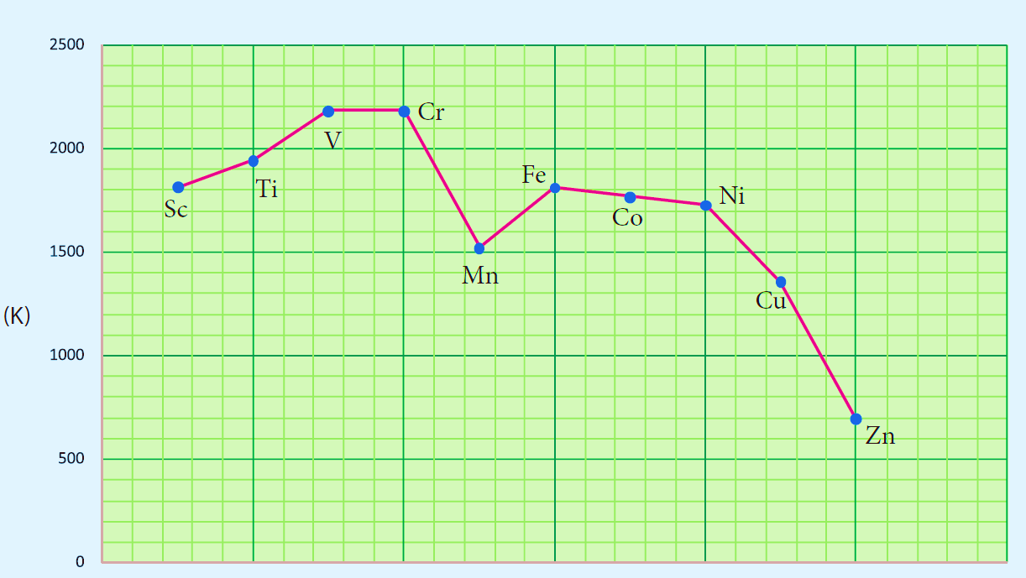
For example, in the first series the melting point increases from Scandium (m.pt 1814K) to a maximum of 2183 K for vanadium, which is close to 2180K for chromium.
However, manganese in 3d series and Tc in 4d series have low melting point.
The maximum melting point at about the middle of transition metal series indicates that d⁵ configuration is favorable for strong interatomic attraction.
The following figure shows the trends in melting points of transition elements.

Slide 22
Variation of atomic and ionic size:

Slide 23
However the increased nuclear charge is partly cancelled by the increased screening effect of electrons in the d – orbitals of penultimate shell.
When the increased nuclear charge and increased Screening effect balance each other, the atomic radii becomes almost constant.
Increase in atomic radii towards the end may be attributed to the electron – electron repulsion.
In fact the pairing of electrons in d – orbitals occurs after d⁵ configuration.
The repulsive interaction between the paired electron causes Increase in Atomic/ ionic radii

Slide 24
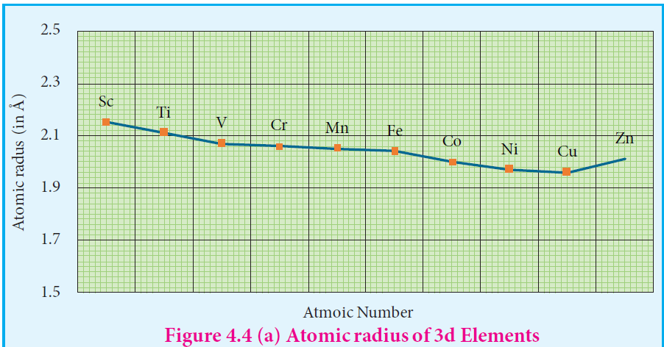
It is generally expected a steady decrease in atomic radius along a period as the nuclear charge increases and the extra electrons are added to the same sub shell.
But for the 3d transition elements, the expected decrease in atomic radius is observed from Sc to V , thereafter up to Cu the atomic radius nearly remains the same.
As we move from Sc to Zn in 3d series the extra electrons are added to the 3d orbitals, the added 3d electrons only partially shield the increased nuclear charge and hence the effective nuclear charge increases slightly.

Slide 26
However, the extra electrons added to the 3d sub shell strongly repel the 4s electrons and these two forces are operated in opposite direction and as they tend to balance each other, it leads to constancy in atomic radii.
At the end of the series, d – orbitals of Zinc contain 10 electrons in which the repulsive interaction between the electrons is more than the effective nuclear charge and hence, the orbitals slightly expand and atomic radius slightly increases.
Generally as we move down a group atomic increases, the same trend is expected d block elements also. As the electrons are added to the 4d sub shell the atomic radii of the 4d elements are higher than the corresponding of the 3d series. However there is an unexpected observation in the atomic radius of 5d elements which have nearly same atomic radius as that of corresponding 4d elements. Th is is due to lanthanoide contraction which is to be discussed later in this unit under inner transition elements.

Slide 27
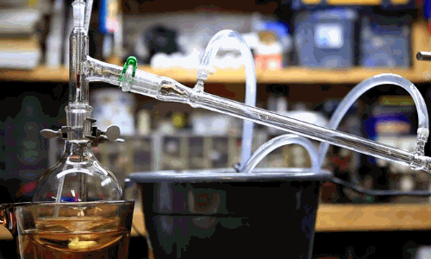

Slide 30
SESSION 2
OBJECTIVES :
Ionization enthalpy
Oxidation state
Standard electrode potentials of transition metals
Magnetic properties.

Slide 31
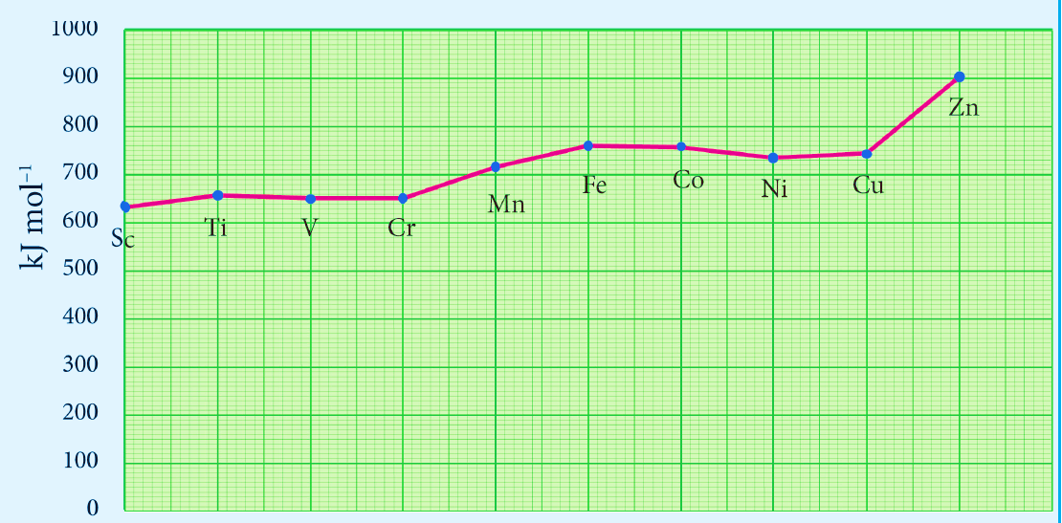
Ionization enthalpy.
Ionization energy of transition element is intermediate between those of s and p block elements.
As we move from left to right in a transition metal series, the ionization enthalpy increases as expected.
This is due to increase in nuclear charge corresponding to the filling of d electrons.
The following figure show the trends in ionisation enthalpy of transition elements.

Slide 32
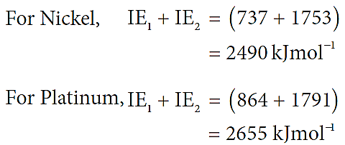
The increase in first ionisation enthalpy with increase in atomic number along a particular series is not regular.
The added electron enters (n-1)d orbital and the inner electrons act as a shield and decrease the effect of nuclear charge on valence ns electrons.
Therefore, it leads to variation in the ionization energy values.
The ionisation enthalpy values can be used to predict the thermodynamic stability of their coumponds.
Let us compare the ionisation energy required to form Ni²⁺ and Pt²⁺ ions.
Since, the energy required to form Ni²⁺ is less than that of Pt²⁺, Ni(II) compounds are thermodynamically more stable than Pt(II) compounds.

Slide 35
Oxidation state:
The first transition metal Scandium exhibits only +3 oxidation state, but all other transition elements exhibit variable oxidation states
Reason : by loosing electrons from (n-1)d orbital and ns
orbital as the energy difference between them is very small.
Let us consider the 3d series; the following table summarizes the oxidation states of the 3d series elements

Slide 36
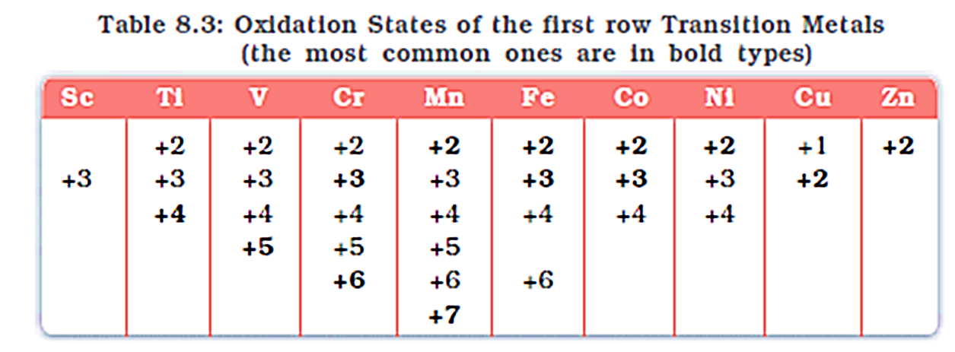
At the beginning of the series, +3 oxidation state is stable but towards the end +2 oxidation state becomes stable.
The number of oxidation states increases with the number of electrons available, and it decreases as the number of paired electrons increases.
Hence, the first and last elements show less number of oxidation states and the middle elements with more number of oxidation states.
For example,
The first element Sc has only one oxidation state +3;
The middle element Mn has six different oxidation states from +2 to +7.
The last element Cu shows +1 and +2 oxidation states only.

Slide 37
The relative stability of different oxidation states of 3d metals is correlated with the extra stability of half filled and fully filled electronic configurations.
Example: Mn²⁺ (3d⁵ ) is more stable than Mn⁴⁺ (3d³ )
The oxidation states of 4d and 5d metals vary from +3( for Y and La) to +8 (for Ru and Os).
The highest oxidation state of 4d and 5d elements are found in their compounds with the higher electronegative elements like O, F and Cl. for example: RuO₄, OsO₄ and WCl₆.
In Ni(CO)₄ and Fe(CO)₅, the oxidation state of nickel and iron is zero.

Slide 38
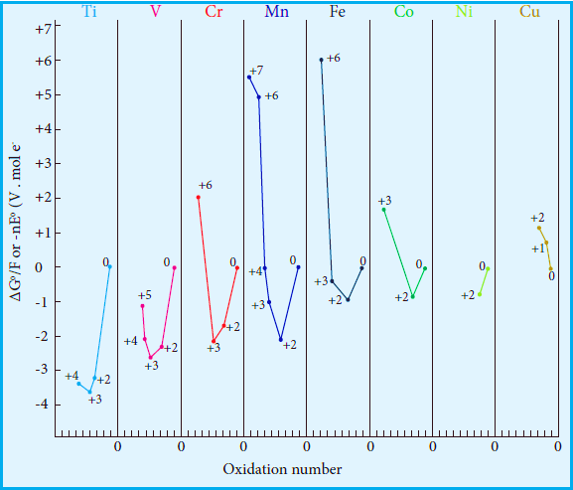
Generally in going down a group, a stability of the higher oxidation state increases while that of lower oxidation state decreases.
It is evident from the Frost diagram (ΔG⁰ vs oxidation number) as
shown below,
For titanium , vanadium and chromium, the most thermodynamically stable oxidation state is +3.
For iron, the stabilities of +3 and +2 oxidation states are similar.
Copper is unique in 3d series having a stable +1 oxidation state.
It is prone to disproportionate to the +2 and 0 oxidation states.
A Frost diagram or Frost–Ebsworth diagram is a type of graph used by inorganic chemists in electrochemistry to illustrate the relative stability of a number of different oxidation states of a particular substance. The graph illustrates the free energy vs oxidation state of a chemical species.

Slide 39
Standard electrode potentials of transition metals
Redox reactions involve transfer of electrons from one reactant to another. Such reactions are always coupled, which means that when one substance is oxidized, another must be reduced.
The substance which is oxidised is a reducing agent and the one which is reduced is an oxidizing agent.
The oxidizing and reducing power of an element is measured in terms of the standard electrode potentials.
Standard electrode potential is the value of the standard emf of a cell in which molecular hydrogen under standard pressure ( 1atm) and temperature (273K) is oxidised to solvated protons at the electrode.
If the standard electrode potential (E₀), of a metal is large and negative, the metal is apowerful reducing agent, because it loses electrons easily.
Standard electrode potentials (reduction potential) of few first transition metals are given in the following table.

Slide 40
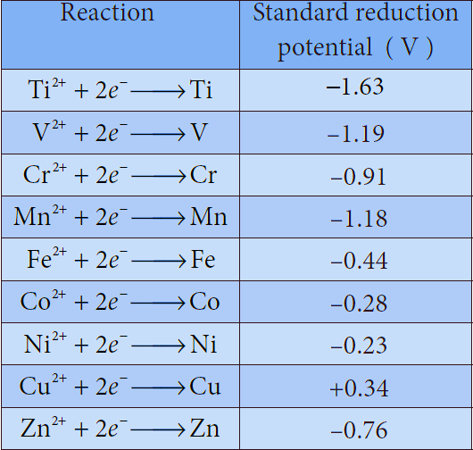
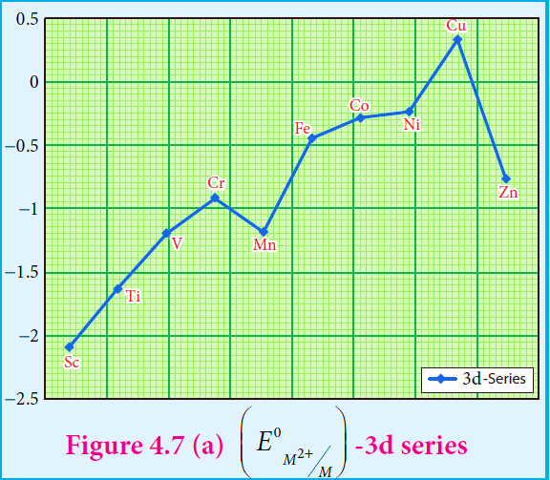
In 3d series as we move from Ti to Zn, the standard reduction potential
(E º _{M}2+ / _{M} ) value is approaching towards less negative value and copper
has a positive reduction potential. i.e., elemental copper is more stable than Cu²⁺.

Slide 41
There are two deviations.,
In the general trend, Fig shows that (E⁰ _{M}²⁺ _{/ M} ) value for manganese and zinc are more negative than the regular trend. It is due to extra stability which arises due to the half filled d⁵ configuration in Mn²⁺ and completely filled d¹⁰ configuration in Zn²⁺.
Transition metals in their high oxidation states tend to be oxidizing . For example,
Fe ³⁺ is moderately a strong oxidant, and it oxidises copper to Cu ²⁺ ions.
The feasibility of the reaction is predicted from the following standard electrode potential values.

Slide 42
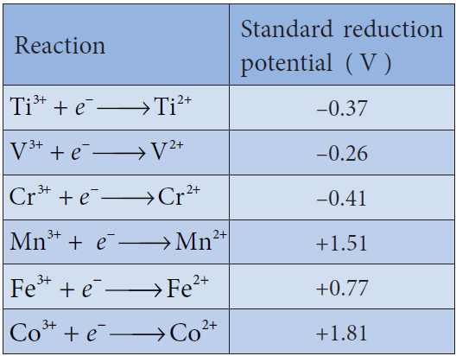
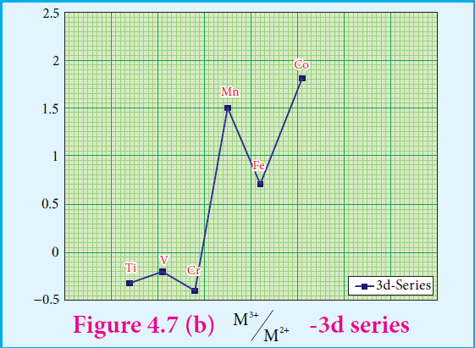

Slide 44
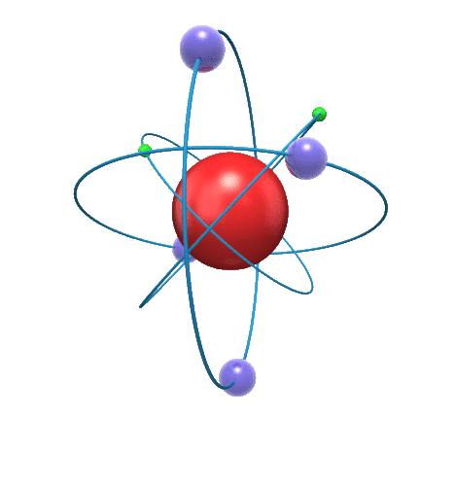
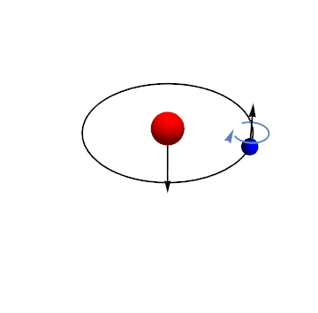
Magnetic properties
Th electron is spinning around its own axis, in addition toe its orbital motion around the nucleus. Due to these motions, a tiny magnetic field is generated and it is measured in terms
of magnetic moment.

Slide 45
Magnetic properties
Paramagnetic
Diamagnetic
Substances which contain electrons in their orbitals – PARAMAGNETIC.
PARAMAGNETIC SUBSTANCES are weakly attracted by the magnetic field.
Substances which do not contain any unpaired electrons and are repelled my magnetic field _ DIAMAGNETIC.
Substances which are attracted very strongly are said to be ferromagnetic.
In fact, ferromagnetism is an extreme form of paramagnetism.

Slide 46
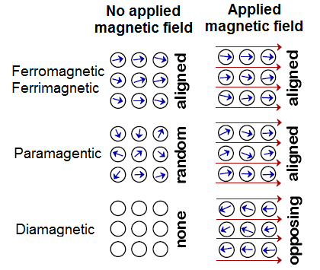

Slide 47
Most of the transition elements and their compounds show paramagnetism.
Paramagnetism arises from the presence of unpaired electrons, each such electron have a magnetic moment.
The magnetic moment of any transition element or its compound/ion is given by (assuming no contribution from the orbital magnetic moment).
μ_{s} = √n(n+2) BM
Here n is the number of unpaired electrons

Slide 49
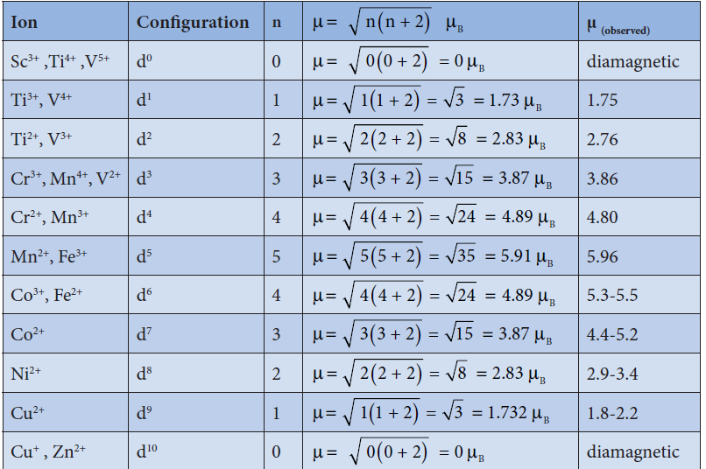

Slide 51
Questions-
Q. 1: Which ion has maximum magnetic moment
(a) V³⁺ (b) Mn³⁺
(c) Fe³⁺ (d) Cu²⁺
Ans: c
Q.2. What is the magnetic moment of Mn²⁺ ion (Z= 25) in aqueous solution ?
Ans.- With atomic number 25, the divalent Mn²⁺ ion in aqueous solution will have d⁵ configuration (five unpaired electrons).Hence, The magnetic moment, μ is
μ = √5(5 + 2) = 5.92BM

Slide 52
Catalytic properties
The chemical industries manufacture a number of products such as polymers, flavours, drugs etc., Most of the manufacturing processes have adverse effect on the environment so there is an interest for eco friendly alternatives.
In this context, catalyst based manufacturing processes are advantageous, as they require low energy, minimize waste production and enhance the conversion of reactants to products.
Many industrial processes use transition metals or their compounds as catalysts.
Transition metal has energetically available d orbitals that can accept electrons from reactant molecule or metal can form bond with reactant molecule using its d electrons.
For example,
Ithe catalytic hydrogenation of an alkene, the alkene bonds to an active site by using its π electrons with an empty d orbital of the catalyst.
The σ bond in the hydrogen molecule breaks, and each hydrogen atom forms a bond with a d electron on an atom in the catalyst.
The two hydrogen atoms then bond with the partially broken π -bond in the alkene to form an alkane.

Slide 53
In certain catalytic processes the variable oxidation states of transition metals find applications.
For example, in the manufacture of sulphuric acid from SO₃, vanadium pentoxide (V₂O₅) is used as a catalyst to oxidise SO₂. In this reaction V₂O₅ is reduced to vanadium (IV) Oxide (VO₂).

Slide 54
Alloy formation
An alloy is formed by blending a metal with one or more other elements.
The elements may be metals or non-metals or both.
The bulk metal is named as solvent, and the other elements in smaller portions are called solute.
According to Hume-Rothery rule
To form a substitute alloy the difference between the atomic radii of solvent and solute is less than 15%.
Both the solvent and solute must have the same crystal structure and valence and their electro negativity difference must be close to zero.
Transition metals satisfying these mentioned conditions form a number of alloys among themselves, since their atomic sizes are similar and one metal atom can be easily replaced by another metal atom from its crystal lattice to form an alloy.
The alloys so formed are hard and often have high melting points.
Examples:
Ferrous alloys, gold – copper alloy, chrome alloys etc.,

Slide 55
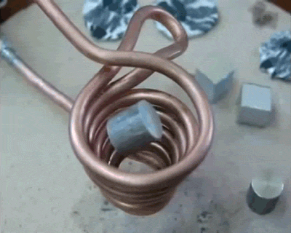

Slide 56
Formation of interstitial compounds
An interstitial compound or alloy is a compound that is formed when small atoms like hydrogen, boron, carbon or nitrogen are trapped in the interstitial holes in a metal lattice.
They are usually non-stoichiometric compounds.
Transition metals form a number of interstitial compounds such as TiC, ZrH_{1.94} , Mn ₄ N etc .
The elements that occupy the metal lattice provide them new properties.
(i) They are hard and show electrical and thermal conductivity
(ii) They have high melting points higher than those of pure metals
(iii) Transition metal hydrides are used as powerful reducing agents
(iv) Metallic carbides are chemically inert.

Slide 57
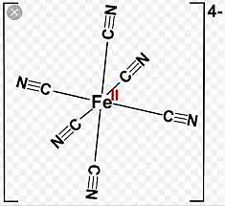
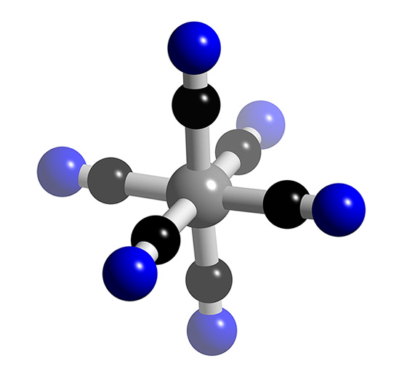
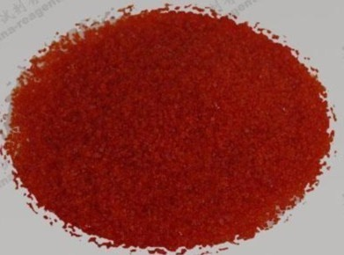
Formation of complexes
Transition elements have a tendency to form coordination compounds with a species that has an ability to donate an electron pair to form a coordinate covalent bond.
Transition metal ions are small and highly charged and they have vacant low energy orbitals to accept an electron pair donated by other groups. Due to these properties, transition metals form large number of complexes.
Examples: [Fe(CN)₆]⁴⁻ , [Co(NH₃)₆]³⁺ ,

Slide 58
Important compound of Transition elements
Oxides and Oxoanions of Metals:
Generally, transition metal oxides are formed by the reaction of transition metals with molecular oxygen at high temperatures.
Except the first member of 3d series, Scandium, all other transition elements form ionic metal oxides.
The oxidation number of metal in metal oxides ranges from +2 to +7.
As the oxidation number of a metal increases, ionic character decreases, for example, Mn₂O₇ is covalent. Mostly higher oxides are acidic in nature, Mn₂O₇ dissolves in water to give permanganic acid (HMnO₄ ) , similarly CrO₃ gives chromic acid (H₂CrO₄) and dichromic acid (H₂Cr₂O₇).
Generally lower oxides may be amphoteric or basic, for example, Chromium (III) oxide - Cr₂O₃, is amphoteric and Chromium(II) oxide, CrO, is basic in nature.

Slide 59
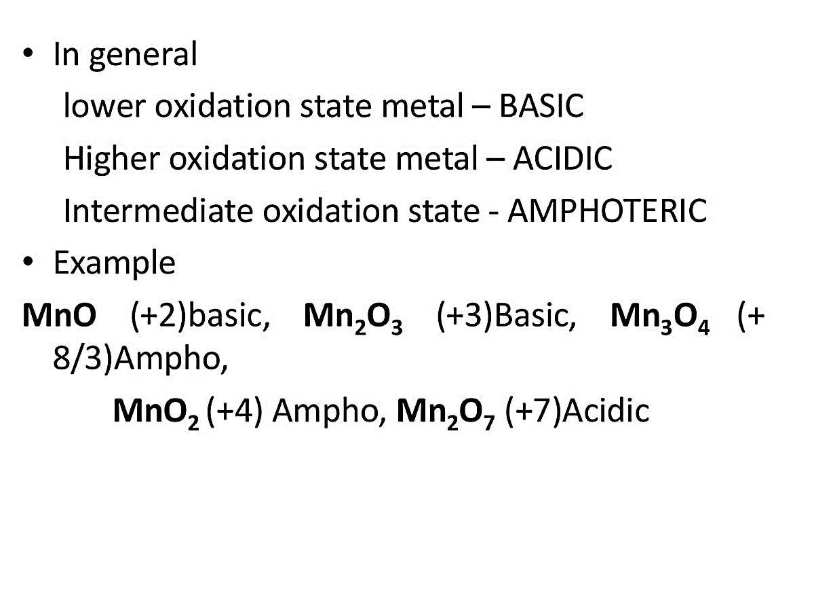
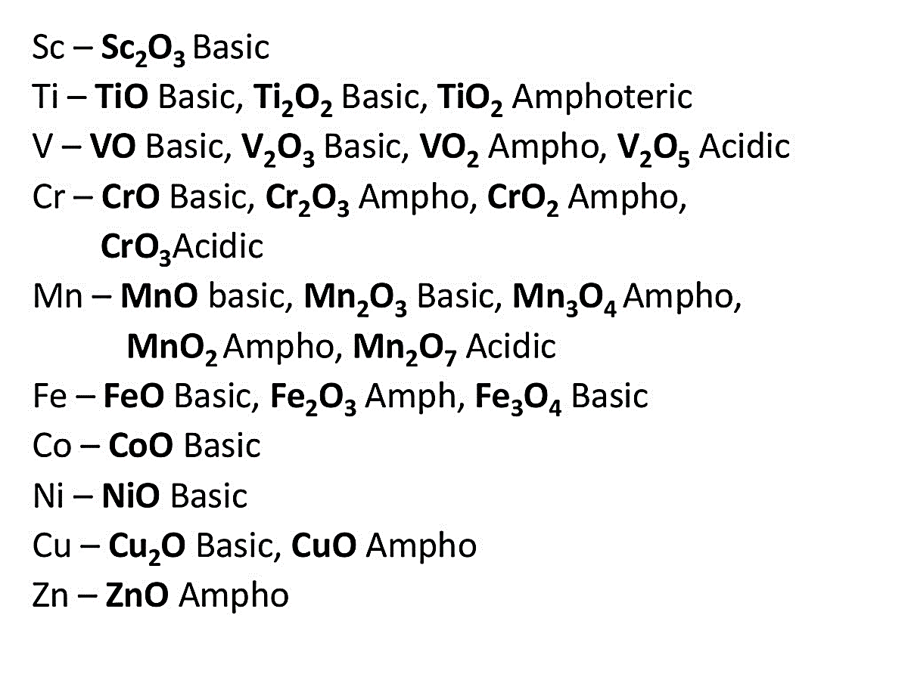

Slide 60
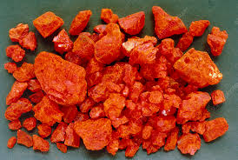
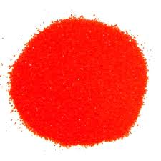
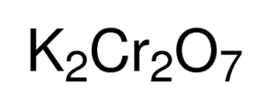
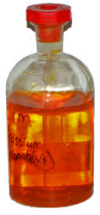
Potassium dichromate( K₂Cr₂O₇ )

Slide 61
Preparation:
STEP 1: Conversion of Chromate ore into potassium di chromate :
Potassium dichromate is prepared from chromate ore. The ore is concentrated by gravity separation. It is then mixed with excess sodium carbonate and lime and roasted in a reverberatory furnace.
STEP 2 : Conversion of Sodium chromate to Sodium di chromate:
The roasted mass is treated with water to separate soluble sodium chromate from insoluble iron oxide.
The yellow solution of sodium chromate is treated with concentrated sulphuric acid which converts sodium chromate into sodium dichromate.

Slide 62
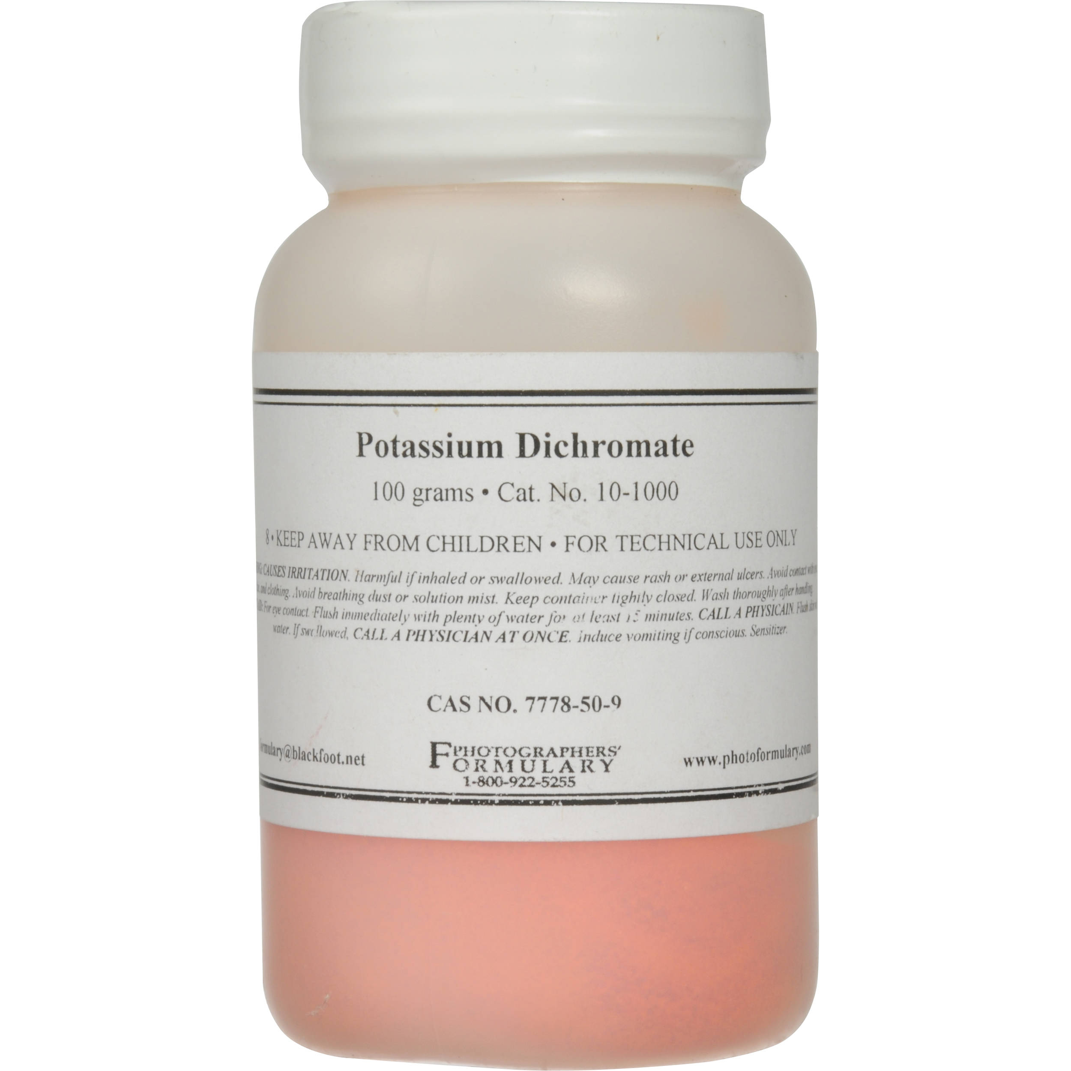
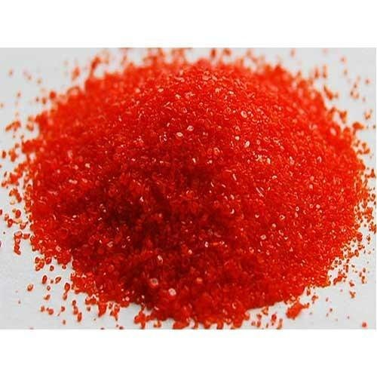
STEP 3: Conversion of Sodium di chromate to Potassium di chromate:
The above solution is concentrated to remove less soluble sodium sulphate. The resulting solution is filtered and further concentrated. It is cooled to get the crystals of Na₂SO₄.2H₂O.
The saturated solution of sodium dichromate in water is mixed with KCl and then concentrated to get crystals of NaCl. It is filtered while hot and the filtrate is cooled to obtain K₂Cr₂O₇ crystals.

Slide 63
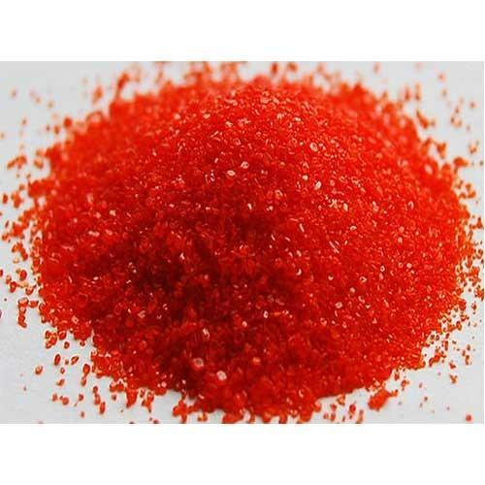
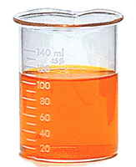
Physical properties Of K₂Cr₂O₇ :
Potassium dichromate is an orange red crystalline solid which melts at 671K and it is moderately soluble in cold water, but very much soluble in hot water.
On heating it decomposes and forms Cr₂ O₃ and molecular oxygen. As it emits toxic chromium fumes upon heating, it is mainly replaced by sodium dichromate.

Slide 64
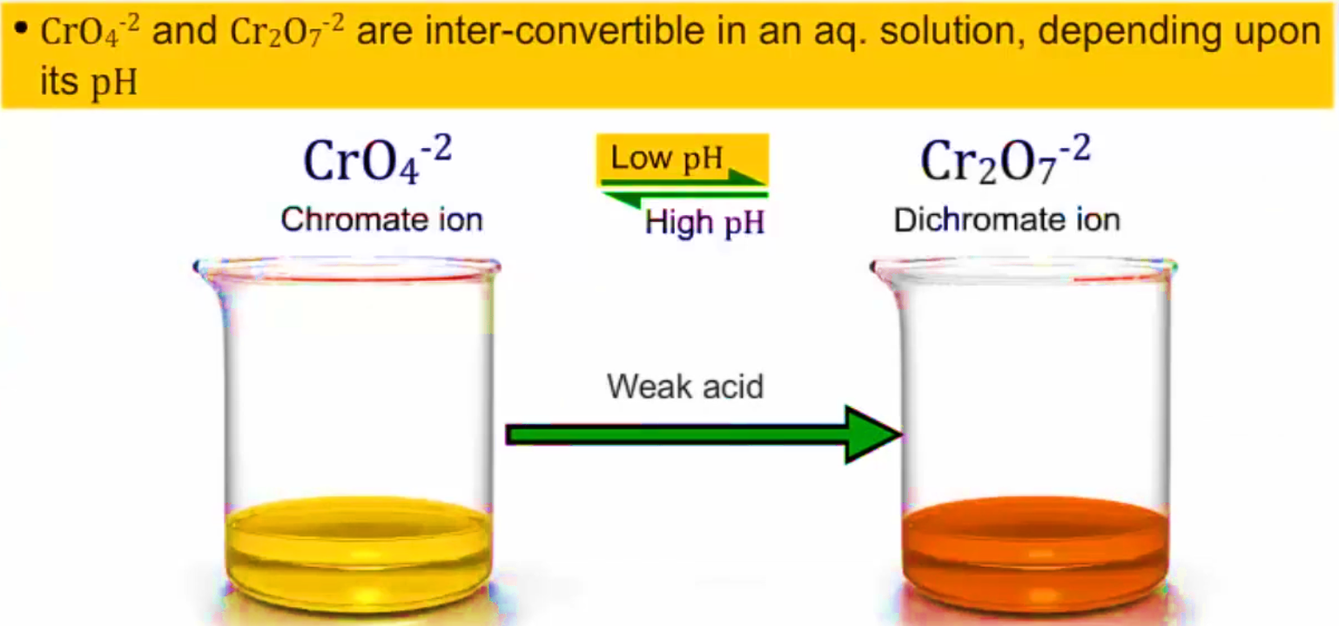
Both chromate and dichromate ion are oxo anions of chromium and they are moderately strong oxidizing agents.
In these ions chromium is in +6 oxidation state.
In an aqueous solution, chromate and dichromate ions can be interconvertible, and in an alkaline solution chromate ion is predominant, whereas dichromate ion becomes predominant in acidic solutions.

Slide 65
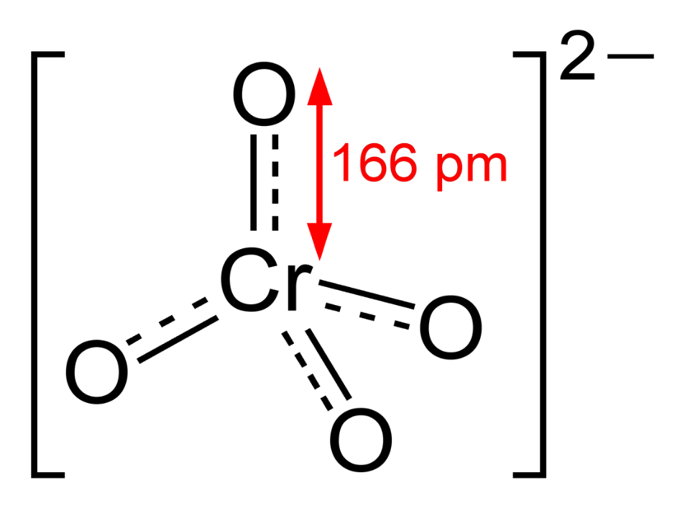
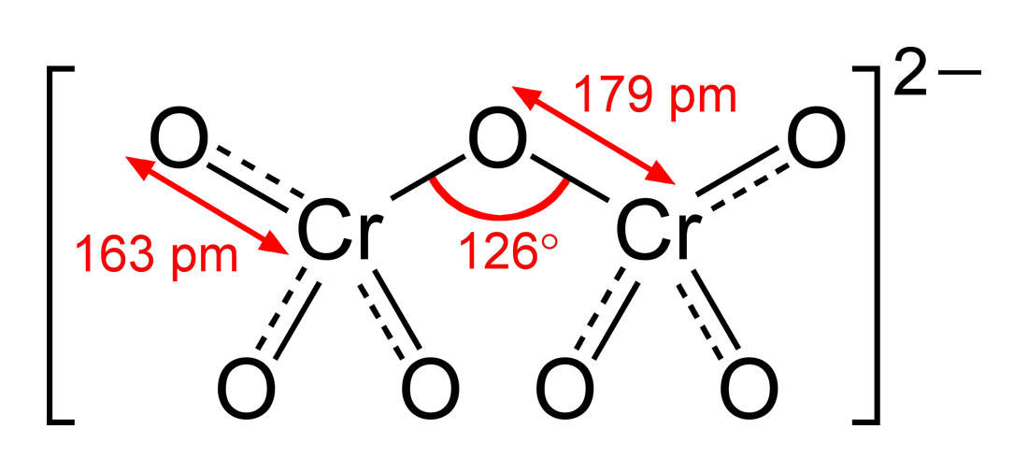
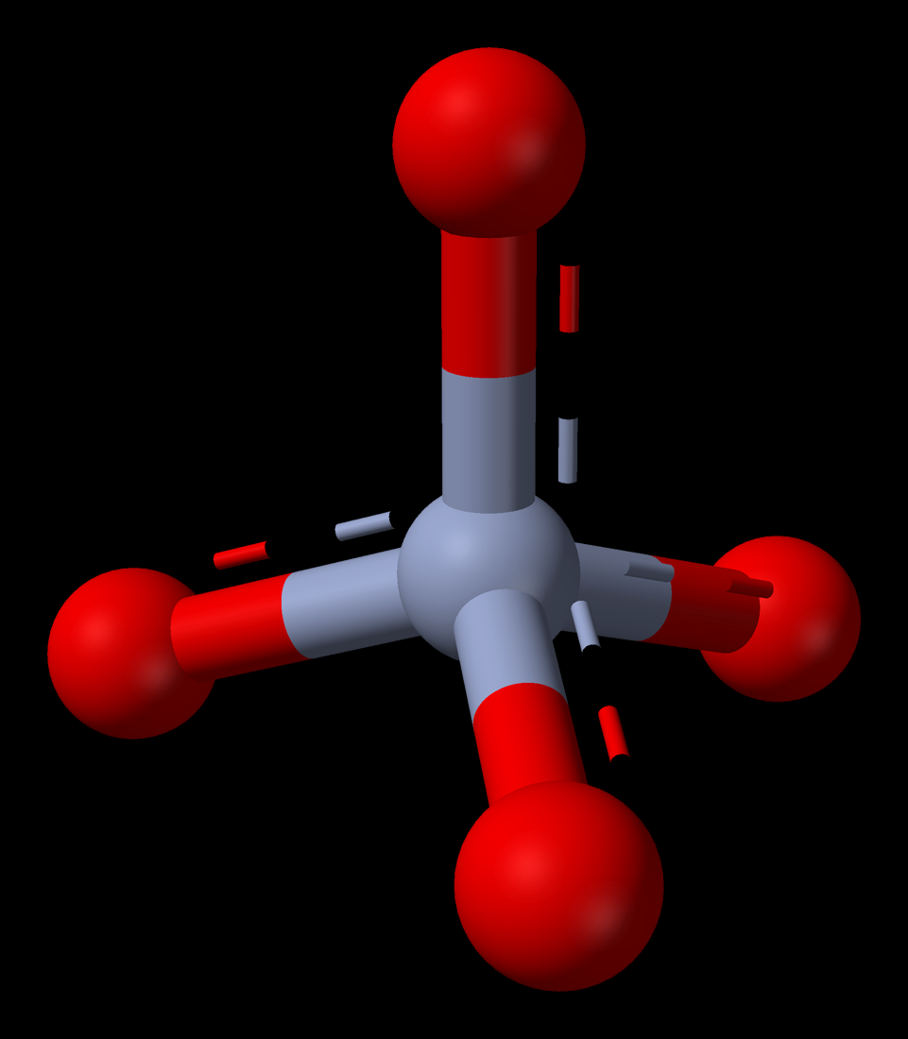
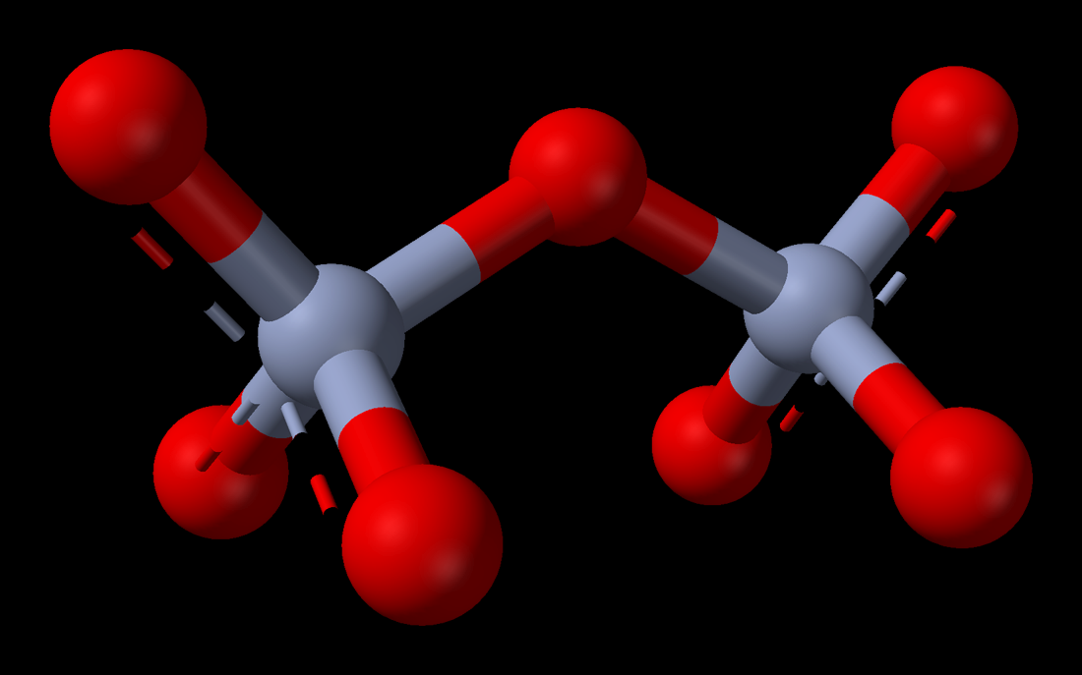
Structure of dichromate ion:

Slide 66
Chemical properties of K₂Cr₂O₇
1. Oxidation
Potassium dichromate is a powerful oxidising agent in acidic medium. Its oxidising action in the presence of H⁺ ions .
You can note that the change in the oxidation state of chromium from Cr⁶⁺ to Cr³⁺.
Its oxidising action is shown below.
The oxidising nature of potassium dichromate (dichromate ion) is illustrated in the following examples.
(i) It oxidises ferrous salts to ferric salts:
(ii) It oxidises iodide ions to iodine:

Slide 67
(iii) It oxidises sulphide ion to Sulphur :
(iv) It oxidises sulphur dioxide to sulphate ion :
(v) It oxidises stannous salts to stannic salt :
(vi) It oxidises alcohols to acids:

Slide 68
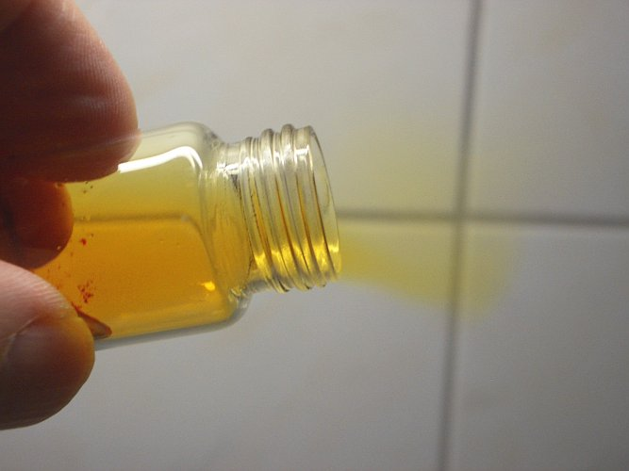
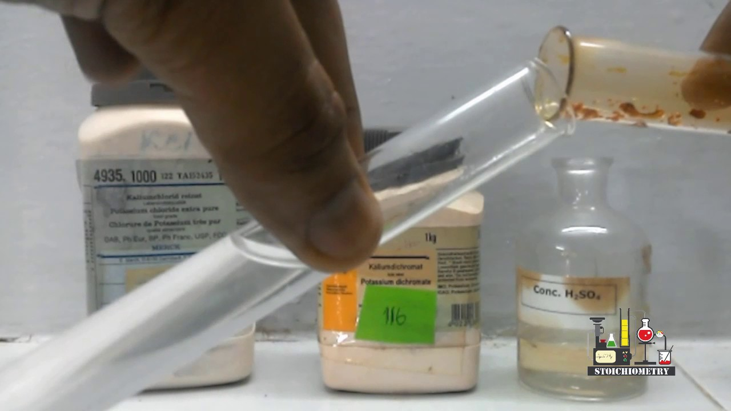
2. Chromyl chloride test:
When potassium dichromate is heated with any chloride salt in the presence of Conc H₂SO₄, orange red vapours of chromyl chloride (CrO₂Cl₂) is evolved. This reaction is used to confirm the presence of chloride ion in inorganic qualitative analysis.
The chromyl chloride vapours are dissolved in sodium hydroxide solution and then acidified with acetic acid and treated with lead acetate. A yellow precipitate of lead chromate is obtained.

Slide 69
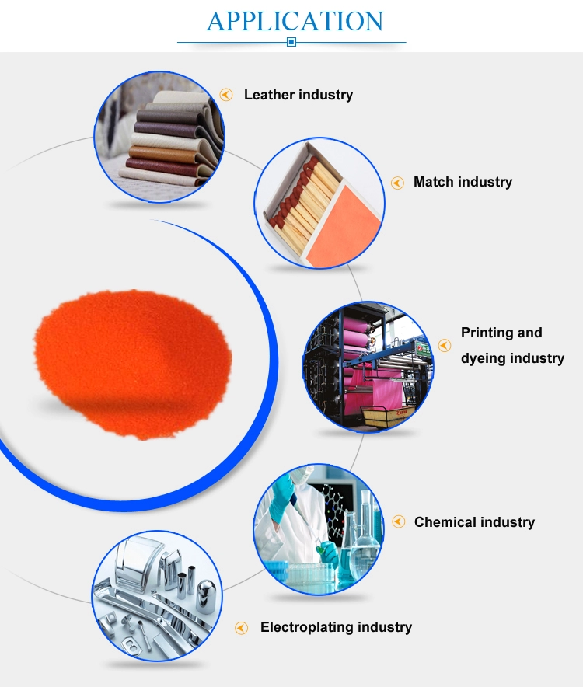
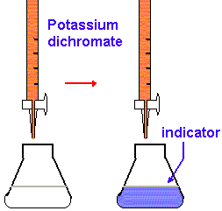
Uses of potassium dichromate:
Some important uses of potassium dichromate are listed below.
It is used as a strong oxidizing
agent.
2. It is used in dyeing and printing.
3. It used in leather tanneries for
chrome tanning.
4. It is used in quantitative analysis
for the estimation of iron compounds
and iodides.

Slide 70
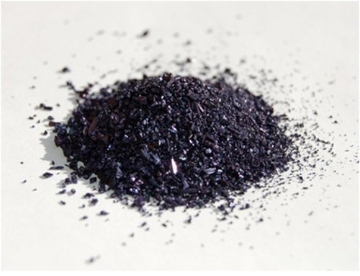
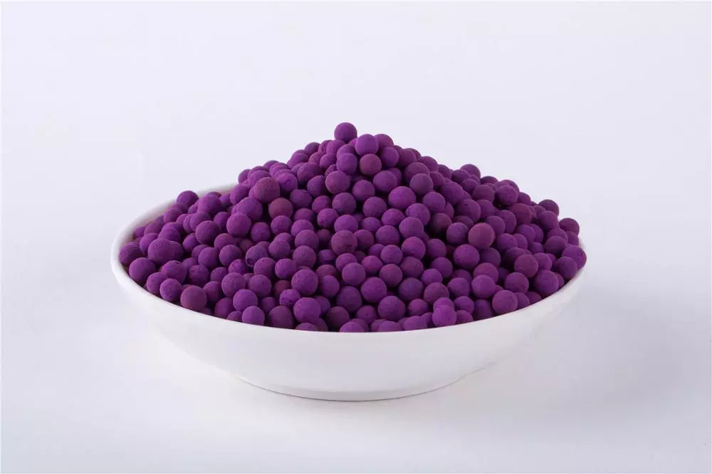
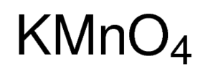
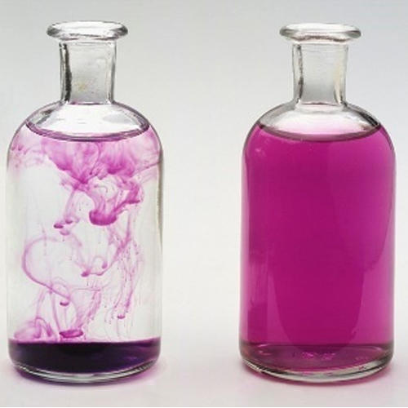
Potassium permanganate - KMnO₄

Slide 71
Preparation:
Potassium permanganate is prepared from pyrolusite (MnO₂) ore.
The preparation involves the following steps.
(i) Conversion of MnO₂ to potassium manganate:
Powdered ore is fused with KOH in the presence of air or oxidising agents like KNO₃ or KClO₃.
A green coloured potassium manganate is formed.
(ii) Oxidation of potassium manganate to potassium permanganate:
Potassium manganate thus obtained can be oxidised in two ways , either by chemical oxidation or electrolytic oxidation.

Slide 72
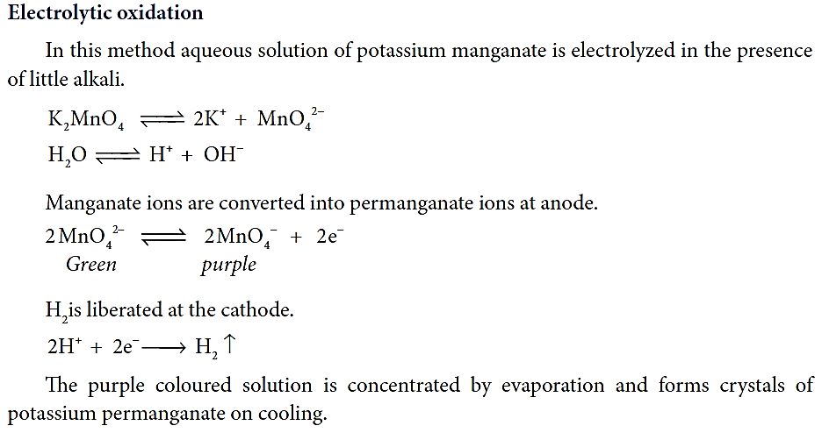

Slide 73
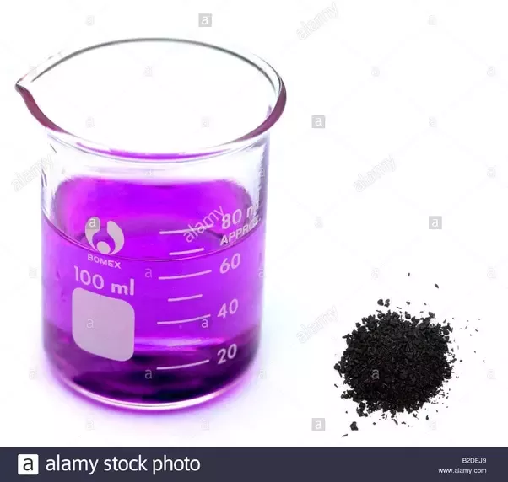
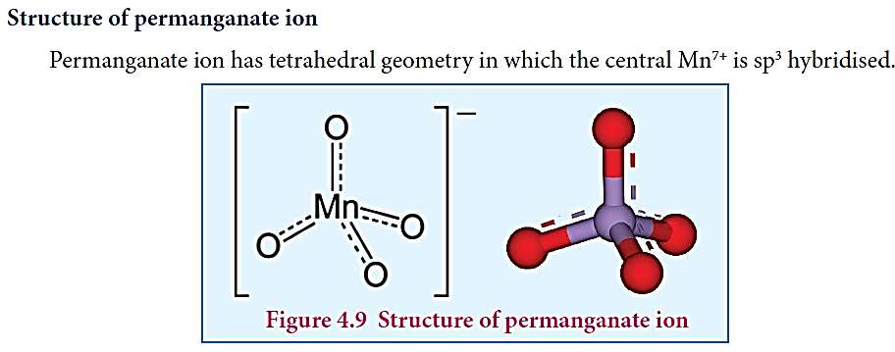
Physical properties:
Potassium permanganate exists in the form of dark purple crystals which melts at 513 K. It is sparingly soluble in cold water but, fairly soluble in hot water.

Slide 74
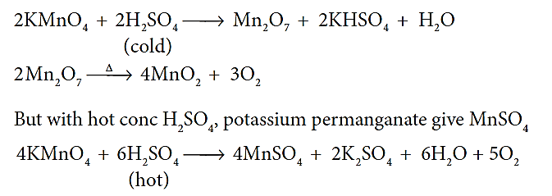
Chemical properties:
1. Action of heat:
When heated, potassium permanganate decomposes to form potassium manganate and dioxide.
2. Action of conc H₂SO₄ :
On treating with cold conc H₂SO₄, it decomposes to form manganese heptoxide, which subsequently decomposes explosively.

Slide 75
3. Oxidising property:
Potassium permanganate is a strong oxidising agent, its oxidising action differs in different reaction medium
a) In neutral medium:
In neutral medium, it is reduced to MnO₂
(i) It oxidises H₂S to Sulphur:
(ii) It oxidises thiosulphate into sulphate:

Slide 76
b) In alkaline medium:
In the presence of alkali metal hydroxides, the permanganate ion is converted into manganate.
This manganate is further reduced to MnO₂ by some reducing agents.
So the overall reaction can be written as follows.
This reaction is similar as that for neutral medium.

Slide 77
Bayer’s reagent:
Cold dilute alkaline KMnO4 is known as Bayer’s reagent. It is used to oxidise alkenes into diols.
For example, ethylene can be converted into ethylene glycol and this reaction is used as a test for unsaturation.

Slide 78
c) In acid medium:
In the presence of dilute sulphuric acid, potassium permanganate acts as a very strong oxidising agent. Permanganate ion is converted into Mn²⁺ ion.
The oxidising nature of potassium permanganate (permanganate ion) in acid medium is illustrated in the following examples.
(i) It oxidises ferrous salts to ferric salts.
(ii) It oxidises iodide ions to iodine

Slide 79
(iii) It oxidises oxalic acid to CO₂ :
(iv) It oxidises sulphide ion to Sulphur :
(v) It oxidises nitrites to nitrates:
(vi) It oxidises alcohols to aldehydes :
(vii) It oxidises sulphite to sulphate :

Slide 80
Uses of potassium permanganate:
Some important uses of potassium permanganate are listed below.
1. It is used as a strong oxidizing agent.
2. It is used for the treatment of various skin infections and fungal infections of the foot.
3. It used in water treatment industries to remove
iron and hydrogen sulphide from well water.
4. It is used as Bayer’s reagent for detecting
unsaturation in an organic compound.
5. It is used in quantitative analysis for the
estimation of ferrous salts, oxalates,
hydrogen peroxide and iodides.

Slide 83
INNER TRANSITION ELEMENTS(f BLOCK ELEMENTS)

Slide 85
1) Lanthanoids ( previously called lanthanides)
Lanthanoid series consists of fourteen elements from Cerium (58Ce) to Lutetium (71Lu) following Lanthanum (57La).
These elements are characterised by the preferential filling of
4f orbitals,
2) Actinoids ( previously called actinides)
Actinoids consists of 14 elements from Thorium (90Th) to Lawrencium (103Lr) following Actinium (89Ac).
These elements are characterised by the preferential filling of 5f orbital.

Slide 86
The position of Lanthanoids in the periodic table
The actual position of Lanthanoids in the periodic table is at group number 3 and period number 6.
However, in the sixth period after lanthanum, the electrons are preferentially filled in inner 4f sub shell and these fourteen elements following lanthanum show similar chemical properties.
Therefore these elements are grouped together and placed at the bottom of the
periodic table. This position can be justified as follows.
Lanthanoids have general electronic configuration
[Xe] 4f¹⁻¹⁴ 5d⁰⁻¹ 6s²
2. The common oxidation state of lanthanoides is +3
3. All these elements have similar physical and chemical properties.

Slide 87
Similarly the fourteen elements following actinium resemble in their physical and chemical properties.
If we place these elements after Lanthanum in the periodic table below
4d series, the properties of the elements belongs to a group would be
different and it would affect the proper structure of the periodic table.
Hence a separate position is provided to the inner transition elements as shown in the figure.

Slide 88
Electronic configuration of Lanthanoids:
We know that the electrons are filled in different orbitals in the order of their increasing energy in accordance with Aufbau principle.
As per this rule after filling 5s,5p and 6s and 4f level begin to fill from lanthanum, and hence the expected electronic configuration of Lanthanum(La) is [Xe] 4f¹ 5d⁰ 6s² but the actual electronic configuration of Lanthanum is[Xe] 4f⁰ 5d¹ 6s and it belongs to d block.
Filling of 4f orbital starts from Cerium (Ce) and its electronic configuration is
[Xe] 4f¹ 5d¹ 6s² .
As we move from Cerium to other elements the additional electrons are progressively filled in 4f orbitals as shown in the table.

Slide 89
In Gadolinium (Gd) and Lutetium (Lu) the 4f orbitals, are half-filled and completely filled, and one electron enters 5d orbitals. Hence the general electronic configuration of 4f series of elements can be written as
[Xe] 4f ¹⁻¹⁴ 5d⁰⁻¹ 6s²

Slide 90
Oxidation state of lanthanoids:
The common oxidation state of lanthanoids is +3.
In addition to that some of the lanthanoids also show either +2 or +4 oxidation states.
Gd³⁺ and Lu³⁺ ions have extra stability, it is due to the fact that they have exactly half filled and completely filled f-orbitals respectively, their electronic c onfigurations are
Similarly Cerium and terbium attain 4f⁰ and 4f⁷ configurations respectively in the +4 oxidation states.
Eu²⁺ and Yb²⁺ ions have exactly half filled and completely filled f orbitals
respectively.

Slide 91
The stability of different oxidation states has an impact on the properties of these elements.
The following table shows the different oxidation states of lanthanoids.

Slide 92
Atomic and ionic radii
As we move across 4f series, the atomic and ionic radii of lanthanoids show gradual decrease with increase in atomic number. This decrease in ionic size is called lanthanoid contraction.

Slide 93
Cause of lanthanoid contraction:
As we move from one element to another in 4f series ( Ce to Lu) the nuclear charge increases by one unit and an additional electron is added into the same inner 4f sub shell.
We know that 4f sub shell have a diffused shapes and therefore the shielding effect of 4f electrons relatively poor. Hence, with increase of nuclear charge, the valence shell is pulled slightly towards nucleus.
As a result, the effective nuclear charge experienced by the 4f electrons increases and the size of Ln³⁺ ions decreases.
Lanthanoid contraction of various lanthanoids is shown in the graph

Slide 94
Consequences of lanthanoid contraction:
1. Basicity differences
As we from Ce³⁺ to Lu³⁺ , the basic character of Ln³⁺ ions decrease. Due to the decrease in the size of Ln³⁺ ions, the ionic character of Ln −OH bond decreases (covalent character increases) which results in the decrease in the basicity.
2. Similarities among lanthanoids:
In the complete f - series only 10 pm decrease in atomic radii and 20 pm decrease in ionic radii is observed. because of this very small change in radii of lanthanoids, their chemical properties are quite similar.

Slide 95
The elements of the second and third transition series resemble each other more closely than the elements of the first and second transition series. For example

Slide 96
Actinoids:
The fourteen elements following actinium ,i.e., from thorium (Th) to lawrentium (Lr) are called actinoids.
Unlike the lanthanoids, all the actinoids are radioactive and most of them have short half lives.
Only thorium and uranium(U) occur in significant amount in nature
and a trace amounts of Plutonium(Pu) is also found in Uranium ores.
Neptunium(Np) and successive heavier elements are produced synthetically by the artificial transformation of naturally occuring elements by nuclear reactions.
Similar to lanthanoids, they are placed at the bottom of the periodic table.

Slide 97
Electronic configuration:
The electronic configuration of actinoids is not definite.
The general valence shell electronic configuration of 5f elements is represented as [Rn]5f⁰⁻¹⁴ 6d ⁰⁻² 7s ².
The following table show the electronic configuration of actinoids.

Slide 98
Oxidation state of actinoids:
Like lanthanoids, the most common state of actinoids is +3.
In addition to that actinoids show variable oxidation states such as +2 , +3 , +4 ,+5,+6 and +7.
The elements Americium(Am) and Thorium (Th) show +2 oxidation state in some compounds , for example thorium iodide (ThI2).
The elements Th , Pa, U ,Np , Pu and Am show +5 oxidation states. Np and Pu exhibit +7 oxidation state.

Slide 100
Differences between lanthanoids and actinoids:

