Slide 1
www.Padasalai.Net

Slide 3
Coordination compounds and double salts:
When two or more stable compounds in solution are mixed together and allowed to evaporate, in certain cases there is a possibility for the formation of double salts or coordination compounds.
For example when an equimolar solution of ferrous sulphate
and ammonium sulphate are mixed and allowed to crystallise, a
double salt namely Mohr's salt (Ferrous ammonium sulphate,
FeSO4.(NH4)2SO4.6H2O is formed.
Let us recall the blood red colour formation in the inorganic qualitative analysis of ferric ion, the reaction between ferric chloride and potassium thiocyanate solution gives a blood red coloured coordination compound, potassium ferrithiocyanate K3[Fe(SCN)6].
If we perform a qualitative analysis to identify the constituent ions present in both the compounds, Mohr's salt answers the presence of Fe²⁺ ,NH₄⁺ and SO²⁻₄ ions, whereas the potassium ferrithiocyanate will not answer Fe³⁺ and SCN⁻ ions.
From this we can infer that the double salts lose their identity and dissociates into their constituent simple ions in solutions , whereas the complex ion in coordination compound, does not loose its identity and never dissociate to give simple ions.

Slide 4
Werner's theory of coordination compounds:
Swiss chemist Alfred Werner was the first one to propose a theory of coordination compounds to explain the observed behaviour of them.
Let us consider the different coloured complexes of cobalt(III) chloride with ammonia which exhibit different properties as shown below.
In this case, the valences of the elements present in both the reacting molecules, cobalt(III) chloride and ammonia are completely satisfied. Yet these substances react to form the abovementioned complexes.

Slide 5
To explain this behaviour Werner postulated his theory as follows
1. Most of the elements exhibit, two types of valence namely primary valence and secondary valence and each element tend to satisfy both the valences. In modern terminology, the primary valence is referred as the oxidation state of the metal atom and the secondary valence as the coordination number. For example, according to Werner, the primary and secondary valences of cobalt are 3 and 6 respectively.
2. The primary valence of a metal ion is positive in most of the cases and zero in certain cases. They are always satisfied by negative ions.
For example in the complex CoCl₃.6NH₃,The primary valence of Co is +3 and is
satisfied by 3Cl⁻ ions.
3. The secondary valence is satisfied by negative ions, neutral molecules, positive ions or the combination of these.
For example, in CoCl₃.6NH₃ the secondary valence of cobalt is 6 and is satisfied by six neutral ammonia molecules, whereas in CoCl₃.5NH₃ the secondary valence of cobalt is satisfied by five neutral ammonia molecules and a Cl⁻ ion.

Slide 6
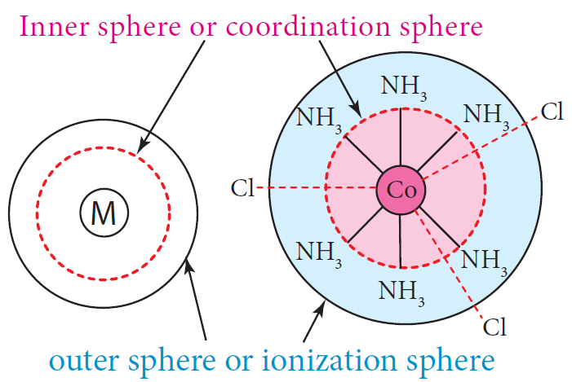
4. According to Werner, there are two spheres of attraction around a metal atom/ion in a complex.
The inner sphere is known as coordination sphere and the groups present in this
sphere are firmly attached to the metal.
The outer sphere is called ionisation sphere.
The groups present in this sphere are loosely bound to the central metal ion and hence can be separated into ions upon dissolving the complex in a suitable solvent.
CoCl3.6NH3

Slide 7
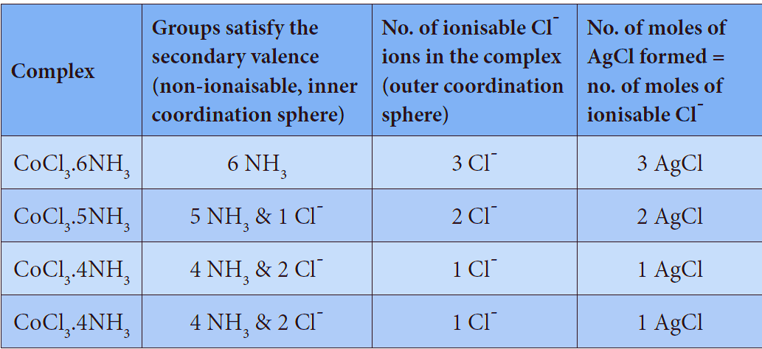
5.The primary valences are non-directional while the secondary valences are directional. The geometry of the complex is determined by the spacial arrangement of the groups which satisfy the secondary valence.
For example, if a metal ion has a secondary valence of six, it has an octahedral geometry. If the secondary valence is 4, it has either tetrahedral or square planar geometry.
The following table illustrates the Werner's postulates.
Limitations of Werner’s theory:
Even though, Werner’s theory was able to explain a number of properties of coordination
compounds, it does not explain their colour and the magnetic properties.

Slide 8
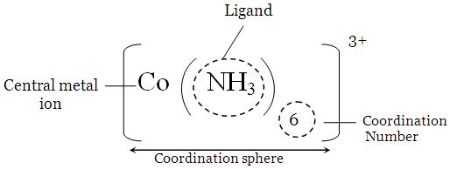
Definition of important terms pertaining to co-ordination compounds:
Coordination entity:
Coordination entity is an ion or a neutral molecule, composed of a central atom, usually a metal and the array of other atoms or groups of atoms (ligands) that are attached to it. In the formula, the coordination entity is enclosed in square brackets.
For example, in potassium ferrocyanide, K4[Fe(CN)6], the coordination entity is [Fe(CN)6]⁴⁻ .
In nickel tetracarbonyl, the coordination entity is [Ni(CO)4].

Slide 9
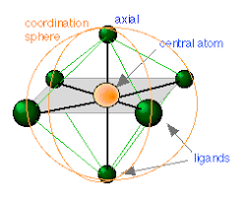
Central atom/ion:
The central atom/ion is the one that occupies the central position in a coordination entity and binds other atoms or groups of atoms (ligands) to itself, through a coordinate covalent bond.
For example, in K4[Fe(CN)6], the central metal ion is Fe²⁺ . In the
coordination entity [Fe(CN)6]⁴⁻ the Fe²⁺ accepts an electron pair from each ligand, CN⁻ and thereby forming six coordinate covalent bonds with them.
since, the central metal ion has an ability to accept electron pairs, it is
referred to as a Lewis acid.

Slide 10
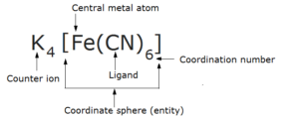
Ligands:
The ligands are the atoms or groups of atoms bound to the central atom/ion. The atom in a ligand that is bound directly to the central metal atom is known as a donor atom.
For example, in K4[Fe(CN)6], the ligand is CN⁻ ion, but the donor atom is carbon and in [Co(NH3)6]Cl3 the ligand is NH3 molecule and the donor atom is nitrogen.

Slide 11
Coordination sphere:
The complex ion of the coordination compound containing the central metal atom/ion and the ligands attached to it, is collectively called coordination sphere and are usually enclosed in square brackets with the net charge. The other ionisable ions, are written outside the bracket are called counter ions.
For example, the coordination compound K4[Fe(CN)6] contains the
complex ion [Fe(CN)6]⁴⁻ and is referred as the coordination sphere.
The other associated ion K⁺ is called the counter ion.
Coordination polyhedron:
The three dimensional spacial arrangement of ligand atoms/ions that are directly attached to the central atom is known as the coordination polyhedron (or polygon).
For example,
in K4[Fe(CN)6], the coordination polyhedra is octrahedral.
The coordination polyhedra of [Ni(CO)4] is tetrahedral.

Slide 12
Coordination number:
The number of ligand donor atoms bonded to a central metal ion in a complex is called the coordination number of the metal. In other words, the coordination number is equal to the number of σ-bonds between ligands and the central atom.
For example,
i. In K4[Fe(CN)6], the coordination number of Fe²⁺ is 6.
ii. In [Ni(en)3]Cl2, the coordination number of Ni²⁺ is also 6. Here the ligand 'en' represents ethane-1,2-diamine
(NH2-CH2-CH2-NH2) and it contains two donor atoms (Nitrogen)
Each ligand forms two coordination bonds with nickel. So,totally there are six coordinationnbonds between them.

Slide 13
Oxidation state (number):
The oxidation state of a central atom in a coordination entity is defined as the charge it would bear if all the ligands were removed along with the electron pairs that were shared with the central atom.
In naming a complex, it is represented by a Roman
numeral.
For example,
in the coordination entity [Fe(CN)6]⁴⁻ the oxidation state of
iron is represented as (II).
The net charge on the complex ion is equal to the sum of the oxidation state of the central metal and the charge the on the ligands attached to it.
Using this relation the oxidation number can be calculated as follows

Slide 14
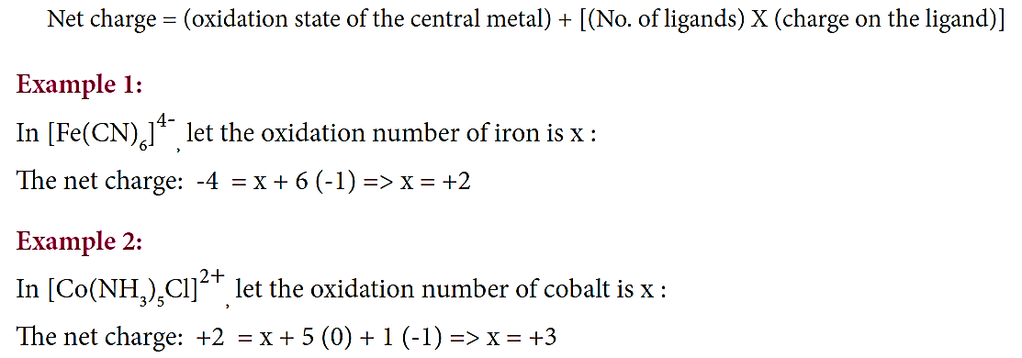

Slide 15
Types of complexes:
The coordination compounds can be classified into the following types based on
The net charge of the complex ion
(ii) kinds of ligands present in the coordination entity.
Classification based on the net charge on the complex:
A coordination compound in which the complex ion
I. carries a net positive charge is called a cationic complex.
Examples: [Ag(NH₃)₂]⁺, [Co(NH₃)₆]³⁺ , [Fe(H₂O)₆]²⁺, etc
ii. carries a net negative charge is called an anionic complex.
Examples: [Ag(CN)₂]⁻, [Co(CN)₆]³⁻ , [Fe(CN)₆]⁴⁻, etc
iii. bears no net charge, is called a neutral complex.
Examples: [Ni(CO)₄], [Fe(CO)₅] , [Co(NH₃)₃(Cl)₃], etc

Slide 16
Classification based on kind of ligands:
A coordination compound in which
i. the central metal ion/atom is coordinated to only one kind of ligands is called a homoleptic complex.
Examples: [Co(NH3)6]³⁺ , [Fe(H2O)6]²⁺ ,
ii. the central metal ion/atom is coordinated to more than one kind of ligands is called a heteroleptic complex.
Example, [Co(NH3)5Cl]²⁺ , [Pt(NH3)2Cl2)]

Slide 17
Nomenclature of coordination compounds
In the earlier days, the compounds were named after their discoverers.
For example,
K[PtCl₃(C₂H₄)] was called Zeise’s salt
[Pt(NH₃)₄][PtCl₄] is called Magnus’s green salt etc...
There are numerous coordination compounds that have been synthesised and characterised.
The International Union of Pure and Applied Chemistry (IUPAC) has developed an elaborate system of nomenclature to name them systematically.

Slide 18
The guidelines for naming coordination compounds based on IUPAC recommendations (2005) are as follows:

Slide 20
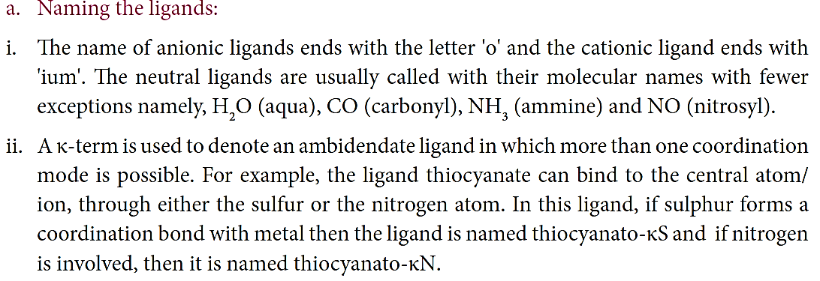
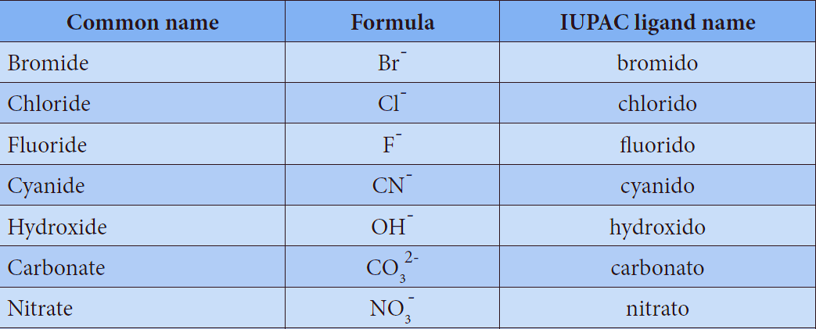

Slide 21
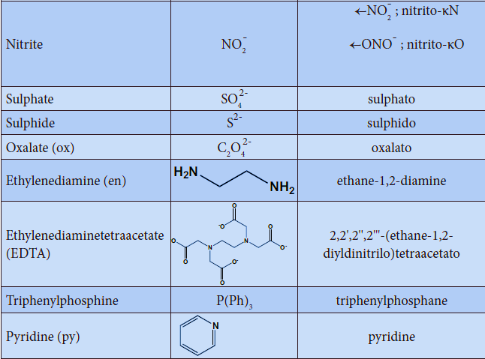

Slide 23
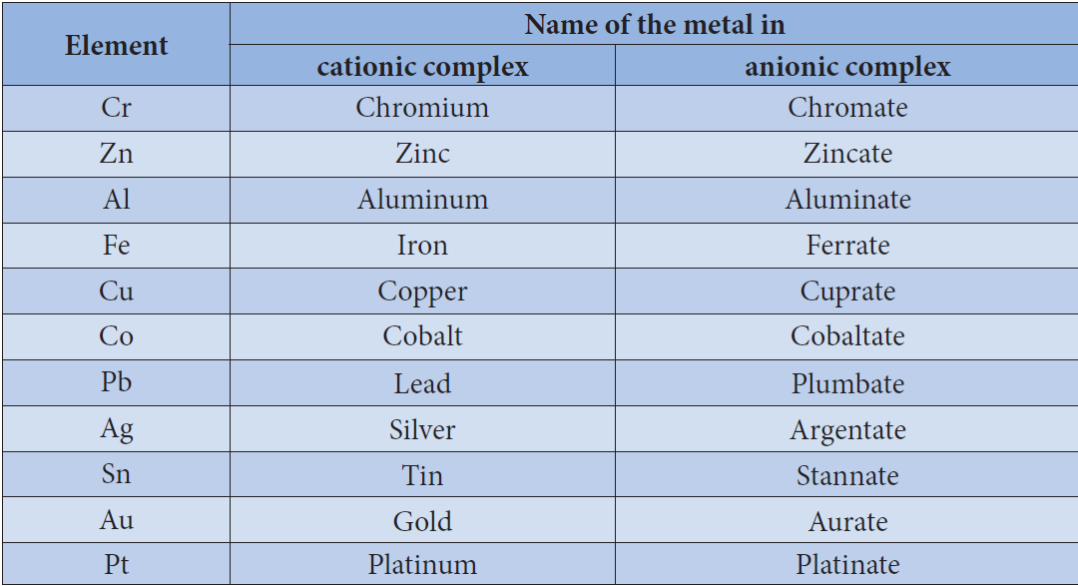

Slide 24
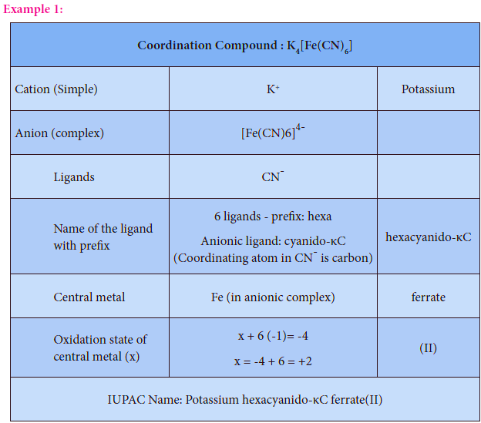
Naming of coordination compounds using IUPAC guidelines.

Slide 26
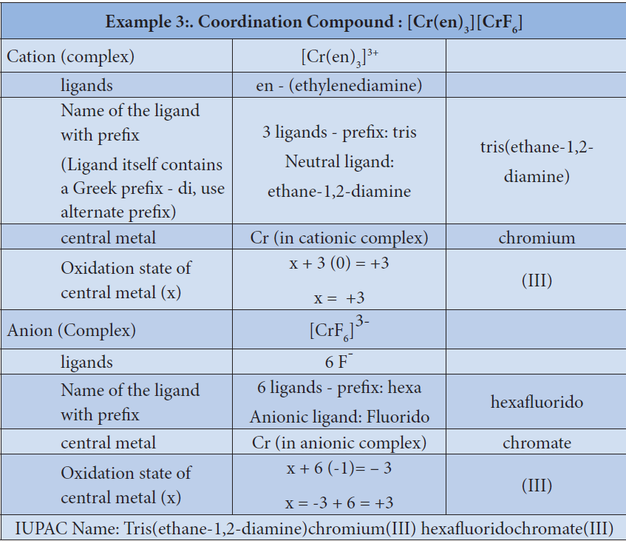

Slide 27
More examples with names are given in the list below for better understanding of IUPAC Nomenclature:

Slide 28
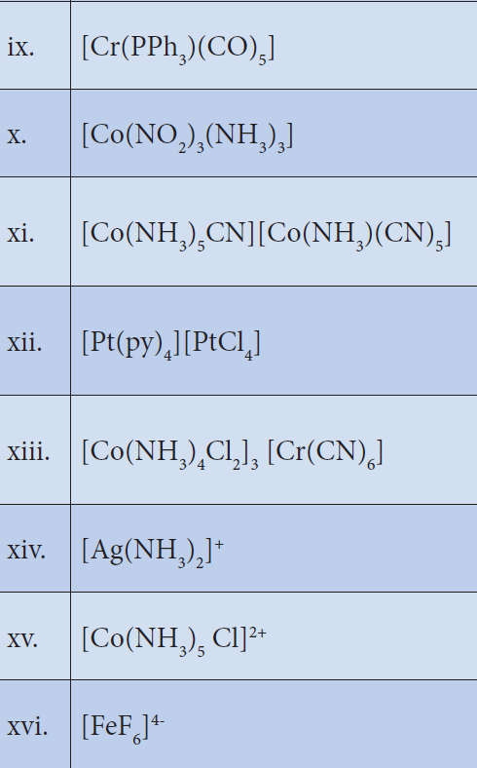

Slide 29
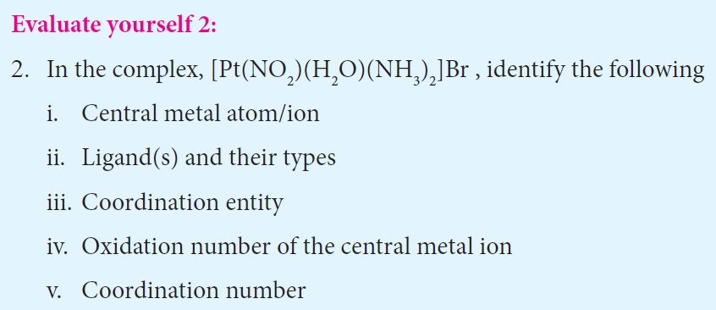
HOME WORK

Slide 31
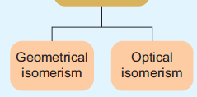
Isomerism in coordination compounds
Isomerism is the phenomenon in which more than one coordination compounds having the same molecular formula have different physical and chemical properties due to different arrangement of ligands around the central metal atom.
The following flow chart gives an overview of the common types of isomerism observed in coordination compounds,

Slide 32
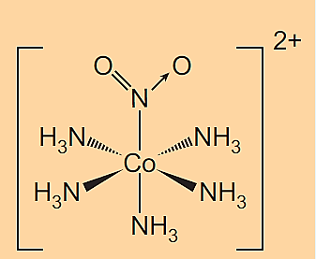
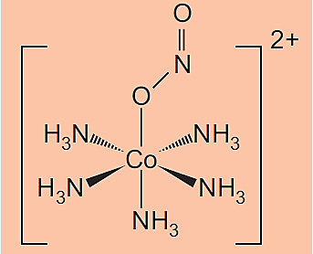
Structural isomers
The coordination compounds with same formula, but have different connections among their constituent atoms are called structural isomers or constitutional isomers.
Linkage isomers:
This type of isomers arises when an ambidentate ligand is bonded to the central metal atom/ion through either of its two different donor atoms.
In the below mentioned examples, the nitrite ion is bound to the central metal ion Co³⁺ through a nitrogen atom in one complex, and
through oxygen atom in other complex.
[Co(NH₃)₅(NO₂)]²⁺

Slide 34
Coordination isomers:
This type of isomers arises in the coordination compounds having both the cation and anion as complex ions. The interchange of one or more ligands between the cationic and the anionic coordination entities result in different isomers.
For example, in the coordination compound, [Co(NH₃)₆][Cr(CN)₆] the ligands ammonia and cyanide were bound respectively to cobalt and chromium while in its coordination isomer
[Cr(NH₃)₆][Co(CN)₆] they are reversed.

Slide 35
Ionisation isomers:
This type of isomers arises when an ionisable counter ion (simple ion) itself can act as a ligand. The exchange of such counter ions with one or more ligands in the coordination entity will result in ionisation isomers. These isomers will give different ions in solution.
For example, consider the coordination compound [Pt(en)₂Cl₂]Br₂. In this compound, both Br⁻ and Cl⁻ have the ability to act as a ligand and the exchange of these two ions result in a different isomer [Pt(en)₂Br₂]Cl₂. In solution the first compound gives Br⁻ ions while the later gives Cl⁻ ions and hence these compounds are called ionisation isomers.

Slide 36
Solvate isomers.
The exchange of free solvent molecules such as water , ammonia, alcohol etc.. in the crystal lattice with a ligand in the coordination entity will give different isomers. These type of isomers are called solvate isomers.
If the solvent molecule is water, then these isomers are called hydrate isomers.
For example, the complex with chemical formula CrCl₃.6H₂O has three hydrate isomers as shown below.

Slide 37
Stereoisomers:
Similar to organic compounds, coordination compounds also exhibit stereoisomerism.
The stereoisomers of a coordination compound have the same chemical formula and connectivity between the central metal atom and the ligands. But they differ in the spatial arrangement of ligands in three dimensional space.
They can be further classified as
Geometrical isomers
Optical isomers.

Slide 38
Geometrical isomers:
Geometrical isomerism exists in heteroleptic complexes due to different possible three dimensional spatial arrangements of the ligands around the central metal atom.
This type of isomerism exists in square planer and octahedral complexes.

Slide 39
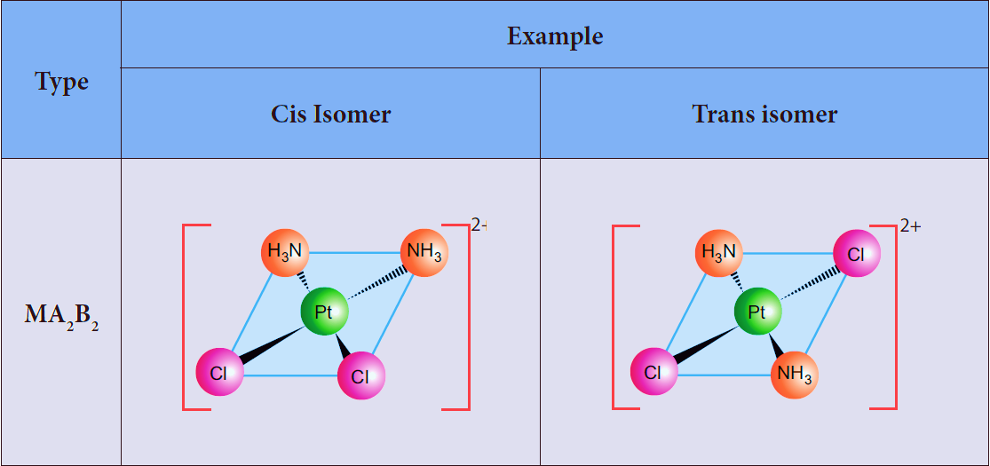
Square planar complex - MA₂B_{2 ,} MA₂BC , M(xy)_{2 ,} MABCD - isomers
MA₂B₂ :
Example [ Pt(NH₃)₂Cl₂]²⁺

Slide 40
MA₂BC :
Example : [Pt(NH₃)₂ Cl Br]²⁺

Slide 41
M(xy)₂ :
Example: [Pt(NH₂ - CH₂ – COO)₂ ]

Slide 42
MABCD
Example: [ Pt NH₃ Br Cl NO₂ ]

Slide 43
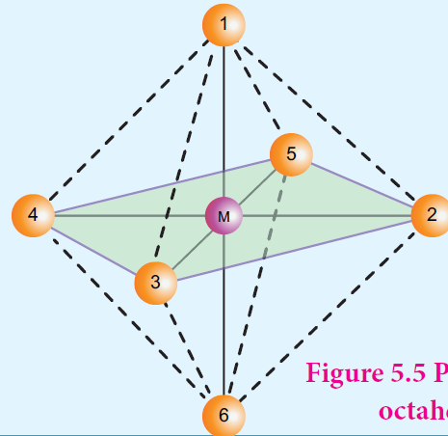
Octahedral complexes:
Octahedral complexes of the type [MA₂B₄]^{n±}, [M(xx)₂B₂]^{n±} shows
cis-trans isomerism.
Here A and B are monodentate ligands and xx is bidentate ligand with two same kind of donor atoms. In the octahedral complex, the position of ligands is indicated by the following numbering scheme.
In the above scheme, the positions (1,2), (1,3), (1,4), (1,5), (2,3), (2,5), (2,6), (3,4), (3,6),(4,5), (4,6), and (5,6) are identical and if two similar groups are present in any one of these positions, the isomer is referred as a cis- isomer.
Similarly, positions (1,6), (2,4), and (3,5) are identical and if similar ligands are present in these positions it is referred as a trans-isomer.

Slide 44
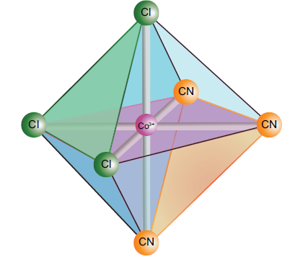
Octahedral complex of the type [MA₃B₃]^{n±} also shows geometrical isomerism. If the three similar ligands (A) are present in the corners of one triangular face of the octahedron and the other three ligands (B) are present in the opposing triangular face, then the isomer is referred
as a facial isomer (fac isomer)

Slide 45
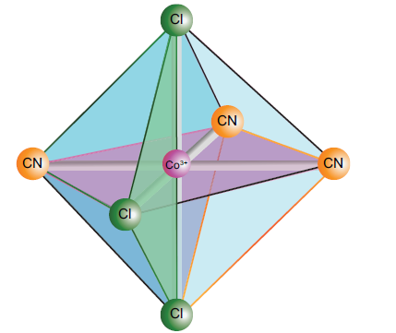
If the three similar ligands are present around the meridian which is an imaginary semicircle from one apex of the octahedral to the opposite apex as shown in the
figure. the isomer is called as a meridional isomer
(mer isomer).
This is called meridional because each set of ligands can be regarded as lying on a meridian of an octahedron.
As the number of different ligands increases, the number of possible isomers also increases. For the octahedral complex of the type [MABCDEF]^{n±}, where A, B, C, D, E and F are monodentate ligands, fifteen different orientation are possible corresponding to 15 geometrical isomers.
It is difficult to generate all the possible isomers.

Slide 46
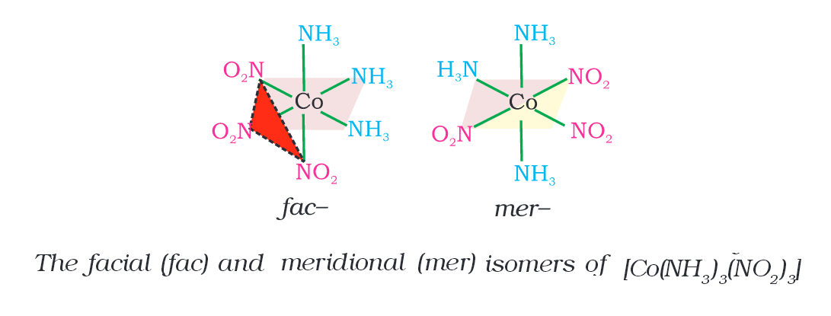
Fac and Mer Stereoisomers:
When three identical ligands occupy one face of an octahedron, the isomer is said to be facial, or fac. In a fac isomer, any two identical ligands are adjacent or cis to each other. If these three ligands and the metal ion are in one plane, the isomer is said to be meridional, or mer.

Slide 48
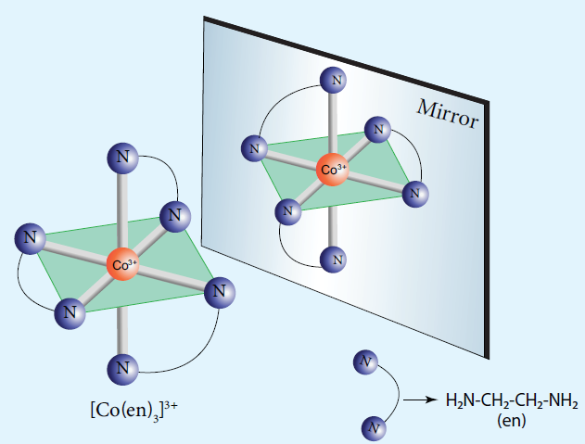

Slide 49
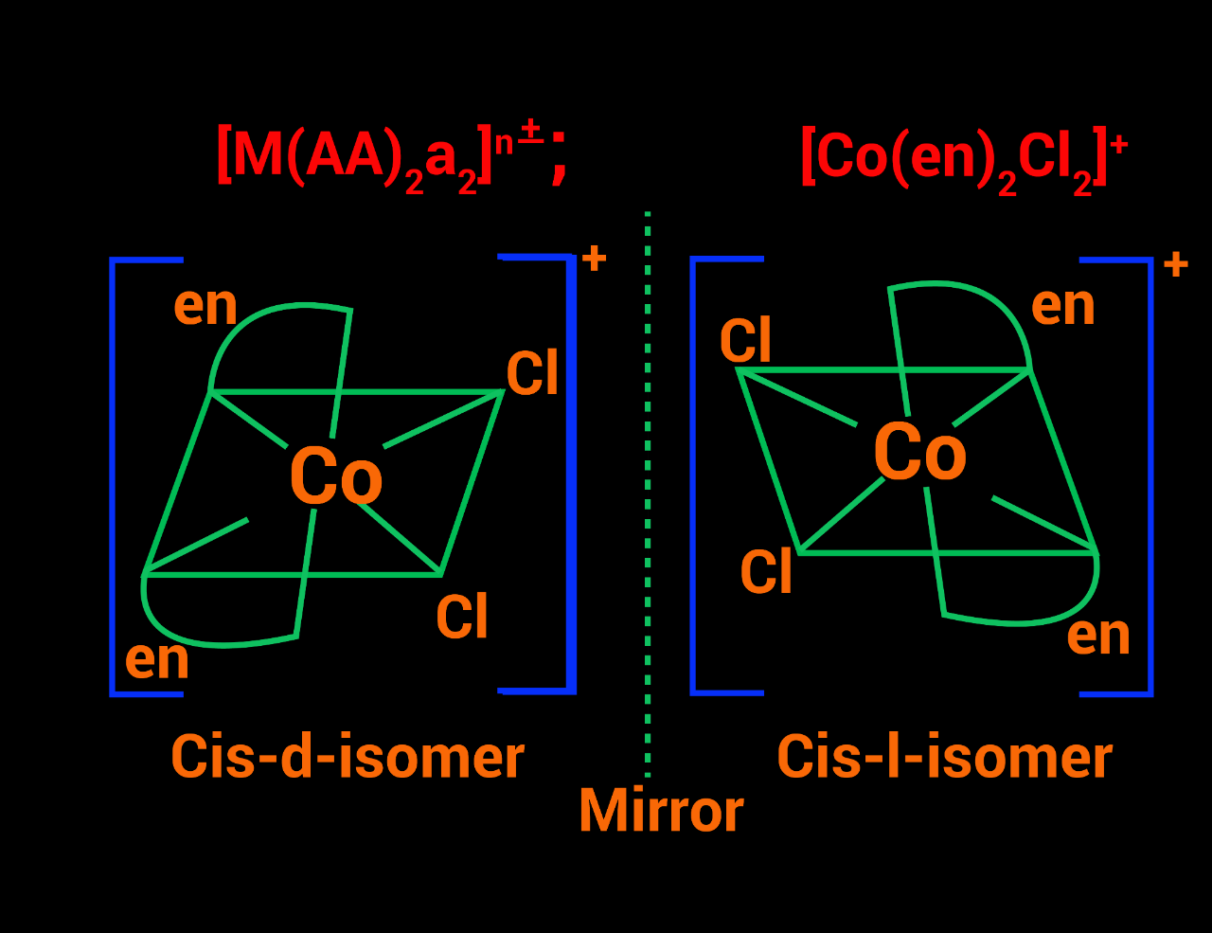

Slide 50
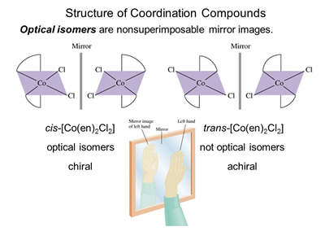

Slide 51
Theories of coordination compound
Alfred Werner considered the bonding in coordination compounds as the bonding between a lewis acid and a lewis base.
His approach is useful in explaining some of the observed properties of coordination compounds.
However, properties such as colour, magnetic property etc.. of complexes could not be explained on the basis of his approach.
Following werner theory, Linus pauling proposed the Valence Bond Theory (VBT) which assumes that the bond formed between the central metal atom and the ligand is purely covalent.
Bethe and Van vleck treated the interaction between the metal ion and the ligands as electrostatic and extended the Crystal Field Theory (CFT) to explain the properties of coordination compounds.
Further, Ligand field theory and Molecular orbital have been developed to explain the nature of bonding in the coordination compounds.
In this porton we learn the elementry treatment of VBT and CFT to simple coordination compounds.

Slide 52
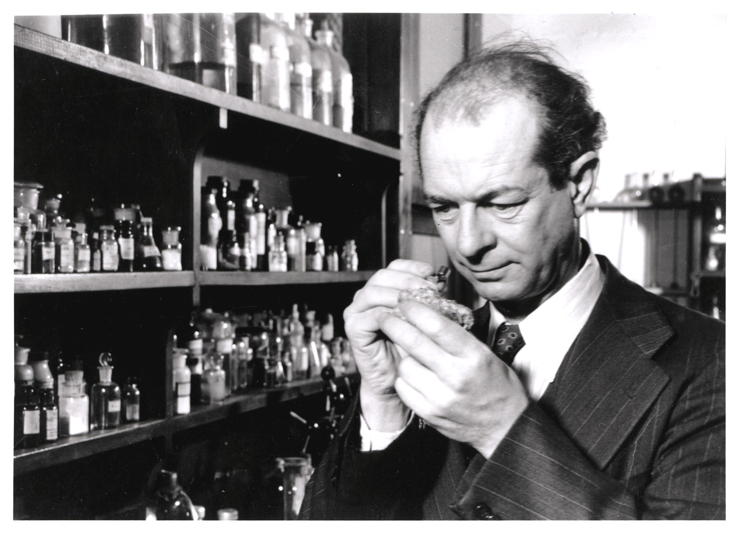
Valence Bond Theory
Linus pauling proposed the Valence Bond Theory (VBT) which assumes that the bond formed between the central metal atom and the ligand is purely covalent.
According to this theory, the bond formed between the central metal atom and the ligand is due to the overlap of filled ligand orbitals containing a lone pair of electron with the vacant hybrid orbitals of the central metal atom.

Slide 53
Main assumptions of VBT:
1. The ligand → metal bond in a coordination complex is covalent in nature. It is formed by sharing of electrons (provided by the ligands) between the central metal atom and the ligand.

Slide 54
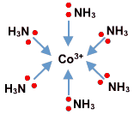
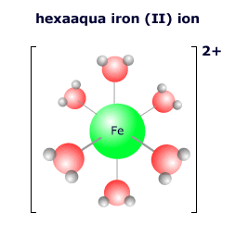
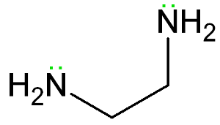
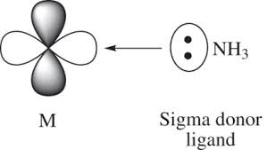
2. Each ligand should have at least one filled orbital containing a lone pair of electrons.
3. In order to accommodate the electron pairs donated by the ligands, the central metal ion present in a complex provides required number (coordination number) of vacant orbitals.

Slide 55
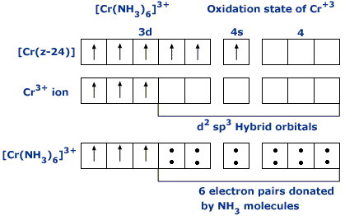
4. These vacant orbitals of central metal atom undergo hybridisation, the process of mixing of atomic orbitals of comparable energy to form equal number of new orbitals called hybridised orbitals with same energy.

Slide 56
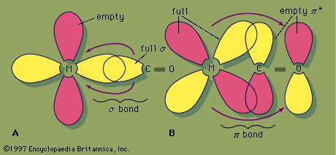
5. The vacant hybridised orbitals of the central metal ion, linearly overlap with filled orbitals of the ligands to form coordinate covalent sigma bonds between the metal and the ligand.

Slide 57
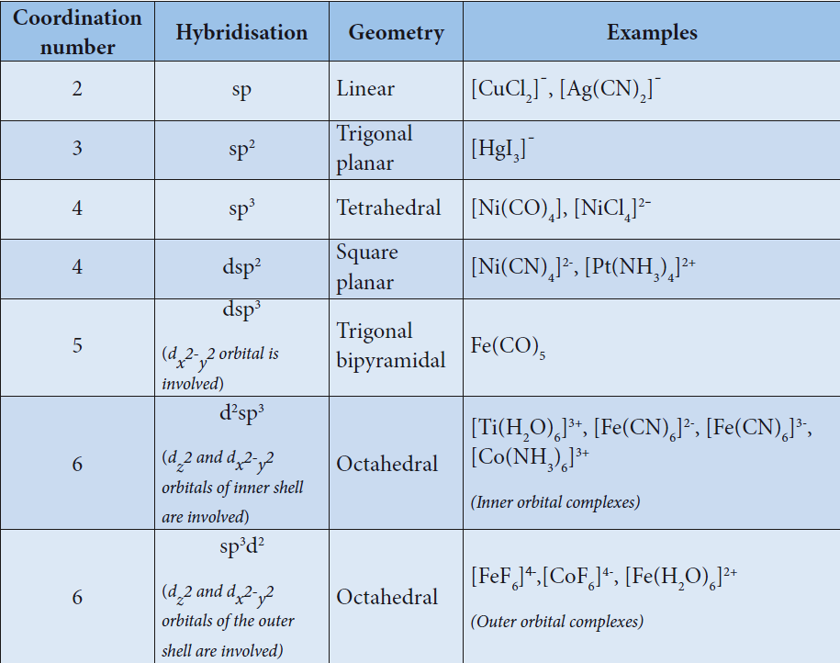
6. The hybridised orbitals are directional and their orientation in space gives a definitengeometry to the complex ion.

Slide 58
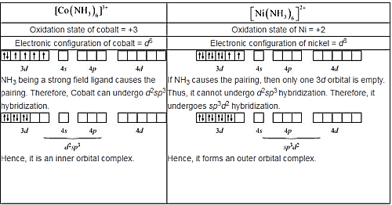
7. In the octahedral complexes, if the (n-1) d orbitals are involved in hybridisation, then they are called inner orbital complexes or low spin complexes or spin paired complexes. If the nd orbitals are involved in hybridisation, then such complexes are called outer orbital or
high spin or spin free complexes. Here n represents the principal quantum number of the outermost shell.

Slide 59
8. The complexes containing a central metal atom with unpaired electron(s) are paramagnetic . If all the electrons are paired, then the complexes will be diamagnetic.
9. Ligands such as CO, CN⁻ , en, and NH3 present in the complexes cause pairing of electrons present in the central metal atom. Such ligands are called strong field ligands.
10. Greater the overlapping between the ligand orbitals and the hybridised metal orbital, greater is the bond strength.

Slide 60
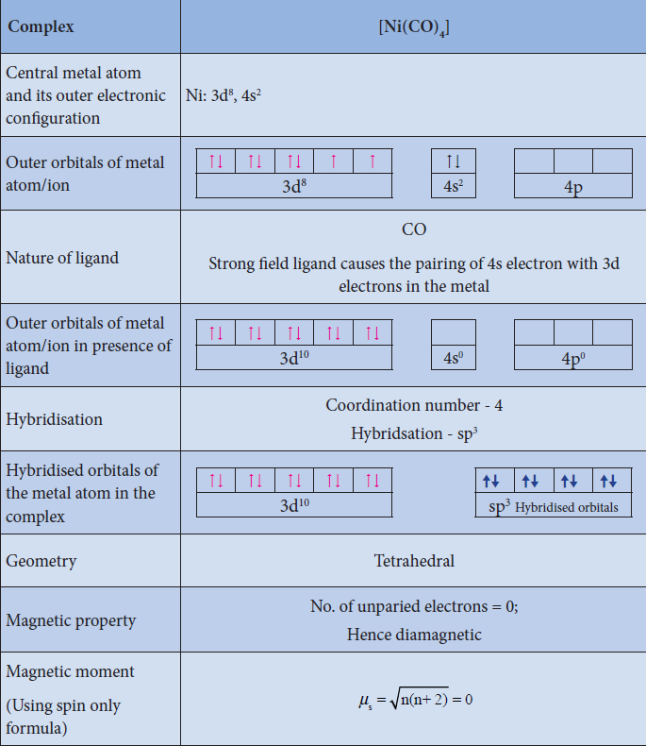
Illustration 1

Slide 61
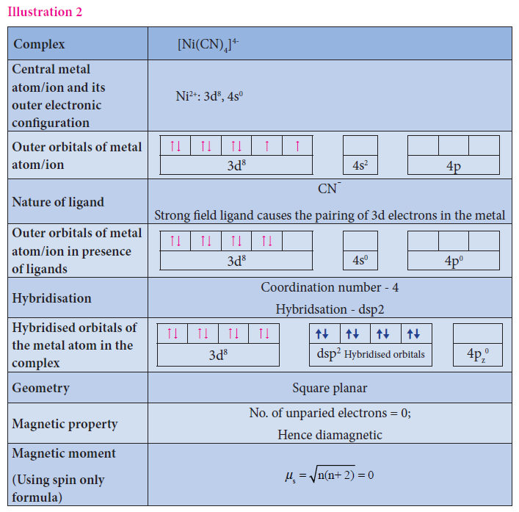

Slide 62
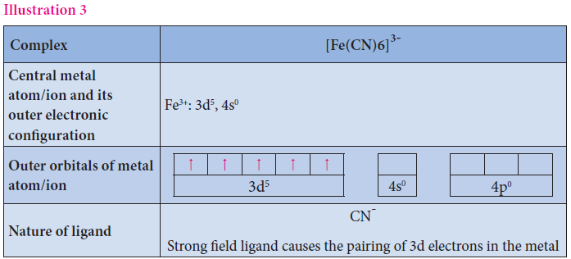
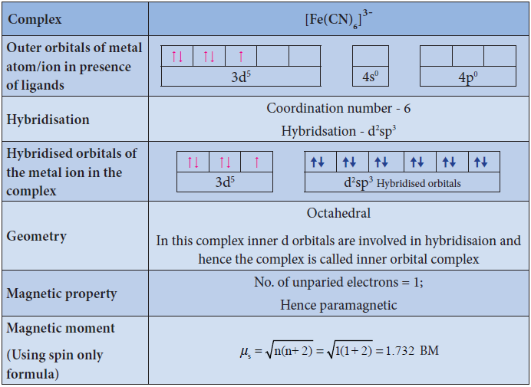

Slide 63
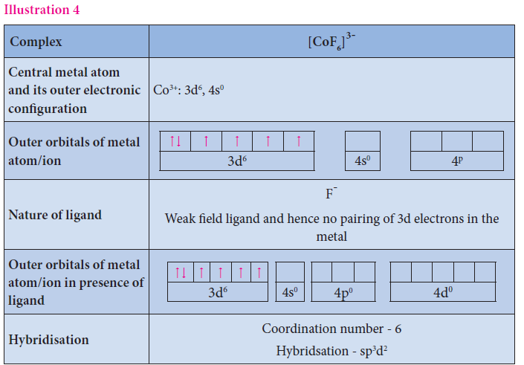

Slide 64
Limitations of VBT
Eventhough VBT explains many of the observed properties of complexes, it still has following limitations
1. It does not explain the colour of the complex
2. It considers only the spin only magnetic moments and does not consider the other components of magnetic moments.
3. It does not provide a quantitative explanation as to why certain complexes are inner orbital complexes and the others are outer orbital complexes for the same metal. For example, [Fe(CN)6]⁴⁻ is diamagnetic (low spin) whereas [FeF6]⁴⁻ is paramagnetic (high spin).

Slide 65
The salient features of CFT
1. Crystal Field Theory (CFT) assumes that the bond between the ligand and the central metal atom is purely ionic. i.e. the bond is formed due to the electrostatic attraction between the electron rich ligand and the electron deficient metal.
2. In the coordination compounds, the central metal atom/ion and the ligands are considered as point charges (in case of charged metal ions or ligands) or electric dipoles (in case of metal atoms or neutral ligands).
3. According to crystal field theory, the complex formation is considered as the following series of hypothetical steps.

Slide 66
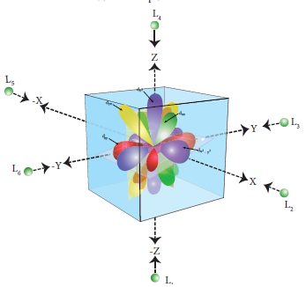
Step 1:
In an isolated gaseous state, all the five d orbitals of the central metal ion are degenerate. Initially, the ligands form a spherical field of negative charge around the metal. In this field, the energies of all the five d orbitals will increase due to the repulsion between the electrons of the metal and the ligand.
Step 2:
The ligands are approaching the metal atom in actual bond directions. To illustrate this let us consider an octahedral field, in which the central metal ion is located at the origin and the Six ligands are coming from the +x, -x, +y, -y, +z and -z directions as shown below.

Slide 67
As shown in the figure, the orbitals lying along the axes dx²-y² and dz² orbitals will experience strong repulsion and raise in energy to a greater extent than the orbitals with lobes directed between the axes (d_{xy,} d_{yz} and d_{zx}). Thus the degenerate d orbitals now split into two sets and the process is called crystal field splitting.
Step 3:
Up to this point the complex formation would not be favoured. However, when the ligands approach further, there will be an attraction between the negatively charged electron and the positively charged metal ion, that results in a net decrease in energy.
This decrease in energy is the driving force for the complex formation.

Slide 68
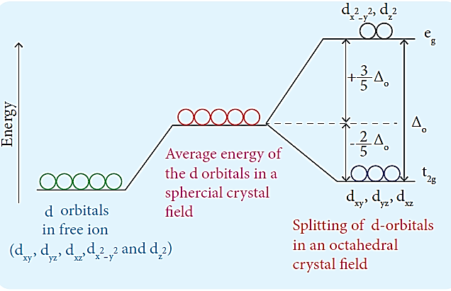
Crystal field splitting in octahedral complexes:
During crystal field splitting in octahedral field, in order to maintain the average energy of the orbitals (bary centre) constant, the energy of the orbitals d_{x}²_{-y}² and d_{z}² (represented as eg orbitals) will increase by 3/5Δo while that of the other three orbitals dxy, dyz and dzx (represented as t2g orbitals) decrease by 2/5Δo. Here, Δo represents the crystal field splitting energy in the octahedral field.

Slide 69
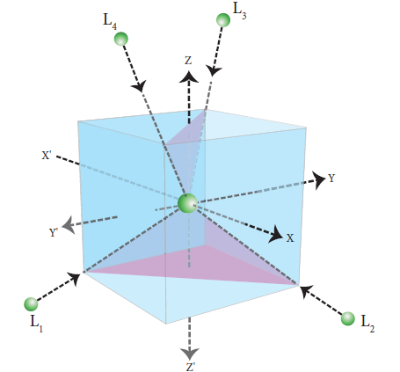
Crystal field splitting in tetrahedral complexes:
The approach of ligands in tetrahedral field can be visualized as follows. Consider a cube in which the central metal atom is placed at its centre (i.e. origin of the coordinate axis as shown in the figure). The four ligands approach the central metal atom along the direction of the leading diagonals drawn from alternate corners of the cube.

Slide 70
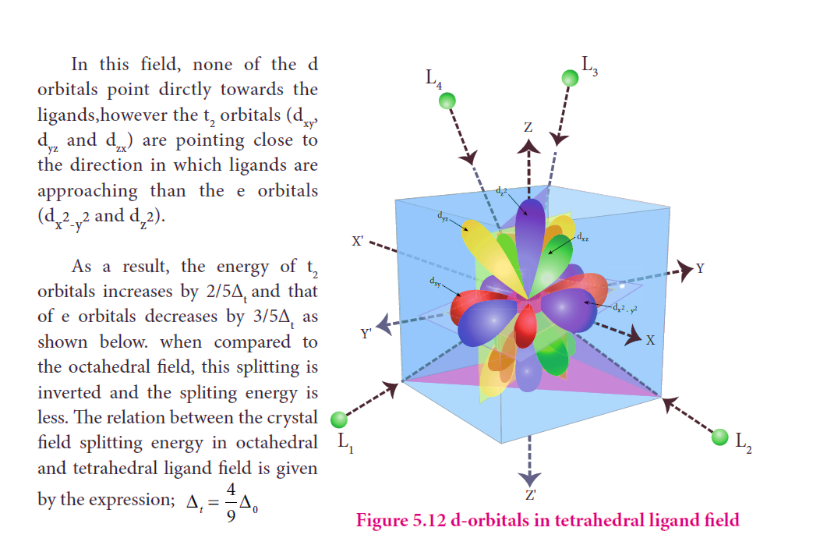

Slide 71
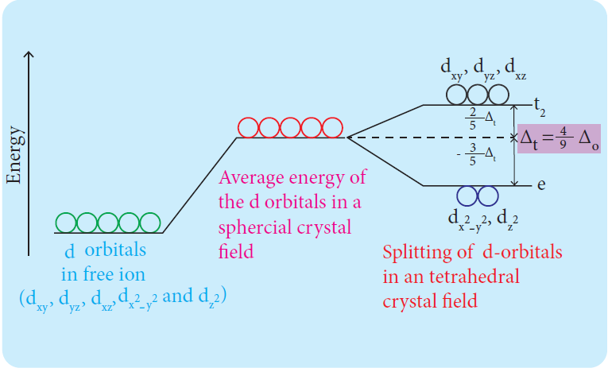

Slide 73
Crystal filed splitting Energy and nature of ligands:
The magnitude of crystal field splitting energy not only depends on the ligand field as discussed above but also depends on the nature of the ligand, the nature of the central metal atom/ion and the charge on it.
Let us understand the effect of the nature of ligand on crystal field splitting by calculating the crystal field splitting energy of the octahedral complexes of titanium(III) with different ligands such as fluoride, bromide and water using their absorption spectral data..
The absorption wave numbers of complexes [TiBr6]³⁻ , [TiF6]³⁻ and [Ti(H2O)6]³⁺ are 12500, 19000 and 20000 cm⁻¹ respectively.
The energy associated with the absorbed wave numbers of the light, corresponds to the crystal field splitting energy (Δ) and is given by the following expression,
where h is the Plank' s constant; c is velocity of light, υ is the wave number of absorptionmaximum which is equal to 1/λ.

Slide 74
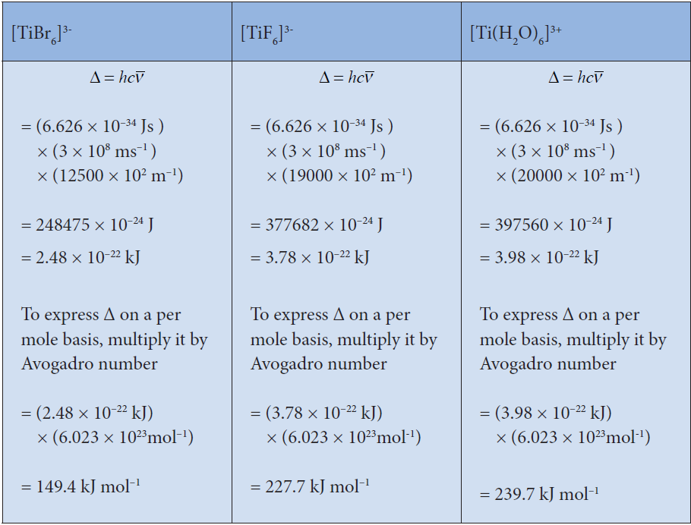

Slide 75
From the above calculations, it is clear that the crystal filed splitting energy of the Ti ³⁺ in complexes, the three ligands is in the order; Br- < F⁻ < H2O. Similarly, it has been found form the spectral data that the crystal field splitting power of various ligands for a given metal ion, are in the following order
The above series is known as spectrochemical series. The ligands present on the right side of the series such as carbonyl causes relatively larger crystal field splitting and are called strong ligands or strong field ligands, while the ligands on the left side are called weak field ligands and causes relatively smaller crystal field splitting.

Slide 76
Distribution of d electrons in octahedral complexes:
The filling of electrons in the d orbitals in the presence of ligand field also follows Hund’s rule.
In the octahedral complexes with d² and d³ configurations, the electrons occupy different degenerate t₂g orbitals and remains unpaired.

Slide 77
In case of d⁴ configuration, there are two possibilities.
The fourth electron may either go to the higher energy eg orbitals or it may pair with one of the t₂g electrons.
In this scenario, the preferred configuration will be the one with lowest energy.
If the octahedral crystal field splitting energy (Δo) is greater than the pairing energy (P), it is necessary to cause pairing of electrons in an orbital, then the fourth electron will pair up with an the electron in the t2g orbital.
Conversely, if the Δo is lesser than P, then the fourth electron will occupy one of the degenerate higher energy eg orbitals.

Slide 78
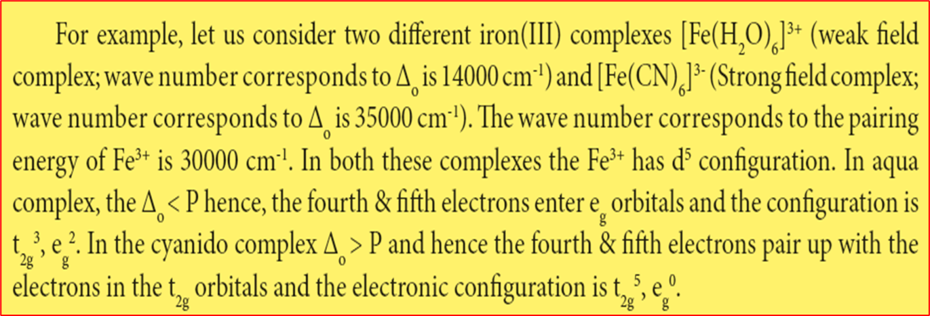
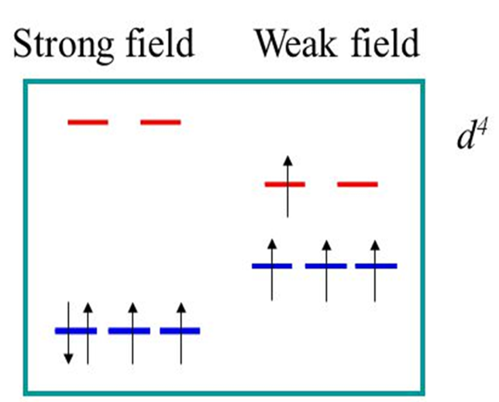
"Pairing energy, P, is the energy required to place two electrons in the same orbital. If the crystal field splitting (Δ) is small because of weak-bonding ligands, then the pairing energy will be larger, and the complex will be high-spin.

Slide 81
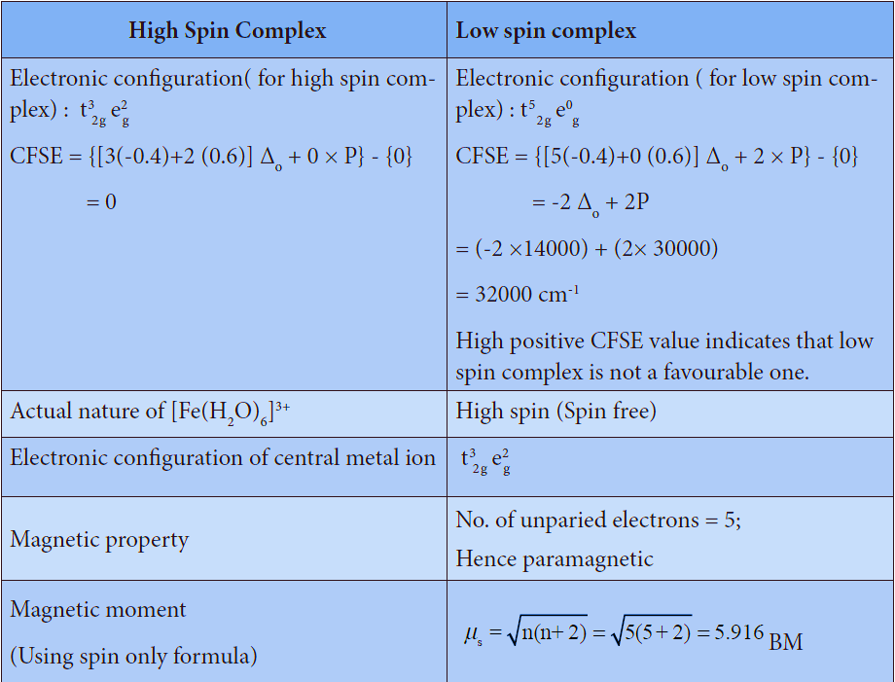

Slide 82
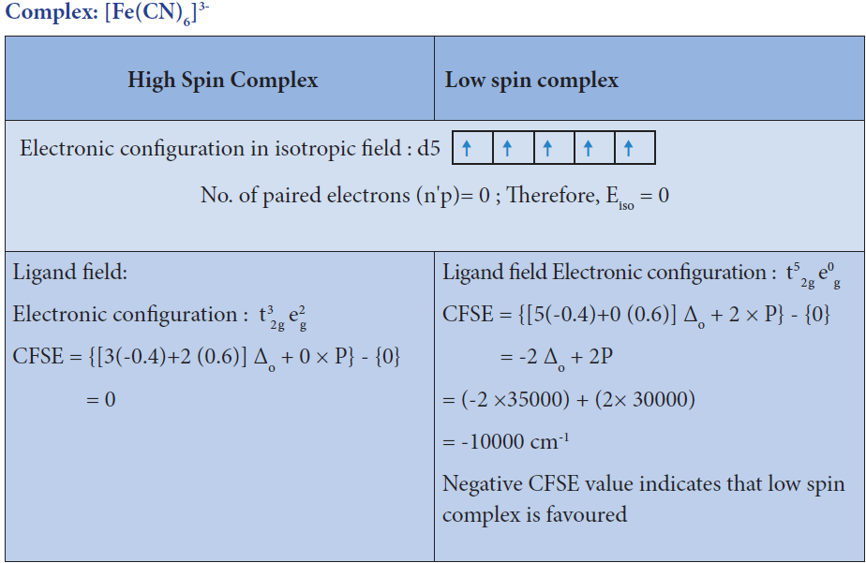

Slide 83
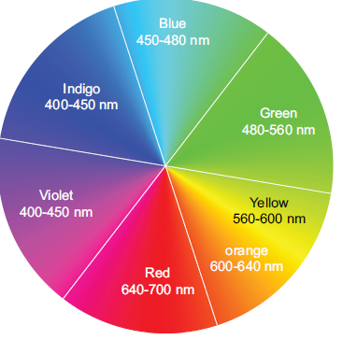
Colour of the complex and crystal field splitting energy:
Most of the transition metal complexes are coloured.
A substance exhibits colour when it absorbs the light of a particular wavelength in the visible region and transmit the rest of the visible light.
When this transmitted light enters our eye, our brain recognizes its colour.
The colour of the transmitted light is given by the complementary colour of the absorbed light.
Colour Wheel - Complementary colours are shown on opposite sides

Slide 84
For example, the hydrated copper(II) ion is blue in colour as it absorbs orange light, and transmit its complementary colour, blue.
A list of absorbed wavelength and their complementary colour is given in the following table

Slide 85
The observed colour of a coordination compound can be explained using crystal field theory.
We learnt that the ligand field causes the splitting of d orbitals of the central metal atom into two sets (t2g and eg).
When the white light falls on the complex ion, the central metal ion absorbs visible light corresponding to the crystal filed splitting energy and transmits rest of the light which is responsible for the colour of the complex.
This absorption causes excitation of d-electrons of central metal ion from the lower energy t2g level to the higher energy eg level which is known as d-d transition.

Slide 86
Let us understand the d-d transitions by considering [Ti(H2O)6] ³⁺ as an example.
In this complex the central metal ion is Ti ³⁺ , which has d¹ configuration.
This single electron occupies one of the t2g orbitals in the octahedral aqua ligand field.
When white light falls on this complex the d electron absorbs light and promotes itself to eg level.
The spectral data show the absorption maximum
is at 20000 cm⁻¹ corresponding to the crystal field
splitting energy (Δo) 239.7 kJ mol⁻¹ .
The transmitted colour associated with this
absorption is purple and hence ,the complex
appears purple in colour.

Slide 87
The octahedral titanium(III) complexes with other ligands such as bromide and fluoride have different colours.
This is due to the difference in the magnitude of crystal field splitting by these ligands.
However, the complexes of central metal atom such as of Sc³⁺ , Ti⁴⁺ , Cu⁺ , Zn²⁺ , etc... are colourless.
This is because the d-d transition is not possible in
complexes with central metal having d⁰ or d¹⁰ configuration.

Slide 88
Metallic carbonyls

Slide 89
Classification:
Generally metal carbonyls are classified in two different ways as described below.

Slide 91
Other examples of this type are,Tc2(CO)10, and Re2(CO)10.

Slide 93
In metal carbonyls, the bond between metal atom and the carbonyl ligand consists of two components.
The first component is an electron pair donation from the carbon atom of carbonyl ligand into a vacant d-orbital of central metal atom.
This electron pair donation forms M O sigma bond.
This sigma bond formation increases the electron density in metal d orbitals and makes the metal electron rich.
In order to compensate for this increased electron density, a filled metal d-orbital interacts with the empty π* orbital on the carbonyl ligand and transfers the added electron density back to the ligand.
This second component metal through sigma bonding and from metal to ligand through pi bonding, this synergic effect accounts for strong M CO bond in metal carbonyls.
This phenomenon is shown diagrammatically as follows.

Slide 95
Stability of metal complexes:
The stability of coordination complexes can be interpreted in two different ways.
The first one is thermodynamic stability and second one is kinetic stability.
Thermodynamic stability of a coordination complex refers to the free energy change (ΔG) of a complex formation reaction.
Kinetic stability of a coordination complex refers to the
ligand substitution.
In some cases, complexes can undergo rapid ligand substitution; such complexes are called labile complexes.
However, some complexes undergo ligand substitution very slowly (or sometimes no substitution), such complexes are called inert complexes.

Slide 99
Stepwise formation constants and overall formation constants:
When a free metal ion is in aqueous medium, it is surrounded by (coordinated with) water molecules.
It is represented as [MS6]. If ligands which are stronger than water are added to this metal salt solution, coordinated water molecules are replaced by strong ligands.

Slide 101
Importance and applications of coordination complexes:
The coordination complexes are of great importance. These compounds are present in many plants, animals and in minerals. Some Important applications of coordination complexes are described below.
1.Phthalo blue – a bright blue pigment is a complex of Copper (II) ion and it is used in printing ink and in the packaging industry.
2. Purification of Nickel by Mond’s process involves formation [Ni(CO)4], which Yields 99.5% pure Nickel on decomposition.

Slide 102
3. EDTA is used as a chelating ligand for the separation of lanthanides , in softening of hard water and also in removing lead poisoning.
4. Coordination complexes are used in the extraction of silver and gold from their ores by forming soluble cyano complex. These cyano complexes are reduced by zinc to yield metals. This process is called as Mac-Arthur –Forrest cyanide process.

Slide 103
5. Some metal ions are estimated more accurately by complex formation. For example, Ni²⁺ ions present in Nickel chloride solution is estimated accurately for forming an insoluble complex called [Ni(DMG)₂].

Slide 104
6. Many of the complexes are used as catalysts in organic and inorganic reactions.
For example,
Wilkinson’s catalyst – [(PPh₃)₃ RhCl] is used for hydrogenation of alkenes.
(ii) Ziegler-Natta catalyst – TiCl₄ + Al(C₂ H₅ )₃ is used in the polymerization of ethene.

Slide 105
7. In order to get a fine and uniform deposit of superior metals (Ag, Au, Pt etc.,) over base metals, Coordination complexes [Ag (CN)₂]⁻ and [Au(CN)₂]⁻ etc., are used in electrolytic bath.
8. Many complexes are used as medicines for the treatment of various diseases. For example,
Ca-EDTA chelate, is used in the treatment of lead and radioactive poisoning. That is for removing lead and radioactive metal ions from the body.
(2) Cis-platin is used as an antitumor drug in cancer treatment.

Slide 106
9. In photography, when the developed film is washed with sodium thio sulphate solution (hypo), the negative film gets fixed. Undecomposed AgBr forms a soluble complex called sodiumdithiosulphatoargentate(I) which can be easily removed by washing the film with water.
AgBr + 2 Na₂S₂O₃ Na₃ [Ag(S₂O₃)₂ + 2 NaBr

Slide 107
10. Many biological systems contain metal complexes. For example,
(i)A red blood corpuscles (RBC) is composed of heme group, which is
Fe²⁺ - Porphyrin complex.it plays an important role in carrying oxygen from lungs to tissues and carbon dioxide from tissues to lungs.

Slide 108
(ii) Chlorophyll, a green pigment present in green plants and algae, is a coordination complex containing Mg²⁺ as central metal ion surrounded by a modified Porphyrin ligand called corrin ring. It plays an important role in photosynthesis, by which plants converts CO2 and water into carbohydrates and oxygen.

Slide 109
(iii) Vitamin B12(cyanocobalamine) is the only vitamin consist of metal ion. it is a coordination complex in which the central metal ion is Co⁺ surrounded by Porphyrin like ligand.

Slide 110
(iv) Many enzymes are known to be metal complexes, they regulate biological processes. For example, Carboxypeptidase is a protease enzyme that hydrolytic enzyme important in digestion, contains a zinc ion coordinated to the protein.

Slide 111
UTHRAKUMAR B
PGT CHEMISTRY
VELAMMAL MATRIC HR SEC SCHOOL-SURAPET,CHENNAI
9790815359

